Slide 1
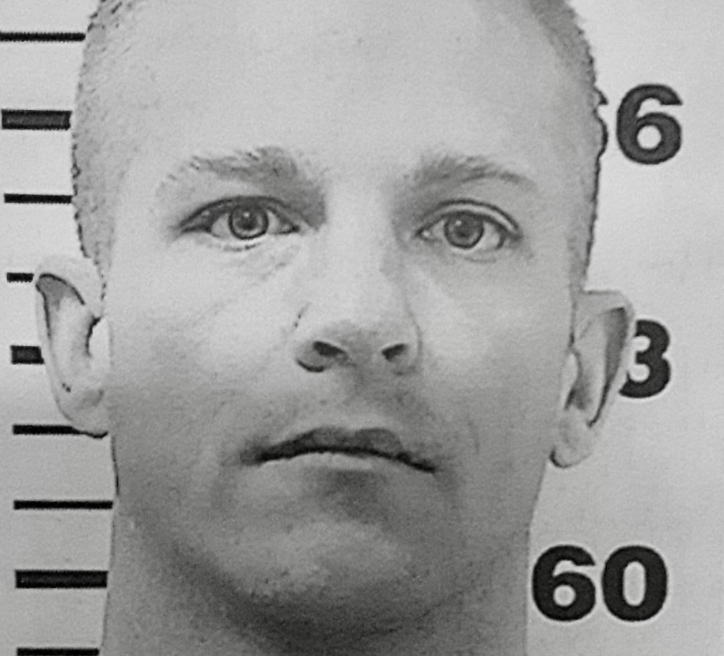
American Injustice: Shawn Rodriguez’ Fight for Freedom After Being Sent to Prison for Life for a Kidnapping He Was Not There for and a “Conspiracy to Commit Murder” He Bravely Sabotaged
By Dr. Angela Meyers Cotellessa
Notes:
Purpose of this presentation: to Highlight the wrongful conviction and imprisonment of Shawn Rodriguez for crimes he partially did commit and much worse crimes he did not actually commit, due to a chorus of bad actors in the justice system and the criminal behavior of other people Shawn knew.
Shawn has been in prison for 20 years. I asked him once if he would consider it “hell.” He thought about it for a minute, and confidently looked me in the eye and said “yes.” Dehuamnization. Trauma. Torture even. Horrible use of taxpayer dollars. Government is ruining lives and they don’t take responsibility for it.

Slide 2
First, please allow me to introduce myself

Slide 3
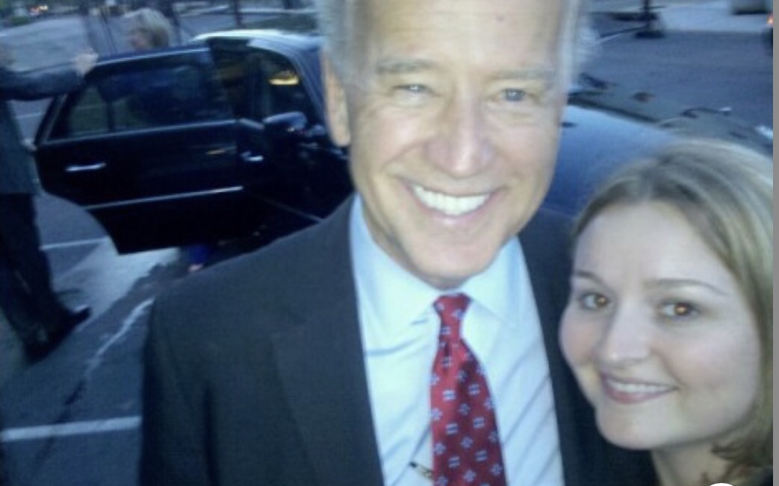
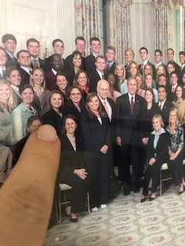
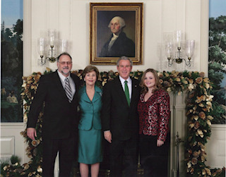
I’m Dr. Angie
Scholar/Academic/Researcher
Doctorate in Human & Organizational Learning
Social Media Content Creator
Author
Spent 15 years working in government, for the State of California and in the Federal Government including at the Executive Office of the President, where I started my federal career. I also spent nearly a decade working in the field of adult education, for the federal government.
Notes:
Currently a self-employed thought leader/social media influencer/author/speaker. In start-up phase of a new organization called the Modern Polymaths Institute, for which I am the Executive Director (still the early stage). I am the sole Owner of Polymath’s Place, LLC. Check out www.drangelameyers.com for more information.
I left government service after almost 15 years of dutiful service because they thought I was inappropriate for extending humanity and kindness to a “criminal” in prison, and because I continued to associate with him when I was essentially told to stop talking to him. Nowadays I focus more on my intellectual contributions and advocacy work, outside of government. I have become a critiquer of our government on social media.

Slide 4
A critique of my doctoral work
Problem: Too much focus on highly elite polymaths only
Solution: Study polymathic people in prison, the most non-elite group possible. Write another book, on this topic in particular.
First Contact: I found Shawn Rodriguez, a California inmate, because of videos he had posted online before I ever knew or met him, including this one: shawn rodriguez v16387 – YouTube
He struck me as a strong polymath and someone who would be appropriate for my study. We became phone pals and pen pals. However, the study I had intended to engage in did not ever really start because several other research curiosities and advocacy efforts took priority instead.

Slide 5
The Actual Studies I Ended Up Engaging In:
Understanding the Lived Experiences of Modern-Day California Male Inmates in Prison
Studying the Placer County Courts as well as the California Department of Corrections and Rehabilitation
Deeply studying the legal case of Shawn Rodriguez who I could see even after a cursory study of his case had been sent to prison for life for crimes he did not commit, for which there was ample evidence he did not commit them.
This led to the formation of the Prison Transparency Project
This led to the writing of a book, still underway, which is an expose on the courts and prison system
This led to the social media efforts for “Help Free Shawn Rodriguez”
Notes:
I had intended to study prison polymaths. Instead, I ended up getting an entirely different education.
As a result of these studies, I began the “Prison Transparency Project,” have been a voice for holding government (not politics) accountable for the level of services they provide for our tax payer dollars, and also created and manage the “Help Free Shawn Rodriguez” movement on four different social media platforms. I’m working on a book that will highlight the brokenness of our government, particular prison and the courts, in hopes that citizens will care what is actually happening behind prison walls and in America’s courts, and realize that any of us can become a victim of our government. We need to hold them more accountable and put more power back where it belongs: in the hands of citizens, and not our behemoth government machine which ruins lives and never takes responsibility for it because individual actors are incentivized to selfish behaviors that are good for them, even at the cost of the mission.

Slide 6
Personal Friendship Forged with Shawn Rodriguez, which Turned into a Romantic Bond
Notes:
What can I say? Shawn is of my best friends. He is a good guy. He is also a strong polymath. Incredibly intelligent.
Resourceful, thoughtful, resilient. So many good qualities. Amazing guy, wrongfully sent to prison for life
Shawn is a repeated victim of a broken government
So yes, I am Shawn’s significant other, but I am also someone who has been in government, has studied government, and now is a critiquer of its brokenness. We must keep government accountable. That’s separate from politics, by the way.

Slide 7
Shifting Gears: Let’s Get Into the Nitty Gritty of “The” Crime
Let’s differentiate between what shawn is actually guilty of versus what he was sent to prison for; the two are not the same.

Slide 8
What Happened: The Crime
TIME AND PLACE: March 2003, Auburn, California. Forty hour experience.
MAIN CHARACTERS:
19 year old Anna Rugg
19 year old Shawn Rodriguez
39 year old Nick Hamman
Erin is a more minor character—that was Shawn’s quasi-girlfriend at the time; she was much older than Shawn, around 30, and was also pregnant. She was an eyewitness to much of what happened, but was bullied out of talking at trial.
RELATIONSHIPS:
Anna and Shawn were “friends” who had met three weeks prior; they were surviving homelessness together.
Nick considered teenager Anna Rugg his girlfriend.
THE LEAD UP: Anna told Shawn Nick had burned her with a cigarette, and made unwanted sexual advances, so she wanted to rob her then boyfriend, Nick. She asked Shawn to be around to help protect her in case he tried to beat her up.
Notes:
TIME AND PLACE: March 2003, Auburn, California. Forty hour experience.
MAIN CHARACTERS:
19 year old Anna Rugg: homeless orphan. Shaved head, men’s clothing, and armed with a knife. Now identifies as a transgender man. Heavily traumatized, ready to kill. History of framing young men for her crimes. There is evidence that she began plotting how to kill Shawn in addition to her desire to kill Nick.
19 year old Shawn Rodriguez: homeless orphan. Agreed to be present for Anna’s robbery; got sucked into her kidnapping scene. Actively sabotaged her efforts to murder Nick, even at his own peril. Shawn was repeatedly framed by Anna for crimes he didn’t commit (church robbery he wasn’t therefore – with eyewitnesses to confirm this – and for kidnapping her, which he had never done; police did not even charge Shawn with kidnapping Anna because it was so obvious Anna lied about that).
40 year old Nick Hamman (convicted child molester, meth addict, and schizophrenic man, often homeless as well). He is the victim in this crime. Also committed perjury during the trial.
RELATIONSHIPS: Anna and Shawn were “friends” who had met three weeks prior; they were surviving homelessness together. Nick considered teenager Anna Rugg his girlfriend. Erin is a more minor character—that was Shawn’s quasi-girlfriend at the time; she was much older than Shawn, around 30, and was also pregnant. She was an eyewitness to much of what happened, but was bullied out of talking at trial.
THE LEAD UP: Anna told Shawn Nick had burned her with a cigarette, and made unwanted sexual advances, so she wanted to rob her then boyfriend, Nick. She asked Shawn to be around to help protect her in case he tried to beat her up.

Slide 9
What Happened (Continued)
ANNA’S ACTIONS
NICK’S ACTIONS
SHAWN’S ACTIONS
Notes:
ANNA’S ACTIONS: Anna planned to get Nick to an abandoned juvenile hall building in Auburn, CA and trap him in a holding cell while Shawn and his girlfriend, Erin, were in a different part of the building altogether. The act of getting Nick into the holding cell and trapping him there is what constitutes kidnapping. Anna did this act alone. After obtaining Nick’s ATM card, ATM code, and car keys, she got $80 out of the ATM. Anna began trying to identify ways to murder Nick. She wanted to push Nick off the Forresthill Bridge, beat him to death with a baseball bat wrapped in barbed wire, and/or gas him to death. The bank card was also used to buy duct tape and hoses (to be explained later). Anna repeatedly framed Shawn (church robbery, false accusations of Shawn kidnapping her).
NICK’S ACTIONS: Nick began acting irate, which made the teenagers too afraid to let him out of the holding cell. Nick eventually gave up his ATM card and code, and car keys. In hopes of county firefighters or police coming to rescue him, Nick foolishly set off the sprinkler while trapped in a room, therefore exposing himself to water for much of the time he was trapped in the room by Anna. Nick lied at trial about how high the level of the water he himself set off got, leading jurors to believe he was near death and his life was under threat, when at no time was he actually at risk of dying. He claimed the water was up to his neck when in reality it was knee height, at most. There was a table where he could sit or stand in the room to avoid the water. He never smelled any car exhaust (Shawn made sure it never got to him and tried to get Anna to give up on murdering Nick, by tricking her into believing Nick had died via gassing when Shawn knew it was impossible). Since 2015, Nick has repeatedly confessed to lying during the 2003 trial, and also confirmed in 2022 that “Anna was the mastermind, not Shawn.” Nick also has paranoid schizophrenia and difficulty telling reality from delusions but has been consistent since 2015 in his confessions of committing perjury at the trial, for which he has never been brought to justice.
SHAWN’S ACTIONS: Shawn got a special tool and tried to turn off the water in the building, to help Nick from the water he set off on himself. Shawn tried to break the glass in the room where Nick was trapped, to help him escape. Shawn tried to unscrew the screws holding the glass in place, so Nick could kick it in and free himself once Shawn and Anna left (investigators never took finger printers which would have proven this). Shawn talked Anna out of pushing Nick off the Forresthill Bridge. Shawn talked Anna out of beating Nick to death with a baseball bat wrapped in barbed wire.

Slide 10
So, now that we know what happened at the crime scene, what happened at trial?
Buckle your seatbelts; it’s ugly

Slide 11
What Happened At Trial?
Shawn was sent to prison for Anna’s intent to kill, which Shawn sabotaged, and then he was given a prison sentence as if someone had died even though nobody was killed or even physically harmed.
One juror wrote after the trial, “Where is the justice?”
Notes:
Jurors all stated they knew Shawn had no intent to kill Hamman, which is a requirement to find him guilty of “Conspiracy to Commit Murder.” So why did they vote Shawn guilty anyway?
District Attorney William Marchi told them that they had to hold Shawn just as guilty as Anna was, since he “aided and abetted” her. (The fact is Shawn did not actually aid and abet the kidnapping nor Anna’s desire to murder Hamman.) Jurors voted Shawn guilty of Conspiracy to Commit Murder, which has the same sentence as actual murder. Many of them admit to being very confused and regretting their votes. Many of them openly wept as Shawn was read his sentence in court.
Bottom line: Shawn was sent to prison for Anna’s intent to kill, which Shawn sabotaged, and given a prison sentence as if someone had died even though nobody was killed or even physically harmed.

Slide 12
What Happened with Sentencing Shawn:
25 to Life
Notes:
Shawn was given a 25 to life sentence for “conspiracy to commit murder.” Though nobody was even physically harmed, he received the same prison term as if a human being had actually died. Nick Hamman is still alive and well today, and had no lasting physical injuries from his experience in March of 2003. Though the emotional turmoil of those 40 hours certainly must have had negative effects on Hamman, he also lied at trial, leading an innocent man to life in prison when he deserved, at most, a handful of years for his involvement in the robbery and auto theft.
In my opinion, if Shawn was not there, Hamman would have died; Anna would have let him die, or she would have actively killed him.
The average prison term in the USA for actual murder is less than 18 years. Shawn has been in prison for more than 20 years despite the fact that no murder occurred and he is there because of someone else’s intent and actions.
Our American Constitution guarantees citizens the right to a fair trial. The only victim lied at trial about very material details, and Placer County has swept this inconvenient truth under the rug since 2015, and arguably since 2003 when District Attorney William Marchi knew Hamman was lying on the stand and went along with it, so he could win the trial. Truth did not matter – only conviction.

Slide 13
Auburn Journal Coverage of the Case
Two arrested on charges of attempted murder of Ophir man | Gold Country Media
Court hears of man's 40 hours of fear | Gold Country Media
Scrutiny of hall follows 3-day lockup | Gold Country Media
Closing arguments presented in juvenile hall kidnapping trial | Gold Country Media
Rodriguez found guilty; sentencing set for Oct. 23 | Gold Country Media
25-years-to-life sentence handed down in kidnap case | Gold Country Media

Slide 14
Let’s step back and examine what we just covered
Go ahead and exhale.

Slide 15
The Highlights of the Shawn Rodriguez Case
Nobody was physically harmed
The only victim, Nick (schizophrenic, child molester, meth addict), has repeatedly confessed to perjury during the trial.
Shawn’s co-defendant, Anna, had a history of framing Shawn, and the judge did not allow in this information at trial
The laws which allowed Shawn to be found guilty of Kidnapping and Conspiracy to Commit Murder – namely, the “natural and probable consequences doctrine,” is no longer valid due to law changes in recent years.
Notes:
Nobody was physically harmed (other than damp feet and one degree colder than average body temperature—both of which are extremely temporary)
The only victim has repeatedly admitted in letters to county authorities that he lied to during the trial (this is a crime known as perjury). He also has paranoid schizophrenia which means he has trouble telling truth from delusions (and is a convicted child molester and known meth user).
Shawn’s co-defendant had a history of framing Shawn, which is what she tried to do in this case, by claiming Shawn had kidnapped her. Anna had a well documented history of trying to rope young men into being there for her crimes so she would have a male scapegoat in the event of getting caught. She had framed Shawn for a robbery at a church he wasn’t even around for, and this was confirmed by multiple eyewitnesses.
The laws which allowed Shawn to be found guilty of Kidnapping and Conspiracy to Commit Murder – namely, the “natural and probable consequences doctrine,” is no longer valid due to law changes in recent years.

Slide 16
Placer County Government’s Performance to Date:
Ignore and minimize confessions of perjury
Ignore jurors stating they were confused by jury instructions and regret their votes
Silence eyewitness testimony (Erin’s) which would have exonerated Shawn from kidnapping and conspiracy to commit murder charges
Critical information such as Anna’s history of framing young men which would have shown Shawn was Anna’s second victim wasn’t allowed into the trial
The county has failed to enact recent law changes which make the natural and probable consequences doctrine, which sent Shawn to prison for life, no longer valid.
Shawn therefore deserves immediate release!
Notes:
Repeated confessions of perjury by the only victim have been swept under the rug. Shawn has repeatedly been denied release from prison despite the only victim’s confessions to lying and jurors begging and advocating on Shawn’s behalf for justice to finally be enacted for him
There are many statements from jurors that they were confused and regret their votes
Critical eyewitness testimony from Erin Hughes was silenced through intimidation by the District Attorney who we believe was later fired or forced to resign for suborning perjury in Shawn’s case, but then Placer County never went back and cleaned up Marchi’s messes. They let Shawn continue to rot in prison even as they knew Marchi had suborned perjury in Shawn’s trial, by allowing in information he knew was false, in Nick Hamman’s testimony.
Relevant information which would have helped exonerate Shawn was not allowed in by the Judge. This information would have changed how jurors viewed Shawn in light of the fact that Anna had framed Shawn already for a crime he wasn’t even around for (the church robbery), falsely accused him of kidnaping her, and she had also started hatching plans to kill Shawn, in addition to killing Nick.
Law changes have been enacted which make the natural and probable consequences doctrine no longer valid; Shawn was sent to prison based on that doctrine, which is now invalid. Placer County has refused to resentence Shawn.
Shawn therefore deserves immediate release from prison since he has already service 3 -5 times the prison sentence he would have received if he went to trial today and was found guilty only for crimes he actually did himself rather than being given punishment for Anna’s intentions and behaviors.

Slide 17
Let’s go deeper and examine each of the main actors in this case.
Shawn, anna, and nick

Slide 18
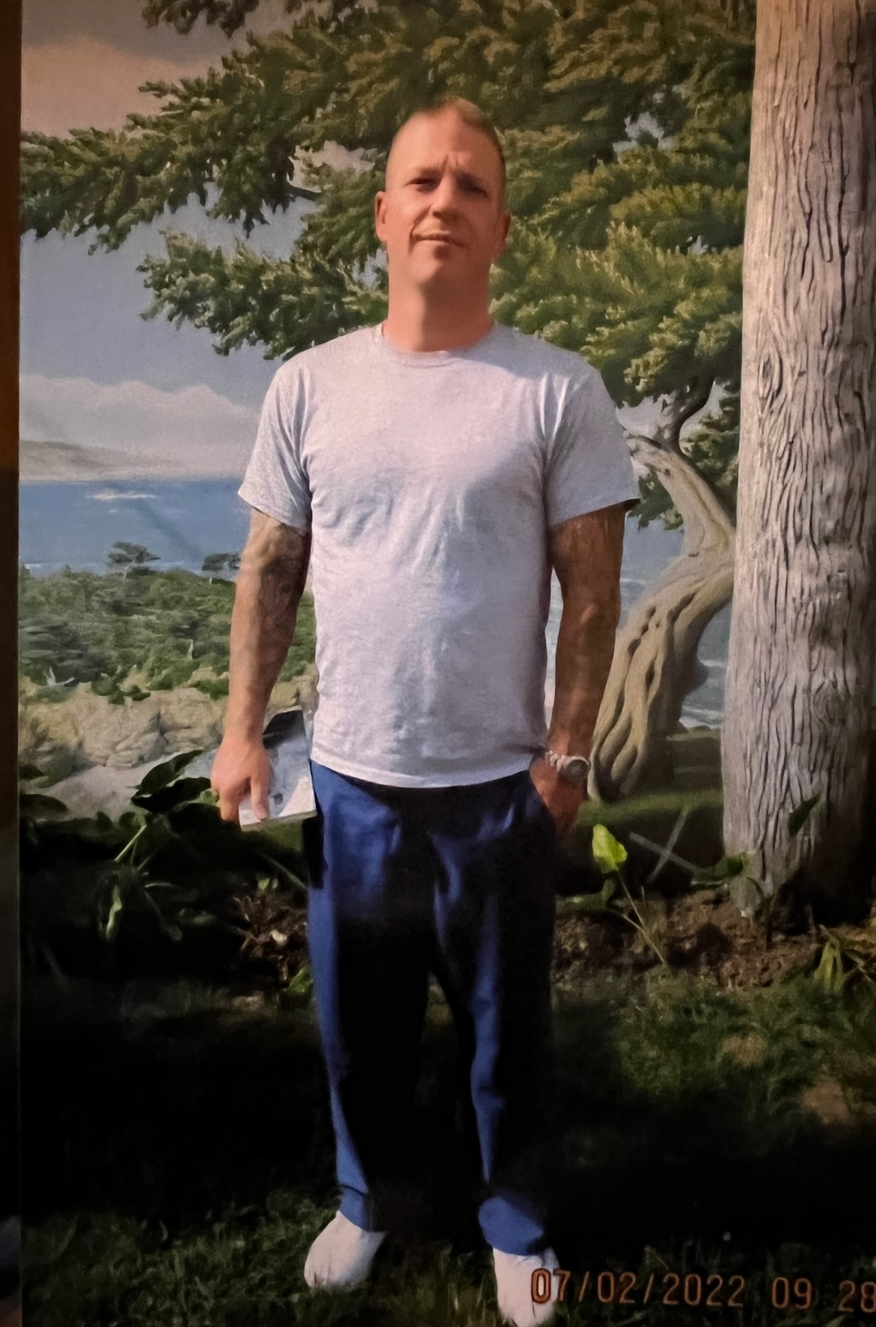
Shawn Rodriguez
Was a 19 year old homeless orphan at the time he get swept into Anna’s crime scene. Shawn did his best to protect Nick as well as his girlfriend, Erin, and himself, against Anna’s desire to kill. Anna was armed with a deadly weapon and had framed Shawn for her crimes in the past already. He had to navigate this carefully so as not to upset her too much, while also sabotaging her efforts to injure or kill Hamman.
Shawn was sent to prison for life for intent to kill that he didn’t have to murder someone who wasn’t even physically harmed and later repeatedly confessed to lying at trial.
Was given over double the prison sentence as Anna Rugg, who was the main perpetrator of the crime, while he was only convicted as her “aider and abettor” but received a harsher punishment despite that fact.
Shawn has earned countless certificates, participated in many different prison programs, and reengaged in countless rehabilitative efforts while incarcerated the last 20+ years
Proudly drug and gang free for his entire prison term
Has read more than 1,000 books while in prison.
Certified as an electrician and ready to work.
Has family to go home to.

Slide 19
Anna Rugg
Anna Rugg was the "mastermind" of the crime - this is the verbiage of the victim, Nick Hamman. He said that Anna was the mastermind, not Shawn, when an attorney interviewed him in 2022, while Nick was in jail for evading his Meghan’s Law requirements, as a registered sex offender/pedophile.
Anna framed Shawn for a robbery he wasn't even there for, at a church, a week or two prior to the Hamman incident.
Also, Anna had a well documented history of trying to get young MALES to be around while she committed a crime so if police showed up and caught her she could blame the male and claim innocence, and be perhaps more believed because she was technically female (though she had a shaved head, wore men's clothes, and now identifies as a transgender man, "CJ"). This is all documented in the Recorder’s Transcripts, available on www.helpfreeshawn.com. Many young men came forward with reports that Anna had tried to frame them for her crimes, too.
Anna also wrote a note claiming Shawn had kidnapped her; she left this in a gas station. She was literally trying to frame Shawn for her repeated crimes and the system basically let her do so.
Anna was armed with a deadly weapon—a very large knife.
Anna began discussing plans to kill Shawn in addition to Nick in front of Erin, who was an eyewitness to many of the crimes that occurred though Erin was later scared into silence.

Slide 20
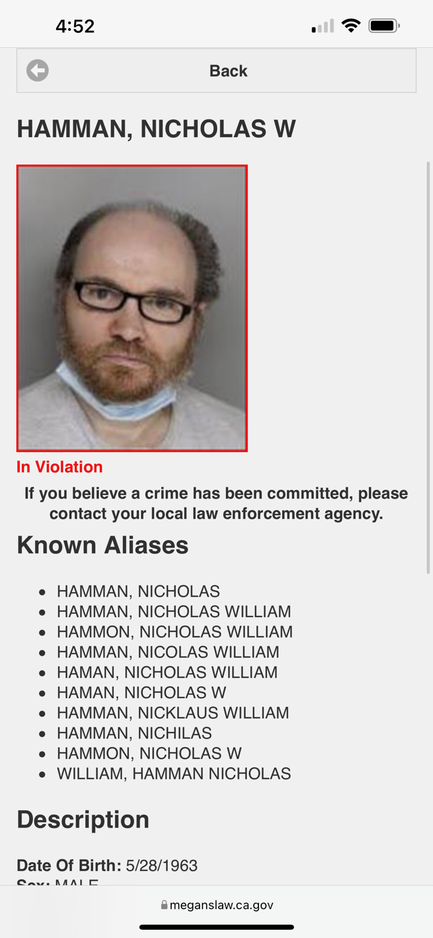
Nicholas Hamman
Nick's Statement: “Anna Rugg was the Mastermind, not Shawn.”
Nick's severe paranoid schizophrenia raises questions about the credibility of his testimony, in general.
Nick Hamman, the victim of the crime, was Anna's boyfriend. He was 39 years old, and she was a 19-year-old at the time.
Anna told Shawn Nick had harmed her by burning her with a cigarette. Shawn also witnessed Nick making unwanted sexual advances at Anna. Nick was also a convicted child molester: a pedophile.
When Anna told Shawn she wanted to rob her boyfriend and wanted Shawn to be "around" to help protect her, although Shawn had only known Anna about three weeks at that time, he agreed to be there.

Slide 21
Nicholas Hamman (continued)
Anna took Nick to an abandoned juvenile hall. Shawn was in the same building with his pregnant girlfriend at the time, Erin. While Erin and Shawn were walking around exploring this abandoned building, Anna shoved Nick in a holding cell from which he could not escape. She alone kidnapped Nick Hamman but later, Shawn received a life sentence for kidnapping when he wasn't even physically present when it was done. Shawn was in a separate building and could not see or hear anything that was happening. Also, Shawn tried to get Nick out of there when Anna wasn't looking.
Nick Hamman was stuck in a holding cell. Anna and Shawn left the building. Nick decided to set off a water sprinkler in the room, because he figured local authorities would be alerted - fire or police --but they weren't. So, there he was, trapped in a room, with water pouring in. Of course, the water escaped through the bottom of the door. The room was not watertight.
At trial, Nick lied and said the water got up to his neck, implying he was close to complete drowning. That was a lie, to which Nick later confessed to 4 times in writing to Placer County, CA authorities. They swept his confession of perjury under the rug and let Shawn continue to rot in prison over Hamman's lies. It has been 8 years since Nick wrote those letters which Placer County did not handle properly.

Slide 22
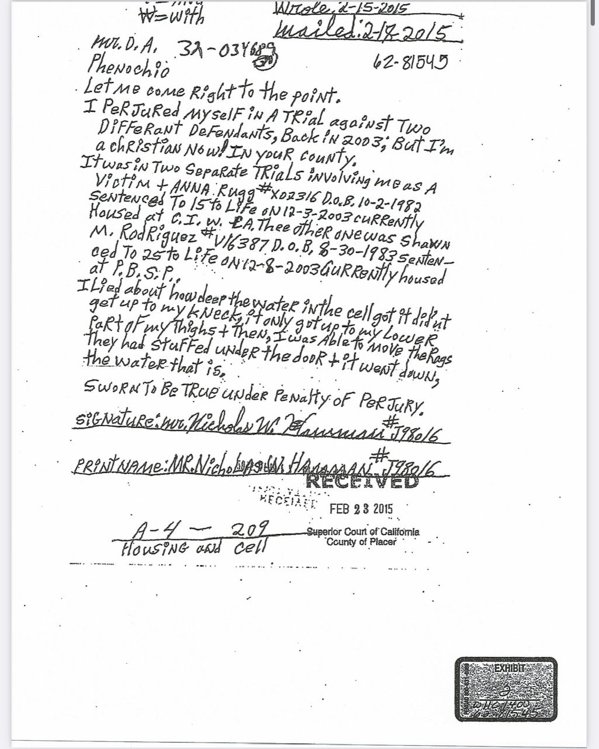
Letter from Nicholas Hamman
“Let me come right to the point. I perjured myself in a trial against two different defendants, back in 2003; but I’m a Christian now in your county…I lied about how deep the water in the cell got. It didn’t get up to my neck it only got up to my lower part of my thighs.”

Slide 23
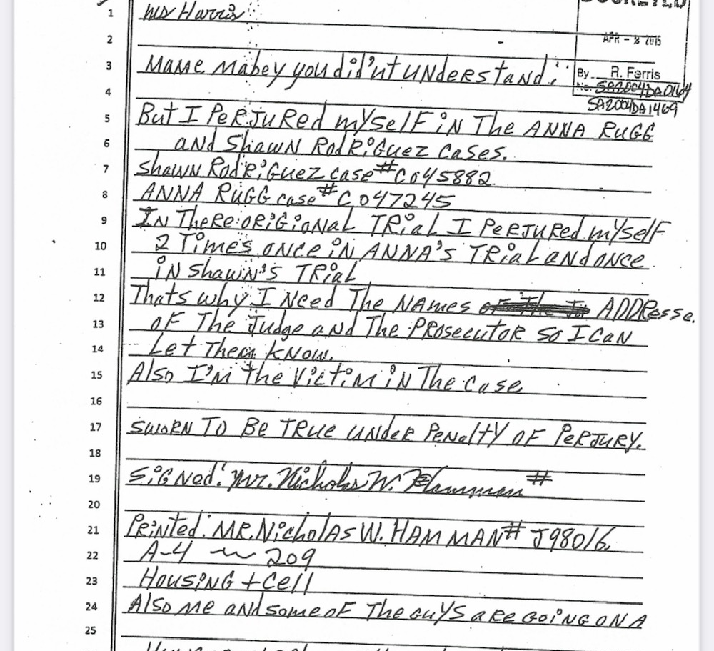
Another of Nick Hamman’s Letters
“Mabey you did’nt understand but I perjured myself in the Anna Rugg and Shawn Rodriguez cases…I’m also the victim in the case.”

Slide 24
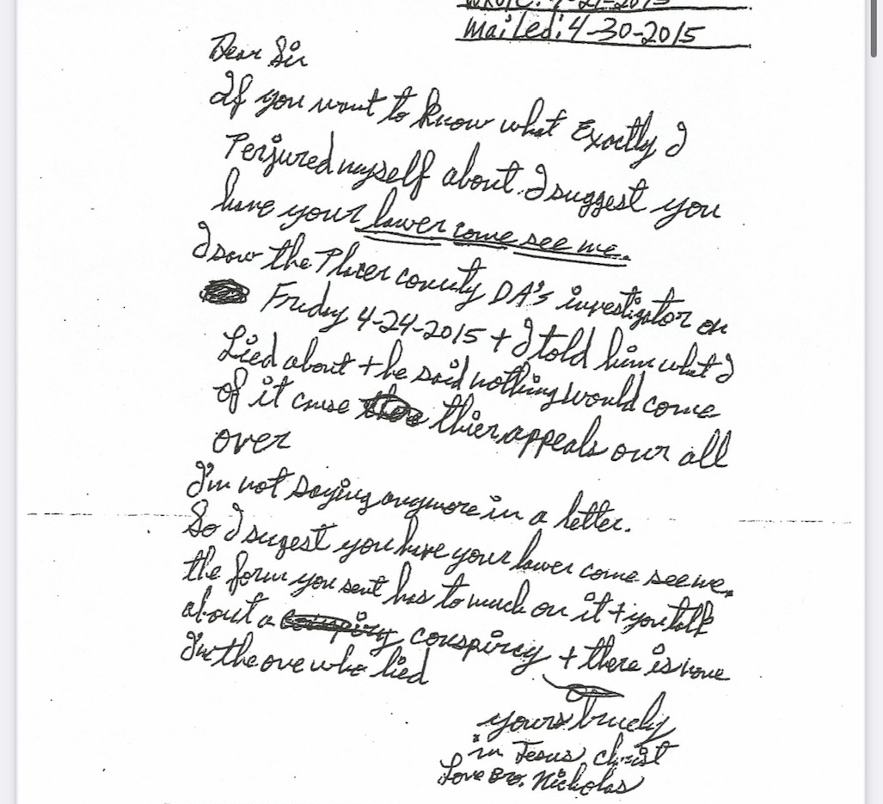
Another Letter from Hamman
“If you want to know what exactly I perjured myself about I suggest you have your lawyer come see me. I saw the Placer County DA’s investigator on Friday 4-24-2015 and I told him what I lied about and he said nothing would come of it cause their appeals are all over. I’m not saying anymore in a letter. So I suggest you have your lawyer come see me…”

Slide 25
Other Bad Actors in this Narrative
Meet the “professionals” paid for by placer county tax payers (and try not to cringe)

Slide 26
District/Prosecuting Attorney William Marchi
District/Prosecuting attorney William Marchi knew Nick Hamman was lying but "suborned perjury" anyway. We are fairly confident that he was later forced to resign/retire for his behavior in Shawn's case, though Placer County never went back and cleaned up his mess.
He also manipulated Erin out of speaking the truth, as a critical eyewitness, which would have alerted the jury that Shawn was Anna Rugg's second victim. Erin knew Shawn was not there for the kidnapping, when Anna alone shoved Nick into the holding cell (which Nick made accumulate water by later setting off the sprinkler himself even while trapped in the room Anna had shoved him in).
At one point, Marchi screamed across the court room for Nick Hamman to “SHUT UP!” because he didn’t want Nick to say the truth, but rather wanted him to keep up with the lies he had probably been coached to tell, or at least encouraged to continue on with.
Notes:
This additional information about the prosecuting attorney's actions and manipulation during the trial. It sheds light on potential misconduct and questionable practices that could have affected the outcome of the case.

Slide 27
Presiding Judge Frances Kearney
Judge Frances Kearney did not allow in critical information that Anna had framed Shawn for the church robbery just prior to the Hamman incident, that she had framed Shawn for kidnapping her as part of the crime at hand, and also that she had a well documented history of many boys/men coming forward saying she had tried to attach them to her crimes as well – clearly, to have a scapegoat.
Jurors did not get to hear this critical information because the judge did not allow it - perhaps because she deemed Shawn guilty until proven innocent, rather than the reverse - which is his right to be deemed innocent until proven guilty.
Notes:
This slide highlights potential issues with the presentation of critical evidence that could have affected the jury's perception of the case in ways which would have helped Shawn.

Slide 28
Erin Hughes
Shawn’s older, pregnant girlfriend.
Witness to much of what occurred with Shawn, Anna, and Nick.
Scared out of testifying by District/Prosecuting Attorney William Marchi, because she was told if she said too much he would have to charge Erin with all the same charges Shawn was being charged with including attempted murder. As a result, Erin pled the fifth repeatedly during trial, and the truth of what had occurred remained hidden.
Erin overheard Anna discussing with Anna’s uncle about killing Shawn, in addition to killing Nick, because Shawn wasn’t going along with her plans to kill Nick. This information also never got into the trial because Prosecuting Attorney William Marchi had worked so hard to scare Erin into silence.

Slide 29
Now Let’s Look at the Jury

Slide 30
The Jurors
Jury Foreman Lied by Omission about Critical Information in his Background
One juror “begged” the judge to change Shawn’s sentence
Many jurors admit to being very confused, and regretting their votes.
Had they known Nick Hamman was lying, and there was evidence that Shawn was Anna’s second victim, perhaps they would have voted differently. There was no fair trial, which is a constitutional right.
One juror said he felt tricked into the verdict by a District Attorney that had a “go for the throat” attitude which was inappropriate and overly aggressive, towards Shawn.
Many jurors openly wept as Shawn was read his sentence.
Notes:
The jury foreman was part of a law enforcement family, but hid this during jury selection. We only know because a news reporter got a quote from him where he shared that his father was a prison warden. This is not a neutral arbiter for justice and he volunteered to be the foreman, and pressured jurors to vote guilty on all counts. He was a commanding figure and was part of why many jurors voted against their gut feelings and beliefs, because they were pressured to do so by the District Attorney and the jury foreman.

Slide 31
A message from Juror Louise Daggett
“It grieves our hearts today as it did 20 years ago when Shawn was given an unjust life sentence. As one of the 12 jurors, we were all shocked and very disappointed that the instructions we were given by the court on how we had to make our verdict would have such a horrible, tragic, unjust consequence for Shawn. We could not imagine such an unfair justice. I’m sure all the other jurors feel the same way. In light of Nick’s perjury confession, my sincere hope and prayer is that this terrible unjust wrong to Shawn will finally have some mercy and even some financial compensation towards his new, free life which he more than deserves in my strong opinion. I gave my deposition. I hope it matters as well as the depositions of all the other jurors who I’m sure feel the same way.”
November 13, 2022

Slide 32
Sample Post-Trial Juror Statement
Did you conclude that the defendant had the specific intent to murder Nicholas Hamman?
“No”
Did the jury seem to discuss and understand that the law requires the same specific intent to kill for conspiracy as it does for attempted murder?
“We discussed but obviously did not understand that the law requires”

Slide 33
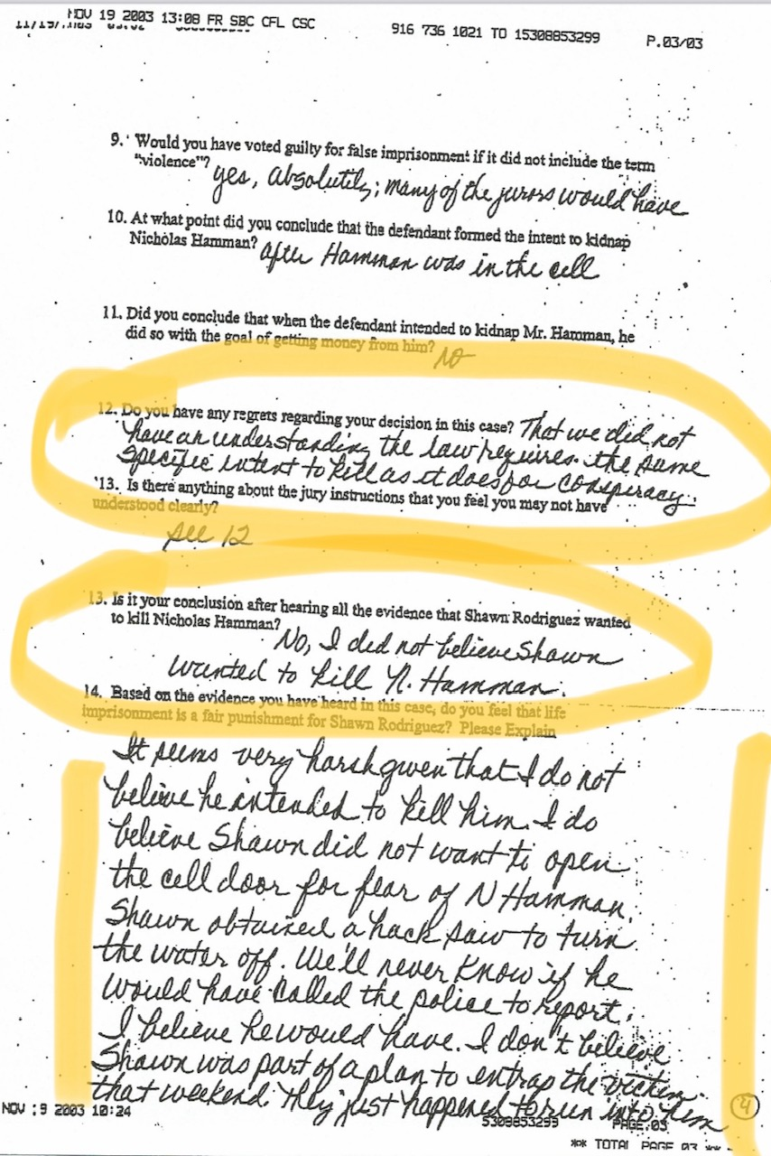
Sample Post-Trial Juror Statement
Do you have any regrets regarding your decision in this case?
“That we did not have an understanding the law requires the same specific intent to kill as it does for conspiracy”
Based on the evidence you have heard in this case, do you feel that life imprisonment is a fair punishment for Shawn Rodriguez? Please explain.
“It seems very harsh given that I do not believe he intended to kill him. I do believe Shawn did not want to open the cell door for fear of N. Hamman. Shawn obtained a hacksaw to turn the water off. We’ll never know if he would have called the police to report. I believe he would have. I don’t believe Shawn was part of a plan to entrap the victim that weekend, they just happened to run into him.”

Slide 34
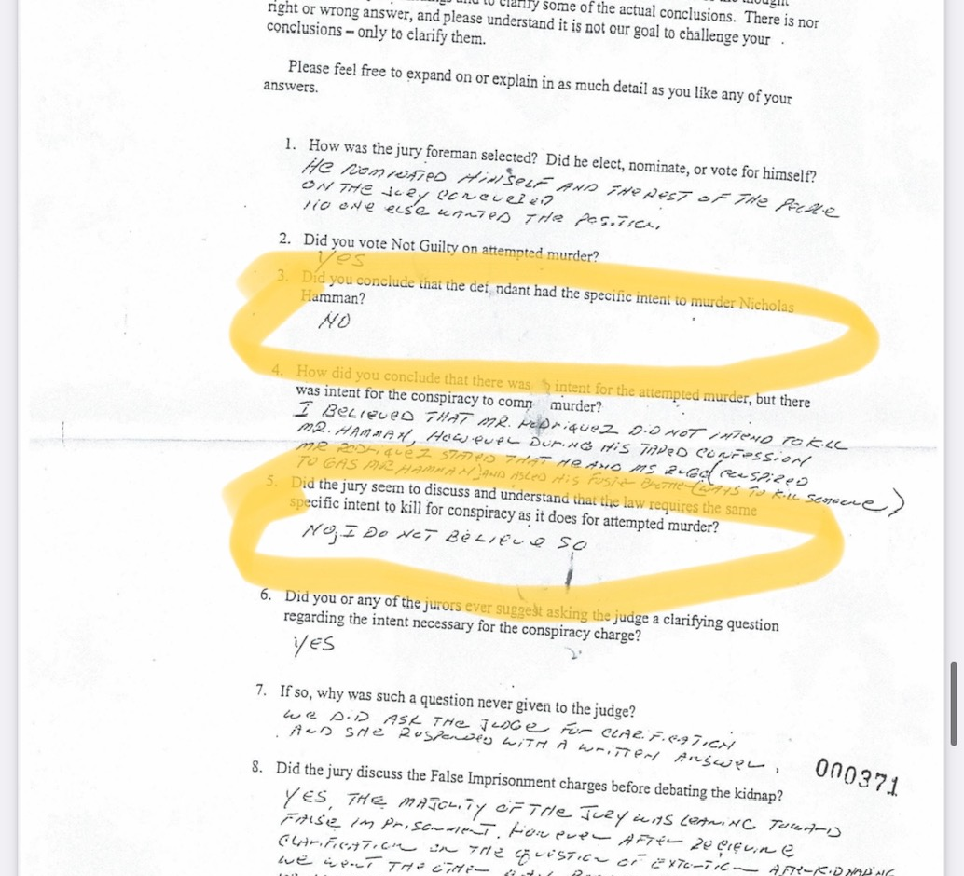
Sample Post-Trial Juror Statement
Did you conclude that the defendant had the specific intent to murder Nicholas Hamman?
“No”
Did the jury seem to discuss and understand that the law requires the same specific intent to kill for conspiracy as it does for attempted murder?
“No, I don’t believe so.”

Slide 35
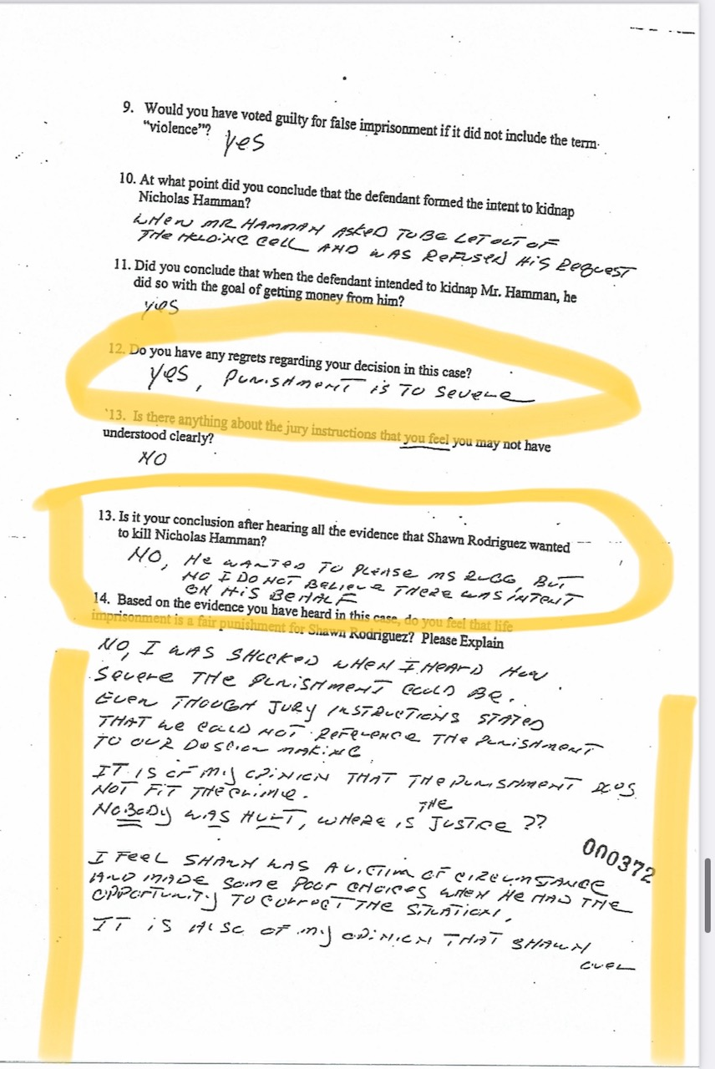
Sample Post-Trial Juror Statements
Do you have any regrets regarding your decision in this case?
“Yes, punishment is to severe”
Is it your conclusion after hearing all the evidence that Shawn Rodriguez wanted to kill Nicholas Hamman?
“No, he wanted to please Ms. Rugg but no I do not believe there was intent on his behalf.”
Based on the evidence you have heard in this case, do you feel that life imprisonment is a fair punishment for Shawn Rodriguez? Please explain.
“No, I was shocked when I heard how severe the punishment could be even though jury instructions stated that we could not reference the punishment to our decision making. It is of my opinion that the punishment does not fit the crime. NOBODY was HURT, where is the justice?”

Slide 36
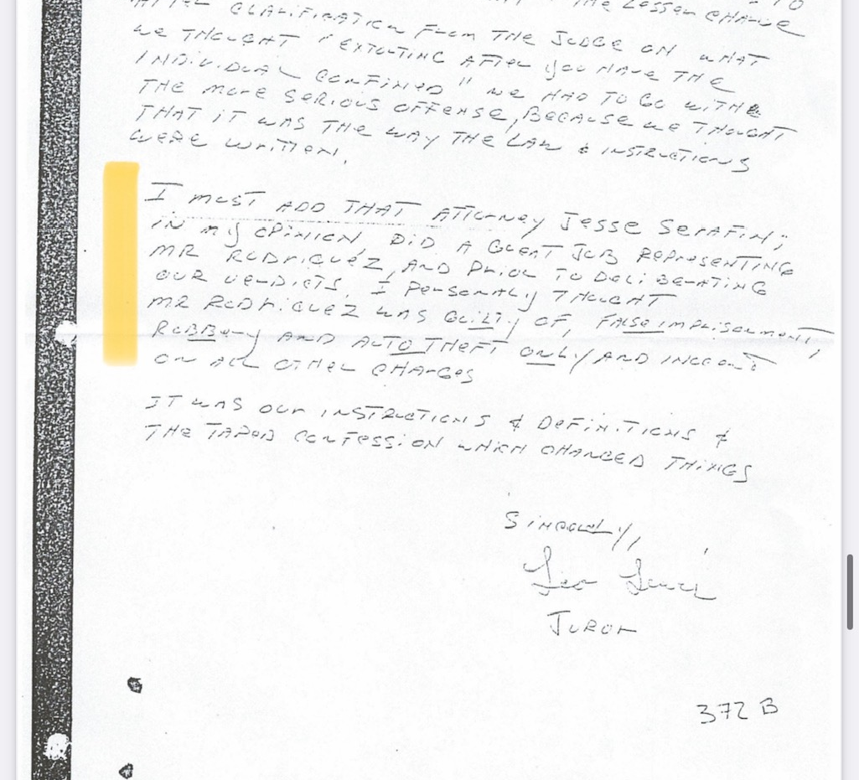
Sample Post-Trial Juror Statements
“I personally thought Mr. Rodriguez was guilty of false imprisonment, robbery, and auto theft ONLY and innocent on all other charges.”

Slide 37
Wrap Up & Review Time
I promise I’ll stop talking soon.

Slide 38
The Timeline
1983
Shawn becomes a ward of the state/an orphan
2001
Shawn is released from the state’s care into homelessness as an 18 year old
2003
“The” crime occurred. Shawn thought it was a robbery. Anna turned it into a kidnapping and potential murder scene while Shawn sabotaged her efforts. At trial, Hamman committed perjury, claiming he was near death because the water in the room he was trapped in was neck-height. He eventually confessed it was only ever up to his knees.
2015
Nicholas Hamman writes a series of letters confessing to perjury
2017
Shawn’s legal efforts to obtain a retrial or a resentencing are squashed by Placer County despite Nick’s confessions
2022
Shawn submitted a writ of habeus corpus to get a retrial or a resentencing given the “natural and probable consequences” doctrine which sent Shawn to prison have been made unlawful. The petition was denied.
2023
Shawn filed a case with the Court of Appeals.
Shawn is born
1991
We are currently awaiting response

Slide 39
What is a “youth offender” in California?
There is scientific evidence showing that parts of the brain involved in behavior control continue to mature through late adolescence, and that human brains only become fully mature when a person is in his or her mid-to-late 20s. Specifically, the area of the brain responsible for impulse control, understanding consequences, and other executive functions is not fully developed until that time.
In reviewing this scientific evidence, both the U.S. Supreme Court and the California Supreme Court have recognized that the younger a person is, the more susceptible he or she is to negative influences and outside pressures, including peer pressure. But as that person ages, maturity can lead to reflection that is the foundation for remorse, renewal, and rehabilitation. Therefore, the California Legislature has determined that, with few exceptions, offenders who commit crimes while under the age of 26 and who are sentenced to state prison are required to have a meaningful opportunity for parole during their natural life.
Notes:
Shawn was 19 at the time of the Hamman incident.

Slide 40
Shawn’s Time in Prison
Certified in Word and Excel
NCCER Core Curriculum Certificate and the NCCER Electronics Systems Technician Level 1 Certification (which gives Shawn the necessary education to obtain a job as an electrician)
Lead Cook 2013-2014
Law Library Clerk 2014
Building Porter 2014 – 2015
Barber 2015
Yard/Facilities Maintenance 2015 – 2016
Building Clerk 2016 – 2017
Lead Law Library Clerk 2019
Recreation Clerk 2019 – 2020
Yard/Facilities Maintenance 2020 – 2021
Healthcare Facilities Maintenance Custodian 2021
Building Porter 2022
Dialectical Behavior Therapy Certified 2017
Alternatives to Violence Project 2018
The B.R.A.I.N. Project 2020
PACE Learning Systems Lifeskills 2021
R.I.S.E. (Rehabilitate, Implement, Scceed, Excel) by the Life Support Alliance 2021
American Community Correctional Institute Certifications in: Anger Management, Contentious Relationships, Substance Abuse, Domestic Violence, Bad Credit, Shoplifting, Drunk Driving
The Change Companies Certifications in Anger Management, Self-Esteem, Victims Impact
Criminals and Gang Members Anonymous 2023

Slide 41
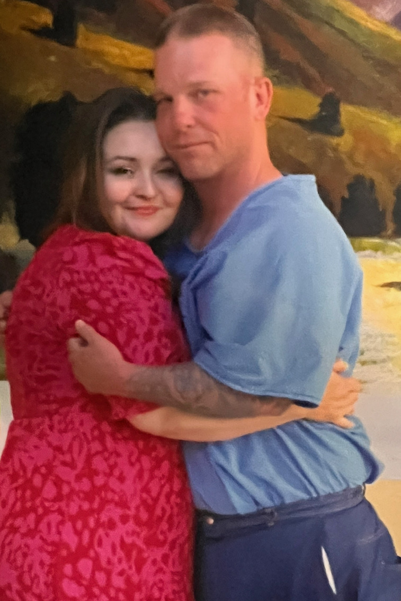
Shawn’s Plans for After Prison
Shawn has a bank account, birth certificate, cell phone, job offers, a place to live, a car to drive, and a family ready to love him, already waiting for him, upon his release from his lengthy incarceration.
He has plans to work in real estate, trucking, and content creation having to do with court and prison reforms which are necessary to create a more humane and more just world for us all to share.
Remember, Shawn’s story could happen to you or someone you care about. Demand justice now for Shawn, and help us ensure other victims of our government get their stories told too, with our upcoming advocacy work.
#helpfreeshawn

Slide 42
Summary of the Shawn Rodriguez Case
Nobody was physically harmed, the only victim has paranoid schizophrenia and lied at trial. His confessions have been swept under the rug by Placer County Officials who are paid by citizens to uphold our laws. Rather than admit their wrongs, they continue to withhold justice. Placer County sent a man to prison for life for crimes he did not commit. Shawn deserves immediate release from prison given he has already served many more years beyond what he deserved for what he actually did. He served many years in prison for what someone else did – who had actually manipulated, framed, and victimized Shawn as her pawn and scapegoat. The system allowed her to get away with it, and also allowed Nick to get away with the crime of perjury.
Government must be held accountable for poor performance. They must right the injustices of the past.
For anyone interested in learning more about the misdeeds of Placer County, please check out the documentary film, “Everyone Counts,” which is available at no cost on YouTube: EVERYONE COUNTS - An Auburn Documentary - YouTube

Slide 43
Current Efforts Underway
In December of 2022, the Placer County Superior Court denied Shawn’s request to be resentenced given law changes which make the natural and probable consequences doctrine no longer valid.
This doctrine really represents the entire reason the jury was able to vote Shawn guilty of a kidnapping he wasn’t there for and a murder he and no intent to support, because the District Attorney argued that Shawn’s culpability must be identical to Anna’s. Now, the law recognizes that individuals should only be held responsible for their own intentions and their own actions, not the intentions or actions of other people.
We currently have an appeal under review with the Court of Appeals in Placer County. We are awaiting their reply, and would like the general public to watch how they respond to this request for a resentencing, which Shawn is entitled to by law. We are afraid they will continue to suffocate justice and stifle Shawn’s freedom, which is long overude at this point.

Slide 44
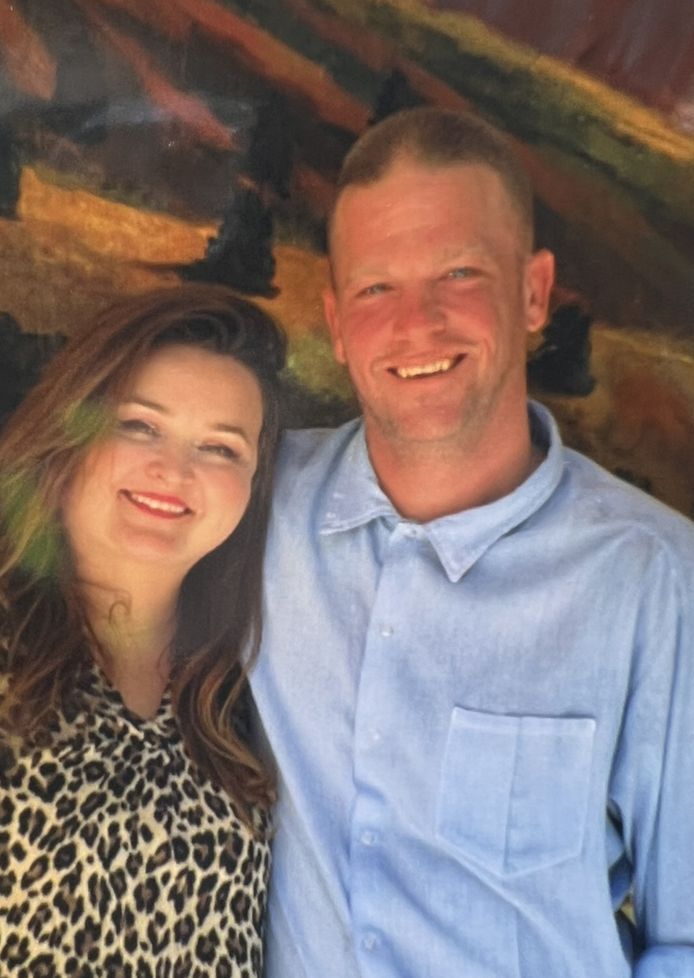
What Does “justice” Look Like Now?
Resentencing of Shawn for his participation in an $80 robbery although technically, Anna was the one who got and used Nick’s ATM card, not Shawn)
Resentencing of Shawn for auto theft
Determination of “false imprisonment” as a charge he deserves or not
Removal of “kidnapping” and “conspiracy to commit murder” from his record
Financial remuneration for his unjust imprisonment all these additional years
Recognition and commendation for likely saving Nick Hamman’s life, even at risk to himself to do so. By staying on the scene, he further allowed Anna to entrap and associate Shawn with her misdeeds, but he also ensured Anna Rugg did not actually kill Hamman. Shawn did all he could to get Anna to leave Nick alone. Had Shawn not been there, Hamman likely would have died.
Notes:
Shawn has been in prison for over 20 years. At most, for crimes he actually committed, he deserved anywhere from 3 to 8 years in prison, based on California sentencing guidelines. California laws no longer allow Shawn to be found guilty of Anna’s crimes simply because he was there. Jurors were given limited information since Erin did not fully testify and Nick Hamman lied in court, and Judge Frances Kearney did not allow in important information which would have shown Anna was manipulating and framing Shawn for her misdeeds. Though Shawn was an “aider and abetter” for robbery and auto theft, he was not an ACTUAL aider and abetter for kidnapping or conspiracy to commit murder, for which he received life sentences. He did nothing to further kidnapping nor a murder, and actively worked against Anna’s attempts to entrap and kill Hamman, for which he has never received credit or recognition for risking his own life to save another’s.

Slide 45
Let’s Crunch Some Numbers Now
This won’t take too long, don’t worry

Slide 46
List of Crimes | Actual Innocence or Guilty | Typical Sentence Range | Appropriate Sentencing for Mr. Rodriguez
$80 robbery (second degree robbery) | Guilty of Aiding & Abetting | 2 – 5 years | 2 – 5 years
Using Another’s Identity to obtain goods or credits | Using the ATM card once or twice should result in the same crime; no double jeopardy. So N/A here | 6 months | N/A
Auto Theft | Guilty | 16 months to 3 years | 16 months to 3 years
False Imprisonment | Innocent (Shawn tried to help Nick get out of there) | 1 year | N/A
Aggravated Kidnapping for Extortion | Innocent (Shawn was not there when Anna trapped Nick in the holding cell; jurors voted Shawn guilty due to the natural and probable consequences doctrine which is no longer valid) | Life in Prison | N/A
Conspiracy to Commit Murder | Innocent (Shawn actively sabotaged Anna’s attempts to murder Nick; he harbored no intent to kill Nick—jurors stated this repeatedly in post-trial statements) | 25 to Life (same as if someone had died even though no murder took place) | N/A

Slide 47
Let’s Review:
Time already served:
Over 20 years
Appropriate sentence Based on What Shawn himself did:
3 to 8 years

Slide 48
We are awaiting Placer County’s Court of Appeals’ Response to our recent submission
Please stay tuned.

Slide 49
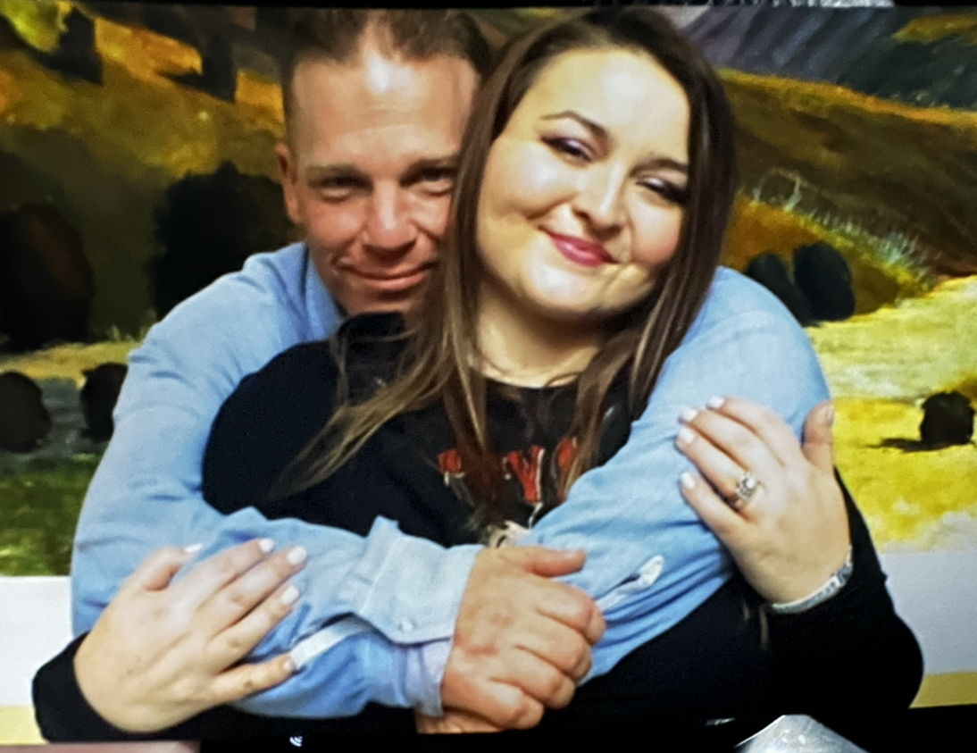
More Information
www.helpfreeshawn.com
YOUtUBE: @helpfreeshawnrodriguez: Help Free Shawn Rodriguez - YouTube
FaceBook: @helpfreeshawnrodriguez: (2) Help Free Shawn Rodriguez | Facebook
TikTok: @helpfreeshawnrodriguez: helpfreeshawnrodriguez｜TikTok Search
Twitter: @HelpFreeShawn: (3) Help Free Shawn Rodriguez (@HelpFreeShawn) / X (twitter.com)

