Slide 1

Tarrant County ena October 7, 2025 Medical City Alliance

Slide 2
Dinner provided by Teleflex
Presentation by Teleflex

Slide 3
Education Geriatric Trauma: Kirk Smart BSN, RN, CEN, CCRN, CFRN

Slide 4

Agenda business meeting
Welcome-Call To Order
Introductions – Board of Directors
President –Larry Lookingbill
President Elect – Colyn Turnbow
Past President – Kris Powel
Secretary – Barry Hudson
Treasurer – Jeanette Kohley
Secretary Elect - Nancy McEntire
Members – Guests - Students

Slide 5

Certification recognition cen, cpen, tcrn, cfrn, ctrn cbrn, faen, ccrn, other

Slide 6
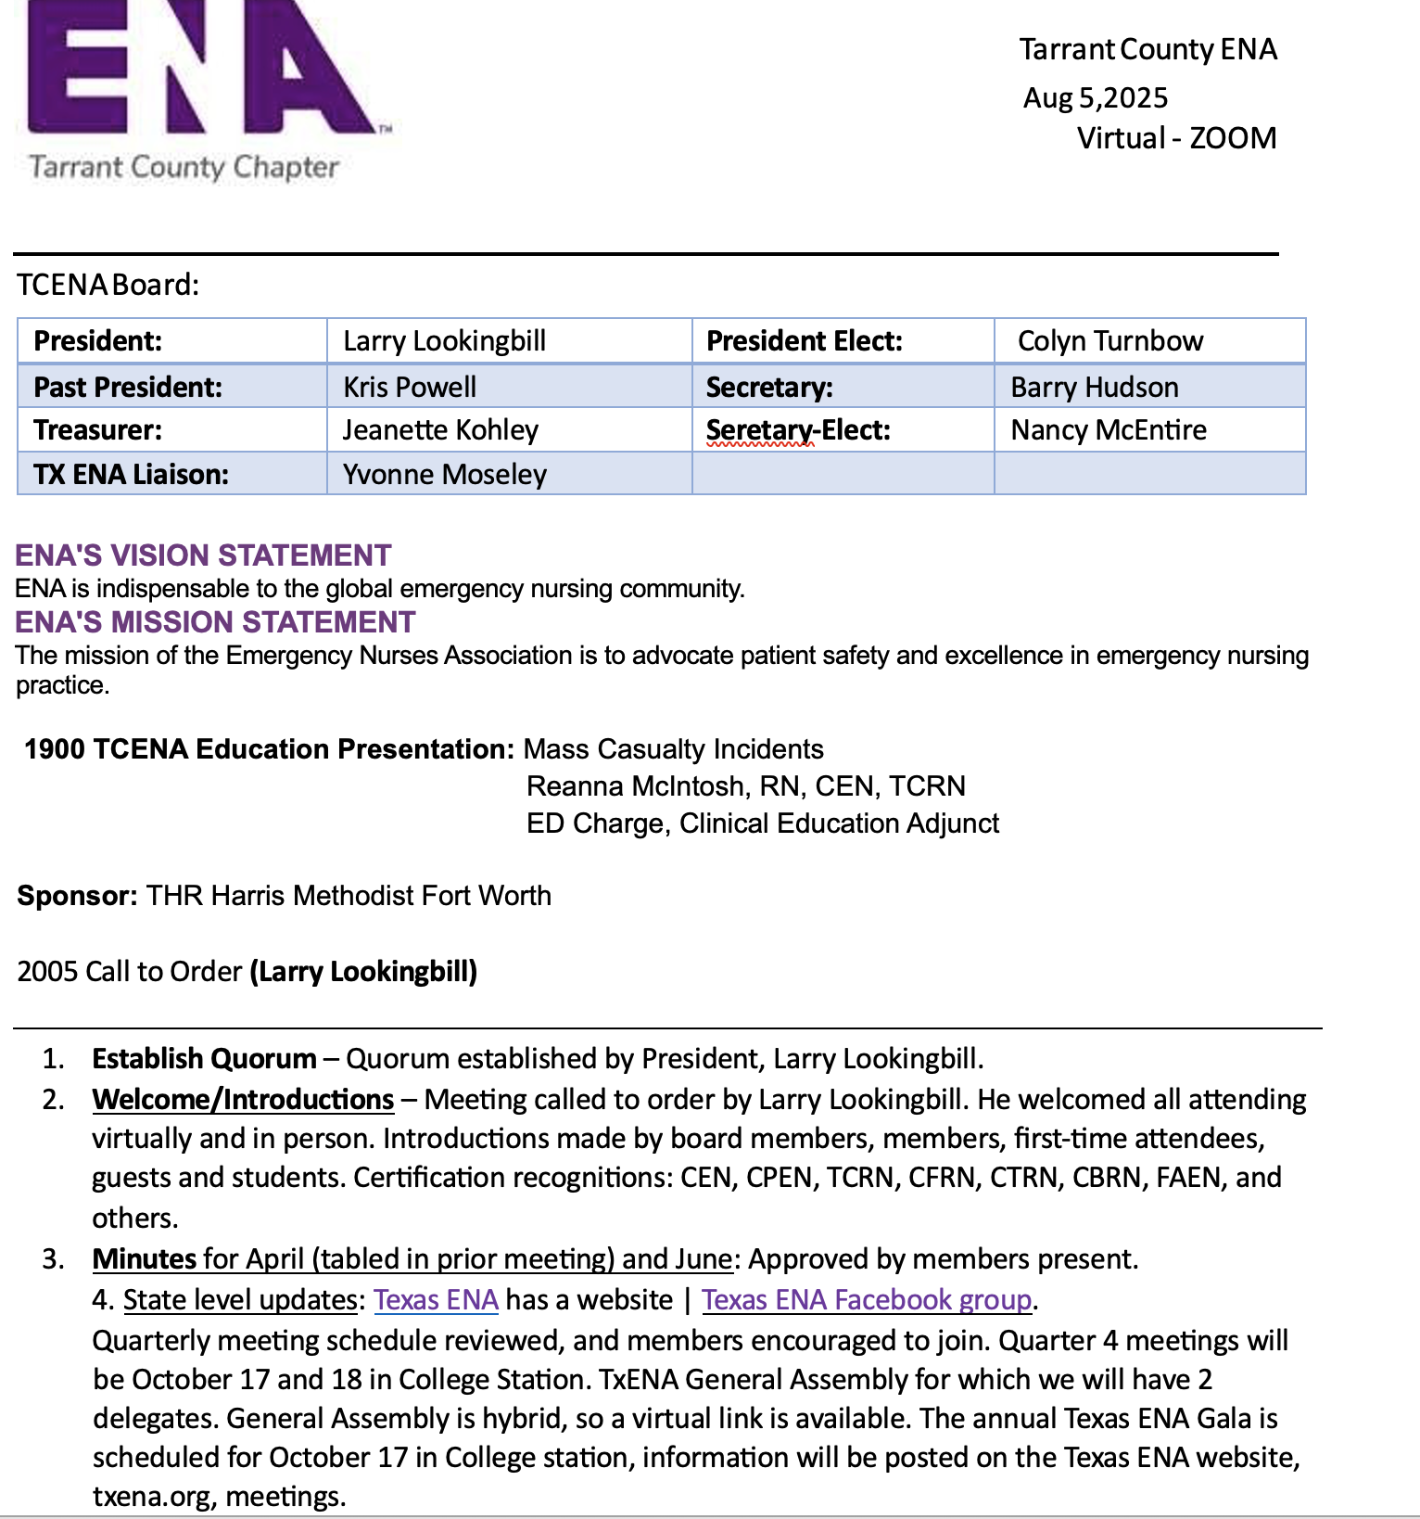
REVIEW OF Meeting Minutes August 5, 2025
Texas Health Fort Worth

Slide 7
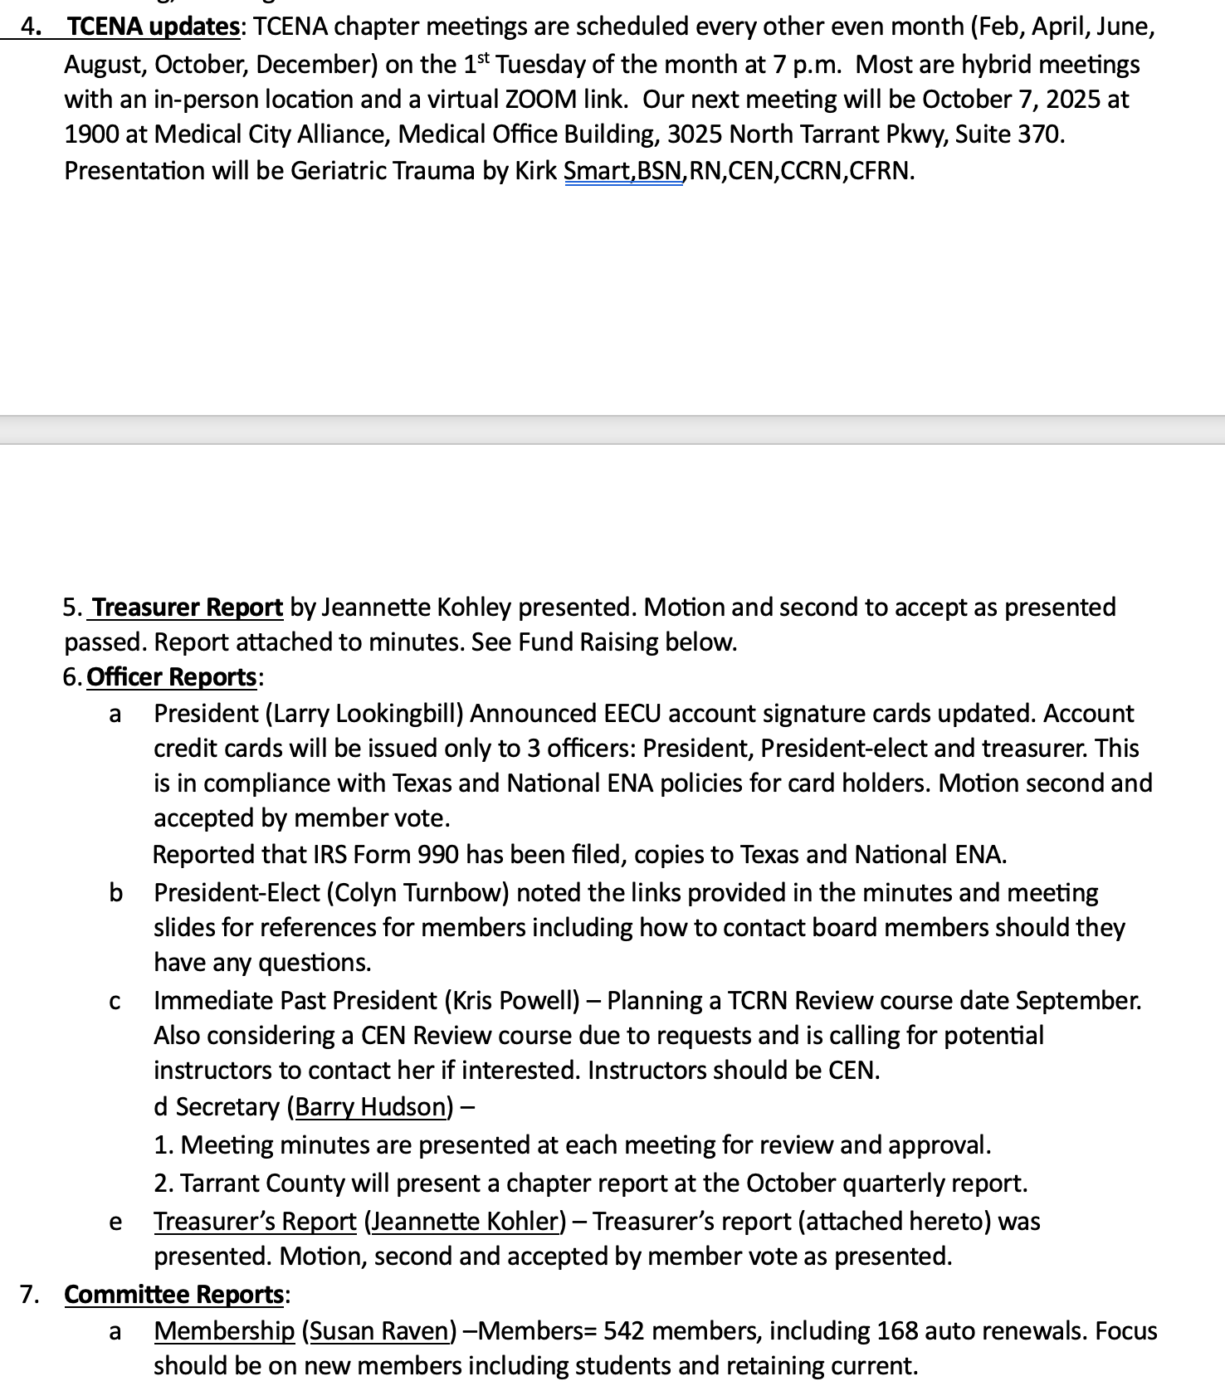

Slide 8
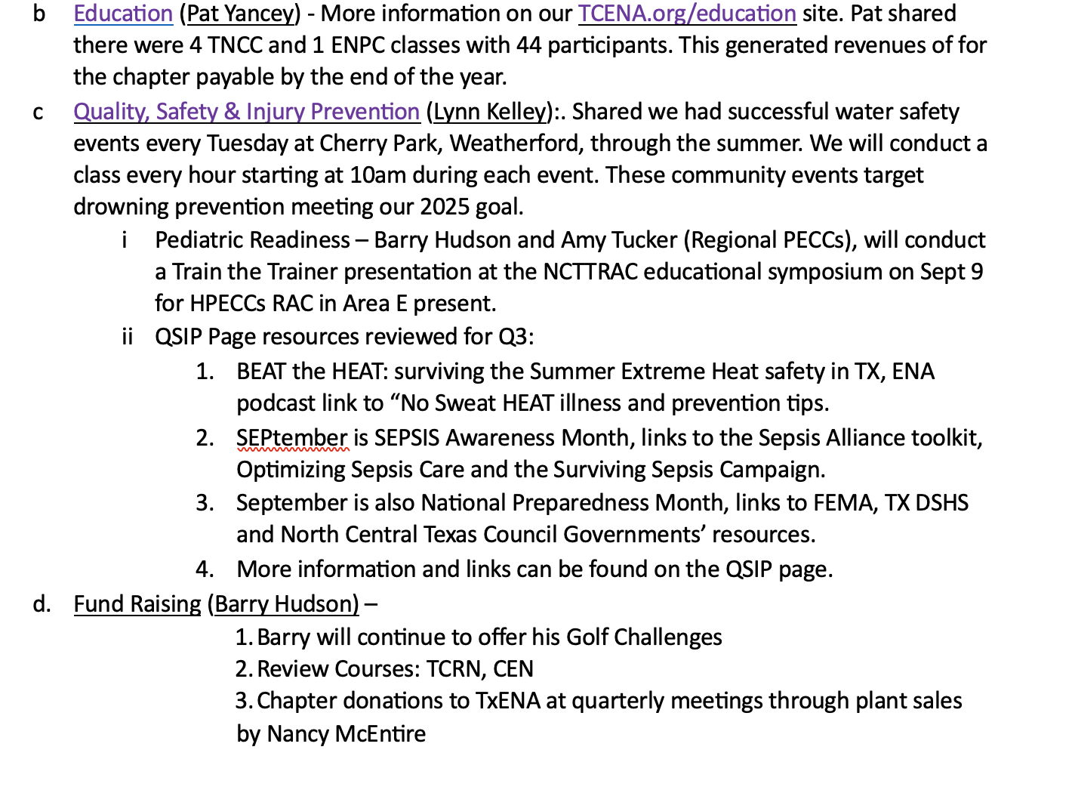

Slide 9
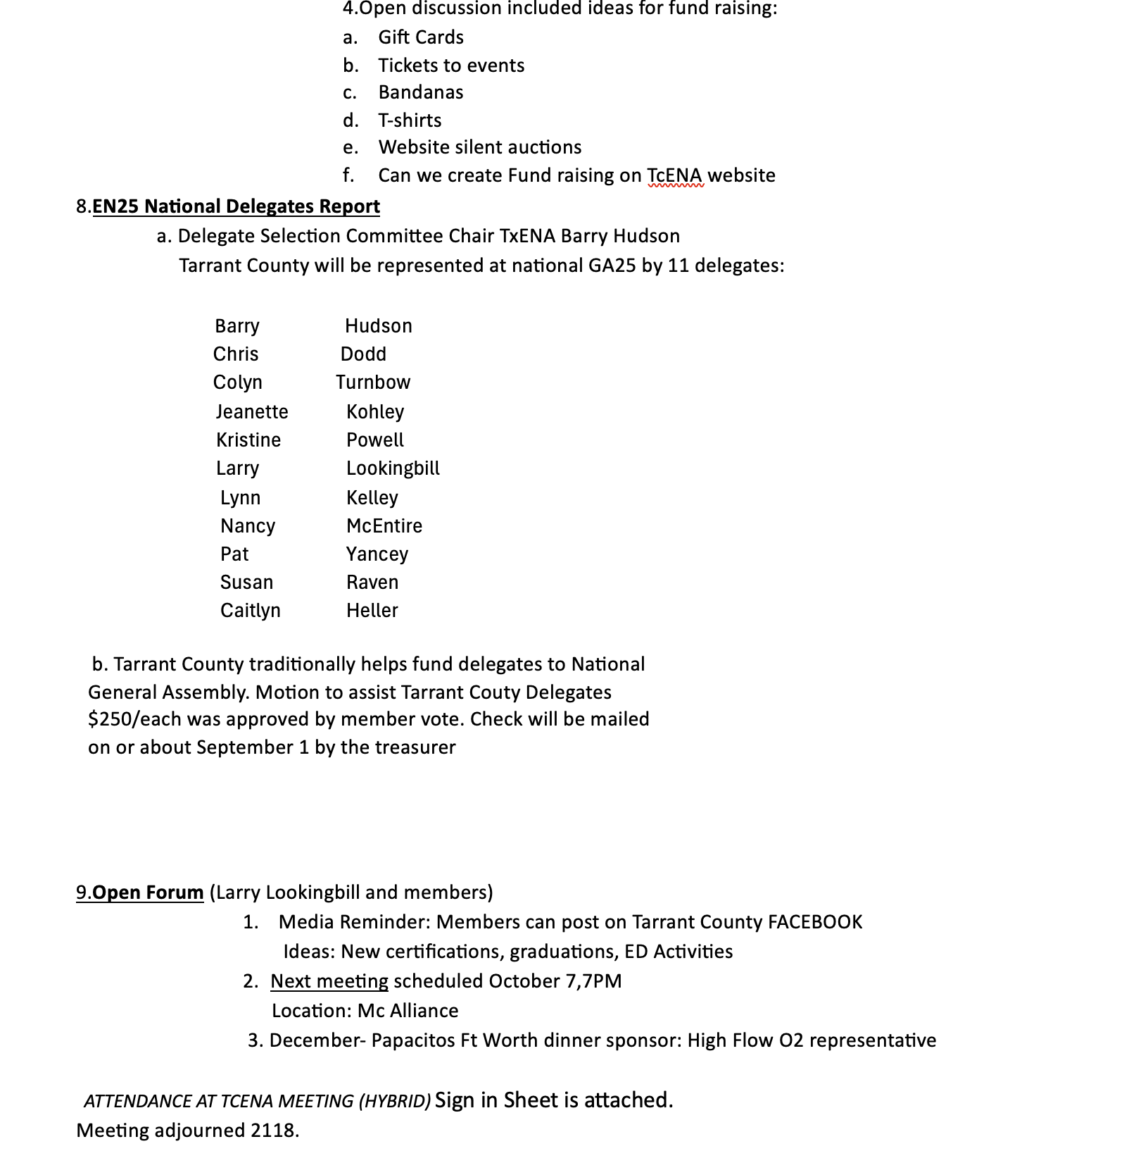

Slide 10

OFFICER REPORTS
TREASURER. - Jeanette
MEMBERSHIP - Susan
EDUCATION - Pat
QSIP - Nancy
FUND RAISING - Barry
MEDIA - Kris

Slide 11
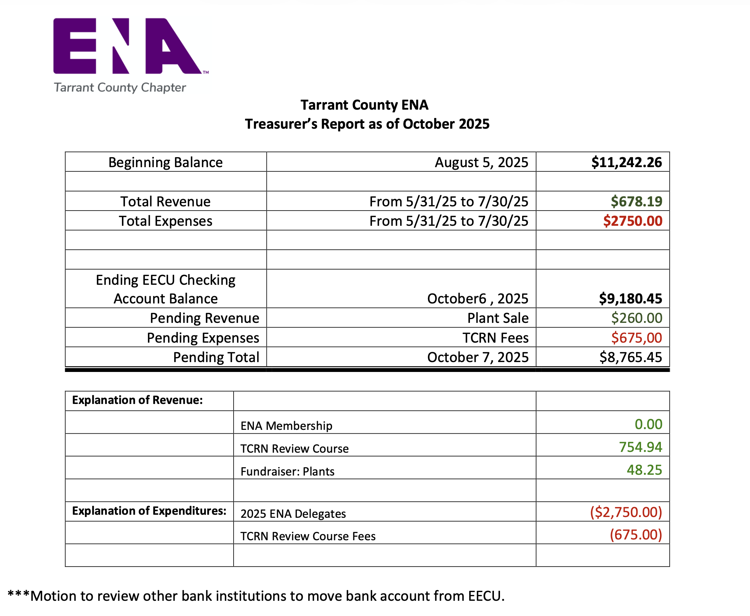
Treasurer Report
Jeanette Kohley

Slide 12
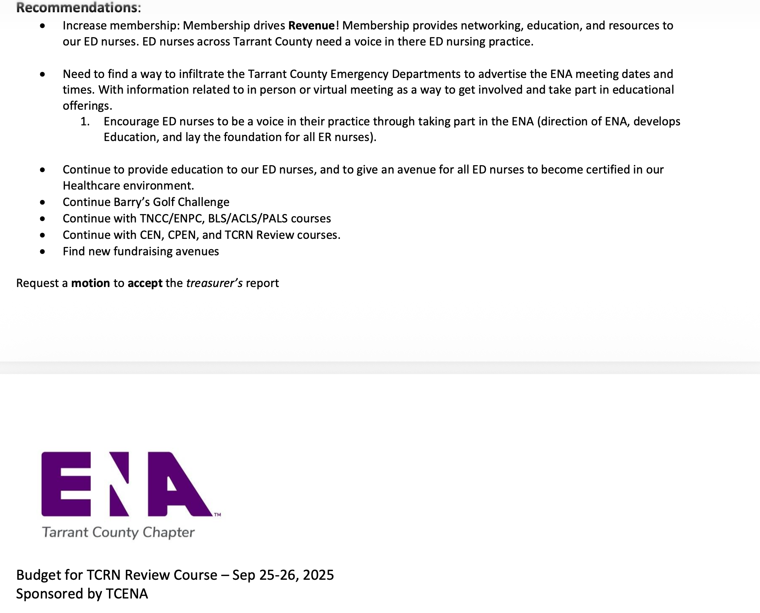

Slide 13
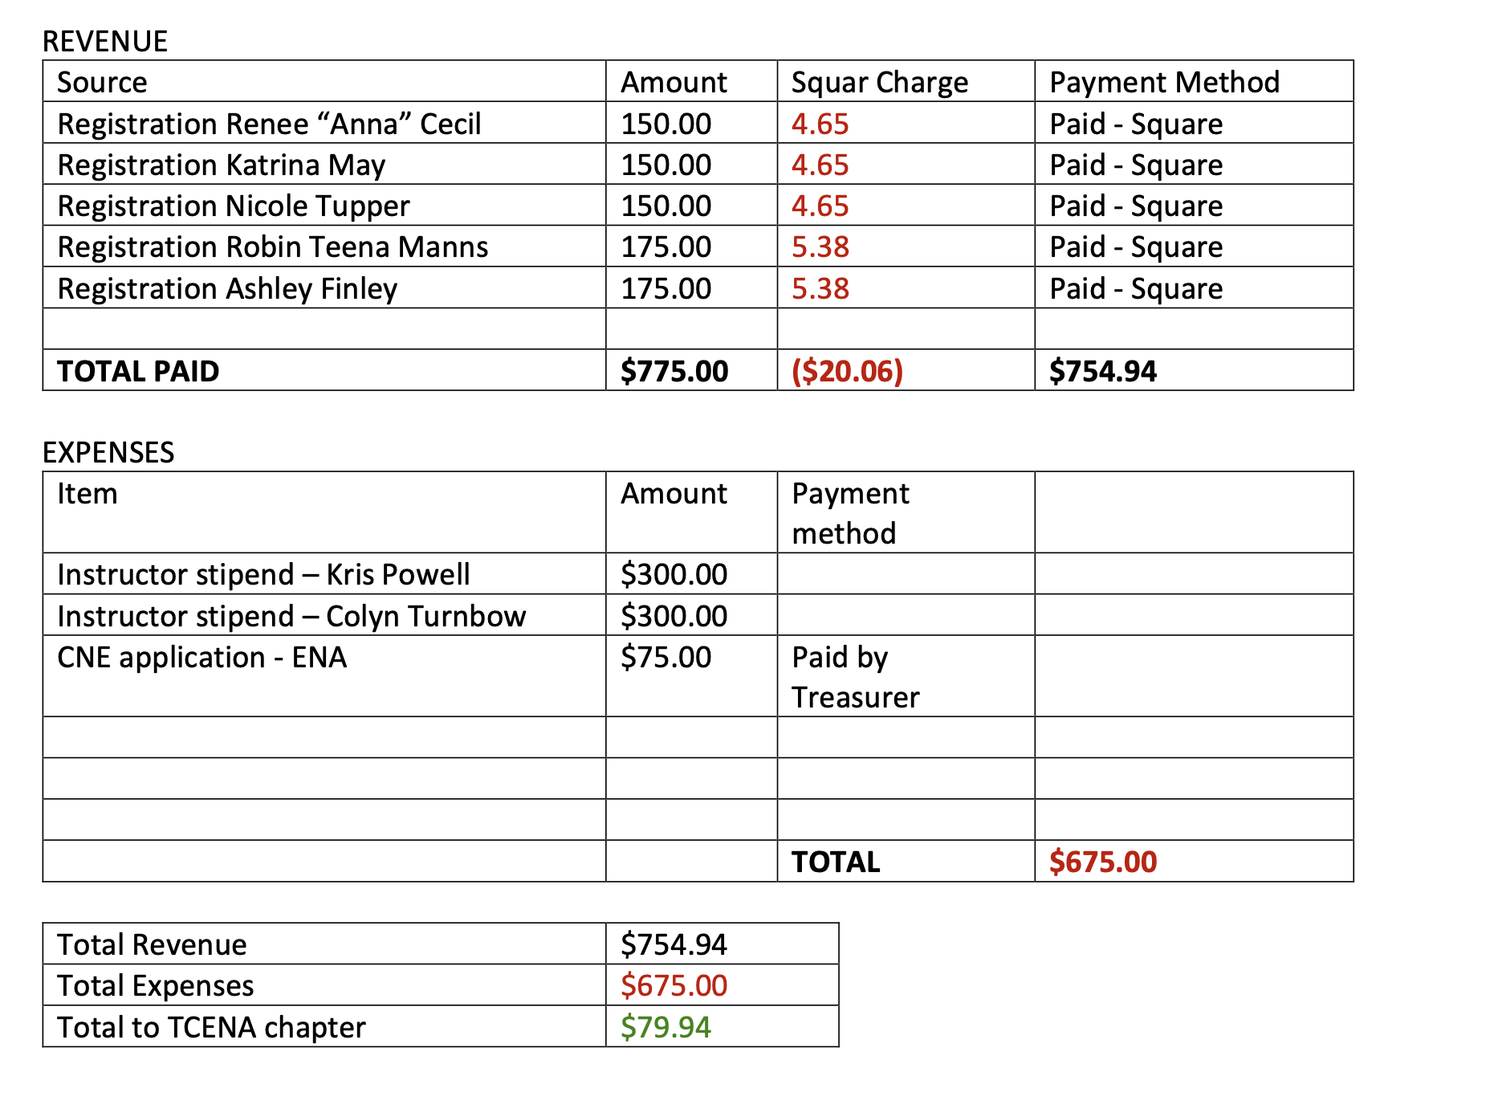

Slide 14
Membership report susan raven
Tarrant County ENA
Total Members to date: 480
New Members: 1
Total Members Expiring: 27

Slide 15
Education report Pat yancey

Slide 16
Qsip report nancy Mcintire

Slide 17
Fund raising barry hudson

Slide 18
Media kris powel

Slide 19
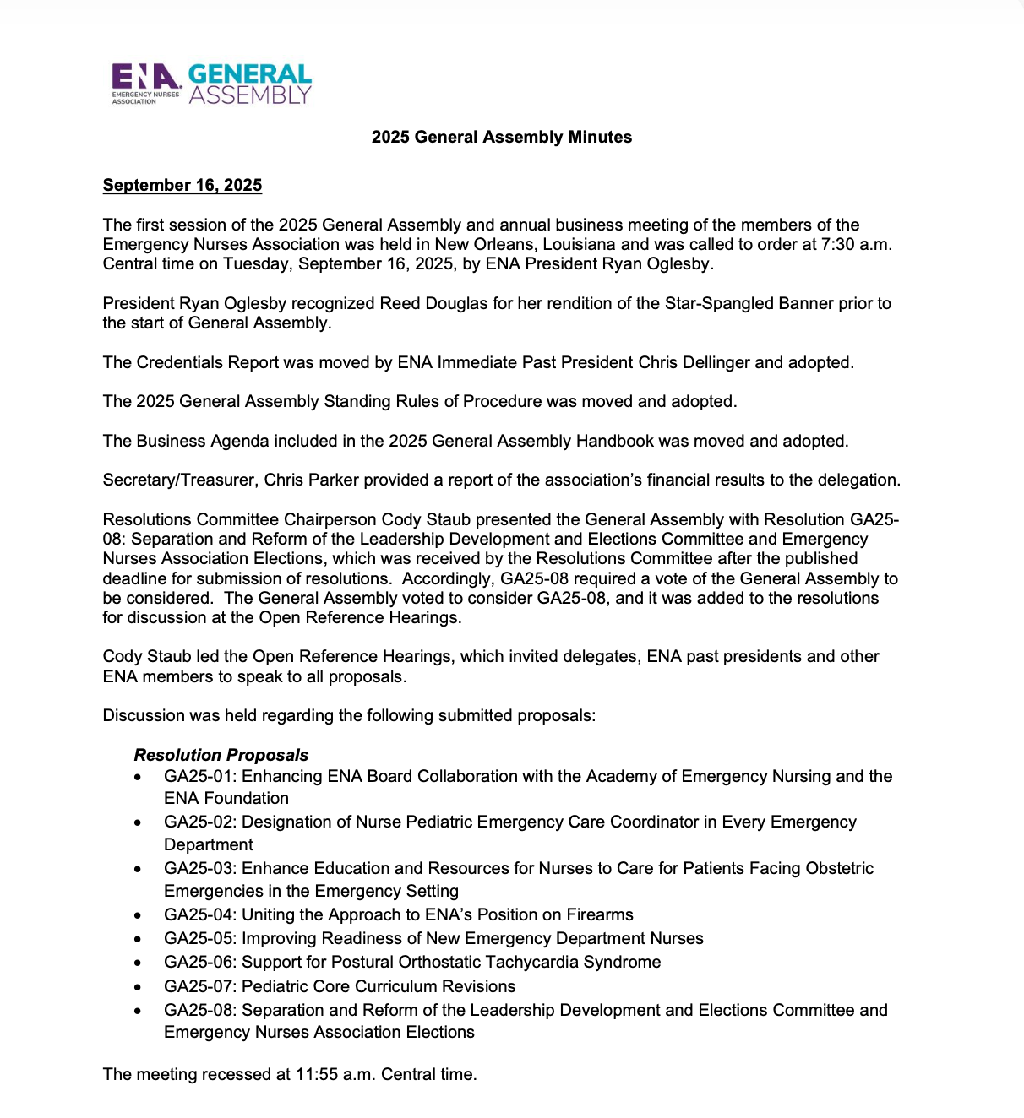
Resolutions from National Barry

Slide 20
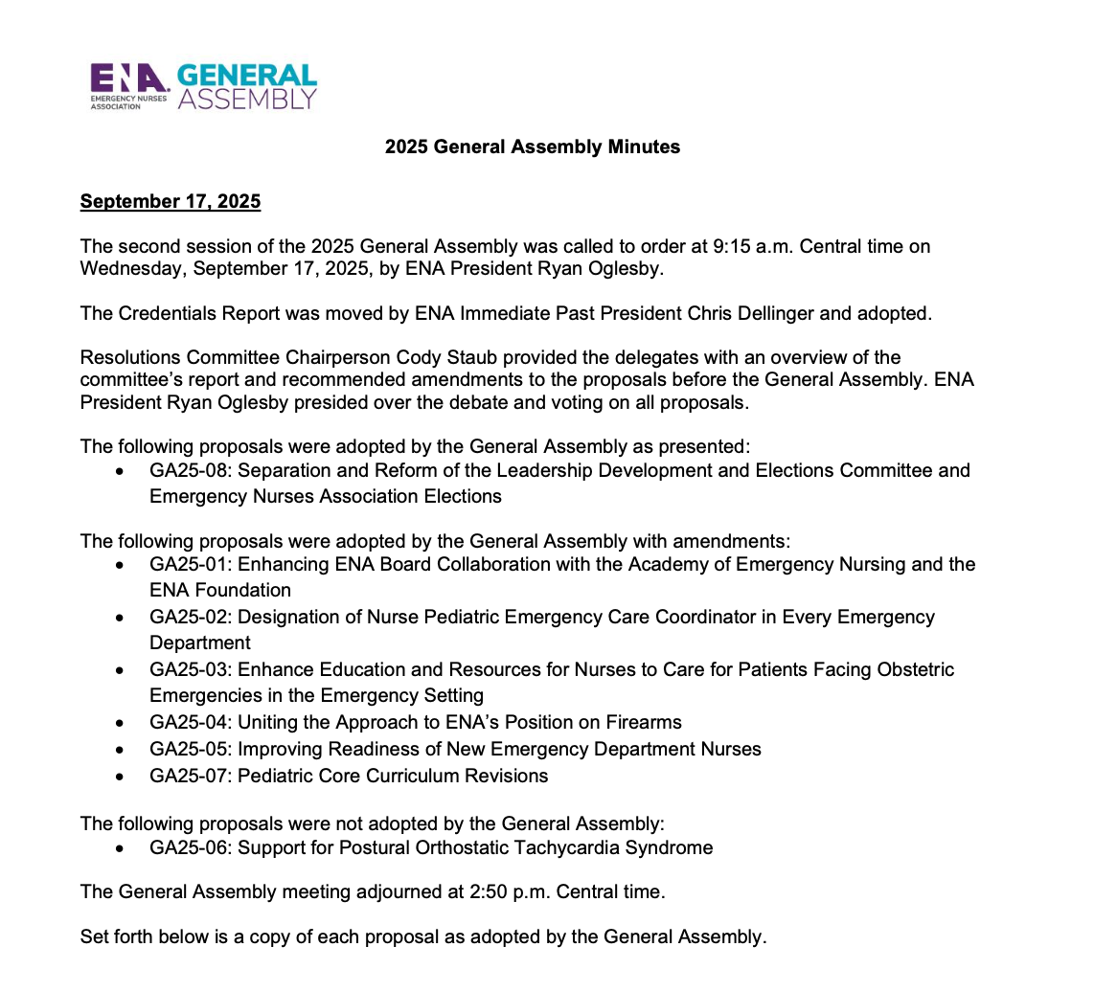

Slide 21
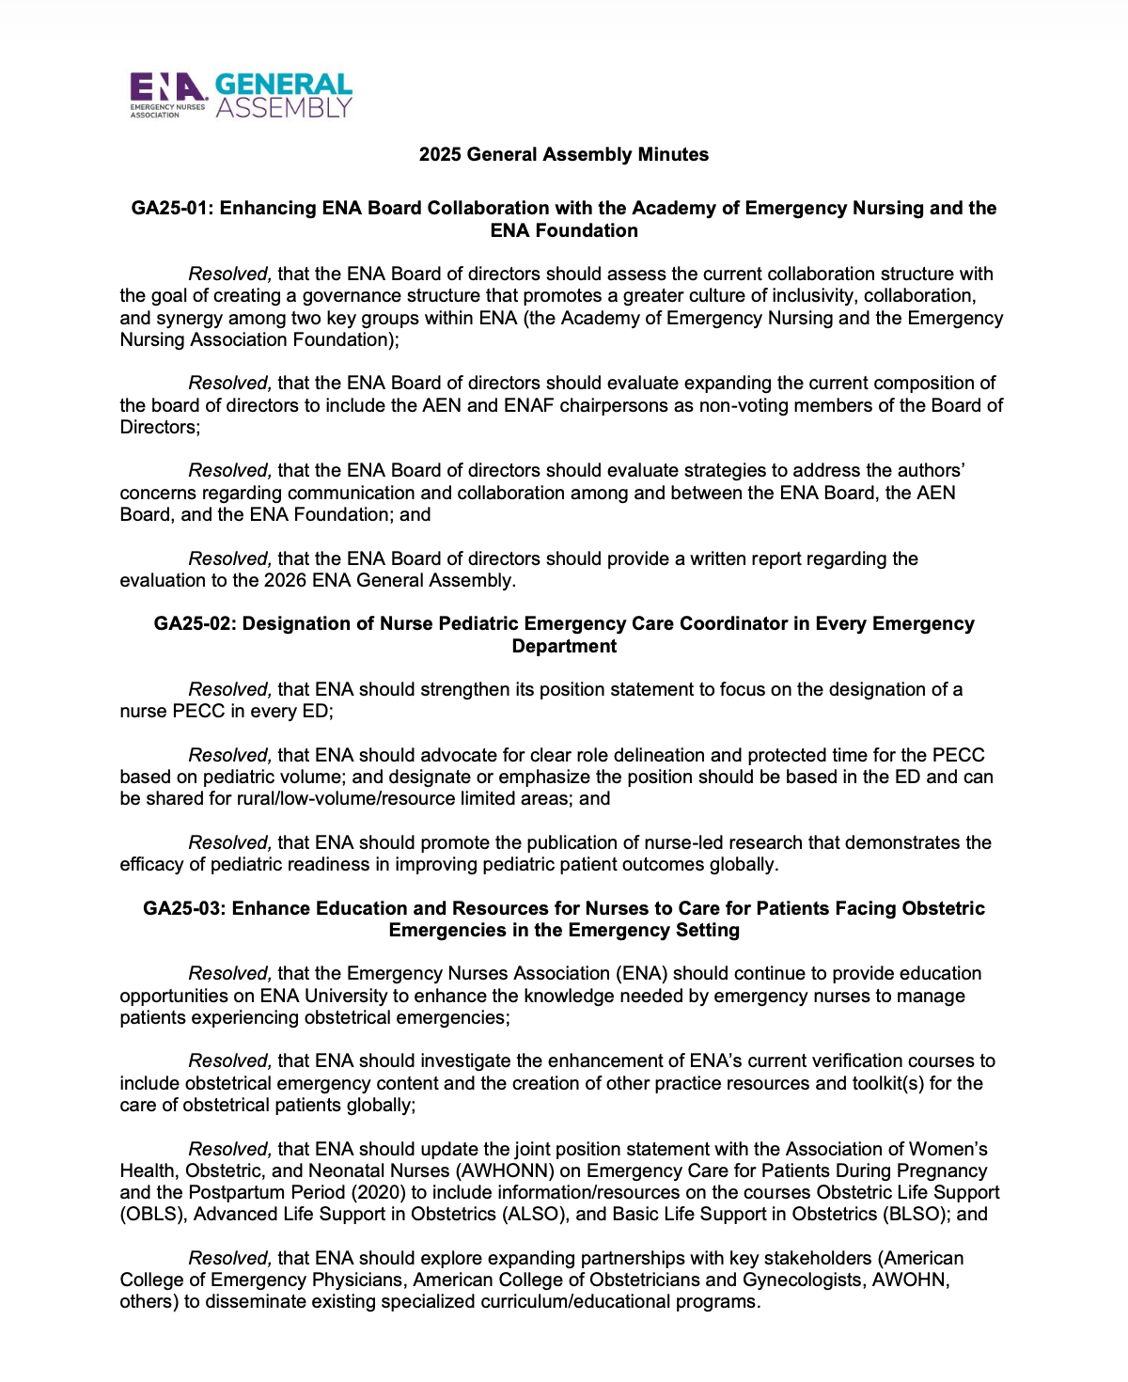

Slide 22
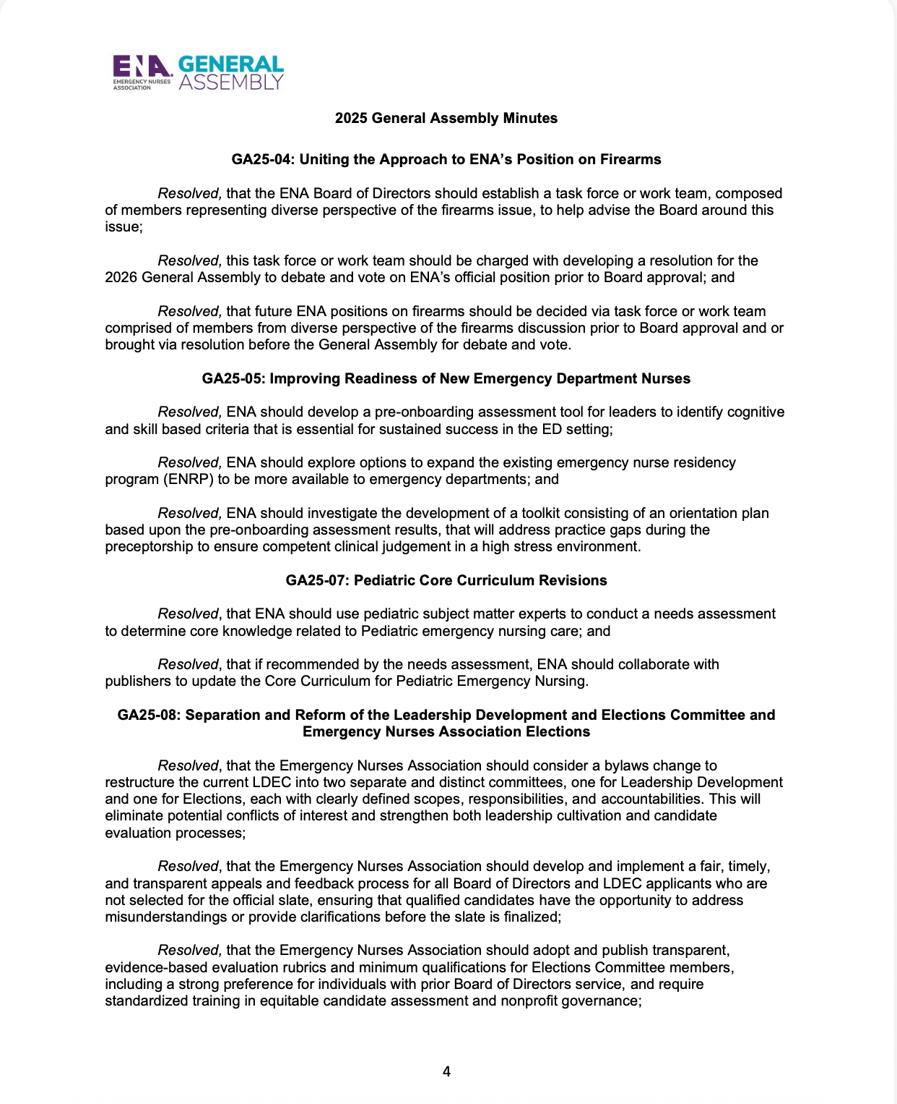

Slide 23
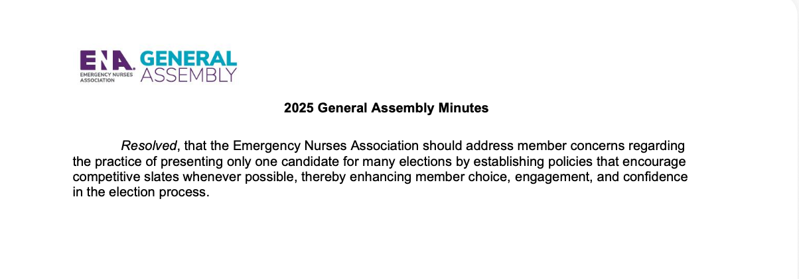

Slide 24
Chapter Elections
President Elect
Treasure Elect

Slide 25

OPEN FORUM

Slide 26
NEXT MEETING December 2, 2025 Pappasitos Fort Worth 2704 West Fwy, Ft. Worth 76102 Food and education provided by Fisher & Paykel High flow nasal Cannula Toy drive, please bring unwrapped toy or gift

Slide 27

Thank you
MEETING ADJOURNED

