Slide 1

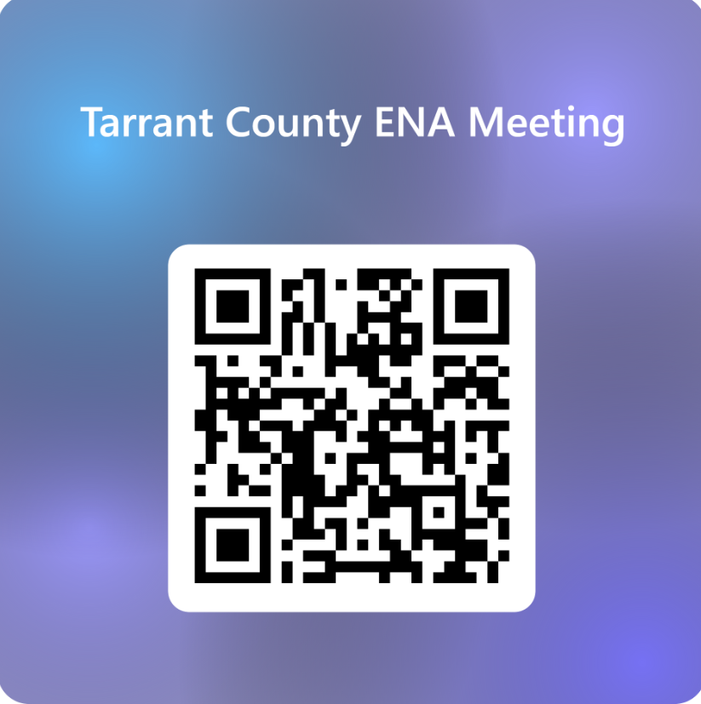

Tarrant County ENA
June 2, 2026

Slide 2
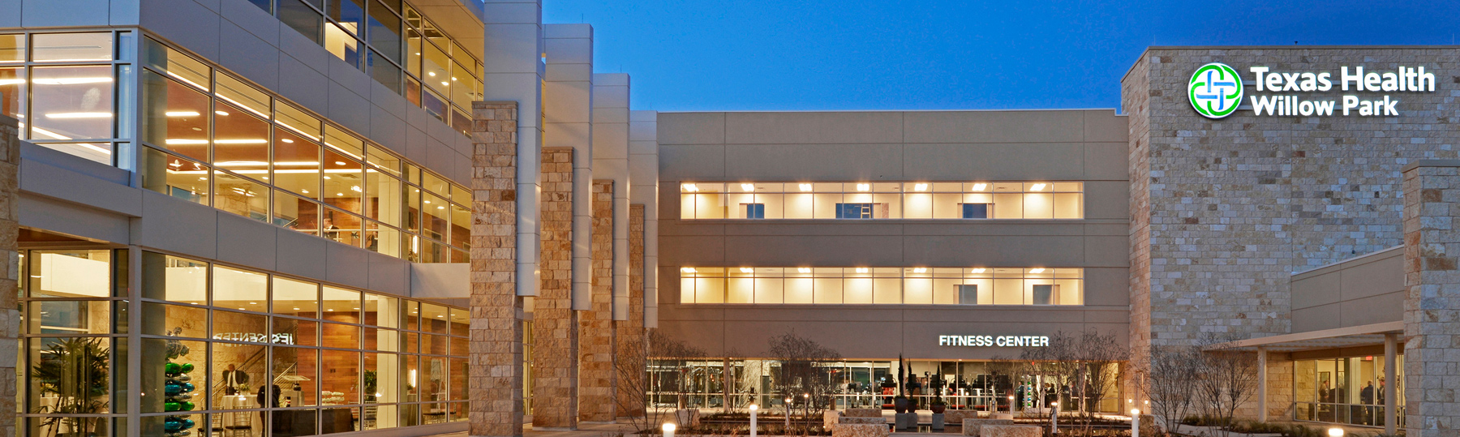
Dinner provided by
Texas Health Willow Park
Thank you to our hosts!

Slide 3


Slide 4
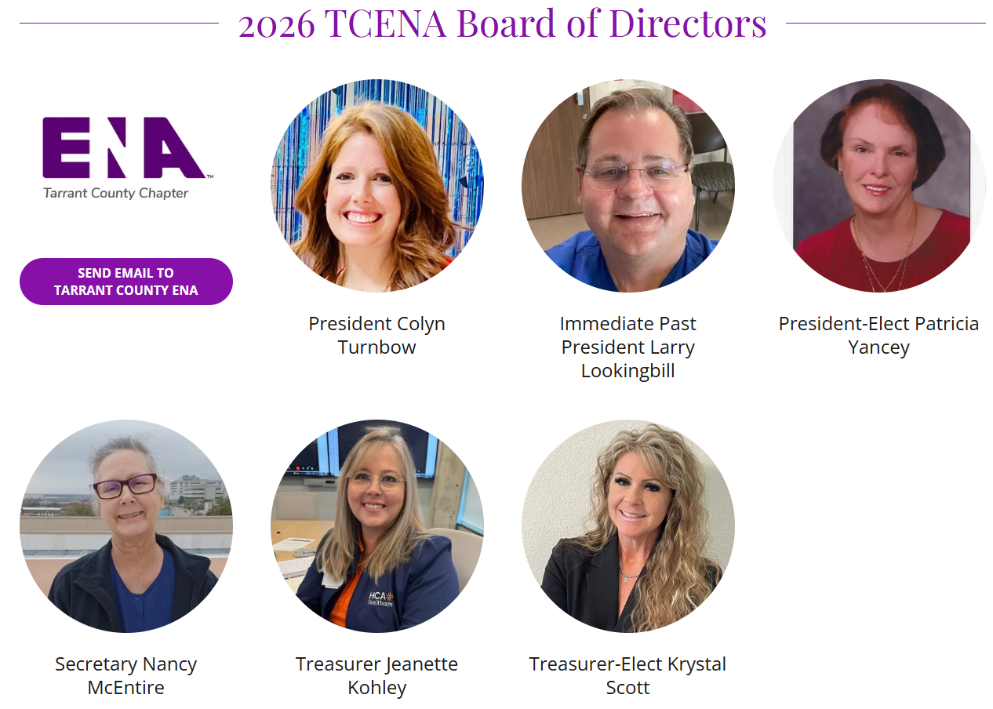
Agenda
Business Meeting
Welcome-Call To Order
Introductions – Board of Directors
President –Colyn Turnbow
President Elect –Pat Yancey
Past President –Larry Lookingbill
Treasurer – Jeanette Kohley
Treasurer-elect – Krystal Scott
Secretary- Nancy McEntire
Members – Guests - Students

Slide 5
Certification Recognition!
CEN, CPEN, TCRN, CFRN, CTRN, CBRN, FAEN, CCRN, OTHER
Student?
First Time Attendees?

Slide 6
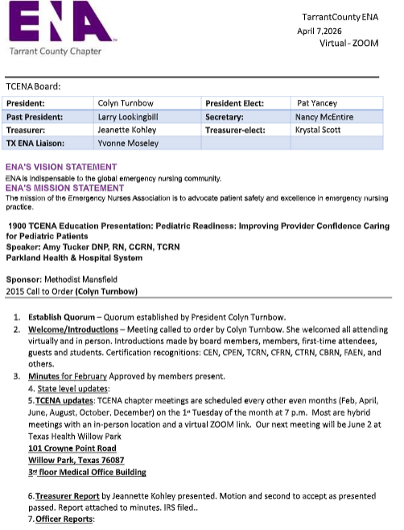
REVIEW of Meeting
Minutes for APPROVAL

Slide 7
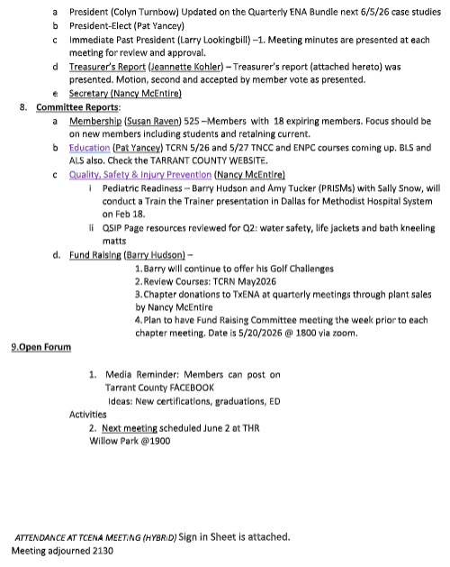
REVIEW of Meeting
Minutes for APPROVAL
Motion to approve the minutes as written?
Edits/Amendments?
ADD ATTENDANCE

Slide 8
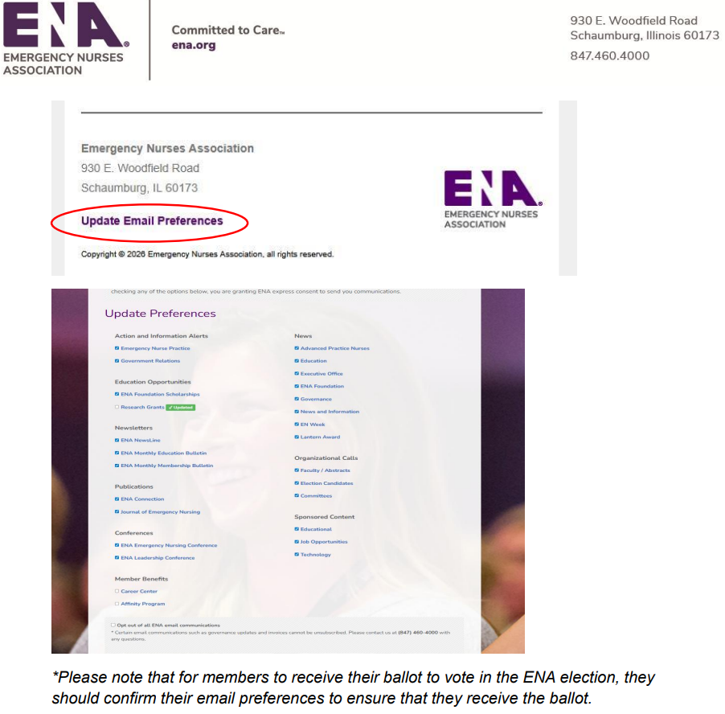
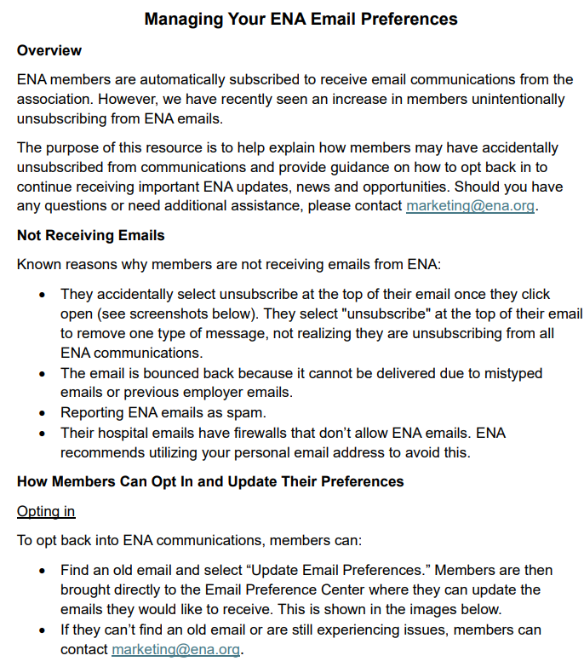
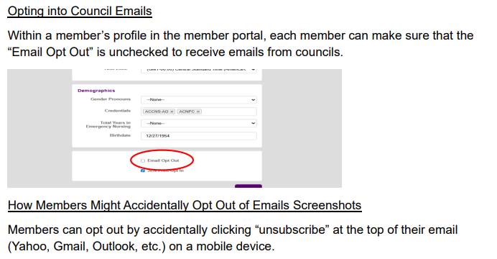
NATIONAL UPDATES

Slide 9


Slide 10
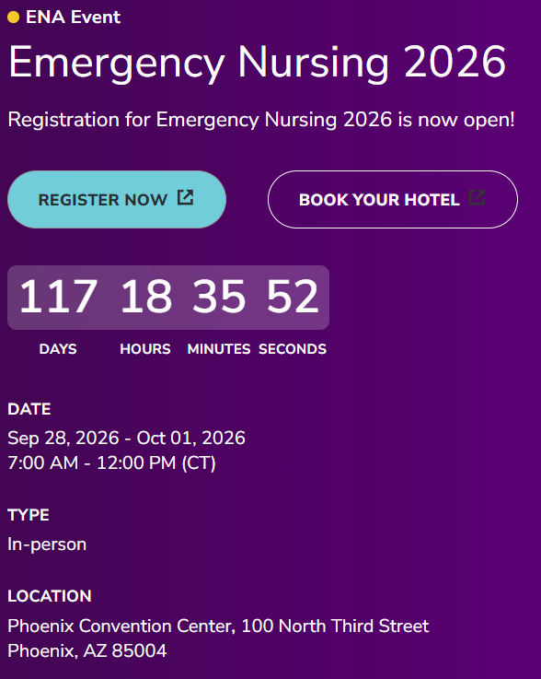
NATIONAL UPDATES
Q2 Leadership meeting May 2026
March, the Board of Directors met at ENA Headquarters.
The Board approved three position statements:
  Patient Experience Satisfaction in the Emergency Care Setting
  Mitigating the Effects of Climate Change on Health and Healthcare: The Role of Emergency Nurses
  Helicopter Shopping: A Consensus Statement
The Board also approved ENA's 2026-2027 Public Policy Agenda. ENA website.
Lastly, a work team of ENA members was formed to revise the Emergency Nurses Association Nursing Code of Ethics. During the meeting, the ENA Board reviewed and approved the revised code, which will be published in an upcoming issue of the Journal of Emergency Nursing.
2026 General Assembly will take place September 27 and 28, ahead of Emergency Nursing 2026 in Phoenix
ENA bylaw amendments and resolutions, deadline June 1.
Notes:
March, the Board of Directors met at ENA Headquarters.
The Board approved three position statements:
Patient Experience Satisfaction in the Emergency Care Setting
Mitigating the Effects of Climate Change on Health and Healthcare: The Role of Emergency Nurses
Helicopter Shopping: A Consensus Statement
The Board also approved ENA's 2026-2027 Public Policy Agenda. The agenda establishes the broad government relations priorities to be addressed by ENA. Take a look at the public policy agenda on the ENA website.
Lastly, a work team of ENA members was formed to revise the Emergency Nurses Association Nursing Code of Ethics. During the meeting, the ENA Board reviewed and approved the revised code, which will be published in an upcoming issue of the Journal of Emergency Nursing.

Slide 11
NATIONAL UPDATES
JUNE/JULY
Dates to Remember
Dates to Remember
6/1 Deadline to submit Bylaw amendments and Resolutions for consideration at the 2026 General Assembly. Proposals must be submitted to governance@ena.org by noon Central time.
6/16 ENA Virtual Town Hall – 1 p.m. Central time
6/17 Government Affairs Chair Call – 2 p.m. Central time
6/25 Pediatric and Trauma Chair Webinar – 2 p.m. Central time
7/1 EN Week planning guide released
TBD 2026 ENA Election candidates announced
TBD Deadline for Emergency Nursing 2026 early-bird registration
7/14 Deadline to register General Assembly delegate captains 7/14-16 ENA Board of Directors meeting
TBD ENA Foundation Global Exchange Scholarship application closes
7/29 General Assembly Handbook posted for delegates
• Delegates and alternate delegates will receive email notification when the handbook is available. The General Assembly Handbook posted to the ENA website.
Notes:
Activities
• Ensure delegates, alternate delegates and council captains are registered in the council portal within your ENA member profile by the deadline.
• Determine if council/chapter will have a fundraising booth at Emergency Nursing 2026. For more information about booth space, email partnerwithus@ena.org.
• Begin process for council and chapter elections of 2027 officers. The 2027 officers are due in the council portal on Oct. 31. Hold elections accordingly.

Slide 12
Questions & Conversation
More questions?
Contact governance@ena.org for questions regarding council and chapter compliance, resolutions, and General Assembly
Contact support@ena.org for assistance with education, membership and all other questions

Slide 13
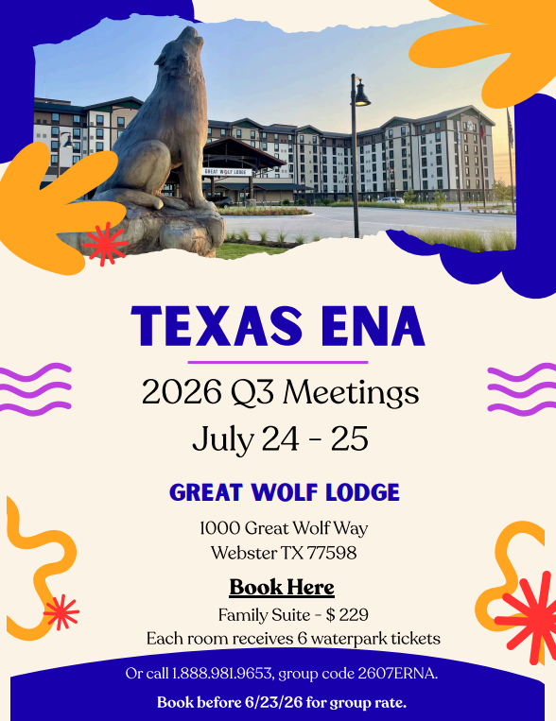


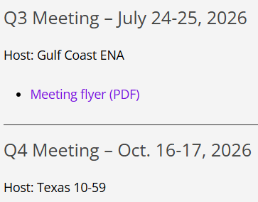
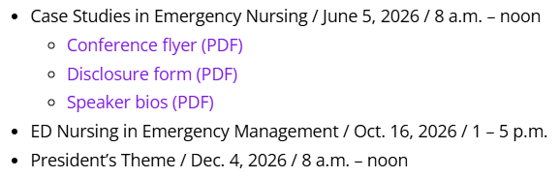
TX STATE COUNCIL UPDATES
Notes:
Topics
Case Studies in Emergency Nursing / June 5, 2026 / 8 a.m. – noon
ED Nursing in Emergency Management / Oct. 16, 2026 / 1 – 5 p.m.
President’s Theme / Dec. 4, 2026 / 8 a.m. – noon
Pricing
ENA Members: $60 per session
ENA Members Bundle (all four conferences): $200
Non-ENA Members: $70 per session
Non-ENA Members Bundle (all four conferences): $250

Slide 14
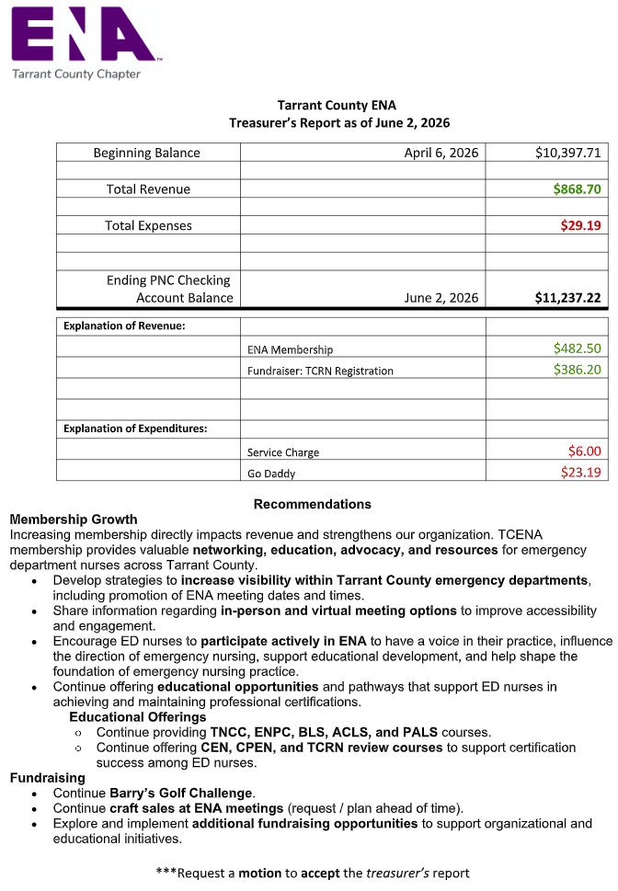
Treasurer Report
Jeanette Kohley

Slide 15

OFFICER REPORTS
MEMBERSHIP - Susan
EDUCATION - Pat
QSIP - Nancy
FUNDRAISING - Barry
MEDIA - Kris

Slide 16
Membership Report
Susan Raven
Tarrant County ENA
Total Members to date:
Feb 468→April 525→June 529
New Members: 19 ?
1/1/26-3/3/26
Total Members Expiring: 18
ENA Takes Lead in Forensic Nursing’s Future as Stewards of IAFN Legacy
Mar 9, 2026
International Association of Forensic Nurses transferring membership, education to ENA
Membership: ENA will assume stewardship of IAFN’s membership. Current IAFN members will transition to ENA membership, gaining access to its full suite of member benefits, professional networks and community platforms.
Notes:
Final Update - Please Read
Dear Forensic Nursing Community,
This email contains IAFN's final update regarding program transfers and the Association's dissolution.
For full details, please visit our FAQ page on the IAFN website before it goes offline at the end of this week:
https://www.forensicnurses.org/news-releases
We encourage you to download and save the FAQ now, as the website will no longer be accessible after this week.
You can also access the FAQ directly here:
https://drive.google.com/file/d/1nQBWtBtGYEKVbqCesGBhzbQ2uQrCQxnE/view?usp=drive_link
Questions can be directed to me at jpw@forensicnurses.org
Thank you for your unwavering support of IAFN and the forensic nursing community. It has been an honor to serve alongside you.
With gratitude,
Jennifer Pierce-Weeks

Slide 17


Education report
Pat Yancey
TNCC in March and an ENPC Instructor class on April 3rd.
2 TNCC in April
ACLS on April 17 &18 and BLS on April 28.
2 TNCC and 1 ENPC in May
1 TNCC on June 1st and 2nd
3 ENPC in 2nd quarter
Challenging with course updates
TNCC next couple of months, switching to 10th edition

Slide 18
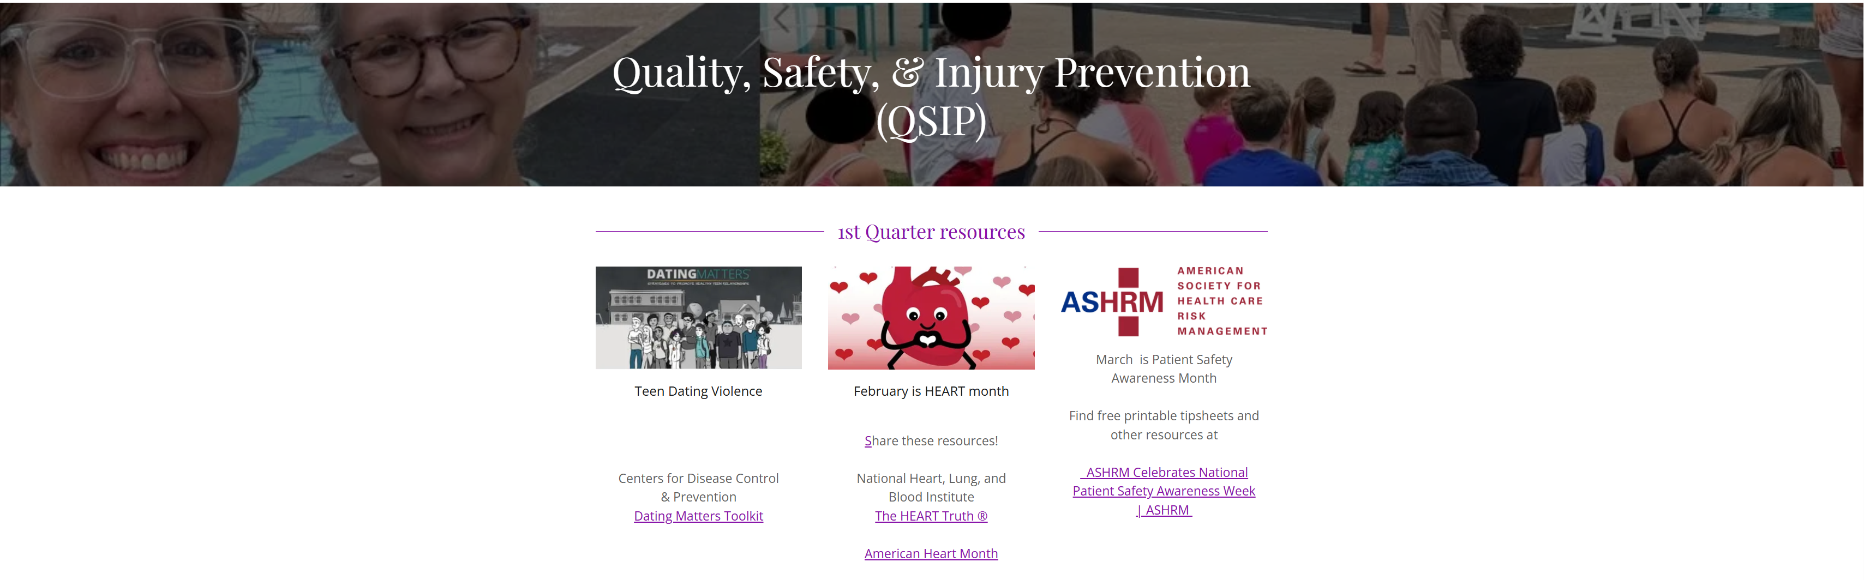



QSIP report
Nancy McEntire

Slide 19

Fundraising
Barry Hudson
Fundraising Activities:
1. Golf Challenge will resume this quarter; the first quarter weather did not permit this activity during the first quarter. Plan to have at least one Golf Challenge each quarter throughout the year. There is a good chance that golf course accessibility will become more important.
2. TCRN review course scheduled for May 26 and 27th – 4 Attendees
3. Nancy McEntire, Kris Powell, and others will have items for sale at each meeting.
4. Nancy McEntire has brought the idea of T-shirt sales.
5. We could consider the sale of bandanas as well.
6. Zoom Fundraising meetings scheduled and on calendar

Slide 20
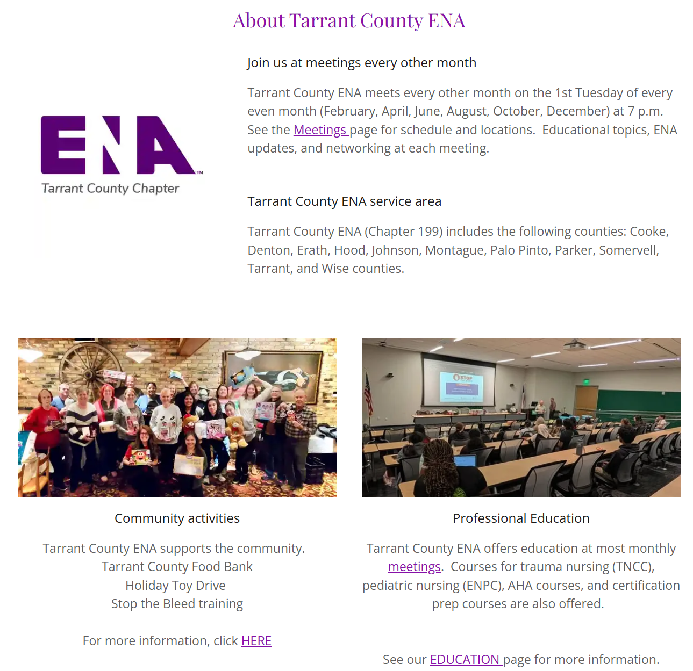


Media
Kris Powell

Slide 21
Open forum
Ideas
Education opportunities
Events
Questions?
IAFN – send invitation to members.
Traffic – consideration of time

Slide 22

Thank you
MEETING ADJOURNED
Make sure your attendance is captured!
Notes:
https://forms.office.com/pages/responsepage.aspx?id=DQSIkWdsW0yxEjajBLZtrQAAAAAAAAAAAAN__rezgVlUQUg0R1U3U1ZSOFNFMFJEM0pZN1YyTTkzVy4u&origin=QRCode&route=shorturl

Slide 23
2026-06-02 19:17:17 From elena to Everyone:
i think Sundance Square is prepping last I saw
Colyn Turnbow - TCENA President:👍
2026-06-02 19:44:26 From Krystal Scott to Everyone:
Would this qualify as a GLF
2026-06-02 20:00:07 From Colyn Turnbow - TCENA President to Everyone:
Hospital-Preparedness-Checklist-FIFA-Worldcup_2026-03.pdf
2026-06-02 20:00:15 From Colyn Turnbow - TCENA President to Everyone:
FWC_Health_Medical_Planning.pdf
2026-06-02 20:03:20 From Colyn Turnbow - TCENA President to Everyone:
https://surgeworld.lachildrenshospital.net/index.php
Anita Sanders:❤️
2026-06-02 20:08:29 From elena to Everyone:
thanks!
2026-06-02 20:09:48 From Colyn Turnbow - TCENA President to Everyone:
https://forms.cloud.microsoft/r/u2ZAxYkxby
2026-06-02 20:10:06 From Colyn Turnbow - TCENA President to Everyone:
https://forms.cloud.microsoft/r/UhU8wqwFA3
2026-06-02 20:11:09 From Colyn Turnbow - TCENA President to Everyone:
{39B4DE29-FEEC-4746-94DA-B2755CE702C0}.png
2026-06-02 20:11:20 From Anita Sanders to Everyone:
Thank you
MEETING CHAT – EDUCATION FIFA

Slide 24
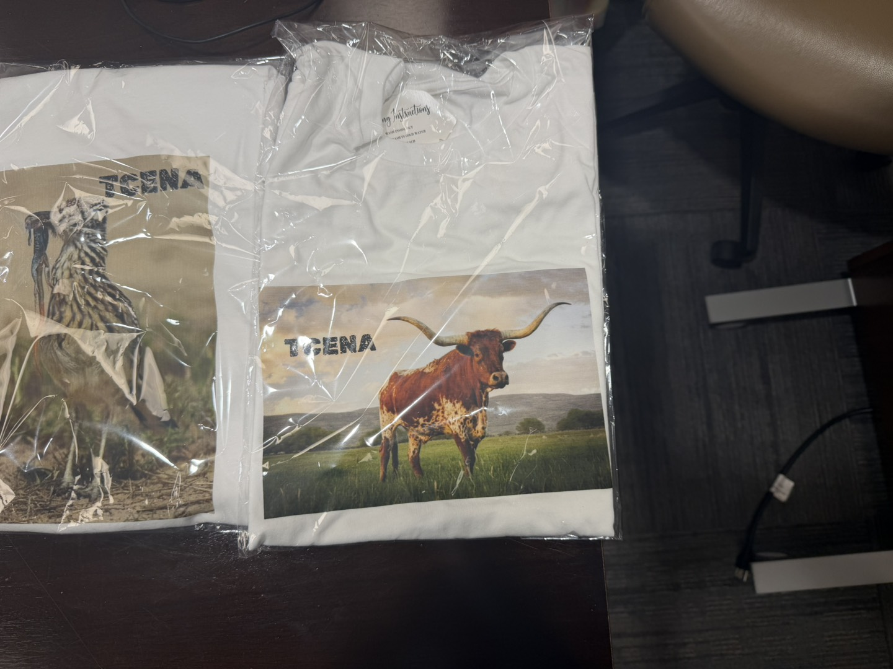
2026-06-02 20:14:22 From Dana Cody to Everyone:
Was there a QR code for the April meeting? Is it possible to get thst if so?
2026-06-02 20:15:34 From Jennifer Collins to Everyone:
Can you add the link for ENA meeting as well?
2026-06-02 20:22:44 From Anita Sanders to Everyone:
BC-CV; Cardiovascular
Colyn Turnbow - TCENA President:👍
2026-06-02 20:52:06 From Larry Lookingbill to Everyone:
202606022052055756150000.jpg, 202606022052056495720100.jpg
Colyn Turnbow - TCENA President:❤️
2026-06-02 20:54:28 From Jennifer Collins to Everyone:
I like the roadrunner
Colyn Turnbow - TCENA President:❤️
2026-06-02 20:56:49 From Lynn Kelley to Everyone:
Good to see everyone. Have to sign off and get to bed. Have an early morning.
Colyn Turnbow - TCENA President:❤️
Krystal Scott, Colyn Turnbow - TCENA President:👋
2026-06-02 21:04:32 From Anita Sanders to Everyone:
how about we ask some of our interns to help with media; this might engage them and get them to join
2026-06-02 21:05:02 From Anita Sanders to Everyone:
We have a new group coming up. I think this would be fun for them.
2026-06-02 21:06:08 From Pat Yancey to Everyone:
It's been a very long day, time for bed. Bye everyone (Pat)
Krystal Scott, Dana Cody:👋
Colyn Turnbow - TCENA President:👍
2026-06-02 21:07:09 From Anita Sanders to Everyone:
Thank you..
MEETING CHAT – BUSINESS MEETING

