Slide 1
Caribbean American Women Association Child Neglect in Primary Education

Slide 2
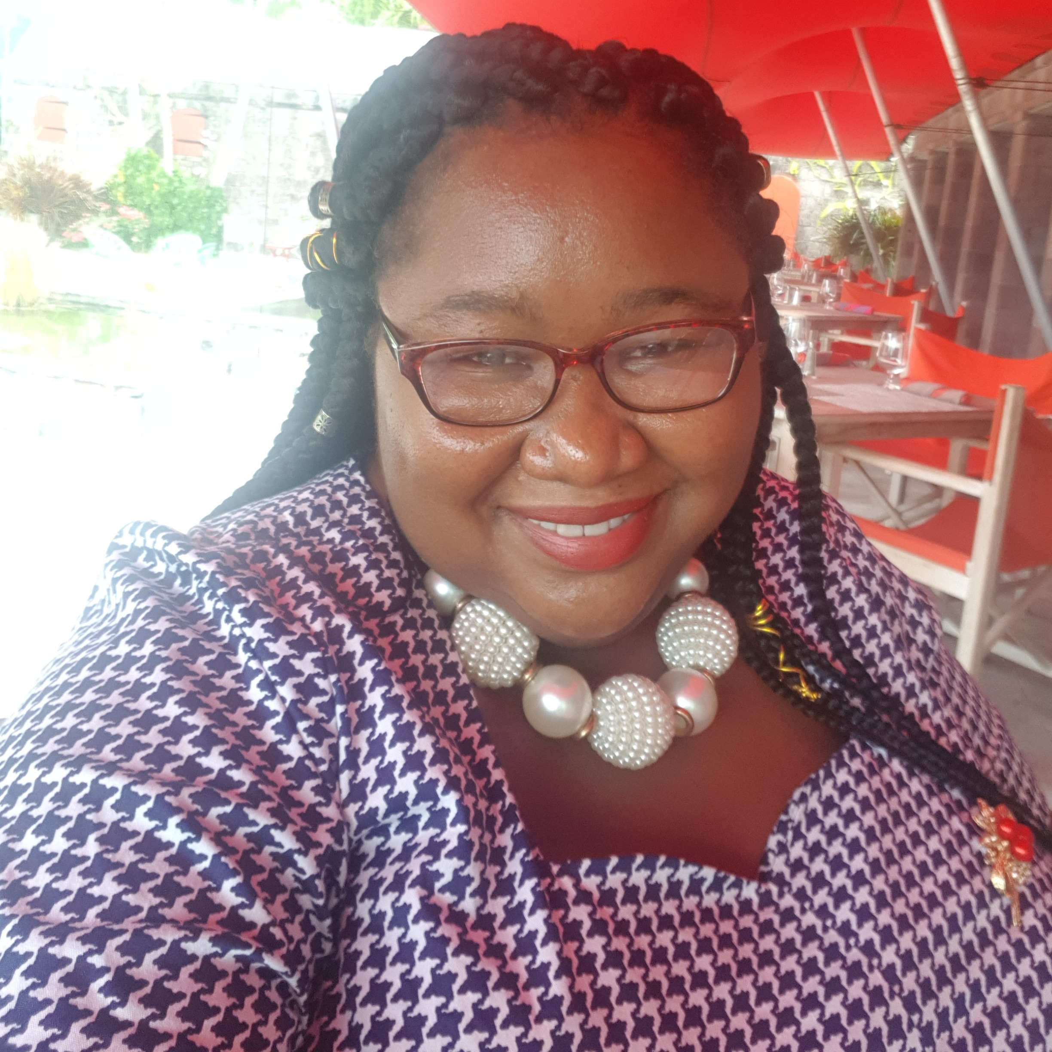
Welcome
I am Ms. Shenelle Pemberton

Slide 3
Thank you for your Invitation
Let’s Jump into the meeting!!

Slide 4
AGENDA
All About Nevis
Nevisian Facts
School Structure in Nevis
Child Neglect (Types)
Dealing with Child Neglect
Caribbean Trends
Questions
Any other Business

Slide 5
All About Nevis
Was inhabited by the Caribs at least 2000 years before Columbus came to Nevis in 1493.
The Caribs name for the island is Oualie ("Land of Beautiful Waters“)
We are part of the Twin Island Federation of St. Kitts – Nevis which is the smallest country in the Western Hemisphere.
We gained independence from Britain on September 19th 1983.
Nevis got its name from the Spanish term “Nuestra Señora de las Nieves” (which means Our Lady of the Snows) – Explain
Nevis is also known as “Queen of the Caribees,” a name it earned in the 18th century when its sugar plantation created much wealth for the British.

Slide 6
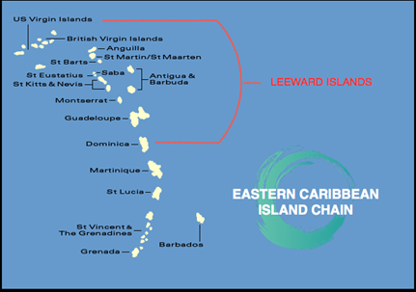
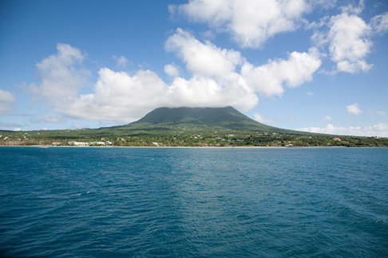
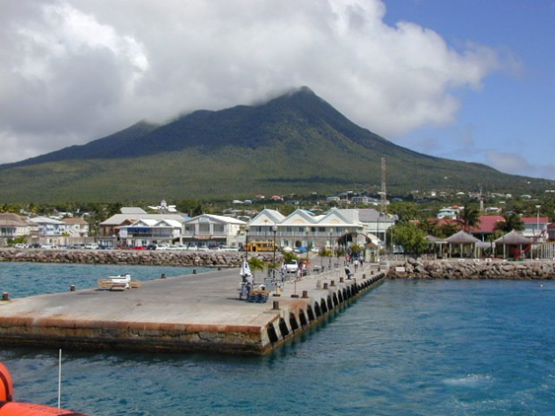
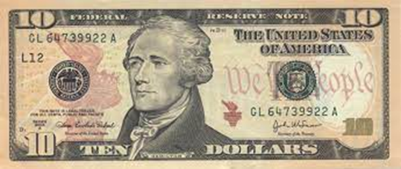
Nevisian Facts
Found in the Leeward Island – 220 Miles Southeast of Puerto Rico
Birth place of Alexander Hamilton – First US Secretary of the Treasury
https://nevisisland.com/

Slide 7
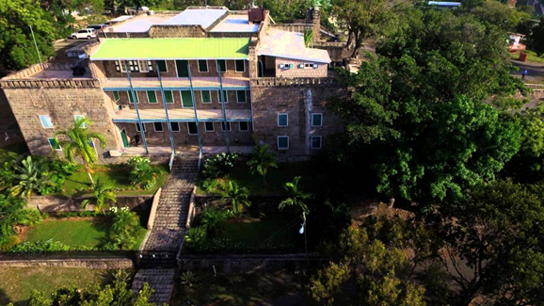
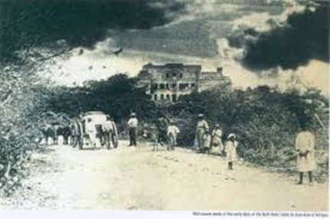
Nevisian Facts
We have the first hotel in the Caribbean – Bath Hotel (1778) next to the Bath Hot Springs
Four Seasons Resort is located on Nevis.

Slide 8
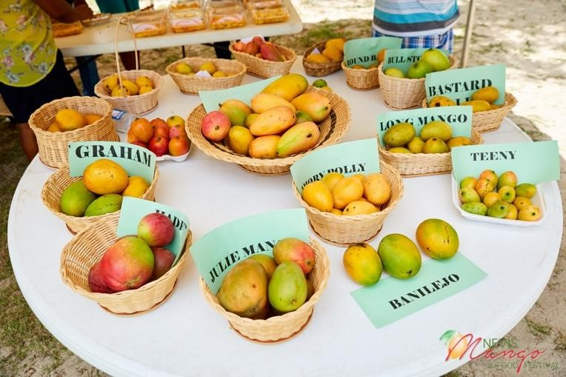
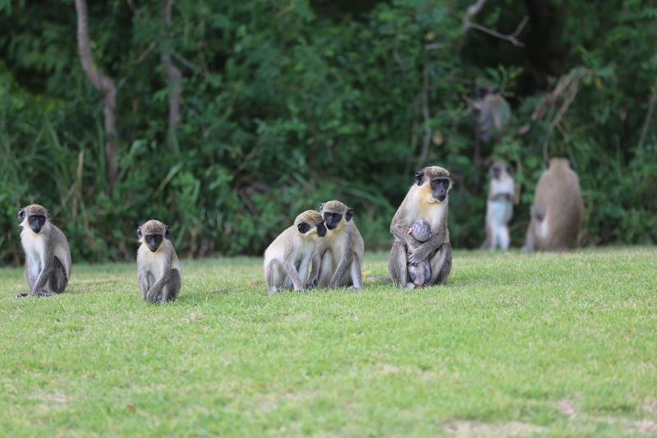
Nevisian Facts
We have over 40 different species of Mangoes. A mango festival is done yearly.
Nevis is home to thousands of African Green Vervet Monkeys. They were brought as pets in the 17th & 18th Century.

Slide 9
Structure of Schools
Principal
Deputy Principal
Management Team
Teachers
Students
Superior to the Principal are: Education Officer, Principal Education Officer, Permanent Secretary, Minister of Education

Slide 10
Structure of Schools
Each School has seven grades (KG – Grade 6) with students are ages 5 – 12 years
In larger schools, there are multiple classes in a specific Grade
In smaller schools like mine, we have one class per Grade level
On average, there are 15 – 20 students in a class in larger schools
In smaller schools, most of the Grades have less than 15 students per grade. There are some exceptions.
Each class has one assigned teacher. (There are no assistant teachers)
There are Instructors for Physical Education, Library, Computer, HFLE and Reading (if available).

Slide 11
Child Neglect
There is no reference to Child Neglect in the Education Act 2005, which schools in Nevis are governed by.
Children (Care and Adoption) Act, 2013 - “neglect of a child” means the failure of a parent of the child to provide the child with adequate care and guidance or other acts or omission by the parent with respect to a child that are inappropriate for the child or likely to be harmful to the child.
Probation and Child Welfare Board Act - lists ‘neglect’ as a part of their definition of Child Abuse.

Slide 12
Child Neglect Types
Educational neglect: Failing to enroll a child in school, allowing a child to repeatedly skip school, or ignoring a child’s special education needs
Emotional neglect: Exposing a child to domestic violence or substance misuse, or not providing affection or emotional support
Inadequate supervision: Leaving a child who can’t care for themself home alone, not protecting a child from safety hazards, or leaving the child with inadequate caregivers
Medical neglect: Denying or delaying necessary or recommended medical treatment
Physical neglect: Failing to care for a child’s basic needs like hygiene, clothing, nutrition, or shelter, or abandoning a child

Slide 13
Dealing with Child Neglect
Schools do not directly proceed over issues of Child Neglect.
Teachers would report certain issues to the Principal and or Guidance Counsellor. They then report this information to Social Services. (Mandatory Reporters)
Social Services has legal permission to investigate and make decisions on what steps are taken in these instances.

Slide 14
Caribbean Trends – We have similar issues.
The OECS Youth Empowerment Strategy (OECS YES)
The OECS Commission, through the Human and Social Development Unit, established this programme to ensure that youth are given the opportunity to engage in a national dialogue to shape the future they will inherit.
Youth of the Eastern Caribbean account for over 30% of the region’s population. The OECS YES targets all OECS Member States: Antigua and Barbuda, the Commonwealth of Dominica, Grenada, Montserrat, Saint-Kitts and Nevis, Saint Lucia, Saint Vincent and the Grenadines Anguilla, the British Virgin Islands, Martinique and Guadeloupe.
The OECS Commission wants to work with the youth to help overcome barriers to their success. As a region, there is the need to develop clear and realistic policies to address critical issues affecting the youth.

Slide 15
Seven areas of focus for the OECS YES:
https://www.oecs.org/en/oecs-yes

Slide 16
YES I Matter - Children & Youth Protection Our youth face many difficult life situations which require protection from individuals in their lives as well as protection from ills of society. This initiative would focus efforts on: Revising or enacting legislation protecting children and youth Providing support for at-risk youth to overcome issues Community education on Child & Youth Protection and Intervention

Slide 18
Thanks!
Any questions?

