Slide 1
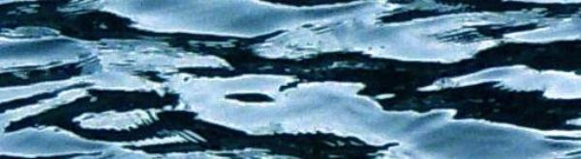

Fishin’ Pole, Pack & Paddle
2014 Fall Issue
President’s Paddle
Tony Adams
What a great year! Excellent paddling on all levels: some of us closer to home, others ventured out west. The River Gods really smiled on us. Yours truly and ten others participated in a “Swift Water Rescue Course” in which we were exposed to basic & level four rescue techniques for two days on the “Balcony Falls” section of the James. The class was quite thought provoking; let’s not get into situations where we have to use these skills! I do encourage all to consider participating in the next course.
The Labor Day Trip at Solitude was wonderful as the “Buchanan Run” was a timely joint effort for the Scotts Creek & George Dickel Chapters, as well as a few members of the Roanoke Chapter. The weather was beautiful and the fishing was killer. A small contingency of us decided to run “Balcony” and were rewarded with good “Maury Confluence” water. The carnage was provided by Taylor Adams tandem with his good bud Zach Rice and then later by the Herb Coleman Chapter (a ‘black sheep’ spin-off of the Scotts Creek chapter)... love it!
“Movie Night on the Rockfish” with the Dickel and Rockfish community and the “Dickel Bash” at the Slate River Property were huge successes! Thanks to all who participated and contributed. A special thanks to Mike & Scott McEwen for showing us how barbecue is done! Those Dickels set the bar for team spirit AND we “Crickels” are proud to be a part of it. God bless all of those members that go over and above, and you know who you are! I hope to see some new faces at the winter meeting and on the “RIVAH!”
-El Guapo
FFV Officers: Click on any link below to send an email.
President: Tony Adams
president@floatfishermen.org
Newsletter Editor: Taylor Adams
editor@floatfishermen.org
Secretary: Ginnie Peck
secretary@floatfishermen.org
Treasurer: Katherine Waller
treasurer@floatfishermen.org
Co-Membership: Scott McEwen
& Ginnie Peck
membership@floatfishermen.org
Webmaster: Traci Martin
webmaster@floatfishermen.org
Asst Webmaster: Derek Glass
asstwebmaster@floatfishermen.org
Conservation: Bill Tanger
conservation@floatfishermen.org
Vise Presidents: Roc Cooper, Bill Duncan, Erica Goode, & Bill Tanger

Slide 2
Carnage Corner
Cold Water Safety Tips
Cold water paddling is upon us.
Please take an extra few minutes, each time you head out, to make sure you have packed the right gear. When paddling in cold weather and/or water you should always prepare for the worst. If the temperature of the water combined with the temperature of the air does not add up to 100, you need cold weather gear. Pack extra in your dry bag and dry warm clothes to change into after.
Feet: Hydro Socks, wool, smartwool , polyblend and/or neoprene boots.
Hands: Neoprene. 2 different pairs and weights.
Base Layer: Quick dry,lighter weight and moisture wicking. I recommend polypropylene or polartec.
Middle Layer: Mid weight polypropylene blends or wool blends. You may choose hydroskin or neoprene instead.
Outer Shell: Paddling Jacket, splash pants or drysuit.
IF YOU DON’T HAVE IT WITH YOU, YOU CAN’T PUT IT ON!!
-Ginnie Peck
Maury/James Confluence
Whether you have flipped over, had a close call, or have known someone who has, you are familiar with the frequency of carnage that this little hellion of a rapid has caused over the years. This past Labor Day trip at Solitude, my friend Zach Rice and I encountered just that; a taste of carnage. That particular weekend was the first substantial amount of paddling Zach had experienced.
With me in the bow, we navigated the zig-zagging flow with little complications. It wasn’t until we started pivoting that problems arose. With the current forcing itself on the boat, we started turning up river, flooding the boat with water (one cubic ft. of water is 62.4 lbs.). That was our first mistake. Our second was not immediately leaving the boat. We assumed that leaning down river would correct the problem, but by then it was too late. Once we left the boat, we were in good hands with a successful boat-over-boat rescue.
Although this occurrence ended well, it may have been avoided altogether with a little more knowledge of how boats react when water acts upon them, and how to quickly assess and react to these situations. -Taylor Adams

Slide 3
Other Float Fishermen News
High Water Everywhere
There is a great blues song by Joe Bonamassa called “High Water Everywhere”. That is what kept running through my head as we boated western rivers in June.
Howard Kirkland and I left June 7 for our first river, the Yampa, where we were to spend six days floating through what I consider the second most spectacular scenery in America, after the Grand Canyon.
Most of the trip is through a Wilderness Area in the Dinosaur Monument National Park. It is largely desert country, starting in Colorado for the first two days and then in Utah for the next four days.
Juanita and I had boated the Yampa back in 1993, with the water level at 2300 cfs. This time we put on with a flow of 8000 cfs. Trees were floating along like alligators, ready to bite the unsuspecting.
We had 22 boaters paddling rafts, catarafts, duckies, canoes, kayaks and even a C-1. The oldest paddler was probably Howard Kirkland at 72 and the youngest, Violet Teodorescu, at 7 years old!
The Yampa is a fun and forgiving river, mostly drop/pool, and pretty safe. It has one Class IV rapid, Warm Springs, and about six Class III’s. But at high water most of the Class III’s had consequences if you missed the line and got into one of the big holes.
We had almost no rain, with maybe a shower for 30 minutes one day. The campsites were really beautiful, mainly on large, long beaches with Ponderosa Pines for some shade. Some were up on the bank among sand dunes or ledges.
We had lots of colorful wildflowers, including some cacti. Bighorn sheep were seen every day, and at one point we stopped for a hike and had a dozen grazing within six feet of us.
Mule deer were friendly as well. No bear, fortunately, although warnings were posted for black bears in some of the campsites.
Our first swimmer was one of the canoeists on Big Joe Rapid, which was a long one. Fortunately, he was rescued pretty quickly near the top of the rapid.
Then one of the girls kayaking flipped, could not roll and then, horrors, could not pull her shockcord to pull off her skirt since the shockcord had been rolled under the skirt instead of on top! Again, boaters nearby came to her rescue quickly. But that was a well illustrated lesson. One not easy to forget.
On the biggest rapid of the day, Warm Springs, we scouted, shot photos, debated lines, but in the end, everyone made it through upright. We all regrouped below the rapid on a sandy beach.
As the boats left the sandy beach, a really strong wind came up, with steady winds of about 45 mph. On the raft in front of me, a dad was rowing with his wife and daughter, but the wind was pushing him toward a really big hole. He was rowing as hard as he could to river left, but the wind pushed harder to river right. He inexorably drifted downstream at the same time toward the monster hole.

Slide 4
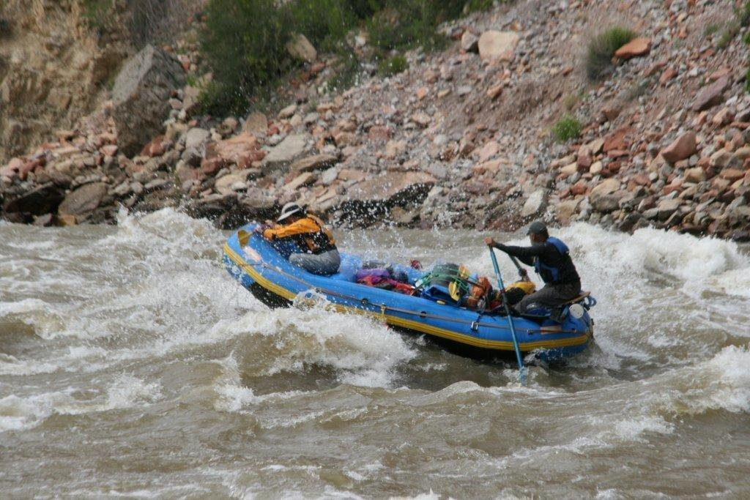
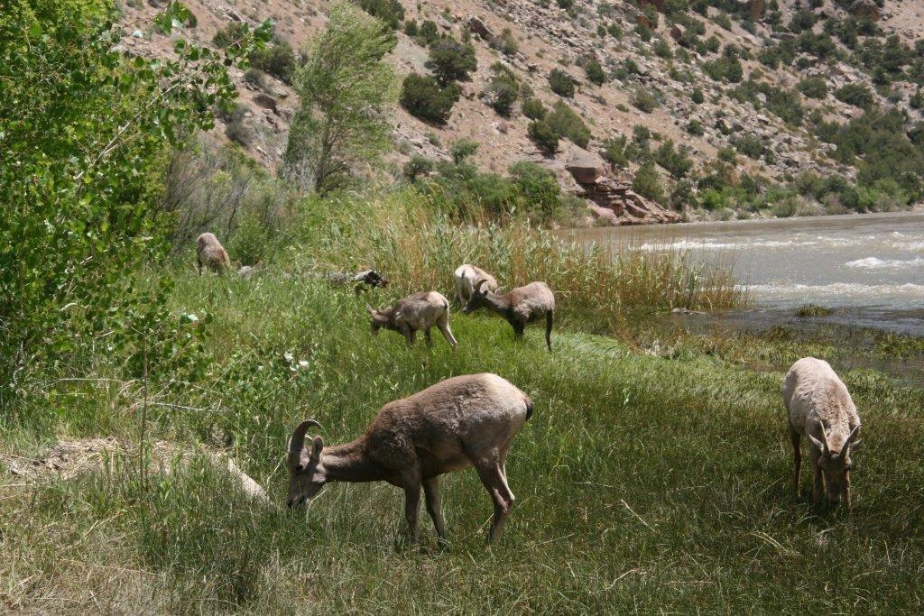
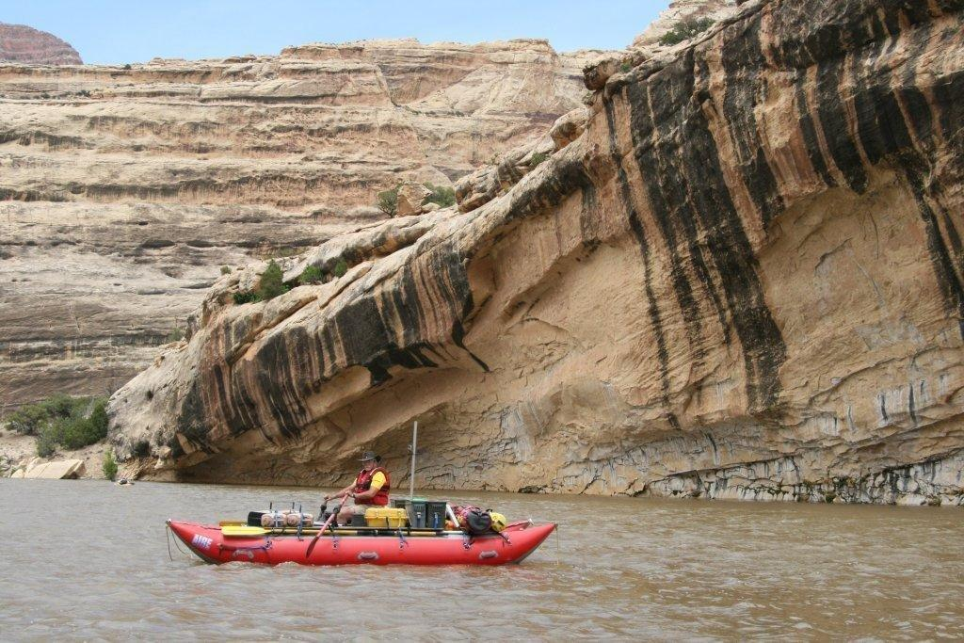
Other Float Fishermen News
High Water Everywhere
Cont’d
At the last minute he saw he was not going to make it but turned the nose of the boat into the hole. The raft tilted up and to the left and he sailed over the side into the water, losing an oar at the same time. Because he had unweighted the boat the raft fell back down flat on the water and the others were safe.
Meanwhile, I was rowing my brains out to river left as well, but since I had no passengers, I just grazed the hole and slid by safely.
We did short hikes, although one at Jones Hole was seven miles round trip. At the end we found pictographs and petroglyphs, a snake, mule deer and bighorn sheep.
So we did 72 miles in six sunny exciting days on my second favorite river in America.
At the takeout is the Dinosaur National Monument Quarry Museum, one of the most famous archeological museums in the world. So we all stopped in for a visit before we split up for other rivers.
You should try a western river or two. We always have room.
Next time: high water on our six day Salmon River trip. We put on at 10,000 cfs and got off with 20,000 cfs! A scary adventure!
High Water 2014 - Bill Tanger

Slide 5
Other Float Fishermen News
Dickel Halloween Float: 10/25/14
With the promise of a gorgeous fall weekend, Dickel’s headed across the state to Glebe Point Campground on the banks of the Great Wicomico River in Northumberland County for the (1st Annual?) Halloween Float and Seafood Bash. Phil and Tawne welcomed Kathleen and Sara, Thomas and Tyler, along with Ginnie and Bob and Konrad Friday night and the campers were circled around the campfire. In fine Dickel style, the beverages flowed and the occupants of the campground (their curiosity getting the better of them) stopped by to investigate the boisterous party and were won over. No one (surprisingly) was injured during the golf cart tour of the grounds. The same couldn’t be said for the golf cart later in the weekend as the Dickels were forced to push it back to the site.
Saturday morning dawned with clear skies, agreeable temperatures, fair winds and the Dickels enjoyed warm strong coffee and conversation while bacon crackled in the fry pan before quickly disappearing down the gullets of the crew. It was time to face the Great Wicomico. With two put in options, the boat ramp that opens into a cove behind the campground or straight from the beach into the river itself, canoes and kayaks were ready for the water. The plan was to fish under the Glebe Point Bridge in the hopes of finding the elusive rock fish. That plan, despite the power of the Pink Pole Posse, never saw success as the fish weren’t biting.
River Currents:
James River Cushaw Take-out Access: FORVA filed a complaint with the SCC arguing that one designated crossing would be much safer than a half-dozen unauthorized crossings. Waiting to hear what the SCC says...
James River Howardsville Landing:
DGIF has delisted this river access. We are working on resolving legal issues and improving it to the point that DGIF will re-list the access point. Met with DGIF several times so far. -- Tom Miller and Bill Tanger
Roanoke River Gorge Put-in:
We are working to improve the put-in just below Niagara Dam. We are laying out our proposed trail to show the NPS what we want to do.
Dam Removal/Recreation:
Working on the Pigg River dam removal with the USFWS, Franklin County and the town of Rocky Mount. Doing hydrologic studies next.
Roanoke River Erosion Problems: Rutrough Point: Have a $10,000 erosion control project getting started, using fees from the paypost at the point.
Price Park:
This is a 45 acre park along Stroubles Creek in Montgomery County that was given to FORVA. We have built a parking area. An Eagle Scout candidate did a footbridge and another did a kiosk. --- Randi Lemmon and Bill Tanger

Slide 6
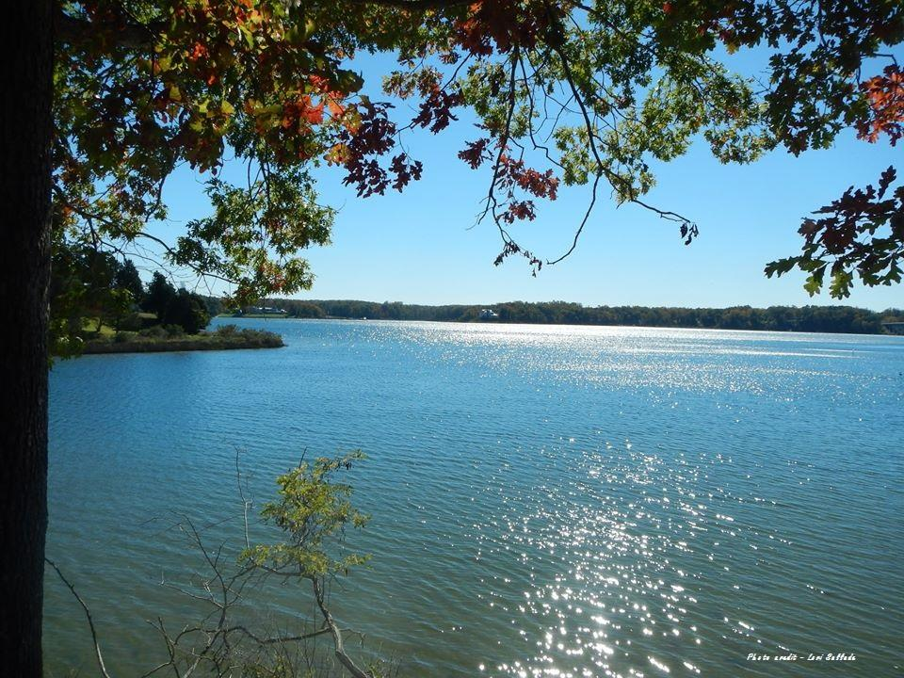
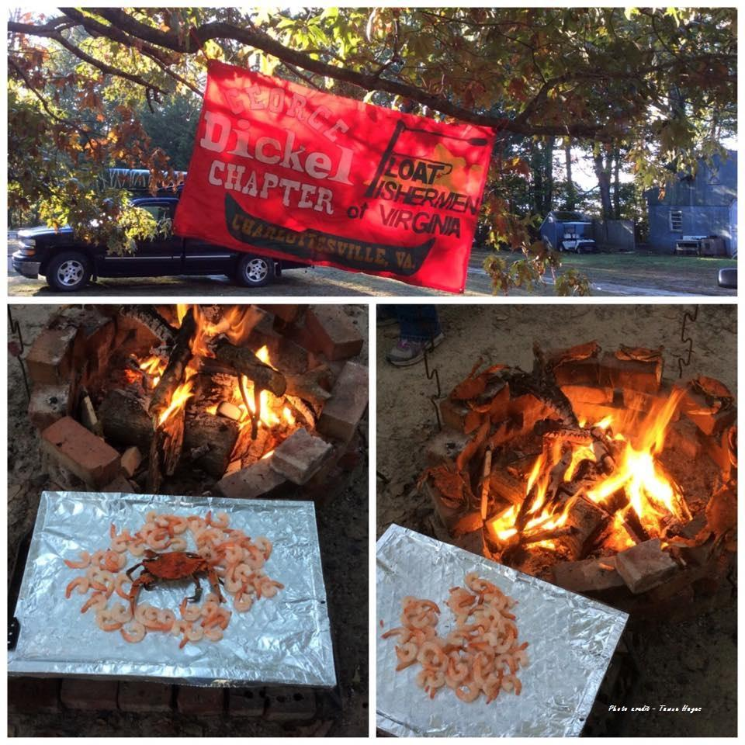
Other Float Fishermen News
Halloween with the Dickels
Cont’d
While Kathleen, Sara, Thomas, Tyler and Konrad continued up river to
investigate the coastal wildlife on display, Phil, Tawne and Ginnie ventured back to camp to prepare for the evening’s seafood feast and await Lori’s arrival.
And what a feast it was! Phil prepared oysters, shrimp and crab in abundance on the grill and around the fire pit and the bounty met a swift demise. Ginnie discovered she preferred her crab roasted over the fire, on a stick, and Tawne tucked into the London Broil that was also grilled to perfection. The evening was made even more special with the 40th birthday celebration of Thomas! Cake was shared along with cocktails and a few tall tales from Bob. More local campers enjoyed the fire and went away with an appreciation of the Dickels.
Sunday was another gorgeous day and rather than paddle, the Dickels headed to Kilmarnock to enjoy breakfast at the Alley Café. Bloody Mary’s, a prerequisite, of course. All plates were cleaned before heading back to camp to break down and head back to the mountains.
The weekend was a first on the Great Wicomico River for the Dickels, but hopefully not the last, as the water was gentle, the wildlife plentiful and the company the best to be found.
How many Dickels does it take to push a golf cart back to camp?
How many Dickels does it take to push a golf cart back to camp?

Slide 7
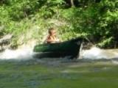
FFV EVENTS
Event Schedule
Winter Business Meeting: 12/6/14 @ Slate River Properties. Meeting will begin at 11:00am. Please bring a covered dish to share at the intermission. BYOB
2015 Schedule TBA @ Winter Meeting
Directions to the Meeting:
Anyone know this kid?
From points NORTH / WEST:
EAST on I-64 E toward RICHMOND to US-15 exit- EXIT 136- toward GORDONSVILLE / PALMYRA. RIGHT onto US-15 S / JAMES MADISON HWY. RIGHT at the fork to go on JAMES MADISON HWY / US-15. RIGHT onto VA- 652 to Bridgeport, VA
From points EAST:
WEST on I-64 W toward CHARLOTTESVILLE. VA-617 exit- EXIT 167- toward OILVILLE / GOOCHLAND.
LEFT onto OILVILLE RD. RIGHT onto US-250 / BROAD STREET RD. LEFT onto FAIRGROUND RD. LEFT onto SANDY HOOK RD / US-522. RIGHT onto VA-6. STRAIGHT to go onto US-15 / JAMES MADISON HWY. RIGHT onto VA-652 to Bridgeport, VA
From points SOUTH:
US-460 E toward APPOMATTOX.VA-24 E / VA-131 S ramp toward ROUTE 60 / APPOMATTOX. LEFT onto VA- 131 / VA-24 / UNION BLVD. Continue on VA-24. SLIGHT RIGHT onto US-60 E / JAMES A ANDERSON HWY. LEFT onto US-15 N / JAMES MADISON HWY. LEFT onto VA-652 to Bridgeport, VA
Continue on VA Route 652 past Bridgeport to campground on left across railroad tracks and bridge over Slate River.
.

Slide 8
Editor’s Note
The opinions expressed in FPP&P are those of the author’s and not necessarily those of FFV or its members. The editor is responsible for editing the content of the newsletter and its construction. Members are responsible for providing content. Please send submissions to the editor via email attachment. The following formats are preferred: Word, RFT, and/or JPEG. The newsletter goes out quarterly: Feb 1, May 1, August 1, Nov 1. All Submissions MUST be received by the 15th of the preceding month.
If you receive this newsletter via US Mail, we do not have a current email address for you. Contact your local treasurer or the Membership Chair to update your information.
Float Fishermen of Virginia
794 Farrar Bridge Lane
Shipman, VA 22971

