Slide 1

Fishing Pole Pack & Paddle
(Spring 2024)
President’s Paddle
Hey FFV,
Happy Spring! Excited for another wonderful season on the river!
This Memorial Day, join us at the Slate River Property for what promises to be an unforgettable time filled with friends, live music, and fantastic paddling.
We’re in the final stages of planning for the Kid Float on Saturday, June 8th. Save the date! Keep an eye out for an email about volunteering. Huge thanks to those who’ve already volunteered or supported us in other ways. We’ve expanded our efforts to include 2 Boys & Girls Clubs in the area, so we’ll need extra hands to help paddle a kid. Details on shuttle logistics and more will be shared closer to the event.
Looking forward to catching up with everyone at the Memorial Day float. And remember, bring along a friend! Feel free to reach out with any ideas or questions.
See you on the river!
---- Erica Goode
FFV State Officers
President: Erica Goode
Ericagoode10@gmail.com
Vice Presidents:
Tony Adams: antonadams@comcast.net
Bill Duncan: wduncan311@yahoo.com
Herb Coleman: herb@clachanproperties.com:
Bill Tanger: riverdancer1943@gmail.com
Secretary: Lauren Jacobs
lorenjacobs@yahoo.com
State Treasurer: Mitch Sims
mitchsims@yahoo.com
*Chapter Treasurers, please e-mail deposit amounts to Mitch, each time you deposit in State Account.*
Membership Chair: Ginnie Peck
**Chapter Treasurers, please e-mail updated membership info to Ginnie @:
ffvbusiness@gmail.com
Newsletter Editor: Gabby Safley
gabby.safley@gmail.com
Webmaster: Traci Martin
traci.martin1970@gmail.com
Conservation Chair: Bill Tanger
riverdancer1943@gmail.com
Annual Dues: Due January each year
$20.00 per Individual or per Family (spouse & children 0-18)
Individual chapters may have additional annual dues.
Contact your CHAPTER Treasurer to pay dues
Please, DO NOT send dues to Membership Chair or State Treasurer
Chapter Treasurers:
George Dickel Chapter: Ginnie Peck
dickels.treasurer@gmail.com
Randy Carter Chapter: Ed Galloway
ewgalloway@verizon.net
Roanoke Valley Chapter: Bill Tanger
billtanger@verizon.net
Scotts Creek Chapter: Rick Mattox
rickmattoxrva@outlook,com
Steve Keller Chapter: INACTIVE Contact Ginnie
Notes:
add michael’s article

Slide 2
Big News!
Courtesy of: Ginnie Peck
Volunteer or Volunteers Needed!!!
Bill Tanger, the FFV Conservation Chair & President of FFV Foundation, is looking to retire.
We are in need of a dedicated volunteer to take on his role as Conservation Chair.
Bill is happy to mentor any volunteers.
We may need more than 1 volunteer, as his years of experience & vast knowledge is unmeasurable.

Slide 3
Michael Powell: One Client’s Compassion in Action
Courtesy of: Ginnie Peck
February 7, 2024
This article is about the George Dickle chapter’s Michael Powell. Michael has been a member of the Float Fishermen of Virginia’’s George Dickle chapter for most of his life. He grew up in the FFV, and has always had a big heart and compassion. Especially when interacting with animals and kids. Michael is always willing to lend a helping hand in any situation, and this article exemplifies that!
- Ginnie Peck
In the normally calm aisles of Harris Teeter, where everyday tasks often revolve around groceries and daily routines, one employee stood out recently for his extraordinary act of compassion and quick thinking. Meet Michael Powell, a familiar face at the Hanbury Road Harris Teeter in Chesapeake, whose passion for helping others extends beyond the supermarket shelves.
Michael, a seven-year veteran of The Choice Group, brings a unique blend of dedication and community spirit to both his work at Harris Teeter and his personal pursuits. When he’s not bagging groceries, collection shopping carts, or delivering groceries to customers’ vehicles, you might find him engaged in a strategic card game with friends or lending a hand at the Hickory Trading Company coffee shop.
When news broke of the disappearance of 82-year-old Janice Hall
who had wandered away from a dental appointment, Michael’s immediate response was to offer his assistance. Without hesitation, Michael began searching, canvassing the area, checking nearby business, and diligently seeking any information that could lead to Janic’s whereabouts. Driven by a deep sense of responsibility and compassion, he embarked on the search independent of his responsibilities as an employee, showcasing his true spirit of community caring.
Interestingly, the incident introduced Michael to Project Lifesaver, a program aimed at tracking individuals like Janice who may have cognitive conditions. Though unfamiliar with it initially, Michael had the opportunity to witness the program’s effectiveness firsthand when shown the radar tracking device by law enforcement.
The pivotal moment came when Michael spotted the ambulance across the street, signaling the safe discovery of Janice. Relief washed over him as he saw the elderly woman safely, albeit hypothermic, reunited with her family.
In reflecting on his experience, Michael shares a powerful message with the community. “Be a Good Samaritan, if you can. Try to help those in need, if you can.” His words echo a simple yet profound call to action, reminding us all of the impact we can have when we extend a helping -

Slide 4
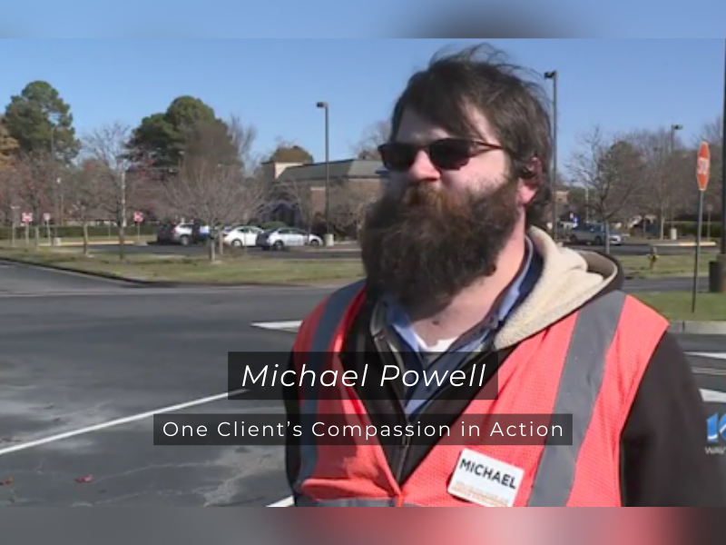
Michael Powell: One Client’s Compassion in Action Cont.
Courtesy of: Ginnie Peck
February 7, 2024
-hand. Michael concluded our interview by expressing a sense of accomplishment and a willingness to do it all over again. To him, his involvement in the search wasn’t just a duty; it was a heartfelt commitment to the well-being of another human being. His actions remind us all that in a world often defined by routine, there is always room for compassion, quick thinking, and the willingness to go the extra mile for someone in need.
Three cheers to you, Michael!
Michael Powell, Photo by Carla Mendez,
February 7, 2024

Slide 5
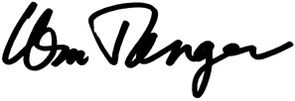
Currents and Eddies
Courtesy of Bill Tanger
April 10, 2024
Craigs Creek: Won our lawsuit February 12 against a property owner who tried to stop navigation on the creek. Could have set a bad statewide precedent. Created Friends of Craigs Creek, with membership now at 167. Fundraising going on now to reduce debt of $4,700.
James River/Allens Creek: New public access created and owned by FFV and FORVA. A critical access to the James. No other access for 20 miles upstream. —- FFV & FORVA
James River Balcony Falls Take-out (Amherst County): FORVA is working to find a political jurisdiction willing to partner on access development. Possible Amherst County. ---- Bill Tanger, FFV
Roanoke River Niagara Dam Relicensing (Roanoke County): Working on recreational access issues along the river. APCO not very helpful. ---- Bill Tanger, Ro River Blueway Committee
Blackwater River (Franklin County): Created a 6-acre access on the Blackwater River at Round Hill Road in Franklin County. Put in a parking lot, ramp, lighting and kiosk. ---- Bill Tanger, Creek Freaks
New River - Price Park (Montgomery County): Improving a 50-acre park along Stroubles Creek in Montgomery County.
---- Randi Lemmon and Bill Tanger
Blackwater River (Franklin county): New 1-acre access on the Blackwater River at Rt. 122. ---- Bill Tanger, FFV; Pat & Ray Williams; Creek Freaks of Franklin County
Roanoke River (Salem City): Tucker Lane stormwater issue (Roanoke River). Filing suit against City of Salem to get corrective action.
Statewide: Working on a proposal for dam recreational safety study and regulations to address the continued drownings at unsafe dams. Have a draft bill. Need volunteers to do letters to legislators.
Statewide: Working on No Tires in The River bill to end incentives for people to throw tires in the river rather than pay landfill fees. Bill stalled in the Senate on a 9-6 vote but will be reintroduced in September 2024.
FFV – Currents –
FFV - Currents - Projects – 4-10-24

Slide 6
Thoughts from the Environment Virginia Symposium
Courtesy of Bill Tanger & Mitch Sims
April 19, 2024
FFV boaters, floaters and campers:
Bill Tanger and Mitch Sims, representing FORVA and FFV, attended the 20224 Environment Virginia Symposium (EVS) at VMI, April 9-11, 2024. EV is the Commonwealth’s premier environmental conference which brings together environmental professionals throughout Virginia from all sectors: government, non-profits, academia, and industry. Attendees relevant to FORVA and the FFV include DWR, DCR, VDOT, DEQ, Dominion, VEE, USGS, and many others.
We bought a 6’ wide booth and used the FORVA table top display with photos and handouts.
The conference provided FORVA an opportunity to network with partners across the state via in-person discussions, to improve visibility of FORVA and its partners (like the FFV) through our booth and the conversations initiated there, and to keep up to speed on the latest developments in Virginia conservation through breakout session attendance.
Below you will find the results from our attendance:
We had several beneficial conversations with DWR, including the Executive Director Ryan -
- Brown, on building support for several key river conservation issues.
  DWR confirmed their support on updating language on the existing MOU which would then require VDOT to include community stakeholders, like FORVA and the FFV, in discussions to consider access points anytime a bridge is rebuilt or modified.
  DWR and FORVA were able to review language FORVA drafted on a recreational Dam Safety bill. We believe DWR will support, but we have a lot of work ahead of us.
We were able to provide some comments to DCR and VDOT on the above-mentioned MOU. We’ll continue to press until we get it done.
We established new relationships with representatives from the Maury River Alliance, The Crater Planning Districts Commission (south of Richmond) and the Nature Conservancy. We hope to partner with these groups on river issues.
Overall, it was a very positive experience. The last time FORVA attended was in 2004, over 20 years ago. It was right after the latest State of the Rivers (2001) report was completed. Bill and Mitch did a lot of outreach while also minding out booth and display.
Happy Paddling - Bill and Mitch
EV 2024 report - 4-18-24
Notes:
Finish slide

Slide 7
Allens Creek Project Emeritus Group
Courtesy of Bill Tanger
April 20, 2024
Here are the FFV volunteers who have spent the better part of a day at Allens Creek working on rehabbing the cabin. We now have a functioning bathroom with sink and toilet.
Coming soon: hot water at the sink and a shower with hot water.
These are the people who get first options to stay at the luxurious Cabin on the Creek!
Bill Tanger
Howard Kirkland
Ben Carter
Jeff Wold
Rock Willoughby
Konrad Zeller
Mo Byrd
Bonnie Turner
Herb Coleman
Mitch Sims
Scott Mcewen
Tim Fridley
Come join in the fun!
FFV-FORVA - emeritus group 4-18-2024
Notes:
Finish slide

Slide 8
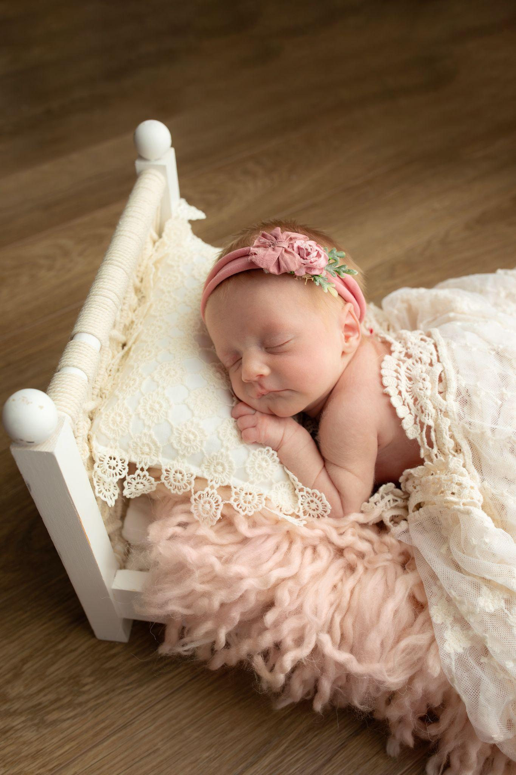
Welcome to FFV
Courtesy of Emily Warren
The newest member of FFV Scott’s Creek Chapter made her debut a month early. Virginia Ann Mattox was born 2-4-24. Everyone is doing great and she is excited to meet the crew at the Memorial Day trip!
Emily Warren
Virginia Ann Mattox: Courtesy of Emily Warren

Slide 9
2024 FFV Event Schedule
Event/Location: Date:
Memorial Weekend (Meeting at 9:00am) May 24th-27th, 2024
Location: Slate
Kids Float: June 8th, 2024
Location: Warren Ferry to Hattons Ferry
Labor Day Weekend (Meeting at 9:00am) Aug. 30th-Sept. 2nd, 2024
Location: Solitude
Dickle Bash Oct. 11-13th, 2024
Location: Slate
Winter Meeting (11:00am) December 7, 2024
Location: Slate
Slate River Property Directions:
Address for GPS:
10330 Bridgeport Road, Arvonia, VA., 23004
From Richmond: Take Route 6 River Road West (from downtown that’s 64 West to the Oilville exit South on 617 Oilville Road, right on 250 West Broad Street Road, Left on 632 Fairgrounds Road, right on Route 6, go West), follow to Fork Union, stay straight on Route 15 James Madison Hwy, cross the James, after roughly 1.5 miles take a right on Route 652 and cross the Slate River. Driveway will be first Left.
From Charlottesville: Take Route 20 South through Scottsville and across the James River. Turn Left onto Route 652 (Bridgeport Road). Follow approximately 9 miles and turn right into field. If you cross the Slate river, you have gone a half mile too far.
From Lynchburg: Take Route 60 East to Route 15 (James Madison Highway) North. Turn Left on Route 652 (Bridgeport Road) at Arvonia. Route 652 and cross the Slate River. Driveway will be first left.
Notes:
add directions to Slate

Slide 10
Editor’s Note
The opinions expressed in FPP&P are those of the author’s and not necessarily those of FFV or its members. The editor is responsible for editing the content of the newsletter and its construction. Members are responsible for providing content. Please send submissions to the editor via email attachment. The following formats are preferred: Word, RFT, and/or JPEG. The newsletter goes out quarterly: Feb 1, May 1, August 1, Nov 1. All Submissions MUST be received by the 15th of the preceding month.
If you receive this newsletter via US Mail, we do not have a current email address for you. Contact your local treasurer or the Membership Chair to update your information.
FFV Membership Chair
794 Farrar Bridge Lane
Shipman, VA 22971

