Slide 1

Fishin’ Pole Pack & Paddle
2016 Summer Issue
Hey Everybody!
Summer is off to a very strong start if you’re into being on the river. We’ve had a wet spring and we still have some good flows. The Memorial Day event had plenty of water all three days on the “Rapp”. The 31st Annual Bateau Festival had a much better flow than last year. Many thanks to the Captain and Crew of the “Clifton Lee” for a great two-day ride.
Our Labor Day event will be at the Slate River Partners Property and The President’s Paddle will be passed to our new leader, Ryan Bomar. Bomar, as he is called by darn near everyone, is an extreme paddling and camping enthusiast with natural river reading and leadership skills beyond his years. We are in very good hands.
It has been an honor and a pleasure to have been your president for the past four years. I want to thank our current and past officers who have put so much work into bringing our organization into the 21st century. Our Website, Newsletter, Treasury, Finance, and Membership all seem to have evolved nicely so others can step into these positions more easily. I especially want to thank our Secretary, Ginnie Peck of the infamous “Dickel Chapter”, for her incredible efforts and involvement in the above-mentioned. Though we do have some sharp players in the outfit, Ginnie has really given of herself above and beyond the scope of her position. She definitely deserves a hearty “Whale Done”!
Finally, I want to thank Bill Tanger for his continuing efforts as Conservation Chairperson and Finance Committee Chairperson. Bill’s accomplishments are countless both within the Float Fishermen and in other conservation oriented organizations. We are very fortunate to have him.
In closing I’ll say it’s been great…I know I’ll see ya’ on the River.
Tony “El Guapo” Adams
FFV OFFICERS
President: Tony Adams
antonadams@comcast.net
Newsletter Editor: Taylor Adams
xtadams94x@gmail.com
Secretary: Ginnie Peck
ginniepeck@gmail.com
Treasurer: Lisa Barbieri-O’Sullivan
Lkb0328@gmail.com
Co-Membership Chair:
Scott McEwen & Ginnie Peck
ffvbusiness@gmail.com
*****This is a new email address for Co-Membership Chairs******
Webmaster: Traci Martin
traci.martin1970@gmail.com
Conservation: Bill Tanger
bill.tanger@verizon.net
Vice Presidents:
Cooper, Bill Duncan, Erica Goode, & Bill Tanger
See FFV Web Page for ALL Officer & Chair Email Contact Info:
http://www.floatfishermen.org

Slide 2
2016 Memorial Day Meeting Minutes by Ginnie Peck
Sunday 5/29/16 @ 9:00am
Membership Chair Cont’d: Ginnie informed the members of the Membership email change. From this point forward, the Membership Chair(s) email will be: ffvbusiness@gmail.com This is the same email for that the Newsletter is housed and sent from. Storing all of the Membership Lists and Newsletters in one location will simplify the Newsletter process. The Membership Chairs; Scott McEwen and Ginnie Peck, will manage this email account.
Webmaster: Traci Martin reported that the fees for Domain renewal are due by 7/18/16. We have the option of paying each year or to renew through 2020. The annual fees are much cheaper if paid through 2020.
Ginnie made a motion to have Traci send the information to Bill Tanger and have the Finance Committee review the numbers and decide the best course of action, in regards to paying the fees. Wright Ellis seconded the motion. No discussion followed. The motion was passed.
Web Page Submissions: Please send submissions to Traci by going to the Web Page and click on the Officers button. Then click on Webmaster: Traci Martin. From here you can email her any news, pictures, etc. for the Web Page.
Newsletter Editor: Taylor Adams reported that there is still $100.00 in reserve, from the original $500.00 given to him (Fall 2014) for newsletter printing and mailing. There are currently 24 people that receive the newsletter via US Mail. Please continue to send Newsletter submissions to: xtadams94x@gmail.com
President: Tony Adams opened the meeting and thanked the Randy Carter Chapter for hosting the event. A special thanks to the Pearson Family for the use of their beautiful property.
Secretary: Ginnie Peck made a motion that the 2015 Winter Meeting Minutes be accepted as printed in the Winter 2016 Newsletter. Wright Ellis seconded the motion. No discussion followed. The motion was passed.
Treasurer: Lisa Barbieri O’Sullivan presented the Treasurer’s Report in a detailed written report. There is a different format for the report which itemizes money received and money paid out. The total balance in the FFV Account as of 4/29/2016: $9,777.88. The total balance of combined CDs, as of 4/29/16: $8,576.80. For a copy of the report, please email Lisa.
Kitty made a motion to accept the Treasurer’s Report as presented. Wright Ellis seconded the motion. There was no further discussion. The motion was passed.
Membership Chair: Scott McEwen reported there are 120 paid members for 2016. This is down from last year. Brian Van de Sande stated that he has collected dues from new members and dues from current chapter members have also been paid this weekend. These changes will be reflected in the updated Membership List, once money has been deposited and reported.

Slide 3
2. Pigg River Dam: FORVA with the help of FFV has purchased the dam with the intent to remove the dam. A battle has ensued, with DEQ, to acquire a permit for the dam removal. The permit was finally approved and should be issued by August of this year. FORVA may be able to receive up to 1 million dollars from Duke University to cover the expense of the dam removal. The dam is 101years old and has been abandoned for 50+ years. The water current and potential for rapids or hazards at the dam site, is unknown at this time.
3. Cushaw Project: Currently there is $200,000.00 in the bank to address the take out site. The battle with CSX has continued. CSX did agree, over a month ago, to allow a tunnel under the tracks at Locke 14; where the rapids meet the flat water. A meeting with an engineer has been arranged to look at the project costs and plans. The project itself could cost upwards of 1 million dollars. There are grants available to help with the project. Periodic maintenance will be required to keep the site safe, clean and intact.
Foundation Report: Bill Tanger discussed the need for FFV to provide volunteer man hours to help with the Cushaw Project and to maintain it once the project is complete. There are 6 other organizations willing to donate hours of labor each year at the take out site. There may be a proposal for $$ to be raised for continued maintenance.
Old Business: $150.00 was approved, at the 2015 Winter Meeting, for Tony to purchase new FFV Stickers.
Meeting Minutes Continued
Newsletter Editor Cont’d: Ginnie Peck informed the members of the electronic email delivery change. The newsletter will no longer be delivered via MailChimp. The Newsletter will be sent as a direct email with a link to the Newsletter on the FFV Web Page. Recipients will open the email the same and click on the link, to the Newsletter on the FFV Web Page, provided.
Conservation Officer: Bill Tanger discussed 3 Conservation Issues:
1. The Bay Journal is best publication regarding the state of the rivers and watersheds in the State of Virginia. It provides current and updated information about issues and events that affect the Chesapeake Bay. The journal is published by Chesapeake Media Service, a nonprofit organization. It is free to all subscribers and can be obtained via electronic mailing or a printed version sent via US Mail. You may subscribe by going to: wwwbayjournal.com or by calling: 717-428-2819. You may also view the publications on the web page.

Slide 4
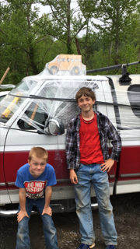
Meeting Minutes Continued
New Business: Ginnie presented the Slate of Officers for the next 2 year term. The new officers will be officially voted in at the end of the Labor Day Meeting:
President Elect: Ryan Bomar
Vice Presidents: Tony Adams, Bill Duncan, Bill Tanger, Erica Goode
Secretary: Ginnie Peck
Treasurer: NEED ONE Lisa Barbieri-O’Sullivan will continue as the current Treasurer through December of this year.
Membership Chairs: Scott McEwen & Ginnie Peck
Webmaster: Traci Martin
Newsletter Editor: NEED ONE Taylor Adams has agreed to continue until we have a volunteer to take the position.
Adjourn Meeting: Wright Ellis made a motion to adjourn the meeting. Kitty seconded the motion. No discussion followed. Motion passed. Tony Adams adjourned the meeting.
Labor Day Weekend Music
Live under the SRPI Pavillion: Tray & Joeanne Eppes
Short Bus Award: Effectively awarded!

Slide 5
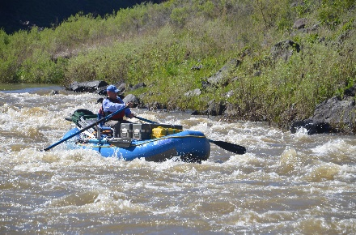
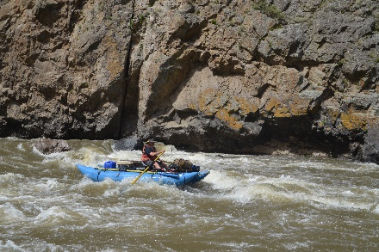
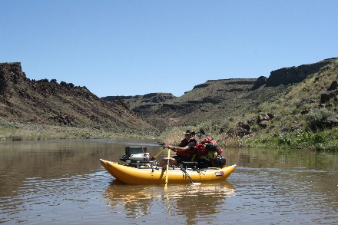
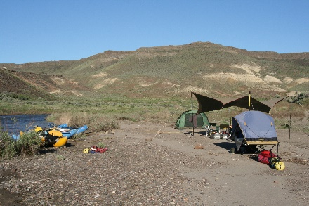
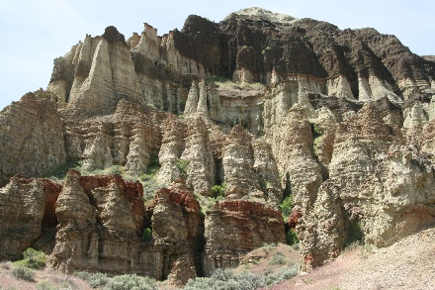
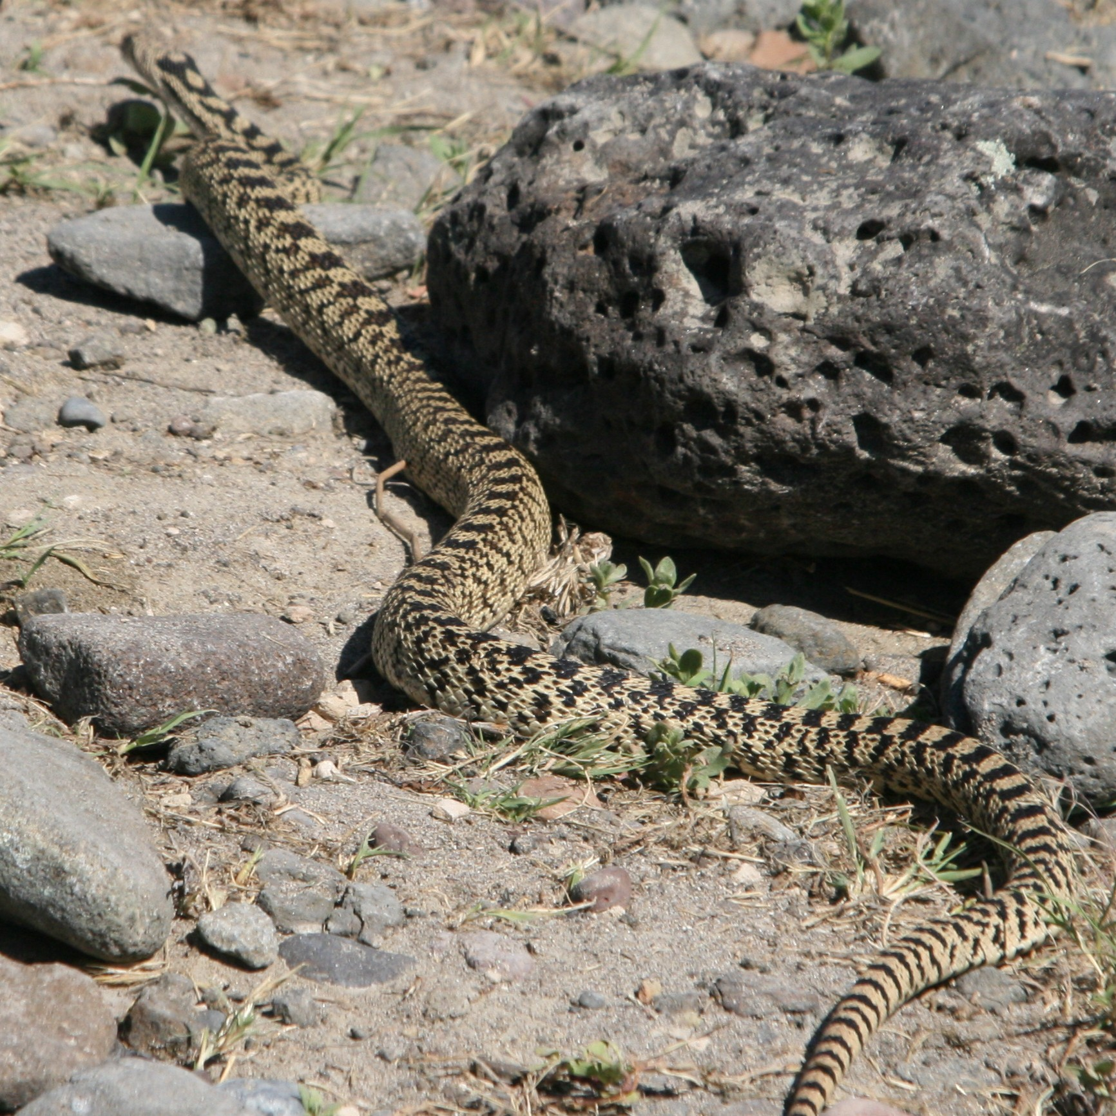
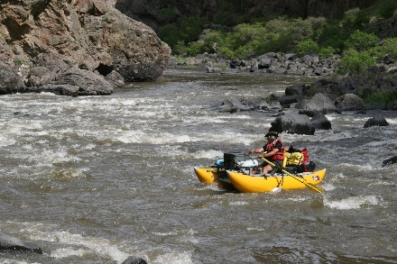
Out-of-Sight Owyhee River
Text and photos by Howard Kirkland and Bill Tanger
Other Float Fishermn News
In early May, Howard Kirkland, Tom Randgaard and I met up in Rome Station, OR, the BLM launch site for the Owyhee River. We were pleasantly surprised to meet David Jarrett and Ron Eachus, two old friends of Howard’s from Salem, OR, who coincidentally had led Howard’s first trip on the Owyhee in 2008. As they had already packed their boats they shoved off ahead of us.
Tom was paddling his Aire Super Puma raft. I chose to row the 14-foot Tributary cataraft, and Howard piloted the Star Slice, a smaller cataraft. Since the Owyhee is a smaller and more technical river, we packed lightly and practiced minimalist cooking and camping.
On Tuesday, May 10, we finally launched. The river was at 1600 CFS, the weather was overcast and breezy, and we wound our way between numerous grassy islets before reaching the entrance to the Owyhee Canyon proper. After about 7 miles, we made camp and cooked a simple dinner over our single-burner backpack stove. The evening became quite chilly, and we soon crawled into our sleeping bags.
The next morning, we found everything coated with a thick rime of frost. Tom’s magical Suunto watch reported a low temperature of 25 degrees. After a quick breakfast of coffee, Spam and eggs, we packed up and headed downstream.
The Owyhee River is a rare jewel of a high desert canyon river, flowing out
of southwest Idaho, into southeastern Oregon, and thence northward and
eastward to its confluence
with the Snake River. Our
stretch ran 65 miles from
Rome Station to Birch
Creek. The geology is
primarily of volcanic
origins, composed mostly of volcanic ash and Rhyolite. Eons
of wind and water have carved these media into many
fascinating and unimaginable shapes. The river has carved its
winding way through this fantastic landscape, thereby
providing the lucky paddler with one of the most scenic and
beautiful routes that one could wish for.
Rapids were frequent, with two Class IVs
and dozens of Class IIIs. We
scouted only the IVs and had no
problems. However, we encountered
other groups who had experienced
several pins, flips and swims. The flow
remained fairly constant, and never
dropped below 1,200 CFS.

Slide 6
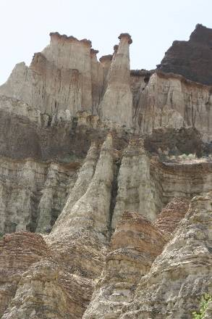
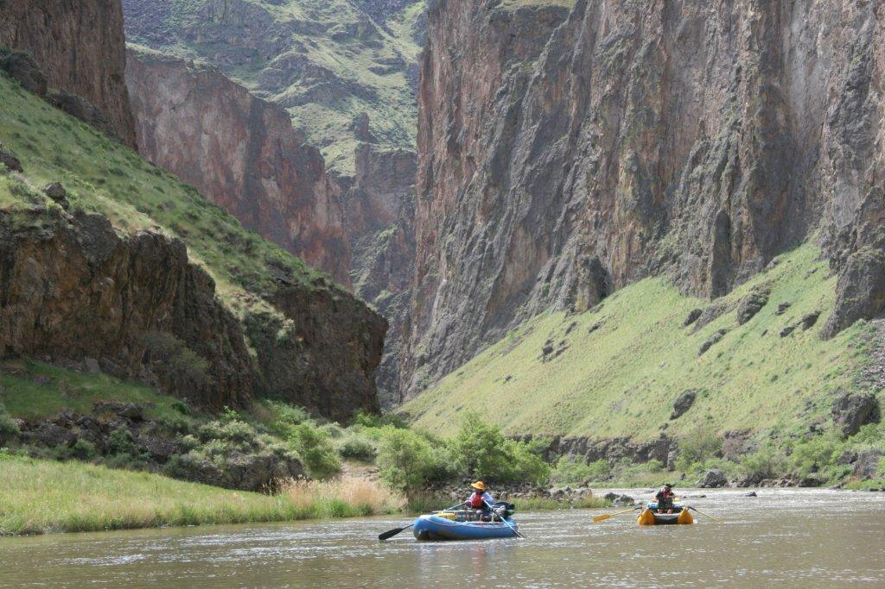
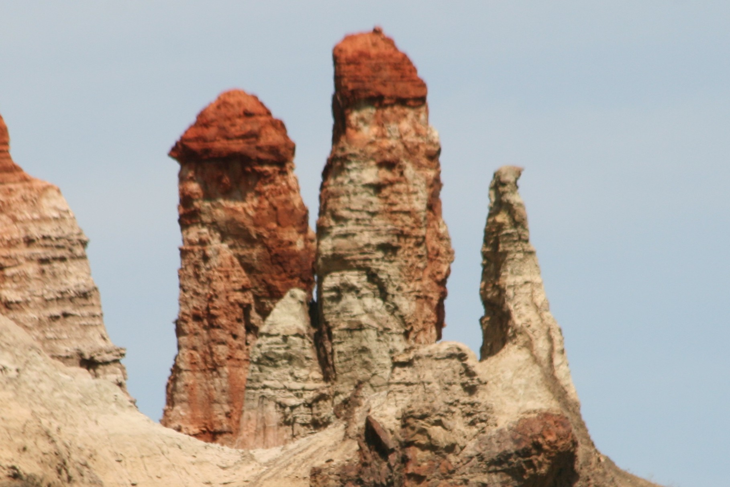
Out-of-Sight Owyhee River
Text and photos by Howard Kirkland and Bill Tanger
Campsites were scenic and accommodating, but the competition for sites sometimes required us to settle for lesser locations, or to share sites with other groups.
With the exception of the first night, the temperatures never dropped below the low 40s. Two sites even sported hot springs, with pools deep enough to lie down in, with water around 104 degrees, albeit a bit turbid.
Dinners were mostly canned or dried foods, such as chili, red beans and rice, mixed vegetables and cookies. Breakfasts consisted of bacon or Spam and eggs. For lunches, we snacked on junk food, or made PB-and-J sandwiches. Nothing fancy, but more than adequate.
We stopped frequently to take short hikes, to visit historic, geologic or scenic features, and to take many photos. The landscape was fantastic and varied, and provided countless opportunities to hike, climb, and gawk in wonder. Layers of volcanic ash hundreds of feet thick had been
covered, super-heated, and compressed by lava flows, which had cooled,
and over the millennia had been eroded into fantastic columns and spires
or “Hoodoos.”
In places, Native Americans had carved their histories into the glossy black
“Desert Varnish” which coated much of the rock formations. Early settlers
had made their mark on the land, leaving the foundation stones of their
crude homesteads as a reminder of their passing. We were occasionally
treated to the sight of big-horn sheep, rabbits, snakes, and an amazing
variety of bird life.
On Friday evening, we finally caught up with Dave Jarrett and Ron Eachus, who had a splendid campsite. We gratefully moved in, and made ourselves at home. Next morning, Howard hiked about 1/8 mile upstream to a hot spring, soaked and sipped coffee for an hour or so. We then fixed breakfast and said good-bye to Dave and Ron who headed on downstream.
The rest of the trip went by too quickly, and all too soon, we arrived at the take-out at Birch Creek. We quickly unpacked our rafts, stowed our gear, winched our rafts onto our rigs, and hit the Class IV road.

Slide 7
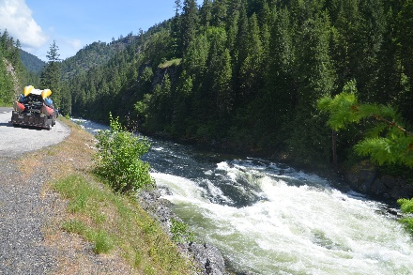
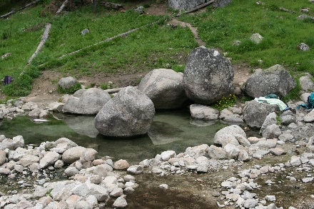
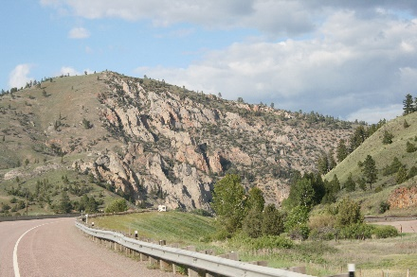
Out-of-Sight Owyhee River
Text and photos by Howard Kirkland and Bill Tanger
The climb out of Birch Creek to the Canyon Rim required us to use 4-wheel-drive and low speeds; the road was steep and rutted, and crossed several creeks, where we dragged the front and back ends of the trailer. Thirty-so miles of dirt and dust found us at the nearest paved road, where we discovered that we had a flat tire on the truck. We managed to pump in enough air to get us to the nearest service station. After a fast patch job, the attendant told us that we were the eighth tire repair job he’d done that morning.
Howard and I said our good-byes to Tom, who headed home.
The next day we drove down into the Owyhee River Canyon at Three Forks, OR, to scout out the section above the one we had just floated. Here, the various forks of the Owyhee join to form a small, beautiful canyon river. This section is rated Class V, and contains several mandatory portages; definitely not for the faint-of-heart.
Our return route carried us northward from Boise, along
the Main Payette River, and then the North Fork Payette,
and the Little Salmon River, into Riggins, ID. During the next
two days, we followed the Lower Salmon River, crossed
over the White Bird Grade, and found our way up along the
Clearwater River, and then the Lochsa River, which we
followed upstream to its confluence with the Selway River
and beyond.
Some years ago, Howard had read an article that listed the
ten best swimming holes in the United States. One of them
was the Jerry Johnson Hot Springs in northern Idaho, near
the Montana border. We decided to check it out. The trail
crossed the Lochsa on a swinging bridge, and followed
Warm Springs Creek for about a mile to the hot springs.
We found several pools, ranging from about 100 to 105
degrees. We spent an hour or so soaking in several of the
pools.
Highway 12 carried us up and over Lolo Pass, and into
western Montana, and followed Lolo Creek down into Butte,
Montana, where we took Interstate 90 east. The scenery
was fantastic and varied. One amazing landscape after
another sped past us as we drove eastward.
All too soon the scenery changed back to what we were
familiar with, as we drove through Wisconsin, Illinois,
Indiana, Ohio, West Virginia, and finally back into Virginia.
We got home on Sunday, May 23, having driven over 6,000 miles since we left home on Monday, April 18. Long trip. Great trip. Already thinking of rivers for next year!

Slide 8
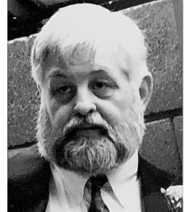
Thomas Wayne Evans, Remembered
Tom Evans was a life-long conservationist and protector of Virginia’s rivers. He was a dedicated member of the Float Fishermen of Virginia. Tom was instrumental in making the VIP Float the success it was in its early years. He would utilize the relationships he developed in his lobbying efforts to convince members of the General Assembly and state officials to join us on the annual VIP Float and support our river conservation efforts. Attendees in those years included Governors Gerald Baliles and George Allen. His lobbying efforts were instrumental in designating the Staunton River as Virginia’s first Scenic River. He may be best known for being the guy who paddled a keg of beer in a 22-foot Grumman canoe on the VIP Floats.
Tom went to that great river in the sky on June 21, 2016. Smooth floating , Tom– we’ll see you downstream!
-Rick Mattox

Slide 9
2016 FFV Event Schedule
Please visit the FFV Webpage for details, updates, & directions.
Labor Day Weekend @ the Slate Property : September 2-5
Contact Rock Willoughby
Dickel Bash @ Ruckers Run : September 30 - October 2
Contact: Ginnie Peck
Winter Meeting @ the Slate Property: December 3 @ 11:00am
Contact: Ryan Bomar
Fruit Cake Float on the Rivanna: January 1, 2017
Contact Konrad Zeller
Directions to Labor Day Weekend Event
Address for GPS: 10330 Bridgeport Rd / Arvonia, VA 23004
From Richmond: Take Route 6 River Road West (from downtown that’s 64 West to the Oilville exit South on 617 Oilville Road, right on 250 West Broad Street Road, Left on 632 Fairgrounds Road, right on Route 6, go West) ), follow to Fork Union, stay straight on Route 15 James Madison Hwy, cross the James. After roughly 1.5 mi. take a right on Route 652 and cross the Slate River. Driveway will be first left.
From Charlottesville:Take Route 20 South through Scottsville and across the James River. Turn Left onto Route 652 (Bridgeport Road). Follow approximately 9 miles and turn right into field. If you cross the Slate river, you have gone a half mile too far.
From Lynchburg: Take Route 60 East to Route 15 (James Madison Highway)North.
Turn left on Route 652 (Bridgeport road) at Arvonia. Route 652 and cross the Slate River. Driveway will be first left.
Directions with maps can be found on the FFV Web Page: http://www.floatfishermen.org/page.html

Slide 10
Editor’s Note
Editor’s Note
The opinions expressed in FPP&P are those of the author’s and not necessarily those of FFV or its members. The editor is responsible for editing the content of the newsletter and its construction. Members are responsible for providing content. Please send submissions to the editor via email attachment. The following formats are preferred: Word, RFT, and/or JPEG. The newsletter goes out quarterly: Feb 1, May 1, August 1, Nov 1. All Submissions MUST be received by the 15th of the preceding month.
If you receive this newsletter via US Mail, we do not have a current email address for you. Contact your local treasurer or the Membership Chair to update your information.
Float Fishermen of Virginia
Membership Chair
794 Farrar Bridge Lane
Shipman, VA 22971

