Slide 1
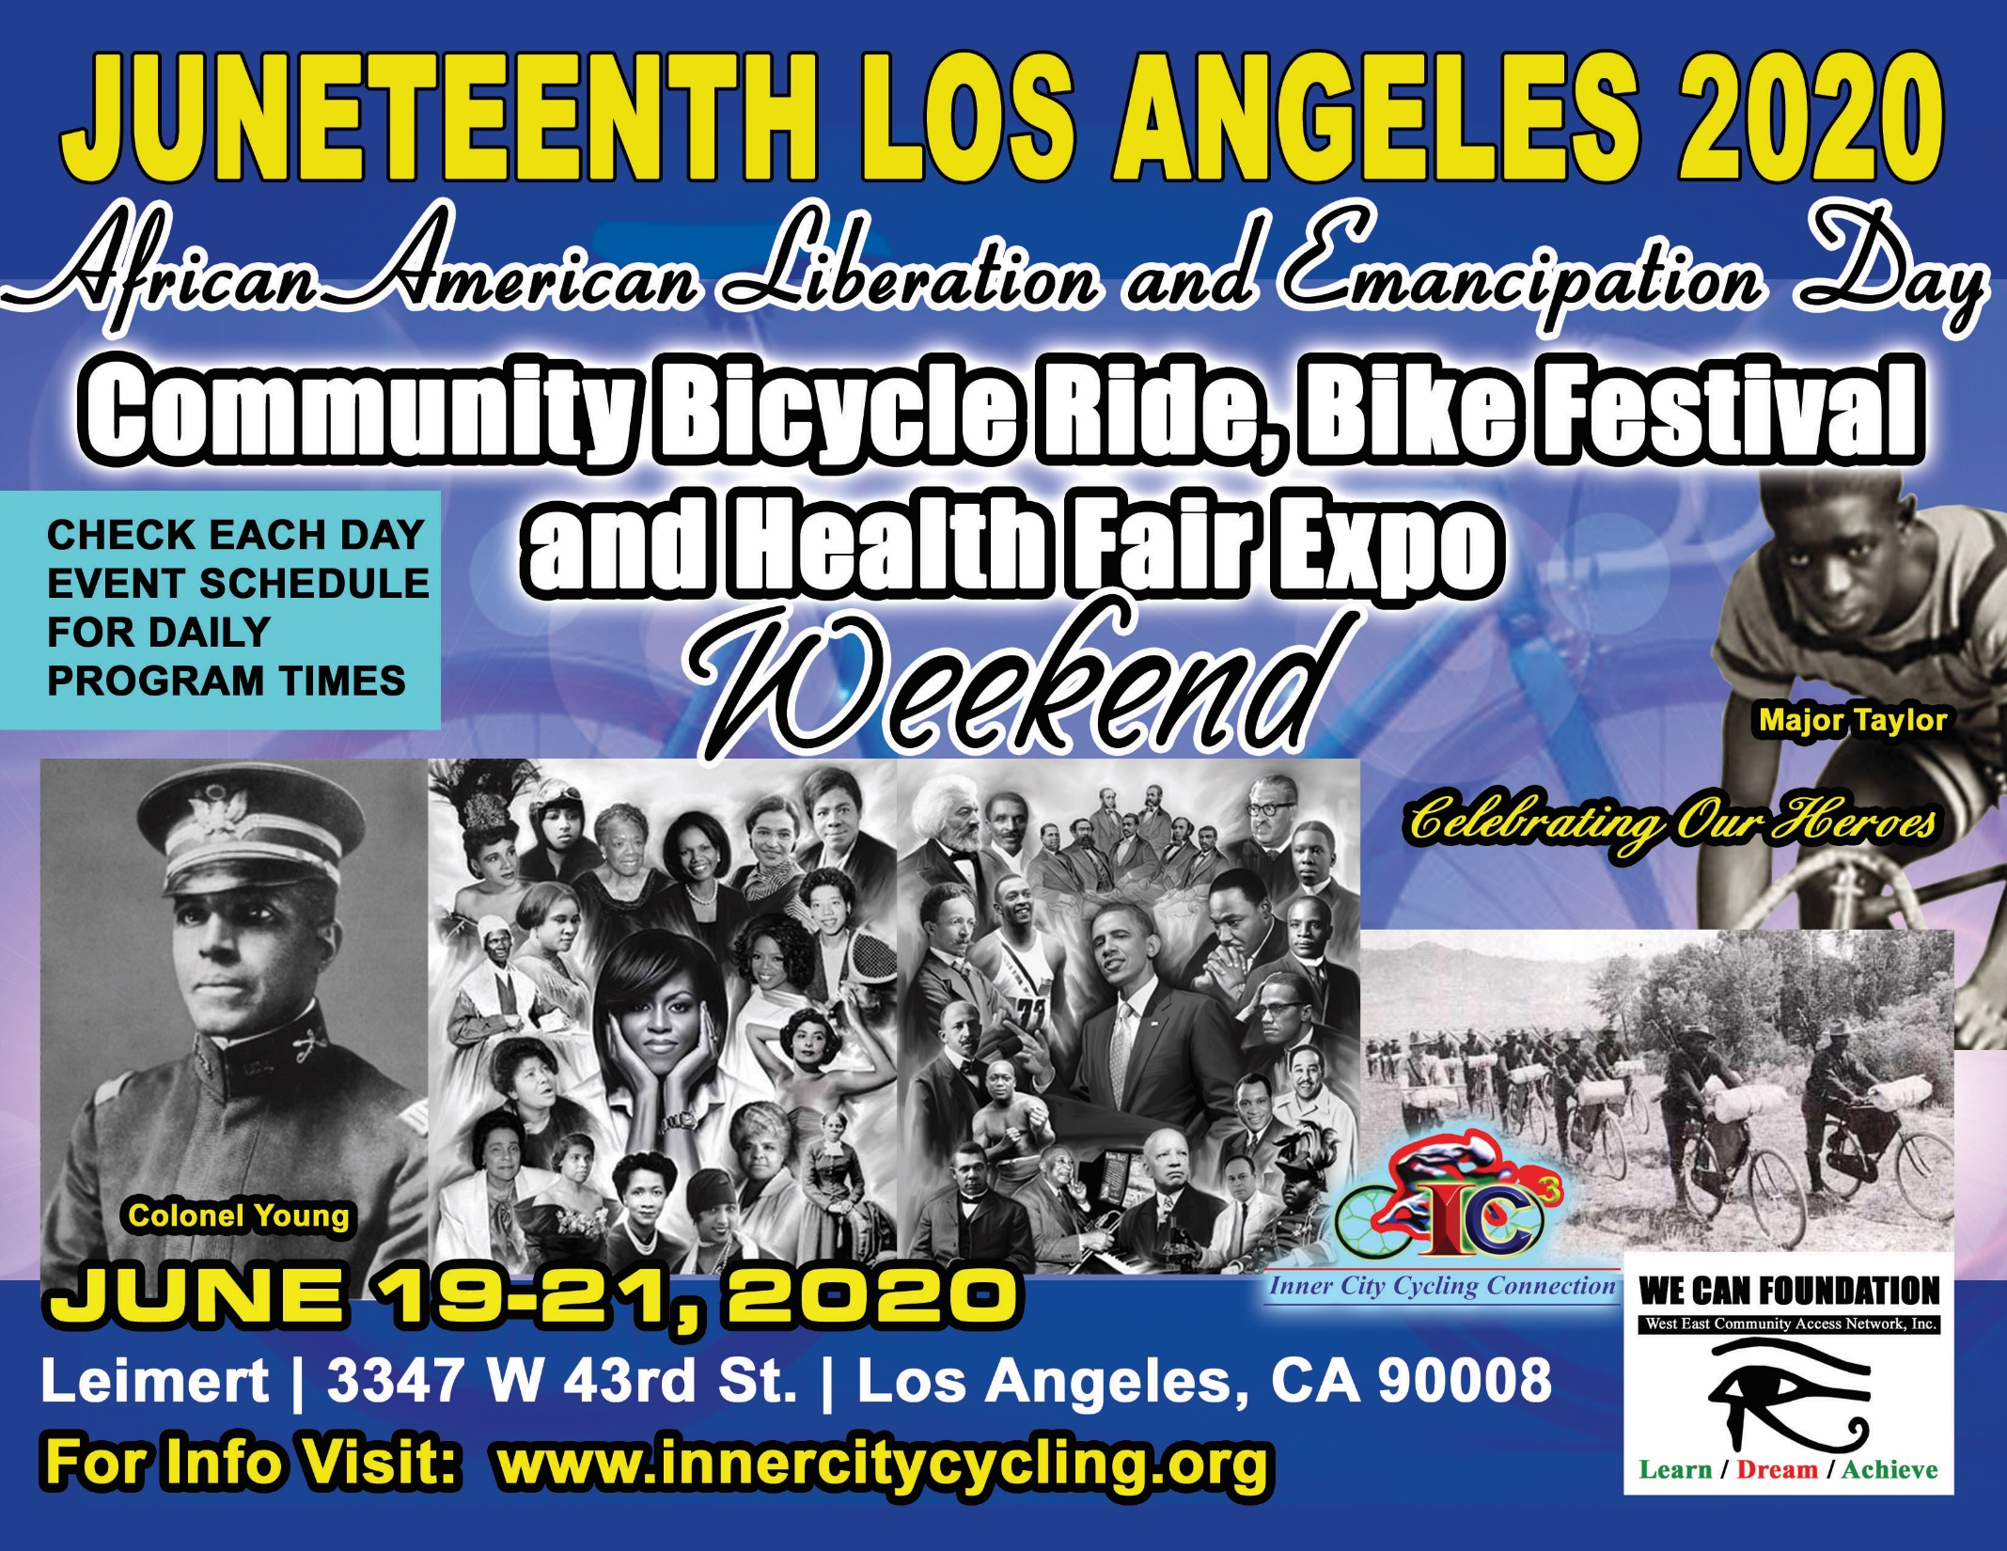
SPONSORSHIP PROPOSAL
EVENT PROPOSAL

Slide 2
Contents
Event Description
Juneteenth Background
Friday June 19 Details
Saturday June 20 Details
Concept of H.E.E.A.L Discussion
Sunday June 21 Details
Festival Details
Vendor Booth Information
Event Layout
Course Map
Attendance and Participation Projection
Sponsorship Opportunities
Principle Organizer Biography – Mr. Don Harris
Principle Organizer Biography – Reverend C. Eziokwu Washington
Contacts
INNER CITY CYCLING CONNECTION, INC.
Promoting Bicycles, Cycling, Bike Safety, Health, Fitness, and a Green Environment In Our Inner Cities.

Slide 3
Community Endorsements
(NJOF) NATIONAL JUNETEENTH OBSERVANCE FOUNDATION
(C.O.R.E) CONGRESS OF RACIAL EQUALITY
KINGDOMDAY PARADE
(NAMI ) NATIONAL ALLIANCE ON MENTAL ILLNESS
(A.S.A.L.H) ASSOCIATION STUDY OF AFRICAN AMERICAN LIFE AND HISTORY
(H.A.A.F) HEALTHY AFRICAN AMERICAN FAMILY
EAGLE WINGS OF ENLIGHTENMENT CENTER
BARBARA MORRISON PERFORMING ARTS ACADEMY
ESO WON BOOKS
HARUM
WORLD STAGE
UMOJA CENTER
WEST EAST COMMUNITY ACCESS NETWORK
LEIMERT PARK VILLAGE MERCHANT AND BUSINESS ASSOCIATION
DREW UNIVERSITY
FRENANDO PULLUM
NAPPY NATURAL
WILSHIRE UNITED METHODIST CHURCH

Slide 4
Event Description
Inner City Cycling Connection, Inc. (IC3), a 501 (C3) organization, (NJOF) National Juneteenth Observance Foundation, and the Barbara Morrison Performing Arts Academy are having a festival called Juneteenth Los Angeles 2020. This event will be a three day event held at Leimert Park in Los Angeles, June 19-21, 2020. Four themes are associated with this events:
Celebrating our culture, heroes, and health
Riding for health, justice, and equality
Exposing our community to the rewards and benefits of cycling
Honoring the life of Major Taylor, Colonel Young, a Buffalo Soldier from the 9th and 10th Calvary, and the US 25th Infantry Buffalo Soldier Cycling Regiment
OUR BELIEF
IC3, ( N.J.O.F.), and the West East Community Access believe that this culture celebration will enlighten our community about legacy Juneteenth and its importance to American society. In addition to the cultural aspect, IC3 will incorporate cycling, health, and fitness into this event by having a community bicycle ride/walk, honoring Marshall W. Taylor (A.K.A.: Major Taylor), and paying tribute to the US Army 25th Infantry Regiment (A.K.A.: The Cycling Buffalo Soldiers). Both Major Taylor and the Cycling Buffalo Soldiers are African-American heroes that need their stories told. This Juneteenth Los Angeles 2020 event will assist in that endeavor.

Slide 5
Juneteenth Background
Juneteenth, also known as Freedom Day or Juneteenth Independence day, is an American holiday that commemorates the June 19, 1865, announcement of the abolition of slavery in Texas which was the last to end slavery, and more generally the emancipation of enslaved African Americans throughout the former Confederate States of America. Texas alone refused to acknowledge the freedom of its slaves at the end of the Civil War on April 9, 1865. Texas held on to its slaves all the way into June 19, 1865 when the Union Army arrived and told the Texas slaves they were free.
The name of the observance is a portmanteau of "June" and "nineteenth", the date of its celebration.
JUNETEENTH LOS ANGELES 2020 IS A CELEBRATION OF THIS AFRICAN LIBERATION DAY!!
INNER CITY CYCLING CONNECTION, INC.
Promoting Bicycles, Cycling, Bike Safety, Health, Fitness, and a Green Environment In Our Inner Cities.

Slide 6
Friday June 19 Details
VENDOR BOOTH SETUP AND REGISTRATION
Registration/Setup time: 7AM to 10AM
JUNETEENTH COMMITTEE PRESENTATIONS
LECTURES BY SCHOLARS
ENTERTAINMENT
Time: 2PM to 6PM

Slide 7
Saturday June 20 Details
HEALTH FORUMS WITH HEALTH AGENCIES AND ORGANIZATIONS
SACRED IDIGENOUS DANCES & LECTURES
BMX BIKE SHOW AND EXHIBITION
KIDDY BIKE RIDES
Teaching bike safety to the kids
ACKNOWLEDGEMENTS, ENTERTAINMENT, MUSIC, & CONCERT

Slide 8
Concept of H.E.E.A.L Discussion
HEALTH
EDUCATION
ECONOMICS
ARTS
LEGACY & CULTURE

Slide 9
Sunday June 21 Details
COMMUNITY WALK, RUN, & BIKE RIDE
Registration: 7am to 10am
Cyclist registration fee: TBD Family walk, run and bike ride starts at 8:00am
Bike ride starts in the parking lot of Carl Jr. (Corner of Vermont and King Blvd.)
LEIMERT PARK FESTIVAL
LIBATION, OPENING BLACK NATIONAL ANTHEM
Presentation & lecture
Musical artists, drummers, gospel
Spoken word, African dancers
Featuring a Major Taylor look a like
25th INFANTRY, 9th AND 10th CALVARY BUFFALO SOLDIERS EXHIBIT
IC3 will have some of our cyclists dress like cycling buffalo soldiers to relive that era
WORKSHOPS - HEALTH, ECONOMICS, HISTORY PRESENTATIONS
Bike safety, health & fitness
Spiritual healing
ACKNOWLEDGEMENTS, ENTERTAINMENT, MUSIC, CONCERT

Slide 10
Festival Details
Location: Leimert Park
Date: Friday June 19 - Sunday June 21, 2020
Vendor booth setup will be between 7AM to 10AM
Vendor booth application and associated fees can be found at www.innercitycycling.org on the Juneteenth LA Ride/Walk link.
Vendor booth application pickup and delivery is available. Call Reverend Washington to schedule an appointment - 310-948-5524

Slide 11
Vendor Booth Information
10 x10 Tent
1 Table 2 Chairs (Provided by event coordinators)
BOOTH PRICES
FOOD - $225 per day
ARTS/CRAFT AND OTHER BUSINESESS - $125
THERE IS $50 DISCOUNT FOR THOSE THAT REGISTER FOR ALL THREE DAYS
DEADLINE TO APPLY IS MAY 31, 2020. AFTER THAT DATE, BOOTH PRICES ARE SUBJECT TO CHANGE

Slide 12
Event
Layout
CORE

Slide 13
Course Map
COMMUNITY BICYCLE RIDE, RUN, WALK
06/21/20

Slide 14
Attendance and Participation Projection
COMMUNITY BICYCLE RIDE, WALK, RUN
500 Participants
COMMUNITY BICYCLE RIDE, WALK, RUN STREET SPECTATORS
50,000+ People
LEIMERT PARK FESTIVAL ATTENDANCE
800+ Persons daily

Slide 15
Sponsorship Opportunities
VENDING SPONSOR - $1,000
Co-Sponsor of Professional Ride
Pre- and Post-Event Media Recognition
Pre-Event Banner Promotion Recognition
START/FINISH Banner Logo Recognition
Website banner link - 1x8 rotating
Logo on print advertisements
Onsite Demo Space Access
BRONZE SPONSOR - $2,500
Same as VENDING SPONSOR +
Up to (3) Course Banners posted, provided by your company

Slide 16
Sponsorship Opportunities
SILVER SPONSOR - $2,000
Same as VENDING SPONSOR +
Website Feature 1x1 column Ad Link
Up to (3) Course Banners posted, provided by your company
Additional Booth (up to (1) 10 x 10 spaces, tent, table chairs & signage)
GOLD SPONSOR - $1,500
Same as VENDING SPONSOR +
Website Feature 1x2 column Ad Link
Additional Booths (up to (2) 10 x 10 spaces, tent, table, chairs & signage)
Up to (5) Course Banners posted, provided by your company

Slide 17
Sponsorship Opportunities
PRESENTING SPONSOR - $5,000
Same as VENDING SPONSOR +
Website Feature 1x2 column Ad Link
Media communication & supporters recognition
Logo on merchandise
Additional Booths (up to (3) 10 x 10 spaces, tent, table, chairs & signage)
Up to (10) posted Course Banners, provided by your company
NOTICE:
Course Banners for this event could be your company vehicle with advertisements on it.

Slide 18
Mr. Don Harris Biography
Don Harris is the Founder and President of Inner City Cycling Connection, Inc. (IC3). He has held this position for the past 20 years. This organization is dedicated to promoting bicycles, cycling, bike safety, health, fitness, and a green environment in our inner cities.
From 1999 to 2010, Don managed and implemented the annual Martin Luther King Jr. Bike Race Classic and Festival in Los Angeles. The budget he handled for those years ranged from $20,000 to $30,000. At these races, Don had to organize and coordinate well over 1500 cyclists and an average of 60 plus vendors each year. In addition, Don works for and is in management at the Los Angeles County Water Reclamation Department. He manages a budget of approximately $250,000 annually, which includes a staff of 3 persons. He has been in this position for the past nine years. Before this position, Don worked at Container Corporation in the city of Los Angeles for 19 years. During that tenure, he managed a budget of 400,000+ annually and supervised a staff of 6 persons.
Don, a devoted Christian and a Vietnam War combat Veteran, has been a member of Wilshire United Methodist Church since 1979. He is presently the president of the Wilshire United Methodist Men’s Fellowship congregation. The social agenda for this group includes developing programs that address aggression and domestic violence, teen pregnancy, juvenile mentorship, STD’s, HIV/AIDS, and other serious issues. Visit the Inner City Cycling Connection, Inc. website to find out more about Don and the organization he loves.
USING CYCLING AS A TOOL TO HELP YOUNG PEOPLE STAY OUT OF TROUBLE IS DON HARRIS PASSION.
IC3 AND WE CAN FOUNDATION / WEST EAST COMMUNITY ACCESS NETWORK
BELIEVE THIS EVENT WILL HELP BRING AWARENESS TO A LOT OF SOCIETY PROBLEMS AND HELP IN GENERATION SOLUTIONS TO SOLVE THEM.
THIS EVENT WILL BE USE AS A PLATFORM TO PROMOTE HEALTH AND FITNESS IN OUR
COMMUNITY.
THIS EVENT WILL BE USE TO IDENTIFY YOUNG MINORITY CYCLING TALENTS EARLY.
THIS EVENT WILL GENERATE EMPLOYMENT AND TAX REVENUE IN LOS ANGELES CITY AND COUNTY.

Slide 19
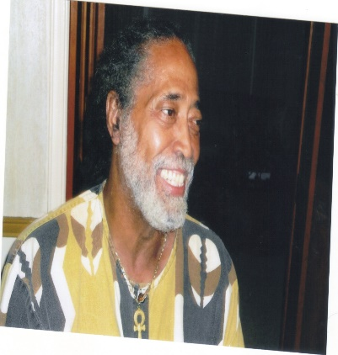
Reverend C. Eziokwu Washington Biography
Rev. Clarence Eziokwu Washington, a Vietnam Veteran and a retired engineer, has worked both national as well as internationally. Internationally, he worked as the West Coast Senior Engineer for Tele Media International headquartered in Rome Italy. He then shifted to a Business Solution Engineer for the Society of International telecommunications and Aeronautics in Geneva, Switzerland.
Reverend Washington was principal and part business owner of CS3 Computing Services Support & Solutions, and was a Senior Engineer for EMLAC Communications. He is Co-founder and Vice President of the WE CAN Foundation, a supplemental educational service provider. The Foundation was established in 1995 for the sole purpose of educating minorities in the inner-city computer technology and information technology.
Today the foundation is engaged in the effort to increase the academic performance of the students in 106 school districts in the State of California. The organization sponsors various program to engage and encourage the children in the community to participate in critical thinking. The We CAN Foundation hosted many events in the historical Black Town of Allensworth to raise scholarship funds for High School students. Their current project is producing the first Global Cultural Family Fair, introducing the Performing Arts and Folkloric Dance to the Central Valley and Allensworth Historical Park.
He has had membership in various organizations including the Black Business Association (BBA), the Asian Business Association (ABA), the Greater Los Angeles African American Chamber (GLAAC), the Latin Business Association (L.B.A), and the California Business Council. He is a current member of Recycling Black Dollars. He has served on the committee for Building Bridges Black and Brown in conjunction with and Loyola Marymount University. He is a community activist and a member of the South Central Organizing Committee.
Other experience’s included a member of the Inner City Computer Society and a member of Maxine Waters Advisory Committee for Telecommunications. Mr. Washington is an ordained minister, a Spiritual Akan High Priest, a member of the Inter Religious Council, a President for the Allensworth Community Volunteer Association, and a Mediator & Dispute Resolutions for the District Attorney Office dealing with race relations. He is the executive producer and director for a local cable show lecturing on Blacks & Economics and on Black Culture.

Slide 20
Contact Information
DON HARRIS
President and CEO, Inner City Cycling Connection, Inc.
(A 501-C3 Non-Profit Organization)
P.O. Box 82311 | Los Angeles, CA 90082 Phone Number: (310)839-5012
Email: ic3cycling@gmail.com
Juneteenth 2020 Weblink: https://innercitycycling.org/juneteenth-la-ride Website: www.innercitycycling.org
For application pickup/delivery and payment you can call 310-948-5524.

