Slide 1


NKOA
Positions & Keys
July 23, 2024

Slide 2
Training Plan for 7/23/2024
Training Topics from NKOA Registration Form
Review 2023 Penalty Enforcement Changes
2024 NFHS Points of Emphasis
Positions and Keys
Breakout Groups

Slide 3
Training Suggestions – Top 5
Mechanics (particularly 7 man)
Penalty Enforcement
Film Review
How to Handle/Communicate with Players & Coaches
Pre-Snap Routines

Slide 4
Foul By | Spot of Foul | End of Play | Basic Spot | Reference
A | Behind Line of Scrimmage | Behind Line of Scrimmage | Previous Spot | 10-4-2d
A | Behind Line of Scrimmage | Beyond Line of Scrimmage | Previous Spot | 10-4-2e
A | Beyond Line of Scrimmage | Behind Line of Scrimmage | Previous Spot | 10-4-2f
A A | Beyond Line of Scrimmage Beyond Line of Scrimmage | Beyond Line of Scrimmage Beyond Line of Scrimmage | Foul Behind End of Related Run – Spot of Foul Foul in Advance of End of Related Run – Succeeding Spot | 10-4-4d 10-4-5e
B | Behind Line of Scrimmage | Behind Line of Scrimmage | Previous Spot | 10-4-2d
B | Behind Line of Scrimmage | Beyond Line of Scrimmage | Succeeding Spot | 10-4-5f
B | Beyond Line of Scrimmage | Behind Line of Scrimmage | Previous Spot | 10-4-2d
B | Beyond Line of Scrimmage | Beyond Line of Scrimmage | Succeeding Spot | 10-4-5f
Summary
Loose-ball play – PREVIOUS SPOT
Running Play:
  Team A fouls
    If either end of run or foul occurs behind LOS – PREVIOUS SPOT
    If both foul and end of run occur beyond LOS – SPOT CLOSEST TO LOS (either end of run or spot of foul)
  Team B fouls
    If run ends behind LOS – PREVIOUS SPOT
    If run ends beyond LOS – SUCCEEDING SPOT

Slide 5
Rule Breakers
For specific non-contact fouls, the basic spot is the spot of the foul as follows:
  Illegal batting or illegal kicking when the foul occurs behind the end the related run
  Illegal participation as in 9-6-4a (entry during a down) and 9-6-4g (helmet off)
  Illegal forward pass and intentional grounding
    Illegal touching is previous spot (exception to the exception!)
The penalty for any Team A foul which occurs in their end zone results in a safety.

Slide 6
2024 Points of Emphasis
Sportsmanship & Altercation Prevention
Player Equipment and Enforcement
  Kneepads are “targeted for emphasis”
  Look for this and address it during pre-game with the coaches – they will take care of it
  Communicate – give players and coaches chance to correct
  Send players out if repeated, but be easy to work with
Formations
  Make it legal if we can
  Review the requirements of a “back” and a “lineman”
  Another good one to address in pre-game (and if you see in previous game film)

Slide 7

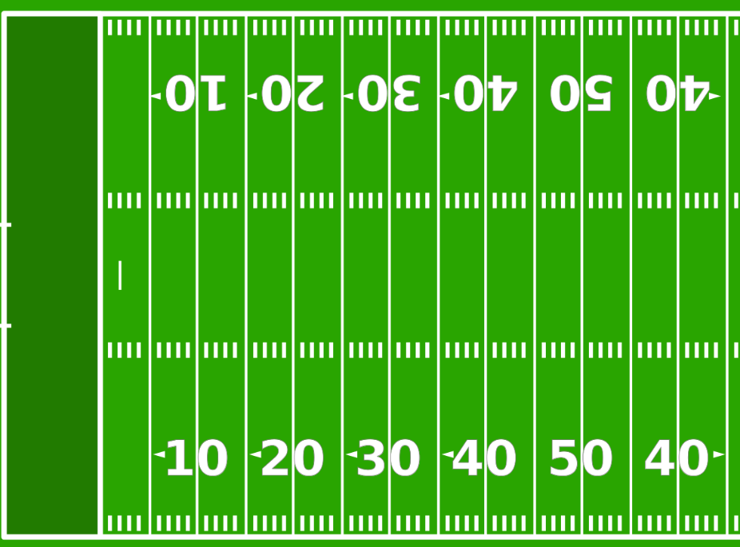

Free Kick
Five Man Pre Kick and During Kick
BJ:
K’s restraining line (usually K40)
Count K & Verify 11, hand ball to Kicker, remind to wait for R whistle, then move with purpose to sideline.
Watch for encroachment, illegal action on kicker, blocking in NZ
If deep, move out onto field at angle.
LJ:
R’s restraining line (usually midfield)
Count K & Verify 11
Watch for encroachment, illegal blocks in NZ, blocks initiated in NZ
If deep, move down field 5-10 yards and watch blocking.
HL:
30 yard line, oppo press box
Count R & Verify 11, watch blocking
U:
20 yard line, press box
Count R & Verify 11, watch blocking
HL
BJ
R:
R’s Goal Line, Hashmark on Press-Box side
Rule on kicks going into R’s EZ and near pylon.
Example Text : Get a modern PowerPoint Presentation that is beautifully designed. I hope and I believe that this Template will your Time, Money and Reputation. Get a modern PowerPoint Presentation that is beautifully designed. I hope and I believe that this Template will your Time, Money and Reputation. You can simply impress your audience and add a unique zing and appeal to your Presentations.
R
U
Press Box
LJ

Slide 8
Free Kick
Five Man - Return
BJ:
First touching by K
Blocking on the kicker
Penalty Enforcement from previous spot
LJ:
First touching by K
Coverage to goal line
Defer spot to U unless long return, clean up OOB if necessary
Watch for blocking and fouls away from the ball
HL & U:
Wind clock if in your area, other than first touching
Pick up runner and officiate
If kick OOB, mark spot with flag
Watch for blocking and fouls away from the ball.
HL spot all the way to GL with help from BJ; U spot unless long return
R:
If kick down middle, wind clock, pick up runner and release to wing
Consider momentum if caught inside 5
Kick to side, move with a purpose to trail, watching action of players and blocking, clean up.
HL
BJ
All Officials:
Stop the clock at the end of the free kick down
Dead ball officiate
Clean change of possession
Move with a purpose
Example Text : Get a modern PowerPoint Presentation that is beautifully designed. I hope and I believe that this Template will your Time, Money and Reputation. Get a modern PowerPoint Presentation that is beautifully designed. I hope and I believe that this Template will your Time, Money and Reputation. You can simply impress your audience and add a unique zing and appeal to your Presentations.
R
U
Press Box
LJ

Slide 9
Initial Position
Five Man – Umpire in Offensive Backfield
R:
14 yards off ball, outside TE, wide and in position to see through QB to (if looking across to oppo tackle)
Count and signal A players
Watching for motion, snap, read and react
LJ:
11-13 yards off ball, opposite R, in position to see oppo tackle
Count and signal A players
Watching for motion, snap, read and react
HL & U:
LOS in the white, off the field
Signal down, ensure box and chains set
Assist receivers with alignment and verify legal formation
Encroachment/False Start
Know line-to-gain and eligible receivers
Read formation, know BJ primary and wing secondary keys
HL
BJ:
18-22 yards off ball
Count and signal B players
40/25 count (hand at 10, count last 5)
Take the initial key
n simply impress your audience and add a unique zing and appeal to your Presentations.
R
BJ
U
LJ
Press Box

Slide 10
Key - Balanced
HL
Strength = side of field with larger number of players outside of the tackle
Keys:
BJ – strength side outside receiver
Wing (strength) - next receivers in and any backs your side that present
Wing (back side) – solo
R
Example Text : Get a modern PowerPoint Presentation that is beautifully designed. I hope and I believe that this Template will your Time, Money and Reputation. Get a modern PowerPoint Presentation that is beautifully designed. I hope and I believe that this Template will your Time, Money and Reputation. You can simply impress your audience and add a unique zing and appeal to your Presentations.
BJ
If balanced, strength to LJ side
U
LJ
Press Box

Slide 11

Keys - trips
HL
Strength = side of field with larger number of players outside of the tackle
Keys:
BJ – takes #2 and #3 inside
Wing (strength) – takes #1 on strong side
Wing (back side) – solo
R
Example Text : Get a modern PowerPoint Presentation that is beautifully designed. I hope and I believe that this Template will your Time, Money and Reputation. Get a modern PowerPoint Presentation that is beautifully designed. I hope and I believe that this Template will your Time, Money and Reputation. You can simply impress your audience and add a unique zing and appeal to your Presentations.
BJ
If balanced, strength to LJ side
U
LJ
Press Box

Slide 12
Scrimmage Kick
Five Man
R:
2 yards in front of initial position of punter, kicking leg side
Count and signal K players
Watching for motion, snap, read and react
Watching contact on K by R, rule on illegal contact
Goal line coverage on return.
U:
Opposite R
Watching blocking
Release downfield and watch return, and blocking in front of return
HL
Stay with the LOS, only move downfield once certain ball has crossed LOS and will not come back behind LOS
LJ:
Release with the snap, move with a purpose, reading gunners, blocking, and sensing the kick (don’t look up in the air)
HL
BJ:
If one receiver – even and on HL side of field
If two receivers – either split or outside on HL side
Beanbag end of kick, slow on whistle to rule on catch/muff, goal line coverage, momentum
BJ
Example Text : Get a modern PowerPoint Presentation that is beautifully designed. I hope and I believe that this Template will your Time, Money and Reputation. Get a modern PowerPoint Presentation that is beautifully designed. I hope and I believe that this Template will your Time, Money and Reputation. You can simply impress your audience and add a unique zing and appeal to your Presentations.
R
U
LJ
Press Box

Slide 13
XP/FG Inside 15 yard line
R:
Opposite kicking leg, deep and wide
Look through snapper/holder to oppo tackle
R whistle on Try/XP
Watching contact on kicker/holder
U:
Under upright
Watching contact on snapper
HL/LJ:
Encroachment/false start
Hustle in after certain kick is made
If “fire”, move to goal line
BJ:
Go under upright
HL
Example Text : Get a modern PowerPoint Presentation that is beautifully designed. I hope and I believe that this Template will your Time, Money and Reputation. Get a modern PowerPoint Presentation that is beautifully designed. I hope and I believe that this Template will your Time, Money and Reputation. You can simply impress your audience and add a unique zing and appeal to your Presentations.
BJ
U
R
LJ
Press Box

Slide 14
XP/FG Outside 15 yard line
R:
Opposite kicking leg, deep and wide
Look through snapper/holder to oppo tackle
R whistle on Try/XP
Watching contact on kicker/holder
U:
Opposite R
Watching blocking & contact on snapper
HL
Stay with the LOS, only once certain ball has crossed LOS and will not come back behind LOS
Go under upright if R’s back is facing you for the attempt
LJ:
Go under upright if R’s back is facing you for the attempt.
Stay with LOS if you are on the LOS and only leave once certain ball will not come back.
HL
BJ:
Under upright
BJ whistle on FG once ball is certain crosses goal line
Example Text : Get a modern PowerPoint Presentation that is beautifully designed. I hope and I believe that this Template will your Time, Money and Reputation. Get a modern PowerPoint Presentation that is beautifully designed. I hope and I believe that this Template will your Time, Money and Reputation. You can simply impress your audience and add a unique zing and appeal to your Presentations.
BJ
U
LJ
R
Press Box

Slide 15


Onside Kick
Five Man Onside Kick
BJ:
K’s restraining line (usually K40)
Count K & Verify 11, hand ball to Kicker, remind to wait for R whistle, then move with purpose to sideline.
Watch for encroachment, illegal action on kicker, blocking in NZ
LJ:
R’s restraining line (usually midfield)
Count K & Verify 11
Watch for encroachment, illegal blocks in NZ, blocks initiated in NZ
Verify ball hits ground and goes 10 yards, or is legally touched first by R in order for K to recover.
HL:
R’s restraining line, oppo press box
Count R & Verify 11, watch blocking
Verify ball hits ground and goes 10 yards, or is legally touched first by R in order for K to recover.
U:
K’s restraining line, press box
Count R & Verify 11, watch blocking
HL
BJ
R:
R’s 10 yard line
Rule on kicks going into R’s EZ and near pylon if they decide to kick it deep.
Make sure at least 4 on each side of kicker at the time of the snap.
Looking for illegal pop-up kick.
Example Text : Get a modern PowerPoint Presentation that is beautifully designed. I hope and I believe that this Template will your Time, Money and Reputation. Get a modern PowerPoint Presentation that is beautifully designed. I hope and I believe that this Template will your Time, Money and Reputation. You can simply impress your audience and add a unique zing and appeal to your Presentations.
R
U
Press Box
LJ

Slide 16
Closing
KHSAA and NKOA Registration
Uniform – get it out and order what you need
Rule books – get in and study
Fitness – we need every one of you for the whole season!
Arbiter Blocks
Rule Quiz #1 – Tomorrow 7/24
Next Meeting – Tuesday 7/30
  5:30 PM – Scott High School football field
  Bring Flag, Bag, and Whistle

Slide 17
Breakout Groups
R & U – Daniel Brummett
Wings – Daryl Crosthwaite
BJ – Joey Shipman

