Slide 1



NKOA
Training Meeting
July 21, 2026
2026 NKOA Registration Form
Scan the Q/R code!

Slide 2
Welcome to the 2026 Season
2026 NKOA Board
Member Recognition
  2025 State Finals Officials – Daniel Brummett, Kenny Lonkard, Andrew Hitchcock (2A); Jake Catron, Matt Bise, Miles McKinney, Tony Grizovic (5A)
  Kenny Lonkard – 2026 Wrestling State Finals
  Brian Sandlin – 2026 Basketball State Finals
  2025 Kentucky Football Official of the Year – Daniel Brummett

Slide 3
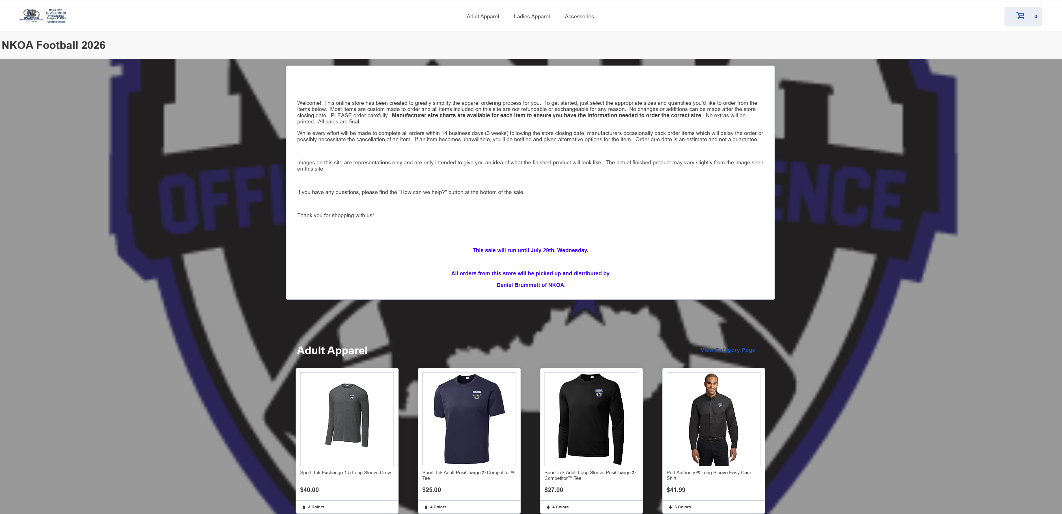

NKOA Items
NKOA Merchandise Webstore – closes 7/29/2026

Slide 4
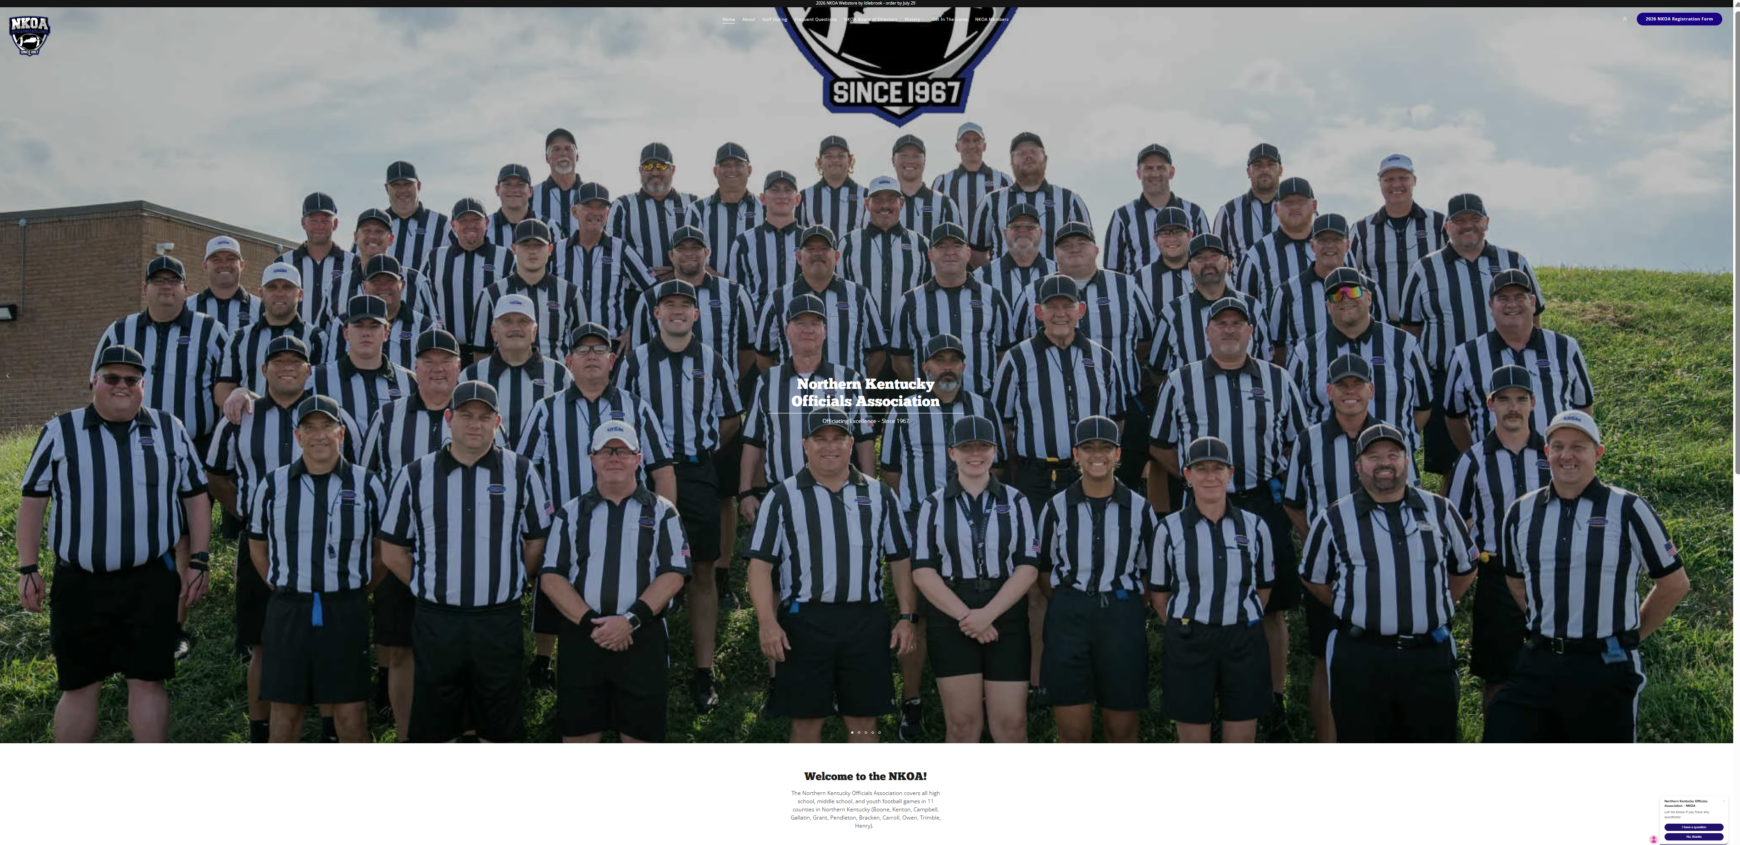
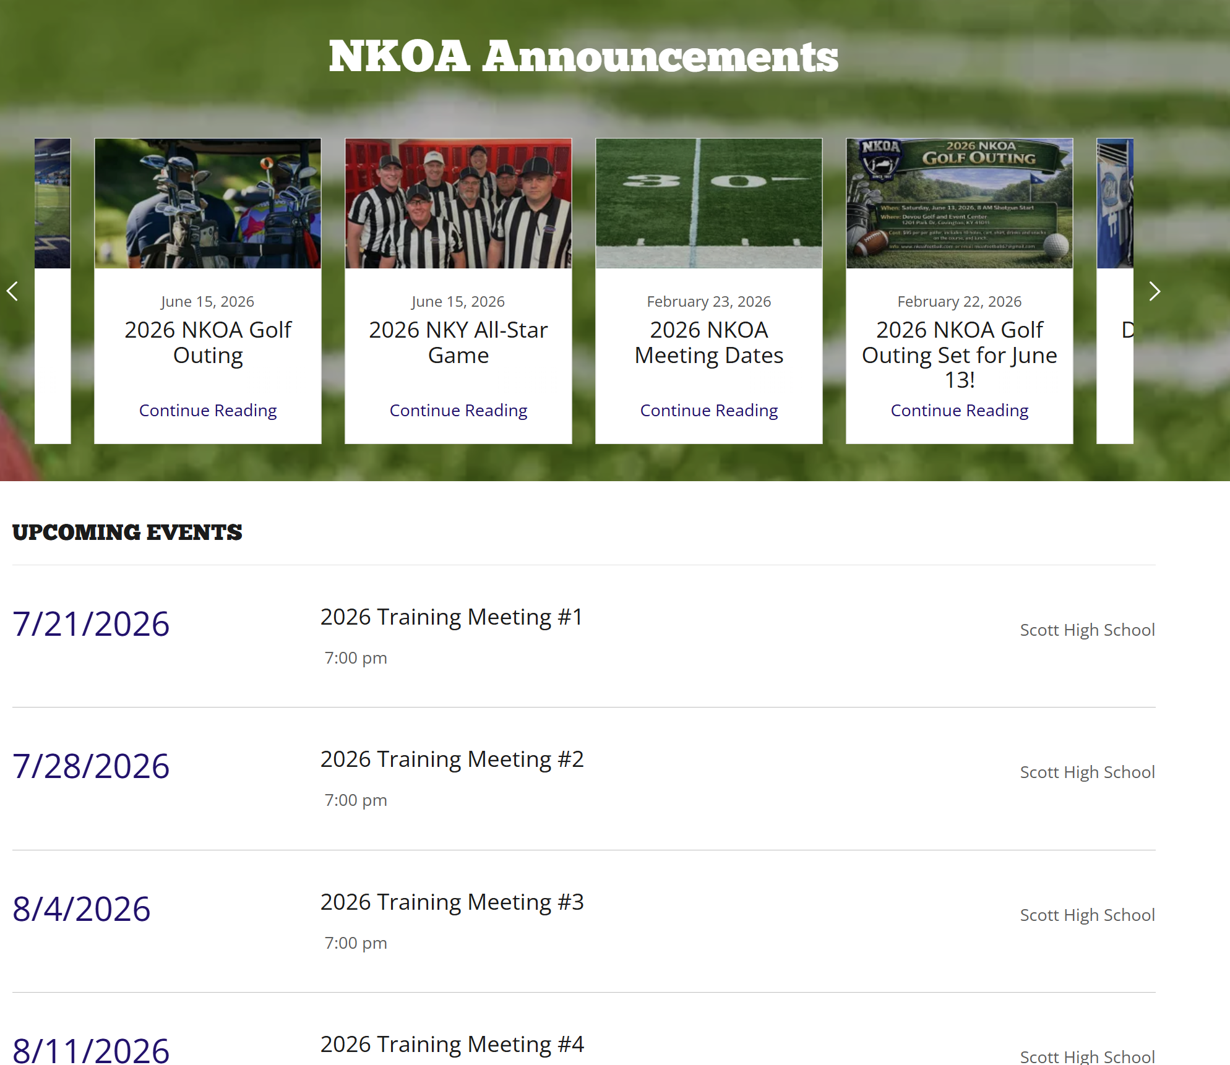
www.NKOAFootball.com
Bookmark the website and visit frequently!

Slide 5

2026 KHSAA Registration
Required to receive any high school or middle school assignments.
Please get this done ASAP!

Slide 6

2026 NKOA Registration
1st Year - $30
2nd – 24th Year - $65
25+ - $0
6 of 9 meetings to remain in good standing

Slide 7
2026 Training Schedule
7/28 – Meeting #2 – Scott HS
8/4 – Meeting #3 – Scott HS
8/11 – Meeting #4 – Scott HS
8/18 – Meeting #5 – Scott HS
9/1 – Meeting #6 – Scott HS
9/15 – Meeting #7 – Scott HS
9/29 – Meeting #8 – Scott HS
10/13 – Meeting #9 – Scott HS
Annual Meeting and Social – TBD
8/6 and 8/8 – additional opportunities for newer officials

Slide 8



2026 Rule Books
NFHS Digital
Apple
Android

Slide 9
Steve Fromeyer
Assignor Remarks

Slide 10
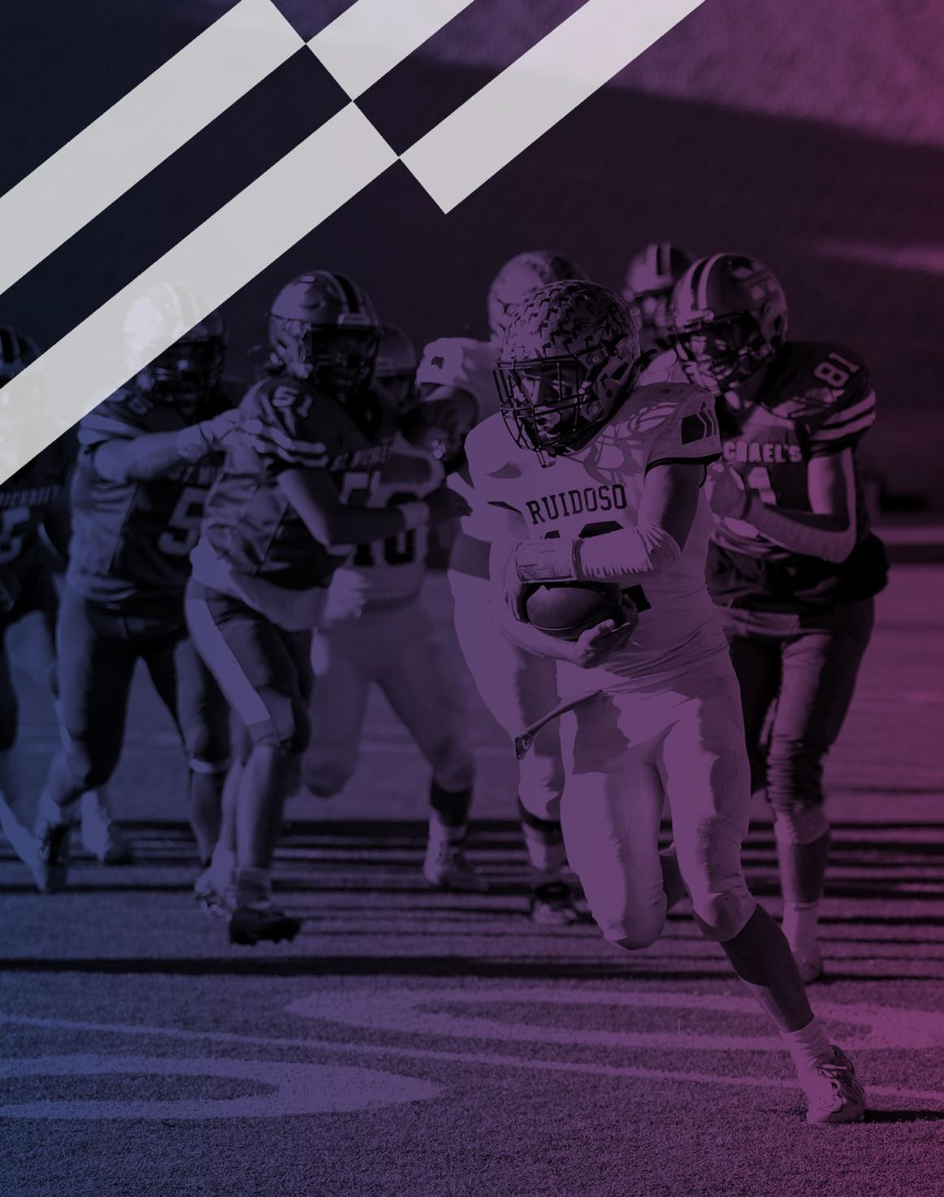


2026 NFHS FOOTBALL RULES POWERPOINT
Copyright© 2026 National Federation of State High School Associations. All Rights Reserved.
This copyrighted power point is presented by the NFHS. This material shall only be reproduced or distributed by member state associations for teaching and training purposes. Distribution to the public is prohibited without the express written consent from the NFHS. Please contact Davis Whitfield, COO at dwhitfield@nfhs.org with requests.

Slide 11

2026 NFHS FOOTBALL RULES CHANGES

Slide 12
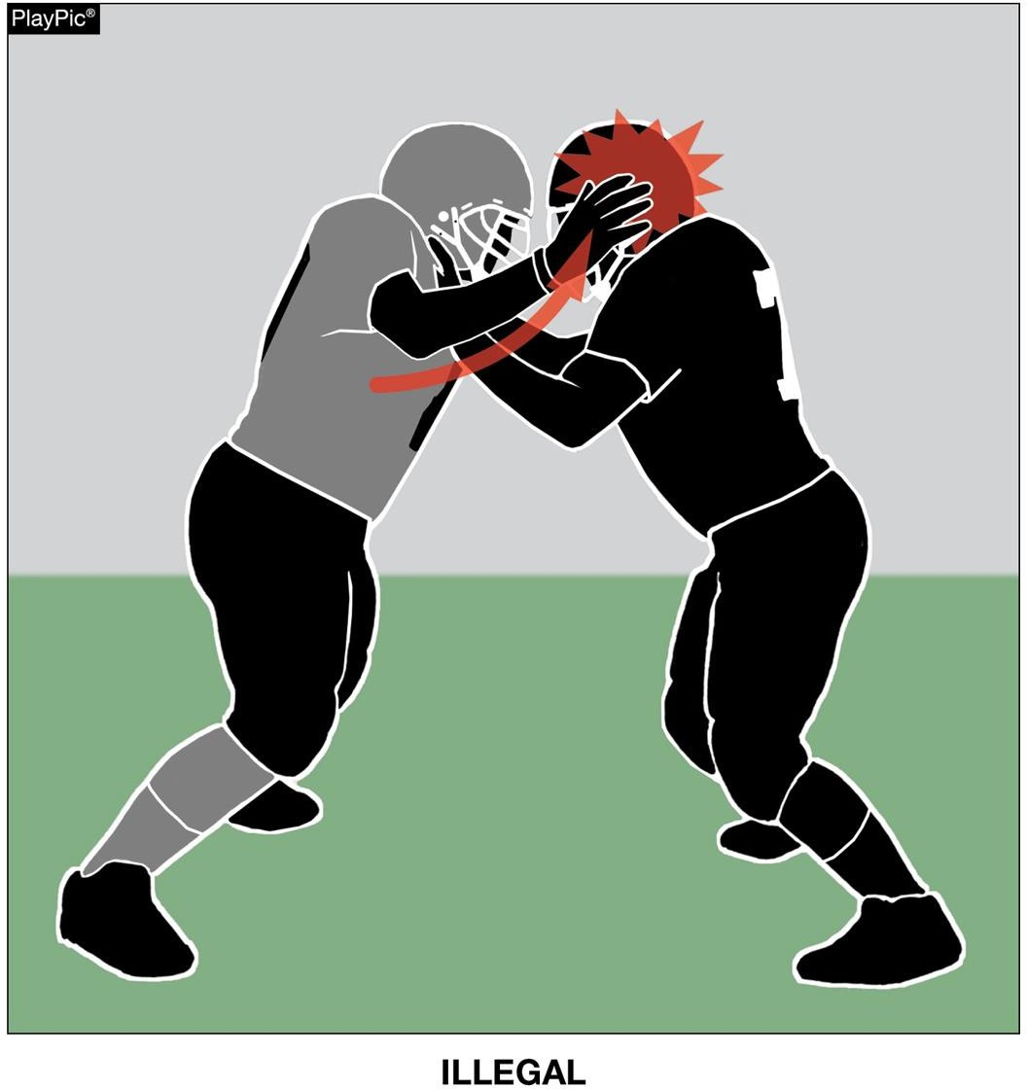
HEAD SLAP RULE 9-4-7
RULES CHANGES
“No player may use the hand(s) to slap the opponent’s head.”

Slide 13
2026 NFHS FOOTBALL EDITORIAL CHANGES

Slide 14
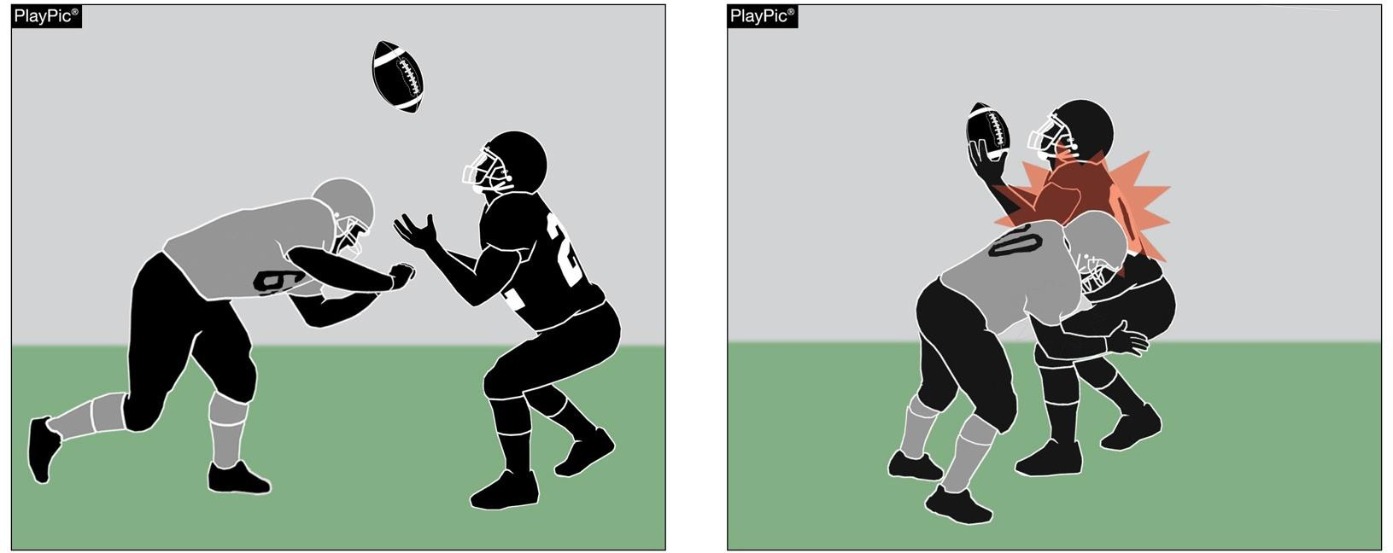
ILLEGAL PERSONAL CONTACT/DEFENSELESS PLAYER RULE 9-4-3p
EDITORIAL CHANGES
No player or nonplayer shall:
p. Initiate forceful contact against a defenseless receiver as in 2-32-16b, 2-32-16c and 2-32-
16e that is not:
Incidental contact as a result of making a play on the ball;
Initiated with open hands; or
An attempt to tackle by wrapping arm(s) around the receiver.

Slide 15
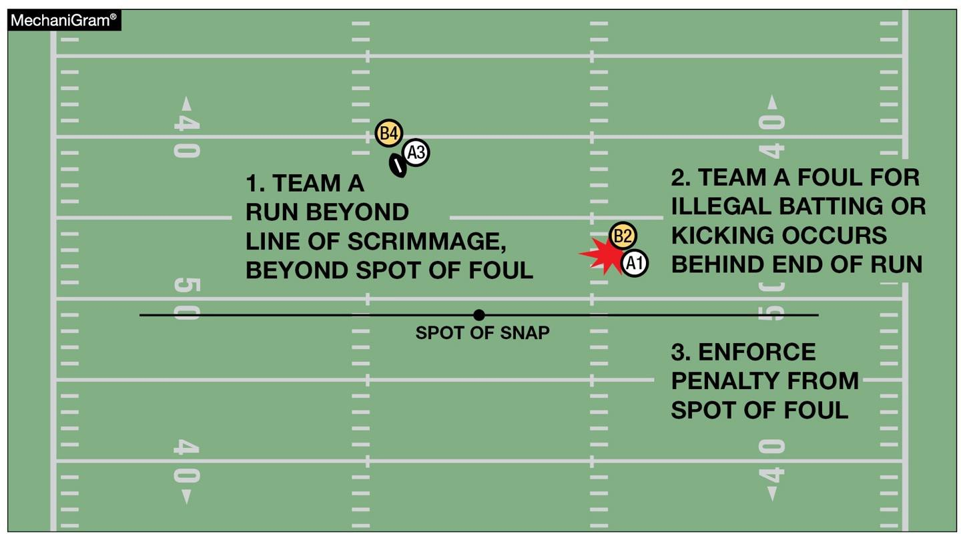
BASIC SPOT RULE 10-4-4a
EDITORIAL CHANGES
The basic spot is the spot of the foul for:
  Illegal batting or illegal kicking by A that occurs behind the basic spot.

Slide 16
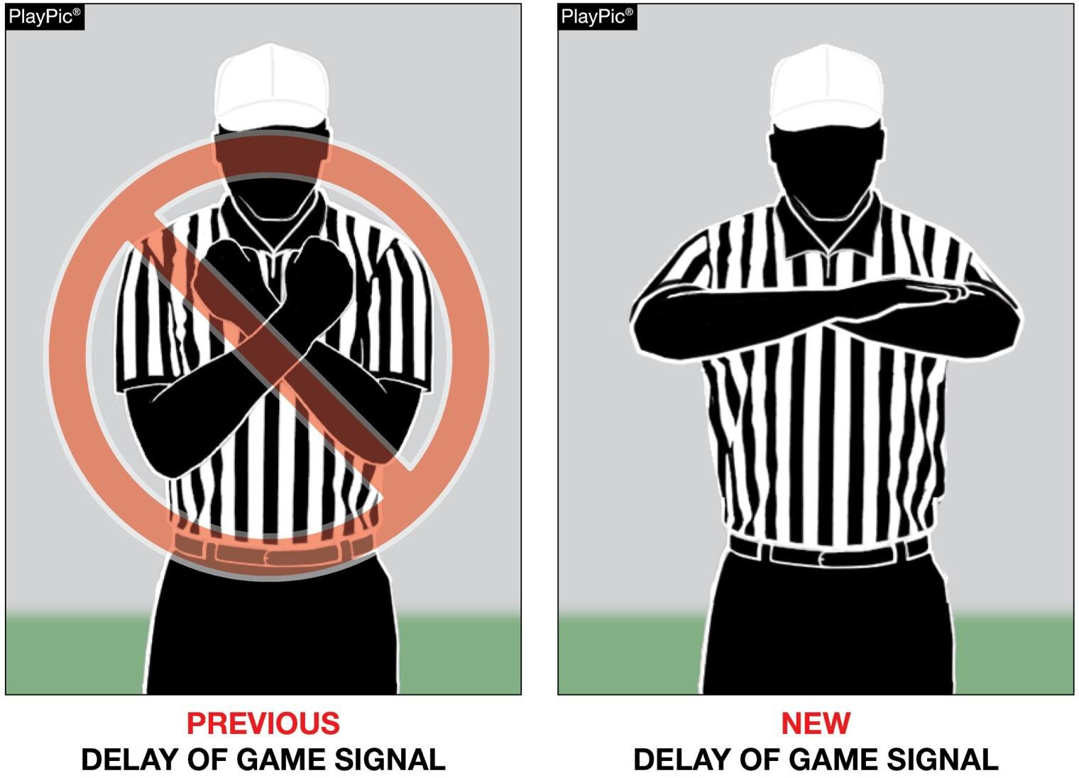
EDITORIAL CHANGES
NEW DELAY OF GAME SIGNAL

Slide 17
2026 NFHS FOOTBALL RULES REMINDERS

Slide 18
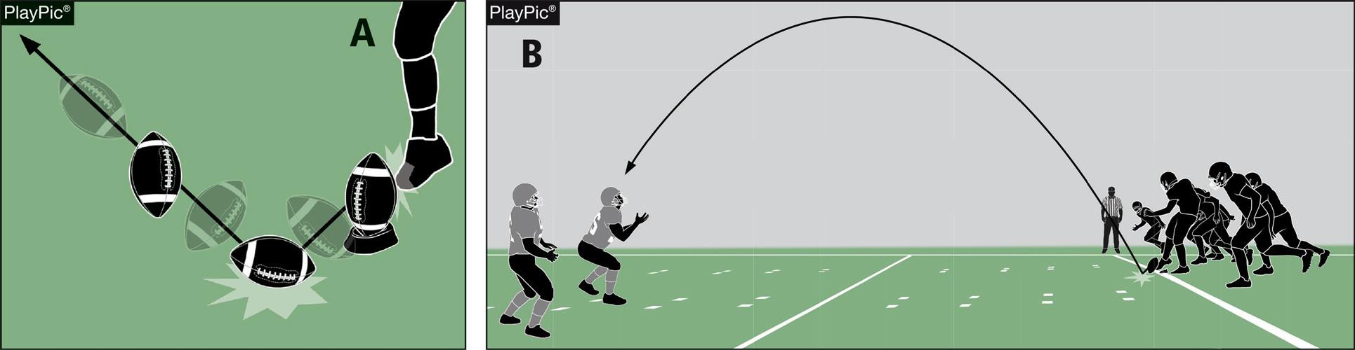
POP-UP KICK
RULES 2-24-10; 6-1-11; 6-1 PENALTY
RULES REMINDERS
A pop-up kick is a free kick in which the kicker drives the ball immediately to the ground, the ball strikes the ground once and goes into the air in the manner of a ball kicked directly off the tee. Such kicks are penalized as a dead-ball foul.

Slide 19
2026 NFHS FOOTBALL POINTS OF EMPHASIS

Slide 20
2026 NFHS FOOTBALL POINTS OF EMPHASIS
Flagrant and Unsportsmanlike Fouls
Helping the Runner
Sideline Management and Control
Identification of the NFHS Authenticating Mark on Game Balls

Slide 21
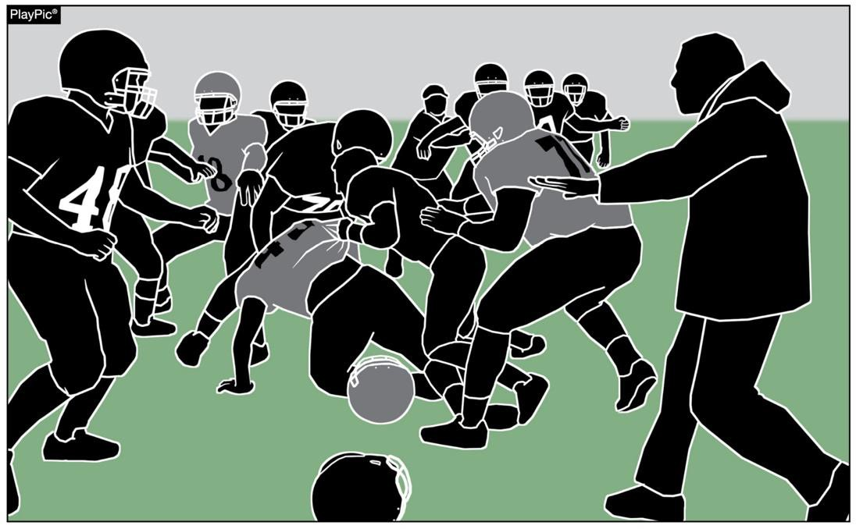
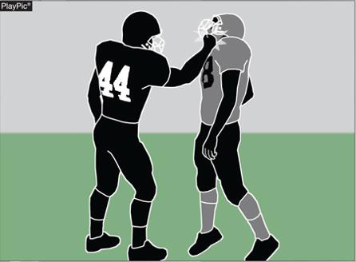
FLAGRANT AND UNSPORTSMANLIKE FOULS
POINTS OF EMPHASIS
In high school football, flagrant fouls and unsportsmanlike fouls are
serious rule violations that threaten player safety and the integrity of the game.
Game officials must consistently penalize both flagrant and unsportsmanlike fouls to maintain control of the game.

Slide 22
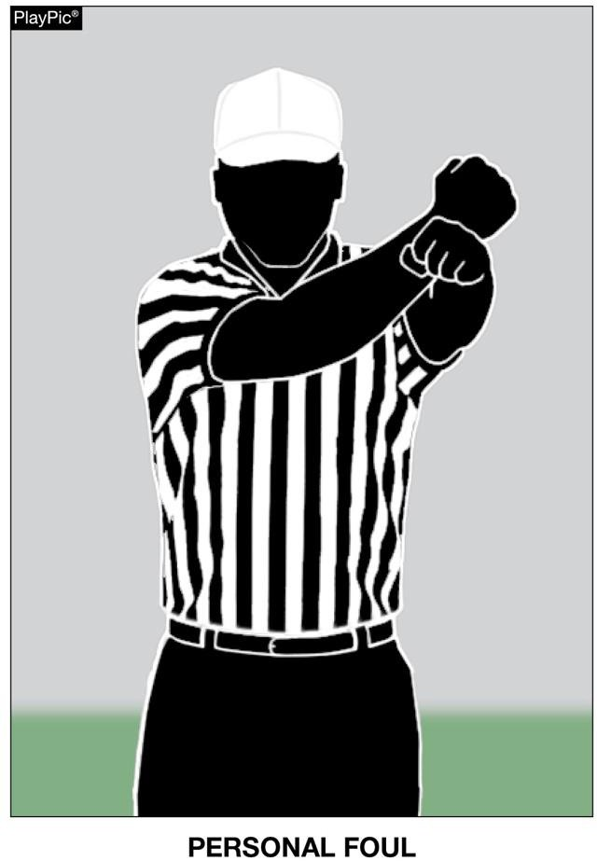
FLAGRANT AND UNSPORTSMANLIKE FOULS
POINTS OF EMPHASIS
Flagrant fouls are the most severe type of personal foul in high school football.
A foul so severe or extreme that it places an opponent in
danger of serious injury, and/or involves violations that are extremely or persistently vulgar or abusive conduct.
These actions involve intentional, reckless or excessively
violent behavior that shows a clear disregard for the
safety of others. Examples include fighting, maliciously
targeting the head or neck area, striking an opponent, or delivering a violent illegal blindside block or late hit.
Disqualification if any foul is judged by the game official to be flagrant.

Slide 23
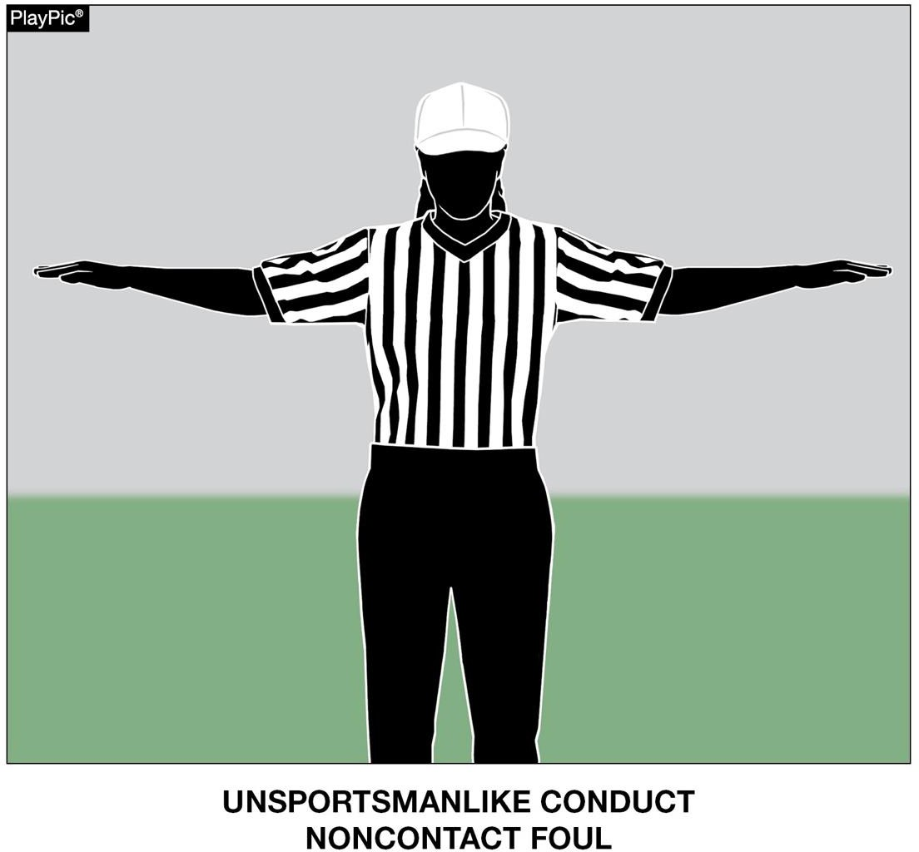
FLAGRANT AND UNSPORTSMANLIKE FOULS
POINTS OF EMPHASIS
Unsportsmanlike fouls are non-contact fouls that violate standards of fair play, respect and sportsmanship.
Common examples include taunting, threatening gestures or posturing, racist comments, trash talking, excessive or choreographed celebrations, aggressively spiking, spinning or throwing the ball high into the air, using profanity, spitting, arguing with game officials, or throwing equipment.

Slide 24
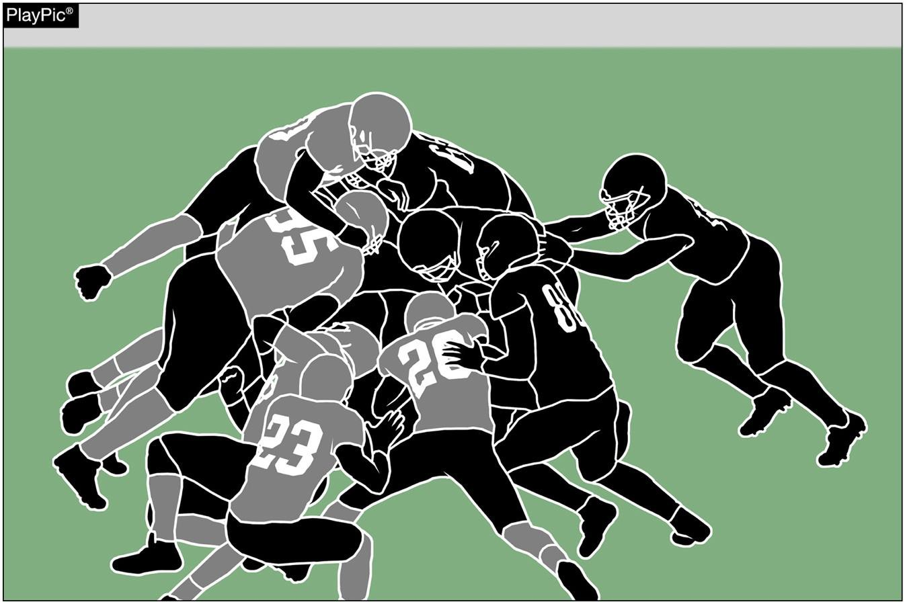
HELPING THE RUNNER
POINTS OF EMPHASIS
Illegally helping the runner to assist forward progress presents a risk of injury to the runner and others. The additional momentum to a particular offensive player, as opposed to the pile, swings the competitive balance toward the offense in a manner not intended by the rules.

Slide 25
HELPING THE RUNNER
POINTS OF EMPHASIS
Although direct contact with the runner is illegal under NFHS rules, these types of plays are becoming more common in the high school game. As guardians of the game, it is imperative that all stakeholders work together to remove
“illegally helping the runner” from our high
school game.

Slide 26
HELPING THE RUNNER
POINTS OF EMPHASIS
Although a foul can occur on any play, game officials should especially be alert for this type of action on short-yardage plays near the goal line and line to gain. Remember, pushing the pile is legal; direct contact while pushing, pulling, lifting of the runner to assist forward progress is not.

Slide 27
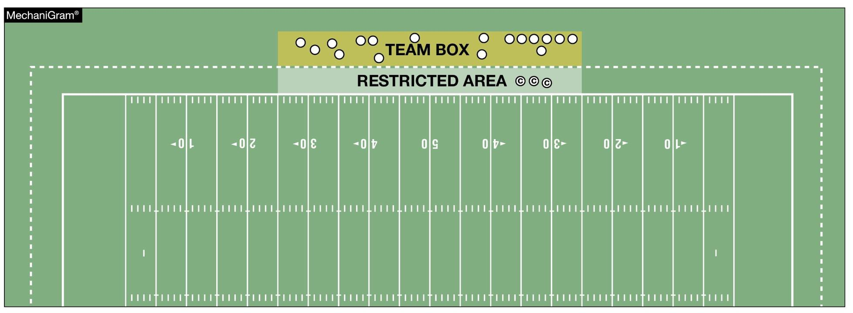
SIDELINE MANAGEMENT AND CONTROL
POINTS OF EMPHASIS
Sideline management has become a recurring “point of emphasis” because it improves game safety. To minimize the risk of all involved, non-players must remain in their team box and out of any restricted areas, especially while the ball is live. The coaches’ area is a minimum of a 2-yard belt between the front of the team box and the sideline, and becomes the restricted area when the ball is live. A maximum of three coaches – and only coaches – may be in this area when the ball is dead between plays.

Slide 28
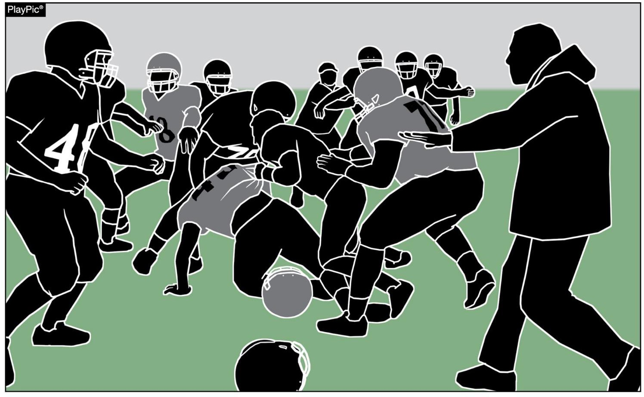
SIDELINE MANAGEMENT AND CONTROL
POINTS OF EMPHASIS
Sideline management and control promotes good sportsmanship and professionalism across all levels of play, and also prevents unnecessary delays and confrontations that can impact game flow and fairness.

Slide 29

Thank You
National Federation of State High School Associations
NFHS.org Phone # 317-972-6900 Email
@NFHS1920 @NFHS_org

Slide 30
Closing
KHSAA and NKOA Registration
Uniform – get it out and order what you need
Rule books – get in and study
Fitness – we need every one of you for the whole season!
Arbiter Blocks
Rule Quiz #1 – Tomorrow 7/22
Next Meeting – Tuesday 7/28
  7:00 PM – Scott High School

