Slide 1
Template update as indicated throughout
Rating Name
Alignment Meeting
Day Month 2025
Presented to: Stakeholder Command Names
Presented by: <Executing Organization>

Slide 2

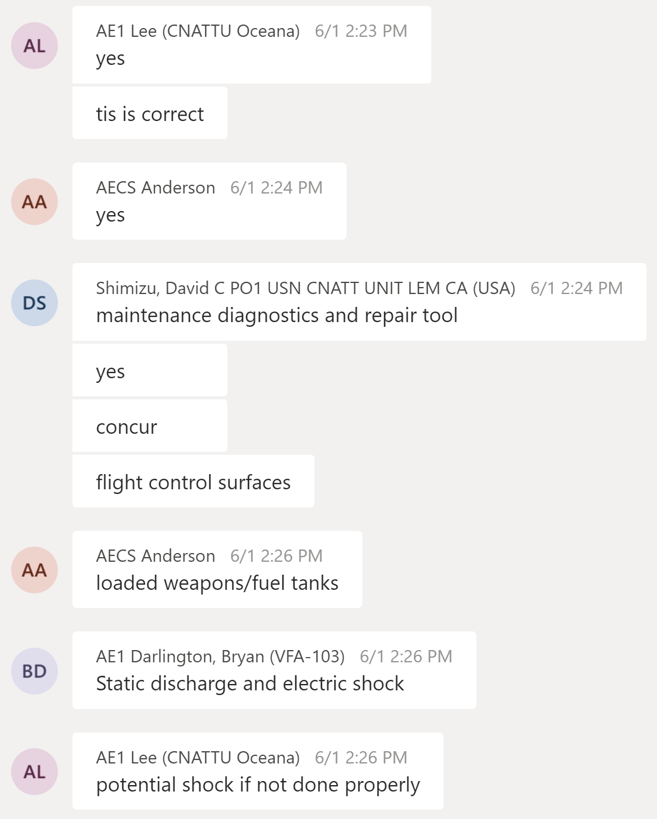
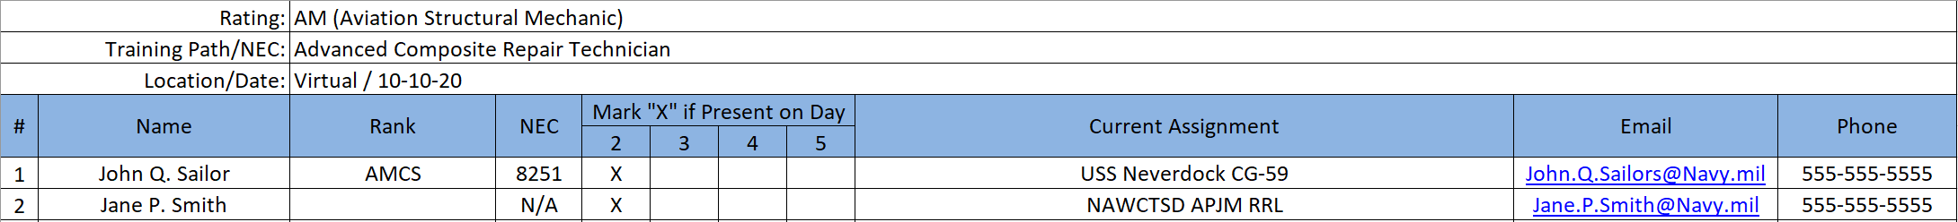
Welcome to the Virtual
Alignment Meeting
We will begin at 1100 ET
Please sign-in using the MS Teams chat feature provide Name, Rank, NEC, Current Assignment, Email, Phone
Chat
The NAWC Team uses collected sign-in information to populate the workshop attendance sheet seen below

Slide 3

Virtual Workshop Rules of Engagement
Mute audio unless speaking
One speaker at a time
Utilize chat feature:
Ask questions
Provide comments
Consensus acknowledgement
Validate/Verify accuracy of data
Be an active listener and participate
Help make a difference

Slide 4
Welcome to In-Person
Alignment Meeting
We will begin at 1100 ET
Please sign-in using the Sign in Sheet provide Name, Rank, NEC, Current Assignment, Email, Phone

Slide 5
In-Person Workshop Rules of Engagement
One speaker at a time
Actively listen and participate:
Ask questions
Provide comments
Consensus acknowledgement
Validate/Verify accuracy of data
Help make a difference

Slide 6
Agendagenda
Roll Call
Purpose of the Alignment Meeting
Introductions and Stakeholder Roles/Responsibilities-Communication Plan
Assumptions/Constraints
Potential Impacts
Risks/Mitigation
GFI Received and Needed
Review Requirements Process
Review Needs Assessment Process – Current Training
Review Schedule
Action Items
Next Steps
Questions

Slide 7
Roll Call
Update with appropriate Stakeholders
NAWCTSD <Executing Organization>
TYCOM – Add Name
SYSCOM – Add Name
USFFC
NETC
Add Name (LC)
Add Name (LS)
Please state your Name and Organization – we will go over Background, Roles and Responsibilities later in Brief. Thank you.

Slide 8
Purpose
Update see Example
BLUF:
Add Content
leadership provides direction to conduct a Needs Assessment to determine the appropriate intervention to improve Fleet performance
TODAY we will
Ensure alignment of the Team through…
Introductions and Stakeholder Roles/Responsibilities-Communication Plan
Assumptions/Constraints
Potential Impacts
Risks/Mitigation
GFI Received and Needed
Review Requirements Process
Review Needs Assessment Process
Review Schedule
Action Items
Next Steps
Questions
Notes:
Reminder: This presentation is to be informal. Please don’t hesitate to ask a question or make a comment for discussion.

Slide 9
S2025 Overview
Navy’s program to improve Navy recruitment, development, and retention - Includes three pillars
Sailor of 2025
Career-Long Learning Continuum
Personnel System Modernization
Ready Relevant Learning
Career Readiness
Modern Delivery at Point of Need
Ready Relevant Learning
Better identify, manage, and reward talent
Expand choice and flexibility
Optimize Total Force
Align Navy Learning
Career learning continuum
Leverage learning technology
Leadership Development
Empowerment and Trust
Resilience, health, and fitness
Family Balance
Diverse and Inclusive
Integrated Content Development
Commander’s Intent
Innovation
Offering the right training at the right time so that our Sailors can operate their equipment at the extreme technical end of its capability to win the high-end fight
IT Investment
IT Investment
Improved Individual Performance and Enhanced Mission Readiness
Notes:
We are here today as part of the RRL pillar/effort. RRL philosophy: “Right place, right time, and right means”
Transformational training initiative to modernize training
Begins with accession “A” and “C” school
Over 70 enlisted ratings
Ensure Sailors receive modernized training. We are modernizing the training by updating the media, methods, and strategies used for training our Sailors. In addition we are seeking to move the training closer to the Sailor’s point of need and first instance of need.
This meeting is being held to align all stakeholders as we move forward to meet the RRL Vision.

Slide 10
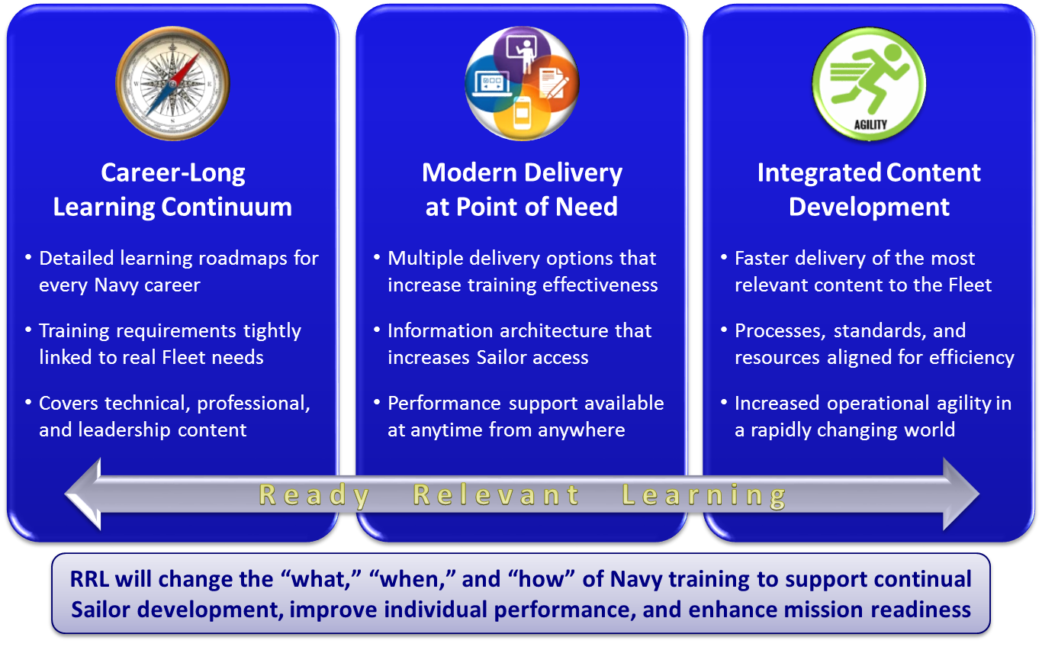
Ready Relevant Learning (RRL)

Slide 11
































RRL Enhanced, Accessible Learning Stage (2018-2025)
Key Outcomes
Information architecture is integrated, and
modernized content is accessible at waterfront
s
Information architecture is integrated, and
modernized content is accessible at waterfront
MPT&E processes managed via an integrated system of databases, and “Learning Stacks” enhance accessibility and speed to enable scheduling, delivery, and tracking of training
Lines of Effort
Forward-deployed Sailors have access to self-directed training, structured OJT, and performance support while pier-side
Career-Long Learning Continuum
Continuum expanded to include
Intermediate and Expert content
Modern Delivery at Point of Need
Enhanced content with multiple
delivery options at waterfront
RTC
Integrated Content Development
Schoolhouse
Processes, standards, and
resources aligned to accelerate
Sailors can access latest digital content for structured OJT and PQS to expand knowledge and skills while pier-side
Sailors can access self- directed training and performance support while pier-side
BUPERS & NAVMAC
Schoolhouse
A-School
Sailors can attend instructor-facilitated training at nearest schoolhouse
Close monitoring of training progress and completion drives relevant MPT&E processes
NETC
Effects  All Training Content is Enhanced and Modernized
Multiple Delivery Options Minimize Operational Impact on Fleet Units

Slide 12


RRL Certification, Governance, Work Structure
Certification and, Assessment
Governance
Integration of Work
RRL Integration Board
Periodicity | Chair | Members | Key Responsibilities
Semi-Annual or as Required | VCNO | CUSFF CNP NAVAIR USFF N1 (Exec. Sec.) | Approves guidance on strategic direction Oversees RRL implementation Resolves seams issues Addresses resource requirements
Lead | Roles and Responsibilities
CUSFF | Certification for Congress Strategic concept development Overall assessment to plan Requirements development Assessment of operational impact on Sailor performance
CNP | MPT&E policy RRL Resource Sponsor Budget and execution
NAVAIR | RRL Training Systems Program Manager Acquisition of RRL training content and supporting hardware systems and devices
USFF N1 | RRL IB Executive Secretary
RRL Executive Steering Committee
Periodicity | Chair / Co-chair | Members | Key Responsibilities
Monthly | USFF N1 CNETC | OPNAV N10 OPNAV N9I NAVAIR Flag/SES (TSPM) USFF N1T (Exec. Sec.) | Reviews program status by phase Reviews Budget execution Reviews efforts to integrate RRL Training requirements into future training systems Reviews implementation of strategic guidance
SECNAV
Work Functions
RRL EA
USFF
Executive Steering Committee
Work Functions
Requirements Development
Course Acquisition/ TSPM
Course Execution/ Delivery
Assessment
Policy, Resources & Communication
Future RS
Lead
USFF/TYCOM | NAVAIR | NETC | USFF/TYCOM | OPNAV N1 | OPNAV N2/6 & N9
Roles and Responsibilities
Defines the what, when, how, and where of RRL Defines afloat IT requirements | Provides acquisition for both course content and hardware Provides TSPM role | Delivers and fields training content and systems Defines shore IT requirements Manages training delivery supply chain and infrastructure | Provides assessment of operational impact on Sailor performance | Provide changes to policy and processes RRL Resource Sponsor Develops and executes coordinated strategic comms plan | Resource Sponsor for TYCOM training requirements
FY-18 NDAA
Each activity is responsible for Budget & Execution of function

Slide 13
Introductions Roles & Responsibilities
Update with Names
Primary POC Role | Secondary POC Role | Responsibility
NAWCTSD <Executing Organization>
IPT Lead Name | Deputy IPT Leads Name | Manage IPT Cost, Schedule, Performance, Risks Provide Status Updates and Track Action Items Schedule meetings, workshops, and deliver deliverables
ISD Lead Name | Name | Oversee Instructional Design Standards and Quality of Analysis deliverables (Briefs, Reports – Alignment, MFRs, TSD, IPRD, IMRD, TPSD, TSFD) Review F2
Rating Coordinator Name | Instructional Systems Specialist Name | Conduct Alignment, Needs Assessment Oversee Contractor Conducting Analysis (Scoping - Training Situation Analysis, Training Task Analysis, Learning Analysis, Media Selection, which includes Site Visits Workshops) Complete Analysis Deliverables (Briefs, Reports – Alignment, MFRs, TSD, IPRD, IMRD, TPSD, TSFD) Review F2
USFFC
Program Analyst Name |  | Attend findings Briefs, Gates Endorse Deliverables (MFRs, Reports)
Notes:
Introduce each player and ask to describe their role.
Validate you have the correct POCs for each category.
List all stakeholders in alignment report.

Slide 14
Introductions Roles & Responsibilities
Primary POC Role | Secondary POC Role | Responsibility
TYCOM
RRL Planner POC Name | Name | Provide access to: Accomplished Performers, Supervisors, Requirements Sponsor, Fleet SMEs for Data Collection GFI Review Findings Briefs and Attend Gates Approve Deliverables (Briefs, Reports – Alignment, MFRs, TSD, IPRD, IMRD, TPSD, TSFD, F2)
SYSCOM
Title Name | Title Name | Review Findings Briefs and Attend Gates Review Deliverables Briefs, Reports (Alignment, MFR, TSD, IPRD, IMRD, TPSD, TSFD, F2)
NETC
N723 Branch Head Name | Instructional Coordinator Name | Attend findings Briefs, Gates Endorse Deliverables (MFRs, Reports) Complete Report – F2
Instructional Systems Specialist Name | Instructional Systems Specialist Name | Review Deliverables Briefs, Reports (Alignment, MFR, TSD, IPRD, IMRD, TPSD, TSFD, F2)
Update with Names
Notes:
Validate you have the correct POCs for each category.
List all stakeholders in alignment report.

Slide 15
Introductions Roles & Responsibilites
Update with Names
Primary POC | Secondary POC | Responsibility
Learning Center / Curriculum Control Authority (CCA)
Executive Director Name | Director of Training Name | Attend findings Briefs, Gates Endorse Deliverables (Briefs, Reports – Alignment, MFRs, TSD, IPRD, IMRD, TPSD, TSFD) Complete Report – F2
LSO Name | Lead Instructional Specialist Name Instructional Systems Specialist Name | Provide Access to: GFI, classes, sites for visits Submarine GFI SMEs for data collection Review and Attend Findings Briefs, Gates Review Deliverables (Briefs, Reports – Alignment, MFRs, TSD, IPRD, IMRD, TPSD, TSFD, F2)
Training Mgr Name | CSS Lead Instructional Specialist Name | SME for data collection collaboration and workshop attendance Review and Attend Findings Briefs, Gates Review Deliverables (Briefs, Reports – Alignment, MFRs, TSD, IPRD, IMRD, TPSD, TSFD, F2)
Notes:
Validate you have the correct POCs for each category.
List all stakeholders in alignment report.

Slide 16
Rating Name Current Training
Accession Level Formal Training
A-School
Add Name
C-School
Add Name
Other
Add Name
Notes:
Discuss your understanding of the current training offered for this community.

Slide 17
Assumptions and Constraints
Update see CS Example
Assumptions
Add content
Constraints
Add content
Notes:
Write any assumptions and constraints gathered from GFI review, stakeholder meetings, one-on-ones, etc.
Add new at meeting

Slide 18
Potential Impacts
Planned or Underway Changes | Impact | Est. Completion Date
Modifications | NA
OCCSTDS | NA
TRR | NA
System | NA
Equipment | NA
Course Content | NA
Other Training Situation | NA
Other | NA
Notes:
Items listed are planned or underway changes that would affect the RRL timeline for Analysis and Content Conversion
Go over the impacts to receive confirmation from the stakeholders

Slide 19
Introductions and Communication Plan
Update with Names
Primary POC | Secondary POC | Responsibility
Learning Site / NTTC
Learning Site POC Name | Name | SME for data collection collaboration and workshop attendance Review and Attend Findings Briefs, Gates Review Deliverables (Briefs, Reports – Alignment, MFRs, TSD, IPRD, IMRD, TPSD, TSFD, F2)
Notes:
Validate you have the correct POCs for each category.
List all stakeholders in alignment report.

Slide 20
Risks and Mitigation
Example, Update Slide
Risk | Mitigation
LC stakeholders availability is limited No LC stakeholders dedicated to RRL | Identify and assign secondary POCs
Missed potential impacts. If the right person is not available or included in the discussion, it doesn’t mean the impact does not exist. | Ensure the right person is present. If not, provide communication to the person who would need to provide a response.
Requested Accomplished Performers (APs) may not be available to participate in the data collection or collaboration | Work around the AP’s schedule to ensure a representative sample data is documented. Request NAVSUP to identify alternate APs.
Notes:
Add any risks indicated before meeting
Update if required at meeting

Slide 21
GFI Received and Needed
Update based on Rating
GFI Received
Add content
GFI Needed
Top 10 issues (identify training or non-training related)
Field commander’s comments
Unit readiness reports
Materiel readiness reports
Audits, inspections, and evaluations
Safety reports
Changes in tactical doctrine
Lessons learned reports, After-Action Reviews (AARs)
Other (please specify)
Notes:
Ask which items is applicable in the GFI needed.
NOTE: The GFI Need for Needs Assessment was requested on 5/31/2022.

Slide 22
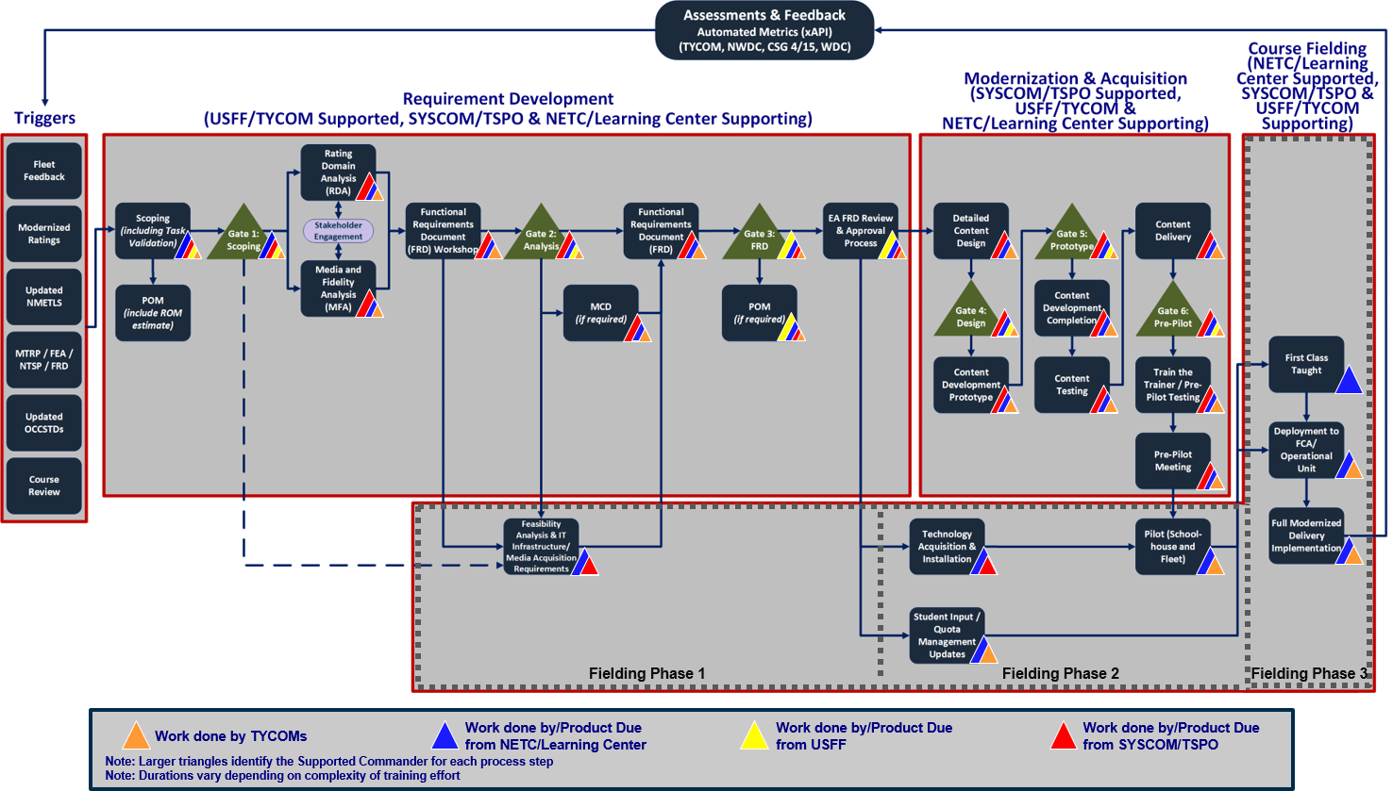
RRL Process Manual Figure 3.2 Modernized Delivery Process
No change
Notes:
Provide a Review of the RRL Requirements Development Analysis Process

Slide 23
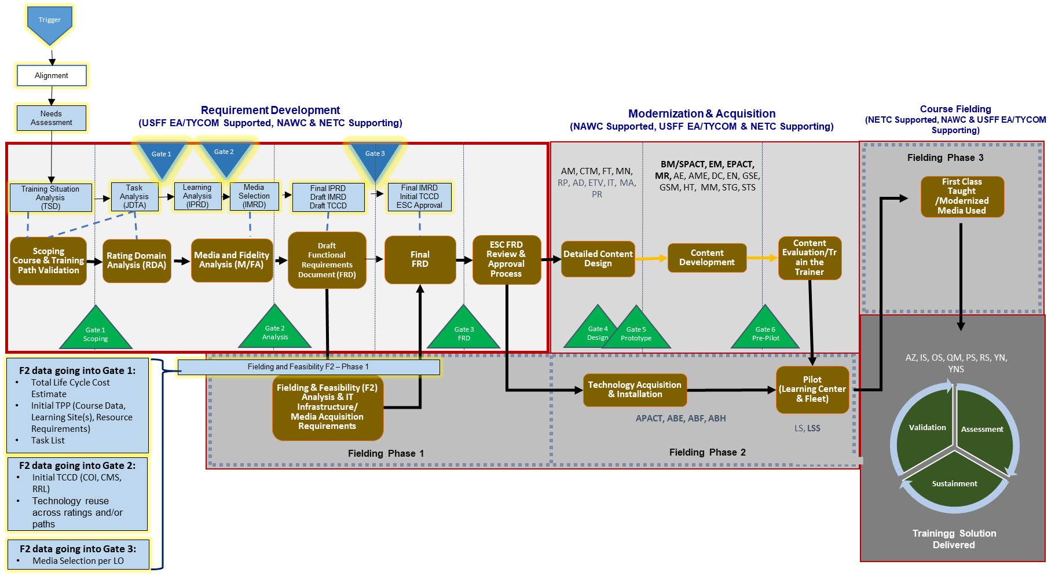
RRL Current and Adjusted Process

Slide 24
RRL Current and Adjusted Process
No change
Current Process (IAW RRL SOP)
Scoping (including Task Validation)
RRL FUNCTIONAL REQUIREMENTS DOCUMENT FRD
Includes the following:
Learning Objectives (TLOs and subordinate ELOs)
Course-Module Grouping
Media Fidelity Data
Media Recommendations (Results)
Complex Media Summary
Rating Domain Analysis
(RDA)
Media and Fidelity Analysis
(MFA) + MCD
DID: DI-SESS-81517
TRAINING SITUATION DOCUMENT
TSD
Used to verify the efficiency of a training system to meet existing training needs and to survey training programs, technologies for applicability to new training need.
DID: DI-SESS-81518:
INSTRUCTIONAL PERFORMANCE REQUIREMENTS DOCUMENT
IPRD
Provides task information (e.g., description, conditions, standards, cues, performance measures), Knowledge, Skills, Attitudes (KSAs) and learning objectives, task attributes (e.g., criticality, frequency, difficulty, probability of error, consequence of error).
DID: DI-SESS-81519
INSTRUCTIONAL MEDIA REQUIREMENTS DOCUMENT
IMRD
Provides specifications for the media selection model used, a description of primary and alternate media requirements, functional requirements for the instructional delivery system.
Adjusted Process
Trigger
Alignment
Needs Assessment
Training Situation Analysis
Task Analysis
Learning Analysis
Media Selection
Courseware / Trainer Acquisition
‘As-is’
‘To-be’ – Scoping, Task Validation, Gap, RDA, MFA
Notes:
Provide a Review of the RRL Requirements Development Analysis Process

Slide 25
RRL Alignment Meeting
No change
DI-SESS-81517
TRAINING SITUATION DOCUMENT
TSD
Used to verify the efficiency of a training system to meet existing training needs and to survey training programs and technologies for applicability to new training need.
DI-SESS-81518:
INSTRUCTIONAL PERFORMANCE REQUIREMENTS DOCUMENT
IPRD
Provides task information (e.g., description, conditions, standards, cues, performance measures), Knowledge, Skills, Attitudes (KSAs) and learning objectives, task attributes (e.g., criticality, frequency, difficulty, probability of error, consequence of error).
DI-SESS-81519
INSTRUCTIONAL MEDIA REQUIREMENTS DOCUMENT
IMRD
Provides specifications for the media selection model used, a description of primary and alternate media requirements, functional requirements for the instructional delivery system.
Trigger
Alignment
Ensures a shared understanding of project scope, schedule, assumptions, constraints, risks mitigations, roles responsibilities to include stakeholders level of effort
Results in a document for concurrence and/or approval by stakeholders
Training Situation Analysis
Task Analysis
Learning Analysis
Media Selection
Courseware / Trainer Acquisition
Needs Assessment
TODAY
Alignment Meeting
Alignment Report
25
Notes:
Provide a Review of the RRL Requirements Development Analysis Process
Trigger:
Direction from higher authority
Mishap
New or revised system
Manpower change
Human Performance Requirements Review (HPRR)
Identified problem
Fleet feedback
Safety Issue
OCCSTD change
ORM factor
Beginnings of gaining a full understanding of the stakeholders needs

Slide 26
RRL Needs Assessment
No change
DI-SESS-81517
TRAINING SITUATION DOCUMENT
TSD
Used to verify the efficiency of a training system to meet existing training needs and to survey training programs and technologies for applicability to new training need.
DI-SESS-81518:
INSTRUCTIONAL PERFORMANCE REQUIREMENTS DOCUMENT
IPRD
Provides task information (e.g., description, conditions, standards, cues, performance measures), Knowledge, Skills, Attitudes (KSAs) and learning objectives, task attributes (e.g., criticality, frequency, difficulty, probability of error, consequence of error).
DI-SESS-81519
INSTRUCTIONAL MEDIA REQUIREMENTS DOCUMENT
IMRD
Provides specifications for the media selection model used, a description of primary and alternate media requirements, functional requirements for the instructional delivery system.
Needs Assessment
Identifies performance gap determines if training is solution
Determines if training is responsibility of RRL Program
=
Decision Point for a rating to move forward into RRL
Trigger
Alignment
Training Situation Analysis
Task Analysis
Learning Analysis
Media Selection
Courseware / Trainer Acquisition
Data gathering meetings, interviews, site visits
Data Review
Needs Assessment findings Outbrief
26
Notes:
Provide a Review of the RRL Requirements Development Analysis Process

Slide 27
RRL Training Situation, Training Task Analysis
No change
DI-SESS-81517
TRAINING SITUATION DOCUMENT
TSD
Used to verify the efficiency of a training system to meet existing training needs and to survey training programs and technologies for applicability to new training need.
DI-SESS-81518:
INSTRUCTIONAL PERFORMANCE REQUIREMENTS DOCUMENT
IPRD
Provides task information (e.g., description, conditions, standards, cues, performance measures), Knowledge, Skills, Attitudes (KSAs) and learning objectives, task attributes (e.g., criticality, frequency, difficulty, probability of error, consequence of error).
DI-SESS-81519
INSTRUCTIONAL MEDIA REQUIREMENTS DOCUMENT
IMRD
Provides specifications for the media selection model used, a description of primary and alternate media requirements, functional requirements for the instructional delivery system.
Trigger
Needs Assessment
Alignment
Training Situation Analysis
Determines training deficiencies and/or deficiencies in RRL Compliance attributes
WHEN – HOW – WHERE
“As Is”
Training Deficiencies
Task
Analysis
Documents job performance requirements:
- Training Task List
-Career Progression Timing (RDA)
-Gaps
Train/No train Decision
Learning Analysis
Media Selection
Courseware / Trainer Acquisition
Site Visit
Data Review
Workshop
Gate 1 Meeting
27
Notes:
Provide a Review of the RRL Requirements Development Analysis Process

Slide 28
RRL Learning Analysis
No change
DI-SESS-81517
TRAINING SITUATION DOCUMENT
TSD
Used to verify the efficiency of a training system to meet existing training needs and to survey training programs and technologies for applicability to new training need.
DI-SESS-81518:
INSTRUCTIONAL PERFORMANCE REQUIREMENTS DOCUMENT
IPRD
Provides task information (e.g., description, conditions, standards, cues, performance measures), Knowledge, Skills, Attitudes (KSAs) and learning objectives, task attributes (e.g., criticality, frequency, difficulty, probability of error, consequence of error).
DI-SESS-81519
INSTRUCTIONAL MEDIA REQUIREMENTS DOCUMENT
IMRD
Provides specifications for the media selection model used, a description of primary and alternate media requirements, functional requirements for the instructional delivery system.
Trigger
Needs Assessment
Alignment
Training Situation Analysis
Task Analysis
Learning Analysis
Using Task Analysis data develop
Learning objectives to support Performance-based training
Instructional strategies for formal training at point of need
Media Selection
Courseware / Trainer Acquisition
Workshop
Data Review
Gate 2 Meeting
28
Notes:
The Learning Analysis is the beginnings of the Design Phase
Steps:
1. Develop LOs. Defines what the trainees need to know and do to perform the training tasks using a performance based training approach. NAWCTSD
2. Categorize LOs by learning type (knowledge, skill, and attitudes) and learning level (ex: fact learning, problem solving, etc (Bloom’s)).
3. Construct the learning analysis hierarchies to depict the relationship of LOs for the most effective and efficient learning sequence. Determines sequence, cluster, hierarchy, and prioritization of learning objectives across SEA1. Includes:
a. Classification (TLO, ELO)
b. Prioritization to recommend training that is most critical
c. Clustering to develop logical and meaningful portions of training such as units, lessons, or segments
d. Sequencing
4. Identify the prerequisite requirements
5. Determine instructional strategies to manage design of training activities and the learning process. Includes:
a. Strategy for student participation
b. Student feedback strategies
c. Student pacing strategies
d. Instructional sequence
6. Determine instructional methods

Slide 29
RRL Media Selection
No change
DI-SESS-81517
TRAINING SITUATION DOCUMENT
TSD
Used to verify the efficiency of a training system to meet existing training needs and to survey training programs and technologies for applicability to new training need.
DI-SESS-81518:
INSTRUCTIONAL PERFORMANCE REQUIREMENTS DOCUMENT
IPRD
Provides task information (e.g., description, conditions, standards, cues, performance measures), Knowledge, Skills, Attitudes (KSAs) and learning objectives, task attributes (e.g., criticality, frequency, difficulty, probability of error, consequence of error).
DI-SESS-81519
INSTRUCTIONAL MEDIA REQUIREMENTS DOCUMENT
IMRD
Provides specifications for the media selection model used, a description of primary and alternate media requirements, functional requirements for the instructional delivery system.
Media Selection
Leveraging Training Situation, Task, and Learning Analyses provide:
Instructional Strategies preliminary Performance-based training supported by media recommendations for training objectives that require modernization and / or new learning objectives
Trigger
Needs Assessment
Alignment
Training Situation Analysis
Task Analysis
Learning Analysis
Courseware / Trainer Acquisition
Workshop Preliminary Design
Data Review
Gate 3 Meeting
Completion of Requirements Development move to Courseware Trainer Acquisition
29
Notes:
Media Analysis
1. Identify instructional concept and course and lesson strategy.
2. Identify sensory stimulus requirements for each LO:
a. Visual
b. Tactile
c. Olfactory
d. Affective
e. Auditory
3. Identify sensory stimulus features for all available media.
4. Match the sensory stimulus requirements with the sensory stimulus features to identify a candidate list of media.
5. Select the media delivery format based on resource constraints, classroom logistics, and all other relevant considerations.

Slide 30
Summary Requirements Deliverables
No change
Executing Organization
Alignment Report
Needs Assessment Findings Outbrief
Analysis and Media Selection
“As Is” - Current Training Situation - Training Situation Report (TSD)
“To Be” - Recommended Training
Training Tasks
Learning Objectives (LOs)
Gaps
RDA
Initial Instructional Design with supported Media/Training Devices/Alternatives i.e. equipment - Instructional Media Requirements Document (IMRD), Training Program Structure Document (TPSD), Training System Functional Document (TSFD)
NETC
Total Life Cycle Cost Estimate (TLCE)
Fielding and Feasibility (F2)
Instructional Performance Requirements Document (IPRD)
Notes:
Summarize the previous slide deliverables

Slide 31
RRL Requirements Process
No change
Requirements Development Steps
MODERNIZATION
& ACQUISITION
(Executing Organization Supported, USFF EA/TYCOM & NETC Supporting)
STEP 1
STEP 3
STEP 5
STEP 2
STEP 4
Trigger
Defer to Appropriate Entity
Gate
1
Gate
2
Gate
3
No
TODAY Alignment
Meeting
Needs Assessment
RRL Intervention
?
Analysis Meeting PAC/KOM
Training Situation Analysis
Task Analysis
Learning Analysis
Media Selection
Yes
Fielding and Feasibility Analysis (F2)
Training Project Plan (TPP)
TODAY
Current Training Situation ‘As-Is’
‘Scoping – Tasks, Gap, RDA’
‘To-Be’ - MFA
INPUT
Trigger
INPUT
Alignment Document
INPUT
Needs Assessment Brief and Collected Data
INPUT
Final IPRD
INPUT
TSD
Initial IPRD
INPUT
Final TSD,
IPRD, IMRD, F2
Initial TCCD
OUTPUT Alignment Report
for Approval
OUTPUT
Needs Assessment Findings Outbrief
for Approval
OUTPUT
Training Situation Document (TSD)
Instructional Performance Requirements Document (IPRD)
Briefs
for Approval
OUTPUT
Final IPRD
and
Brief
for Approval
OUTPUT:
Final IMRD, F2 Initial TCCD, and
Brief
for Approval
OUTPUT:
IMI
Complex Media
Curricula Materials
USFF EA / TYCOM Supported – Executing Organization, NETC (LC/LS), SYSCOM Supporting
Notes:
Explain at Step 1 TODAY
Explain that they are in the Alignment Meeting. Inputs and Output.
Inform the Stakeholders that NETC will be sending out an updated Process Map with micro details. This is high level.
Inform stakeholders the next step is Needs Assessment following the Alignment meeting. Move to next slide
Explain that the TSA, Task Analysis, Learning Analysis, and Media Selection will be performed by a contractor. NAWCTSD will perform the contract oversight.

Slide 32
RRL Requirements Process cont.
No change
Requirements Development Steps
MODERNIZATION
& ACQUISITION
(Executing Organization Supported, USFF EA/TYCOM & NETC Supporting)
STEP 1
STEP 3
STEP 5
STEP 2
STEP 4
Trigger
Defer to Appropriate Entity
Gate
1
Gate
2
Gate
3
No
TODAY Alignment
Meeting
Needs Assessment
RRL Intervention
?
Analysis Meeting PAC/KOM
Training Situation Analysis
Task Analysis
Learning Analysis
Media Selection
Yes
Fielding and Feasibility Analysis (F2)
Training Project Plan (TPP)
TODAY
Current Training Situation ‘As-Is’
‘Scoping – Tasks, Gap, RDA’
‘To-Be’ - MFA
INPUT
Trigger
INPUT
Alignment Report
INPUT
Needs Assessment Brief and Collected Data
INPUT
Final IPRD
INPUT
TSD
Initial IPRD
INPUT
Final TSD,
IPRD, IMRD, F2
Initial TCCD
OUTPUT Alignment Report
for Approval
OUTPUT
Needs Assessment Findings Outbrief
for Approval
OUTPUT
Training Situation Document (TSD)
Instructional Performance Requirements Document (IPRD)
Briefs
for Approval
OUTPUT
Final IPRD
and
Brief
for Approval
OUTPUT:
Final IMRD, F2 Initial TCCD, and
Brief
for Approval
OUTPUT:
IMI
Complex Media
Curricula Materials
USFF EA / TYCOM Supported – Executing Organization, NETC (LC/LS), SYSCOM Supporting
Notes:
In Step 2 Needs Assessment we will be determining the “As Is” state with recommendation for improvement.
Needs Assessment Findings Outbrief will be provided for approval

Slide 33
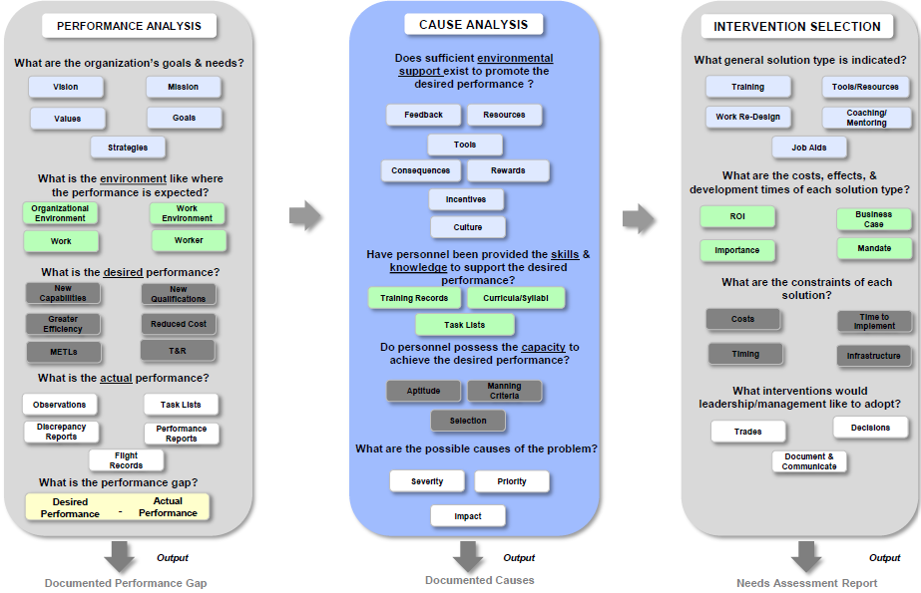
STEP 2 - Need Assessment Process
No change
Performance Gaps
Root
Causes
Needs Assessment Meeting Brief TYCOM Decision Approval
Notes:
Step 2 – Needs Assessment Process
First conducted is the Performance Analysis
Organizational Goals and Needs – documents the desired or direction of the organization and document the standards for desired or optimal performance.
Organizational Environment – documents how the performer is interacting with external stakeholders, customers, suppliers, distributor, regulators, etc.
Work Environment – measure how the environment influences and critical factors to achieve desired performance (e.g., manpower, time, tools, job aids, materiels, equipment, space, performance feedback).
Work – measures effectiveness and efficiency of the job design (e.g., processes, procedures, responsibilities, ergonomics)
Worker – measures the skill, knowledge, capacity, motivation, and expectations to achieve optimal performance.
Second is the Cause Analysis
Final stage is the Selection of the appropriate Intervention
We will need you engagement throughout the process as well as decision and approval at the Needs Assessment Meeting to proceed with RRL. TYCOM is the approval authority.

Slide 34
Schedule
Update based on Rating
Alignment
Conduct Alignment Meeting: Day Month Year - TODAY
NAWCTSD document Report: Day Month Year
Stakeholders review Alignment Report: Day-Day Month Year
TYCOM provides Alignment Report Approval: Day Month Year
Needs Assessment – Kick Off - TODAY
NAWCTSD review GFI and collaborate with stakeholders for data collection
NAWCTSD conduct Performance and Cause Analyses data collection site visits, interviews: Day-Day Month Year. If required, Day-Day Month Year
NAWCTSD develop Needs Assessment Brief: Day Month Year
Stakeholders review Needs Assessment Brief: Day-Day Month Year
NAWCTSD implements comments to Needs Assessment Brief: Day Month Year
NAWCTSD conduct Needs Assessment Meeting. Stakeholders participate for concurrence of findings. TYCOM provides decision on RRL continuance: Day Month Year
TYCOM provides Needs Assessment Brief and MFR Approval: Day Month Year
Notes:
We already received concurrence at the weekly CS/CSS – please look at them at your leisure.

Slide 35
Action Items
Update based on Rating
A=Alignment Meeting for Configuration Management
# | Action Item | Assigned To | Start - Due Date
A1
A2
A3
A4
A5
Notes:
Review the Action Items. Ensure you get POCs and commitment or Est completion.

Slide 36
Next Steps
Update based on Rating
Update Schedule with Alignment Meeting Stakeholder Input
Send out Alignment Meeting Report
Send out MS Teams
Recurring status updates – Weekly, Day 0000 EST
Learning Site and Fleet Site Visits – Day-Day Month Year
Needs Assessment Outbrief Decision Meeting – Day Month Year
RRL Flankspeed site: https://flankspeed.sharepoint-mil.us/sites/MYNAVYHR-RRL
Notes:
Discuss the Way Ahead

Slide 37
Questions

