Slide 1
TIME LIMIT:
40 minutes
Topic; Interpreting, analysing, evaluating.
Lesson Title:
Imaginative And Informative
Student Subject and Grade:
Literature & Literacy -
Kindergarten
Curriculum alignment:
ACELY1648
Learning Objective:
Students should be able to identify differences between imaginative and informative texts.
Property of OA4E©

Slide 2
TIME LIMIT:
40 minutes
Lesson sequence
The lesson will begin by Introducing the topic.
Teacher gauges prior knowledge of students by asking everyday questions about the topic or revising a previous lesson.
Teacher explains topic using powerpoint /video.
Teacher further demonstrates topic using worked examples from simplest to hardest level of difficulty.
Teacher gauges student understanding.
Students attempt further tasks as a group/individually as teacher observes.
Teacher recognises student comprehension then summarises topic.
Student complete follow up worksheets in class or as homework.
Property of OA4E©

Slide 3
Imaginative And Informative Texts
Introduction
Do you know the differences between imaginative and informative texts?
Imaginative texts
Also called fiction
Imaginative texts are made up. It is a story that is not real.
Informative texts
Also called nonfiction
Informative texts are based on real life. They are true and based on facts.
Property of OA4E©
Notes:
https://cdn.pixabay.com/photo/2015/07/27/20/16/book-863418__340.jpg

Slide 4
Imaginative and Informative Texts
Is this story imaginative or informative?
Elliot The Elephant
Property of OA4E©
Notes:
https://cdn.pixabay.com/photo/2018/07/09/17/44/baby-elephant-3526681__340.png

Slide 5
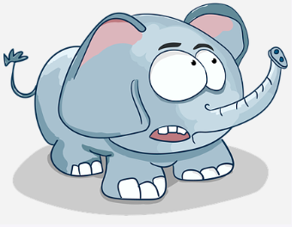
Imaginative and Informative Texts
Is this story imaginative or informative?
Elliot The Elephant
Property of OA4E©
Notes:
https://cdn.pixabay.com/photo/2017/02/13/16/36/elephant-2063065__340.png
https://pixabay.com/vectors/elephant-animal-jungle-savannah-1598359/
https://cdn.pixabay.com/photo/2016/03/31/19/31/elephant-1295085__340.png

Slide 6
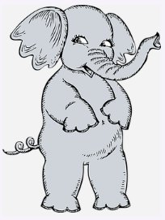
Imaginative and Informative Texts
Is this story imaginative or informative?
Elliot The Elephant
Property of OA4E©
Notes:
https://cdn.pixabay.com/photo/2012/04/12/21/22/elephant-30698__340.png

Slide 7
Imaginative and Informative Texts
Is this story imaginative or informative?
Elliot The Elephant
Property of OA4E©
Notes:
https://pixabay.com/vectors/elephant-animal-zoo-happy-smiling-159987/

Slide 8
Imaginative and Informative Texts
Is this story imaginative or informative?
Is this story imaginative or informative?
How do you know? What clues did the story give you to tell you what kind it was?
Was Elliot an imaginative or informative character? Explain.
What was Elliot’s problem in the story?
Are the events that happened in the story imaginative or informative?
What is the setting?
Is the setting imaginative or informative? Explain.
Property of OA4E©
Notes:
https://cdn.pixabay.com/photo/2013/07/12/14/44/elephant-148704__340.png

Slide 9
Imaginative and Informative Texts
Is this story imaginative or informative? Answers to questions.
This story imaginative.
How do you know? What clues did the story give you to tell you what kind it was?
Elliot was an imaginative or made up character.
Elliot’s problem in the story was his fear of being left by his family.
The events that happened in the story are imaginative.
The setting is imaginative in an imaginary place.
Property of OA4E©
Notes:
https://cdn.pixabay.com/photo/2013/07/12/14/44/elephant-148704__340.png

Slide 10
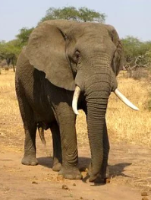
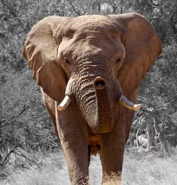
Imaginative and Informative Texts
Is this story imaginative or informative?
African Elephants
Property of OA4E©
Notes:
https://cdn.pixabay.com/photo/2013/05/29/22/25/elephant-114543__340.jpg
https://cdn.pixabay.com/photo/2013/02/21/10/37/elephant-84186__340.jpg

Slide 11
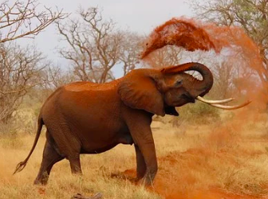
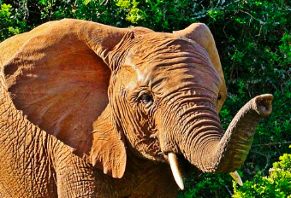
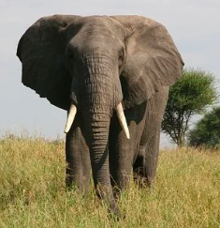
Imaginative and Informative Texts
Is this story imaginative or informative?
African Elephants
Property of OA4E©
Notes:
https://cdn.pixabay.com/photo/2013/05/17/07/12/elephant-111695__340.jpg
https://cdn.pixabay.com/photo/2017/02/03/16/36/elephant-2035481__340.jpg

Slide 12
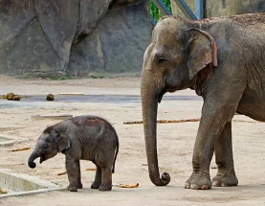
Imaginative and Informative Texts
Is this story imaginative or informative?
Is this story imaginative or informative?
How do you know? What clues did the story give you to tell you what kind it was?
Was there a named character in the story? Explain.
Was there a problem in the story?
Were there any facts in this story? Explain.
How is the story “Elliot the Elephant” different than “African Elephants”? Explain.
Property of OA4E©
Notes:
https://cdn.pixabay.com/photo/2017/07/07/12/23/elephant-2481332__340.jpg

Slide 13
Imaginative and Informative Texts
Is this story imaginative or informative?
This story was informative.
There were many facts in this story.
The story took place in the real world, using real animals characters.
Property of OA4E©
Notes:
https://cdn.pixabay.com/photo/2017/07/07/12/23/elephant-2481332__340.jpg

Slide 14
Gauge student understanding.
Questions
1. What are imaginative texts?
2. What are informative texts?
3. Is “Elliot The Elephant” imaginative or informative? Is “African Elephants” imaginative of informative?
Approximately 2 minutes
Property of OA4E©

Slide 15
Check-up Time!
What are imaginative texts?
Property of OA4E©

Slide 16
Check-up Time!
What are informative texts?
Property of OA4E©

Slide 17
Check-up Time!
How are imaginative and informative texts different?
Property of OA4E©

Slide 18
Gauge student understanding.
Discussions
1. Imaginative texts are made up.
2. Informational texts contain facts and are real.
3. “Elliot The Elephant” is imaginative and “African Elephants” is informative.
Approximately 2 minutes
Property of OA4E©

Slide 19
Student Exercise
Name some other imaginative texts?
HINT: Another word for this is fiction.
Property of OA4E©
Notes:
https://cdn.pixabay.com/photo/2016/10/09/17/27/fake-1726362__340.jpg

Slide 20
Student Exercise
Name some informative texts?
HINT: Another word for this is nonfiction.
Property of OA4E©
Notes:
https://cdn.pixabay.com/photo/2016/08/20/09/46/magnifying-glass-1607160__340.jpg

Slide 21
Student Exercise
Out of the two stories you listened to, which one had imaginary characters?
HINT:
The first story was “Elliot the Elephant” and it was about a little elephant who had to leave his family. The second story was “African Elephants” and contained information about African elephants.
Property of OA4E©
Notes:
https://cdn.pixabay.com/photo/2017/01/31/14/45/lips-2024681__340.png

Slide 22
Summarise topic.
Summarise the topic and explanation previously provided information to check if students have understood the concepts.
1. Imaginative texts are made up.
2. 2. Informational texts contain facts and are real.
3There are several types of imaginary texts and informational texts.
Approximately 2-5 minutes
Property of OA4E©

Slide 23
Discussion or Worksheet questions can be completed online or printed for homework.
9. What was Elliot’s problem in the story “Elliot The Elephant”?
10. What was Elliot’s solution to his problem in the story “Elliot The Elephant”?
11. Why did Elliot have to leave his mother and other family members in the story “Elliot The Elephant”?
12. What is a fact you learned from the text “African elephants”?
13. What is another fact you learned from the text “African elephants”?
14. How are both passages similar?
15. How are the passages different?
16. Look at the images for both stories. Which ones are imaginative and which ones are informative?
Property of OA4E©

Slide 24
Answers to discussion worksheets.
9. Elliot’s problem was that he had to leave his herd and become a man.
10. Elliot left and found his own herd.
11. All male elephants at that age must leave and start their own herd.
12. I learned that the end of their trunk works like fingers.
13. Elephants spray dirt on themselves to keep the bugs away and to stay war during Thanksgiving.
14. The passages are similar because they are both about elephants and both about the male elephant needing to leave.
15. One passage is fictional and the other contains all facts.
16. The images for “Elliot The Elephant” are fake. The images for “African Elephants” are of real elephants.
Property of OA4E©

Slide 25
CONGRATULATIONS
You have completed the topic.
Images provided by Pixabay.com
Property of OA4E©

Slide 26
Not for reproduction. Property of OA4E©

