Slide 1
TIME LIMIT:
40 minutes
Measuring periods
Student subject and grade
Curriculum alignment: ACMMG021
Learning Objective: Students learn about describing and ordering duration of events
Not for reproduction. Property of OA4E©

Slide 2
TIME LIMIT:
40 minutes
Lesson sequence
The lesson will begin by Introducing the topic
Teacher gauges prior knowledge of students by asking everyday question on topic or revising a previous lesson.
Teacher explains topic using PowerPoint /video
Teacher further demonstrates topic using worked examples from simplest to hardest level of difficulty.
Teacher gauges student understanding.
Students attempt further tasks as a group/individually as teacher observes.
Teacher recognises student comprehension then summarises topic.
Student complete follow up worksheets in class or as homework.
Not for reproduction. Property of OA4E©

Slide 3
Introduction
Think and make assumptions, when do you usually do the listed activities?
Going skiing
Collecting colorful leaves
Going to school
Swimming in the sea
Having holidays
Approximately 5 minutes.
Not for reproduction. Property of OA4E©

Slide 4
Explanation
seconds
Seconds
add up to minutes;
minutes
create hours;
hours
add up to days;
days
create weeks;
weeks
create months
minutes
hours
days
weeks
months
Approximately 10 minutes.
Not for reproduction. Property of OA4E©

Slide 5
Working demonstration
minutes
seconds
. . . . . .
1 hour
Not for reproduction. Property of OA4E©

Slide 6
Working demonstration
1 month
week
days
hours
. . . . . .
. . . . . .
Not for reproduction. Property of OA4E©

Slide 7
Gauge student understanding.
Ask three questions regarding explanation previously provided to check if students have understood the concepts.
1. Which one is longer month or a week?
2. What is the relation between seconds and hours?
3. Are couple of minutes more than an hour?
Approximately 2 minutes
Not for reproduction. Property of OA4E©

Slide 8
Gauge student understanding.
Discuss the three questions regarding explanation previously provided to check if students have understood the concepts.
1. Discuss the connection between hours and months.
2. Sort the following periods from the shortest one to the longest: day, second, month, week.
3. Sort by descending length: year, minutes, months, days.
Approximately 2 minutes
Not for reproduction. Property of OA4E©

Slide 9
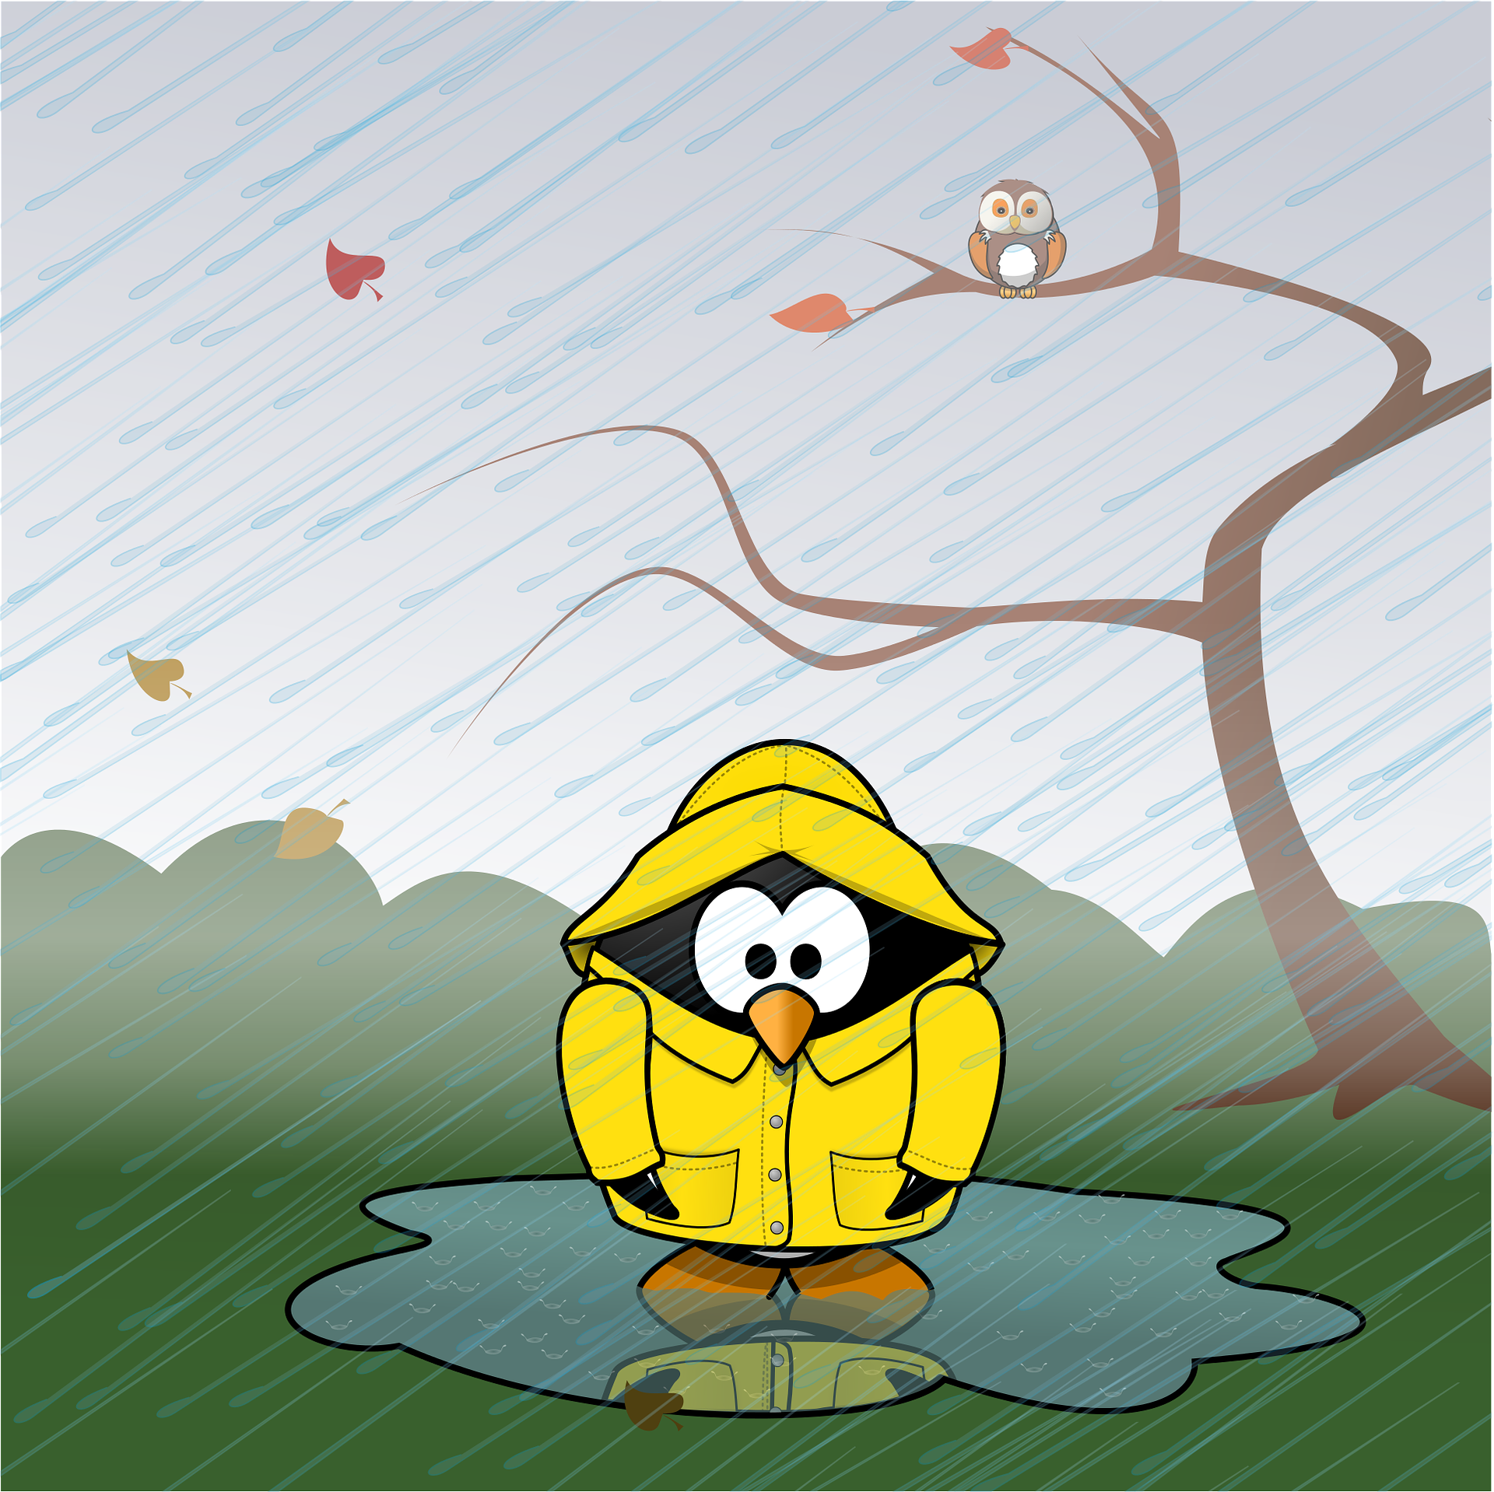
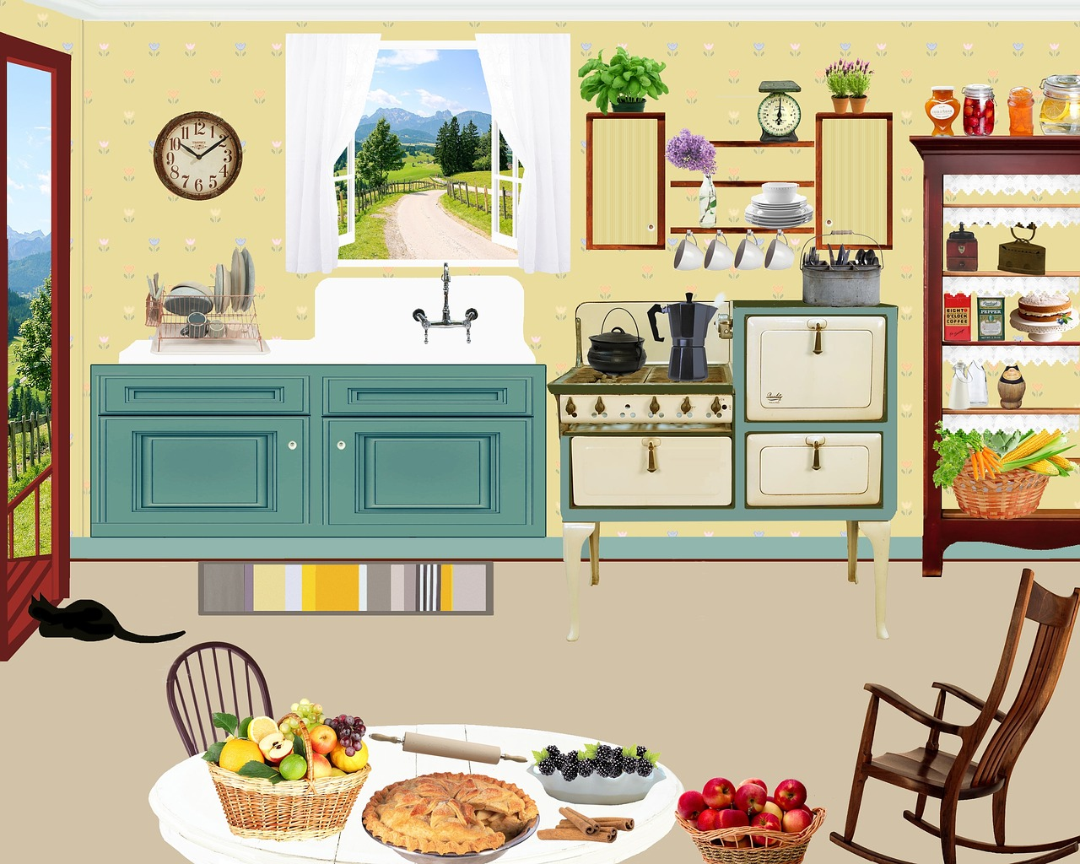
Your turn…
Student Excercise.1. Easy level.
Group the activities and events shown in the picture according to what period of time they take
Approximately 2 minutes.
autumn
winter
School lesson
Running exercise
hours
seconds
minutes
days
weeks
months
cooking
Note: https://pixabay.com/vectors/soccer-girl-play-run-enthusiasm-311157/; https://pixabay.com/illustrations/wintry-house-tree-winter-snow-2915190/; https://pixabay.com/vectors/animal-autumn-calendar-cold-fall-1293883/
Not for reproduction. Property of OA4E©

Slide 10
Your turn…
Student Excercise.1. Mid level.
Sort the events beginning with the one that starts the soonest and ending with the one which starts the latest.
A movie in an hour
Favorite TV show in 15 minutes
Summer in a month
Football championship in a week
Lesson in an hour
Approximately 2 minutes.
Not for reproduction. Property of OA4E©

Slide 11
Summarise topic.
Summarise the topic and explanation previously provided information to check if students have understood the concepts.
1. The relation among seconds, minutes and hours.
2. The relation among hours, days, weeks and months.
3.
Approximately 2-5 minutes
Not for reproduction. Property of OA4E©

Slide 12
Work sheets to be completed online or printed for homework.
Decide if the statement is true or false: | 7. There are several hours in a day
1. Weeks contain months. | 8. Tom’s birthday is in one month and Kelly’s birthday is in a week. Whose birthday is sooner?
2. Weeks contain days. | 9. Mom got back from a vacation a week ago. Dad got back from the vacation 3 weeks ago. Who returned more recently?
3. Hours add up to days. | 10. Neil’s lesson starts in 15 minutes. Lily’s lesson starts in an hour. Who is in more hurry?
4. Month is longer than a week | 11. Susan’s granddaughter lives 2 hours drive away. Her grandson lived 1 hour drive away. Who lives closer?
5. Day is shorter than an hour | 12. Ana’s plant needs 1 week to grow flowers, Mary’s plant needs 1 month. Who will have flowers sooner?
6. 2 months are longer than 3 days
Not for reproduction. Property of OA4E©

Slide 13
Answers to work sheets.
1. False | 7. True
2. True | 8. Kelly’s birthday is sooner.
3. True | 9. Mom returned more recently.
4. True | 10. Neil is in a hurry more than Lily is.
5. False | 11. Grandson lives closer.
6. True | 12. Ana’s will have flowers sooner
Not for reproduction. Property of OA4E©

Slide 14
CONGRATULATIONS
You have completed the topic.
Images provided by Pixabay.com Not for reproduction. Property of OA4E©

Slide 15
Not for reproduction. Property of OA4E©

