Slide 1

Please visit: Quetzallitheauthor.com
In an effort to save paper, all publications used in the presentation as well as a copy of the PowerPoint can be found on my website, quetzallitheauthor.com. Thank you!

Slide 2
SUSAN ZIMMERMAN OROZC0
Back to Basics:
Rhetorical Forms for Jumpstarting Works of Non-Fiction
Articles –But Not News: WWWWWH
Essays
Substack
Memoirs
Notes:
Presentation inspired by Substack.
Copywright ussues of exampes…looked to my own. Oooops

Slide 3
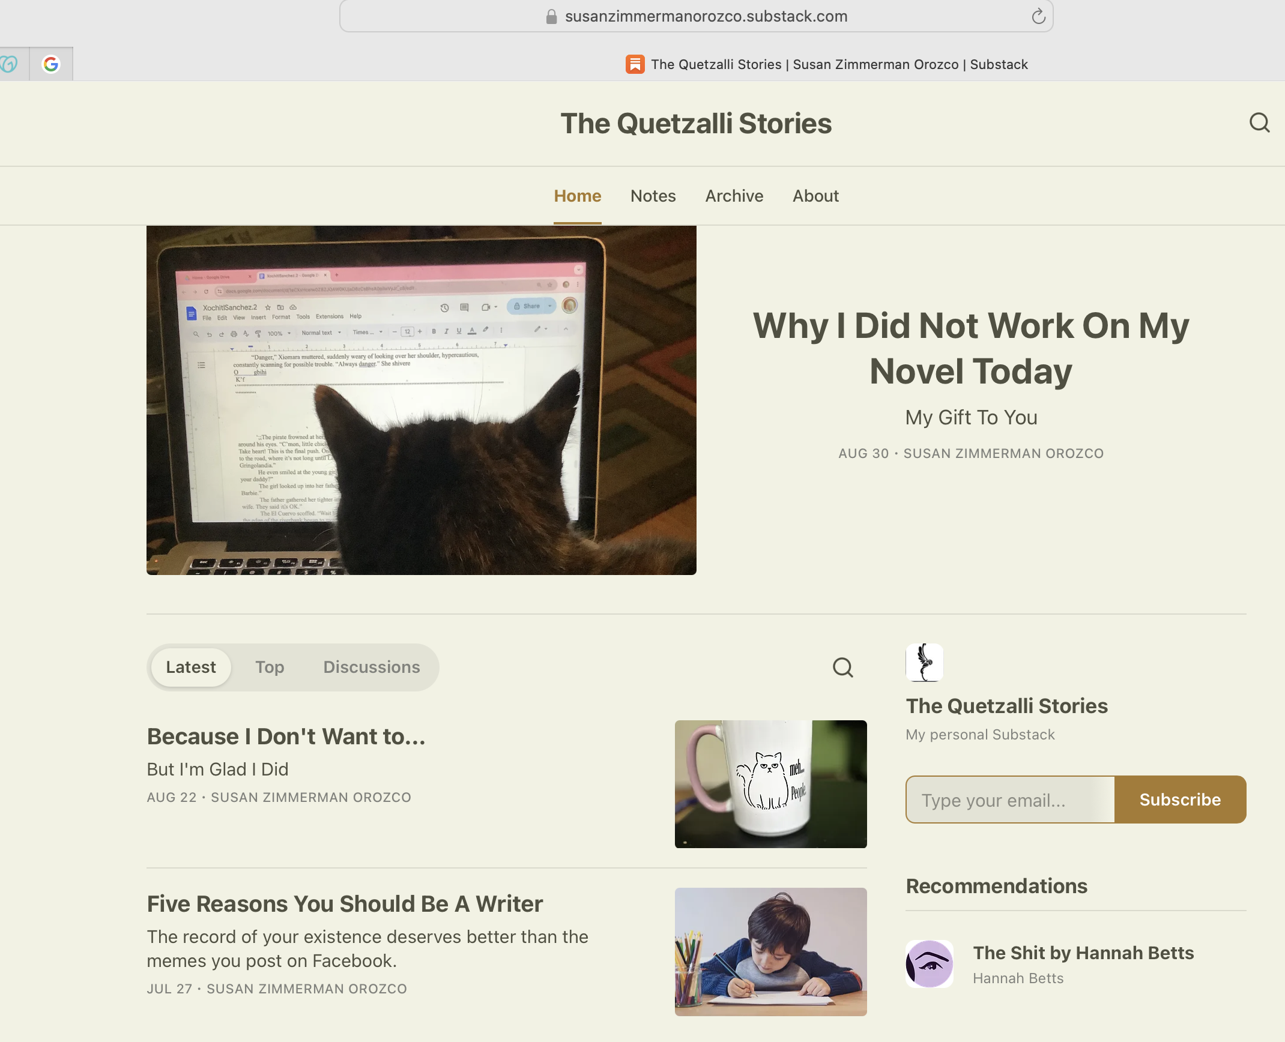
Quetzalli
Quetzalli
Susanzimmermanorozco.com
Notes:
Linjk to Sub stack
Looking for examples, first thought of many excellent substacks, but…permission
Checked, and my own substack sucked., could have benefgited from the things I talk about here.

Slide 4
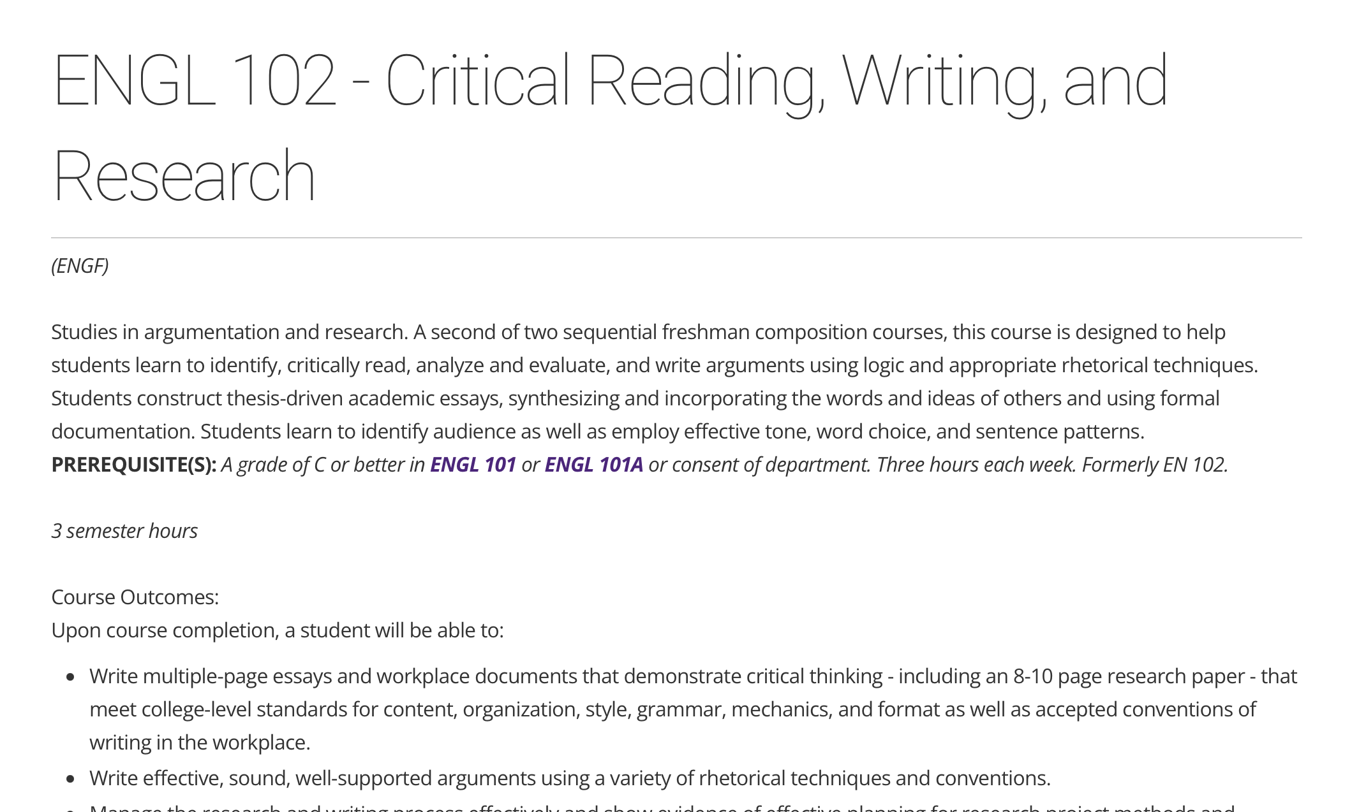
Upon course completion, a student will be able to:
Write multiple-page essays and workplace documents that demonstrate critical thinking - including an 8-10 page research paper - that meet college-level standards for content, organization, style, grammar, mechanics, and format as well as accepted conventions of writing in the workplace.
Write effective, sound, well-supported arguments using a variety of rhetorical techniques and conventions.
Notes:
Reminded of EN102
At beginning, pre-courxe examples, lots of good ideas, use of anguage, grammar, but hard to follow and MEH
Final essay, passed the course based on ratings by two independent instructors.
What happened?

Slide 5

x
Picture credit: LisaSieverts.com
Notes:
Had success writing fgeature type articles beginning at age 16, newspaper, local pub,icatiko s: Gazette, Mexico Exoatriot pb,ucations
My method..topic, intro, ending, write to the e nd.
But headtwitch=u nmany rewrites to make orderout olf chaos
PLANNER

Slide 6
Structuring the Essay
Introduction
Hook
Background
Statement or situation that alludes to the content/purpose
Body
Reason 1
Reason 2
Reason 3
Conclusion
An anecdote or example that relates back to your Introduction
Importance of topic
Strong closing statement – “Ahha!” or “Awww” or “Yes!”

Slide 7
Rhetorical Forms
Chronological Order: Arranging information based on a timeline, ideal for historical events or processes that unfold over time.
Order of Importance: Presenting points from most important to least important, useful when prioritizing
Compare and Contrast: Analyzing similarities and differences between two or more subjects.
Problem-Solution: Identifying a problem and then proposing solutions, often used in persuasive essays
Spatial/descriptive
Cause-and-Effect: Examining the causes of an event and its subsequent effects, often most important to least.
How to…do something.
Notes:
How-to: Recipe articles that only get to recipe at the end. See, New York Times

Slide 8
Introductions and Conclusions
“You had me at hello.”
Alternately,
“Grab them by the .”
Censored

Slide 9

https://ascd.org/el/articles/border-kids-in-the-home-of-the-brave#

Slide 10
Introduction
Hook
Background
Statement or situation that alludes to the content/purpose
Begin with:
Anecdote
Statistics/ fun fact
Quotes
Scenario/intense description

Slide 11
Standard Introduction that you learned in high school
Nationally, educators have had difficulty educating the wave of unaccompanied minors who are coming across the United States' southwest border. Teachers have no experience teaching these students because they are often uneducated in their own countries and don’t speak English. Fortunately, schools and the students themselves have found creative ways to succeed despite the challenges.

Slide 12
“Border Kids in the Land of the Brave”
When 8-year-old Nelson Rivera arrived at Mills-Parole Elementary School in Annapolis, Maryland, this fall, he spent the first day of class crying. Later in the year, at ease and among friends in the classroom, Nelson was able to explain the story behind his tears:
I was crying because of the color of the school, the walls; it's the same color as the cell where I was in jail. I was afraid they were going to lock me up again and never let me out.
More and more educators have been scrambling to educate the wave of unaccompanied minors like Nelson who have flowed across the United States' southwest border. Many of these "border kids" are being resettled in areas as far-flung as New Hampshire and South Carolina, where services for English language learners (ELLs) may be minimal or new.
Notes:
Begin with
Anecdote
Statistics/ fun fact
Quotes
Scenario/intense description
Derscriptoive set the scene

Slide 13
Conclusion
An anecdote or example that relates back to the Introduction
Importance of topic
Strong closing statement – “Aha!” or “Aww” or “Yes!”
Strong closing – “Aha!” or “Aww” or “Yes!”
Notes:
Started writing for pybliceuatio associaton reseqrch publications
Subsunmmed by popular I nternational publication
Started teaching:
Submitted nfeatures to Ed Leadership
Why mind were accepted

Slide 14
Schools have met the challenge of educating unaccompanied minors in many ways. For example, they co-teach with ESOL or bilingual teachers, group students with other students who speaks their language, and encourage them to make friends. The youngest children adapt quickly, but even teens can be motivated to graduate and go on to college.
In the fall of 2014, as I was interviewing students for this article, there was an undertone of hostility among media reports about "those children" who were massing at our borders and apparently demanding to be taken in, fed, clothed, and educated. The older students I interviewed were keenly aware of that sentiment, sensitive to it, and eager to prove their desire to become productive citizens. …I explained that the closing words of the U.S. national anthem proclaim that we are "the land of the free and the home of the brave." Surely their courage and yearning to be free are the embodiment of these fundamental American values.

Slide 15
Five Reasons you, Too, Should Be a Writer
5 Reasons
Introduction
…If the fun of writing has been sucked dry from your life, I want to restore it. There is no one else in the world like you. Write the best-selling story of your life! So my present to you is this , 5 reasons you should start writing:
Closing
Excuse me. Why are you still staring at this page? Get writing!

Slide 16
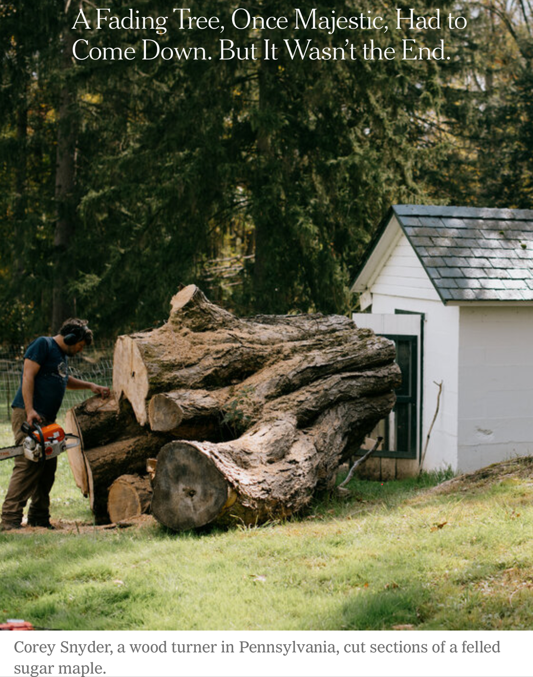
A Fading Tree
By Darlyn Brewer Hoffstot
Photographs by Kristian Thacker
New York Times, 10/16/2024
https://www.nytimes.com/2024/10/16/climate/sugar-maple-tree-pennsylvania.html?smid=nytcore-ios-share&referringSource=articleShare
A Fading Tree

Slide 17
Introduction
“When you live a long time with trees, they become part of you.”
Conclusion
“The birds that once called the old maple home have had to move on, to sing elsewhere. So must I.”

Slide 18
Organization

Slide 19
Rhetorical Forms
Chronological Order: Arranging information based on a timeline, ideal for historical events or processes that unfold over time.
Order of Importance: Presenting points from most important to least important, useful when prioritizing
Compare and Contrast: Analyzing similarities and differences between two or more subjects.
Problem-Solution: Identifying a problem and then proposing solutions, often used in persuasive essays
Spatial/descriptive
How to do something
Cause-and-Effect: Examining the causes of an event and its subsequent effects, often most important to least.

Slide 20
Compare and Contrast
Intro
Point 1 A
Point 1 B
Point 2A
Point 2B
Point 3A
Point 3B
Conclusion
Intro
Point 1 A
Point 2A
Point 3A
Point 1B
Point 2B
Point 3B
Conclusion
OR

Slide 21
Autumn is the best season!
Compare and Contrast
Point 1 A
Point 2A
Point 3A
Point 1B
Point 2B
Point 3B
Introduction
Point 1A
Point 1B
Point 2A
Point 2B
Point 3A
Point 3B
Sports
Sports!
Parents stretched thin with kids’ sports
Leaves/weather
Holidays/Events
Leaves/weather
OR
Leaves fall, grey days, sad scenery
Parents stretched thin with kids’ sports
Holidays/Events
Leaves fall, grey days, sad scenery
Nostalgia, winter is coming
Nostalgia, winter is coming
Conclusion

Slide 22

‘
Just Do It!
Compare & Contrast
INTRO: Social media has been both a blessing and a curse for authors.
POINT 1A
POINT 2A
POINT 2A
POINT 2B
POINT 3A
POINT 3B
CONCUSION:

Slide 23
/
QUETZALLITHEAUTHOR.COM

