Slide 1
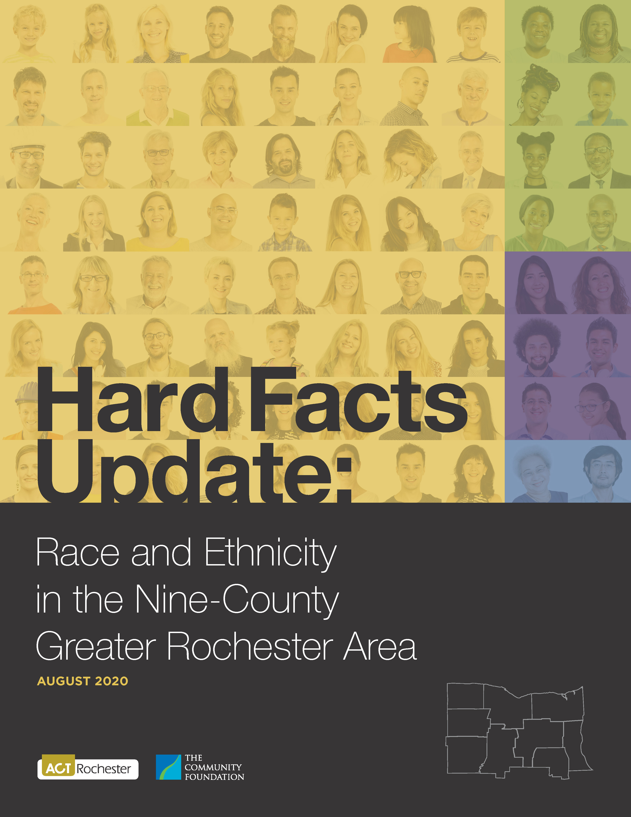
Hard Facts 2020
WDN Meeting
November 19, 2020

Slide 3
Hard Facts 2020
Method: Two Basic Questions
How do the outcomes for African Americans and Latinos compare with Whites within the nine-county Rochester region?
How do the outcomes for African Americans and Latinos in the nine-county Rochester region compare with those for People of Color nationwide and in New York State?
Gaps among racial
and ethnic groups
within the region
Gaps
between
our region
and the U.S. and/or
NY State

Slide 4
Hard Facts 2020
Why the emphasis on African Americans and Latinos?
The nine-county regional population is more than 82% White.
The 128,400 African Americans in the region account for 10.8% of the population, and are, by far, the largest minority group.
The region’s 81,600 Latina/Latino residents account for 6.8% of the total population.
The disparities experienced by these two groups are very similar and are dramatic.
While there are other minority groups, they are relatively small in number. Asians, the next largest group, account for 2.6% of the regional population.
Note: For those interested in greater detail, Appendices A & B contain full breakdowns by groups for each County.

Slide 5
Hard Facts 2020
Key Findings of the report:
Disparities impact individuals and families throughout their lives, and even into future generations. Wide gaps exist in all measures.
The gaps between racial and ethnic groups are greater in the Rochester region than in the United States or New York State as a whole.
These results have a demonstrable impact on the well-being of the Rochester region.

Slide 6
Hard Facts 2020
Some Conclusions to Ponder: We pay a great cost.
If People of Color regionally had the same poverty rate as Whites, the region would have nearly 50,000 fewer people in poverty (that’s about the total population of the Town of Irondequoit).
If People of Color here had the same poverty rate as People of Color nationwide this study estimates that there would be nearly 22,000 fewer people in poverty (that’s nearly half the population of the Town of Webster).
The bonus in terms of lower costs and higher local tax revenues would be enormous.

Slide 7
Hard Facts 2020
Inequalities within the region – Child Health and Well-being:
African American children are nearly 4 times more likely to experience child poverty than Whites, while for Latino children the likelihood is slightly more than 3 times.

Slide 8
Hard Facts 2020
Comparing the nine-county region to the nation - African Americans are:
More likely to be in poverty (34% compared with 24%);
Have children who are more likely to be in poverty (49%, versus 35%);
More likely to experience unemployment (13.8% compared with 10.6%);
Have lower incomes (75 cents on the dollar compared with the nationwide level).

Slide 9
Hard Facts 2020
Comparing the nine-county region to the nation - Latinos:
More likely to be in poverty (32% compared with 21%);
Their children are more likely to be in poverty (40%, versus 28%);
More likely to experience unemployment (10.8% compared with 6.8%);
Have lower incomes (66 cents on the dollar compared with the nation);

Slide 10
Hard Facts 2020
Inequalities within the region – Housing and Intergenerational Wealth:

Slide 11
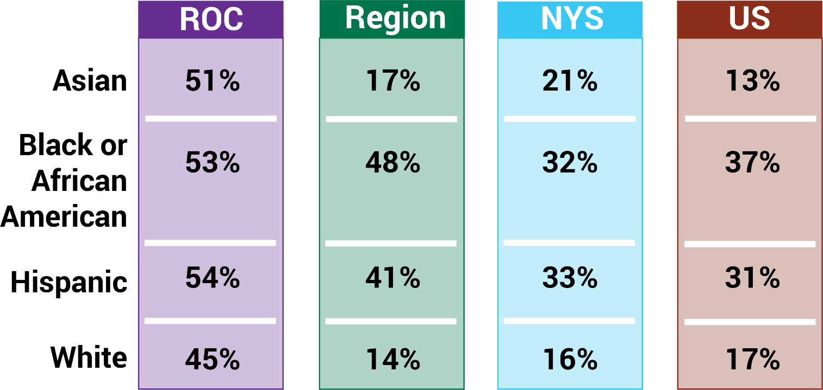
Children Living in Poverty by Race/Ethnicity
Source: U.S. Census Bureau
2012 – 16 Statistics

Slide 12
Hard Facts 2020
Inequalities within the region – Education:
For the foundational Grade 3 English Language Arts, the African American passing rate is slightly less than half (48%) that of Whites, while for Latino students it is slightly more than half (52%).

Slide 13
Hard Facts 2020
Comparing the nine-county region to NY State - African Americans students:
Had a lower passing rates for:
Grade 3 English Language Arts (25% compared with 45%);
Grade 3 Math (28% versus 43%);
Grade 8 English (17% compared with 37%).
Had a slightly lower graduation rate (72% versus 75%).

Slide 14
Hard Facts 2020
Comparing the nine-county region to NY State – Latino students:
Had a lower passing rates for:
Grade 3 English Language Arts (27% versus 43%);
Grade 3 Math (31% versus 43%);
Grade 8 English (20% compared with 39%).
Had the same graduation rate (75%).

Slide 15
Hard Facts 2020
The racial and ethnic disparities within the nine-county region are profound.
In many ways, the disparities between our region and the national and statewide measures are even more disturbing. Since the region is a microcosm of the nation, outcomes for African Americans and Latinos should reflect their counterparts.
The conclusion is inescapable:
Racial and Ethnic inequalities are a reflection of societal injustice, and that injustice is stronger in the Rochester region than in the nation as a whole, or NY State as whole.

Slide 16
Hard Facts 2020
More information, or to download the report:
ACTRochester.org

