Slide 1
Swimming Pool Basics
Wood County Health Department
April 18, 2019

Slide 2
Why is my pool licensed and inspected by the health department?
The Ohio Revised Code (ORC) Section 3749 requires that all pools, wading pools, spas, special use pools or spray grounds that are located at a dwelling that houses more than three families, including hotels/motels be considered PUBLIC and is therefore licensed and inspected by the local health department

Slide 3
What are my responsibilities as a pool operator?
Submit the annual license application each year. DUE BY APRIL 30
Ensure the licensed facility remains in compliance with rules set forth in the Ohio Administrative Code (OAC) 3701-31-04
Allow for regular inspections by the Local Health Department
These rules can be viewed at http://www.odh.ohio.gov/rules/final/finalrules.aspx

Slide 4
How often will WCHD inspect my pool/spa?
2 Standard Inspections- every 365 days
1 Equipment Inventory- every calendar year
Follow up inspections will be conducted as needed.
Complaints will be handled as they are received.

Slide 5
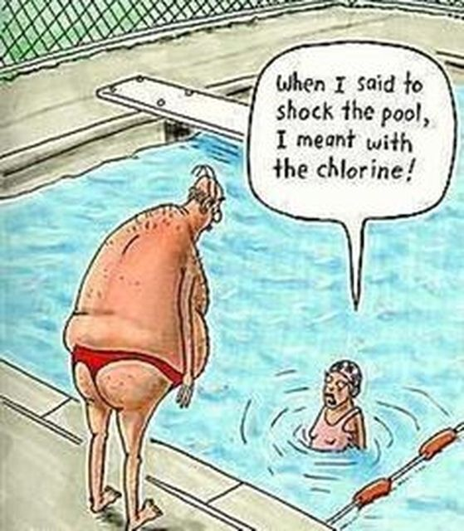
Licensed pools in Wood County
91 Licensed pools/spas
  75 pools
    50 Seasonal
    25 Year round
  13 spas
    4 Seasonal
    9 Year round
  3 special use pools

Slide 6
What can I expect during a standard inspection?
Poolside chemical testing
Records review
Safety equipment checks
Proper signage
Education
  Inspectors are there to provide education and guidance to help your pool/spa run safely. Please ask questions during the inspection!
Equipment Inventory
SVRS testing
Main drain cover verification
Lifeguard Certification Verification(as needed)

Slide 7
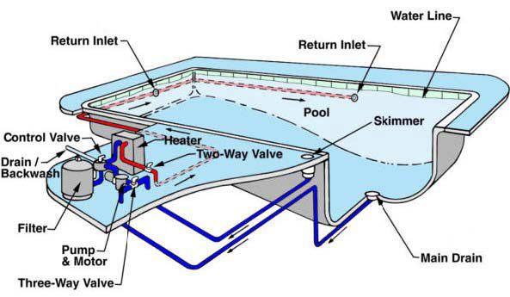
Pool System

Slide 8
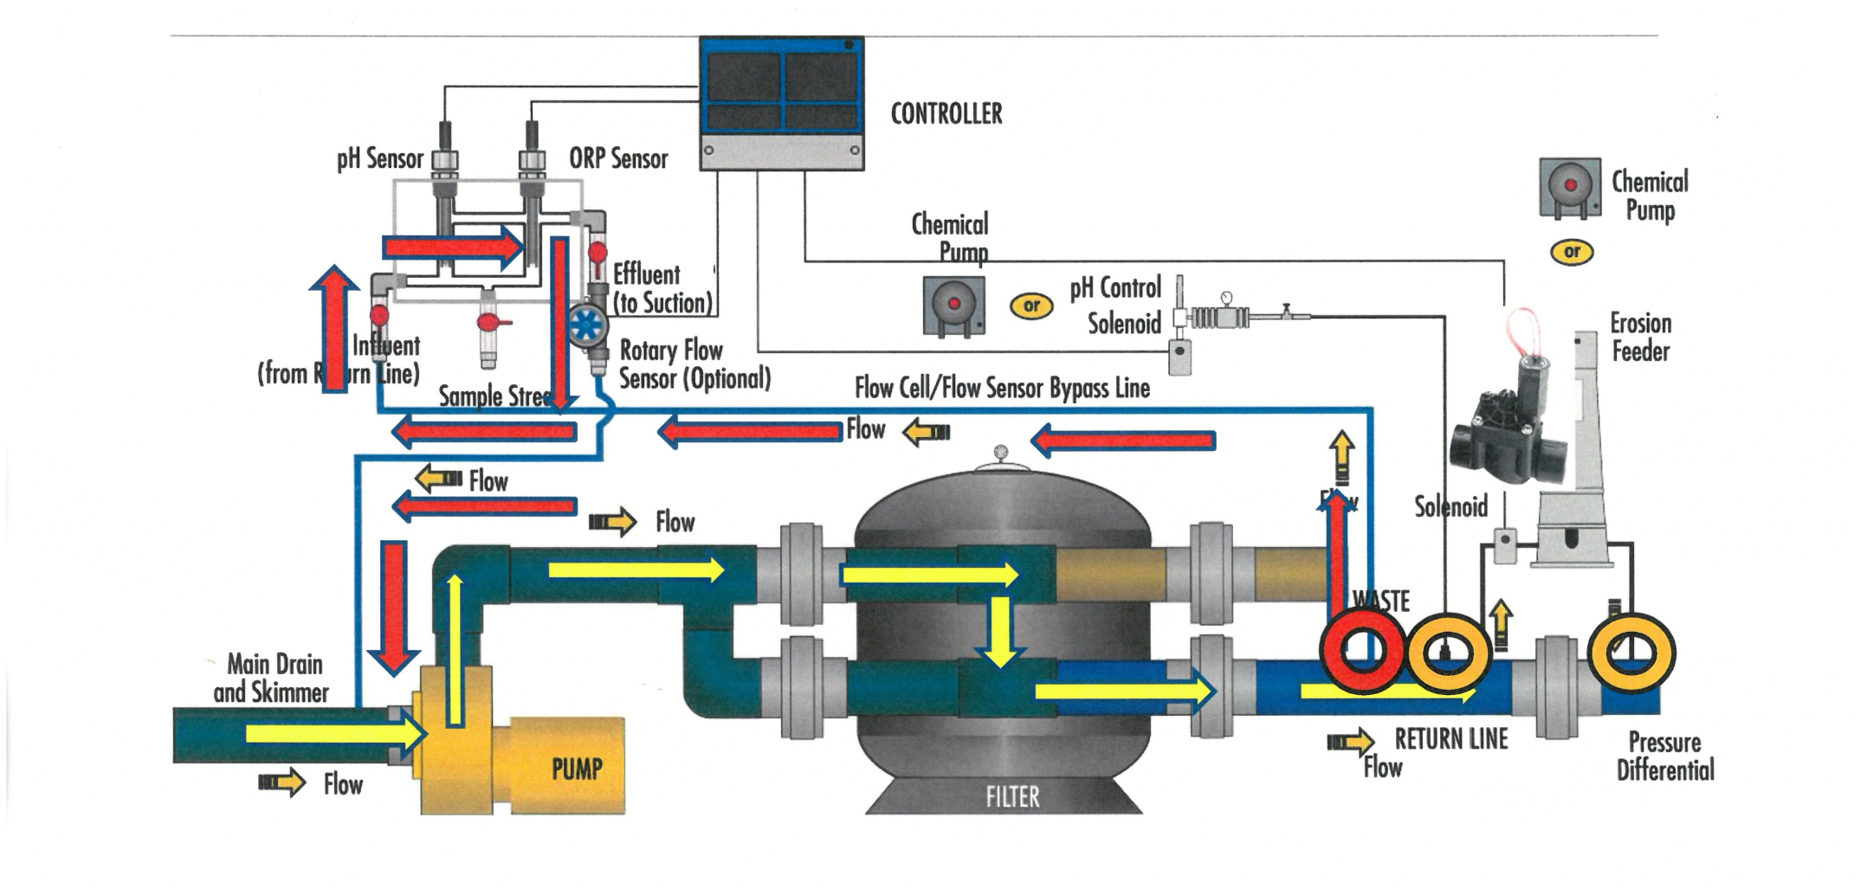
Circulation Diagram

Slide 9
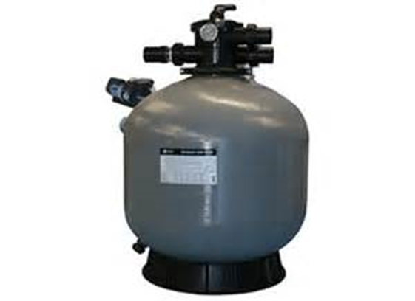
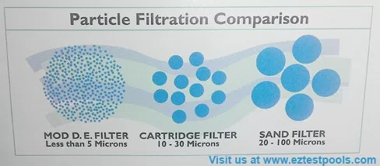
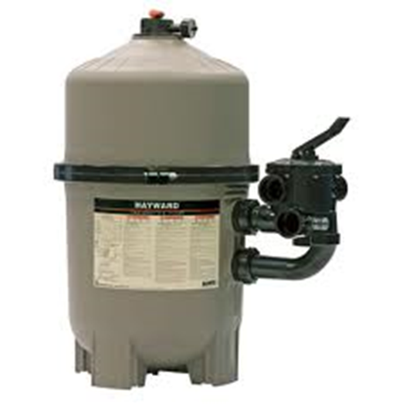
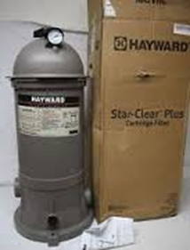
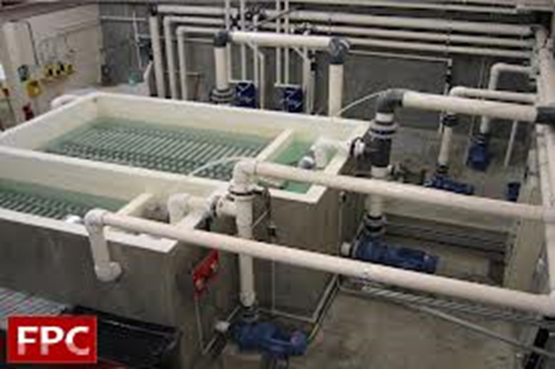
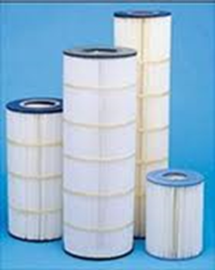
Filter Types

Slide 10
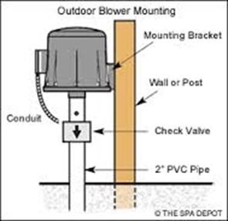
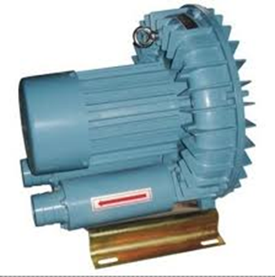
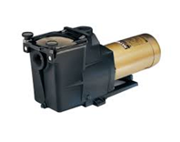
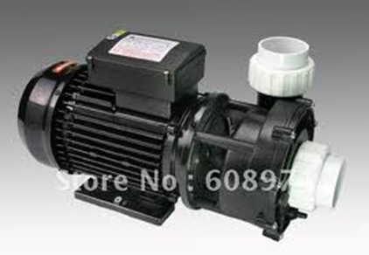
Pumps
Blower Pump
Recirculation Pump
Spa Jet Pump

Slide 11
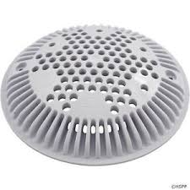
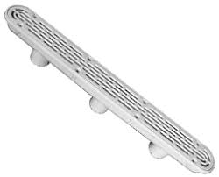
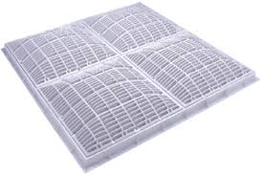
Main Drain/Suction Ports
Each licensed pool/spa must provide documentation showing that all main drain covers are VGB compliant and not expired.
If paperwork cannot be observed, covers must be replaced prior to opening for the 2019 season.
Lack of documentation may result in a violation

Slide 12
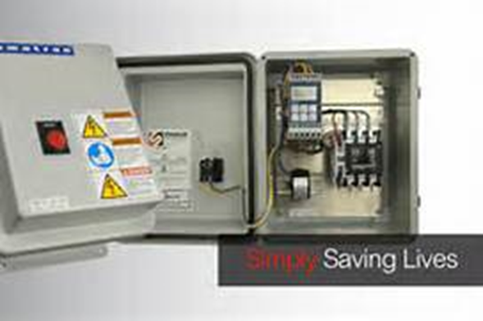
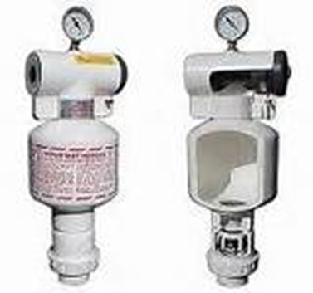
SVRS
(Safety Vacuum Release Systems)
Electrical current
Pressure/release
Detect blockage and automatically shut down the pump.
Test according to manufacturers specifications.
Record test results monthly
Keep all maintenance records.

Slide 13
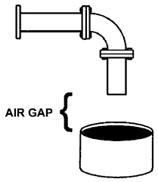
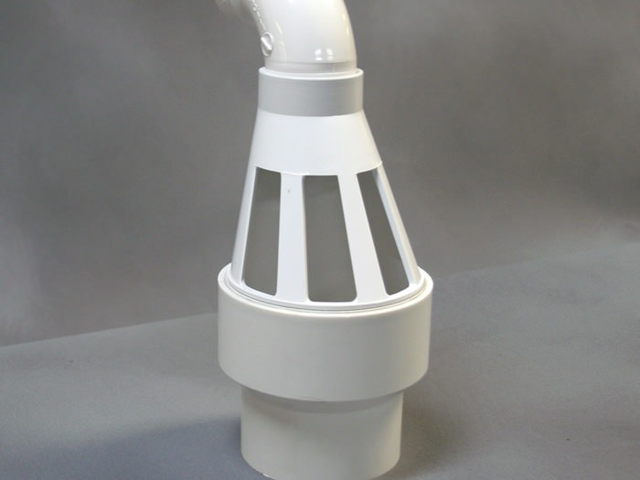
Air gaps/Backflow prevention
Lines discharging into backwash or drainage sumps must have an air gap and remain freely open to drain.

Slide 14
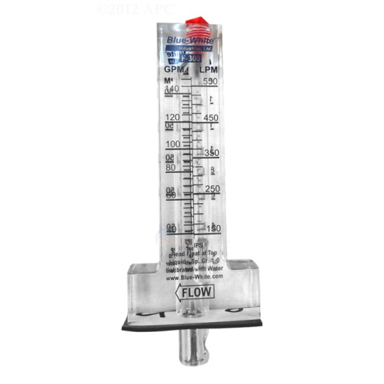
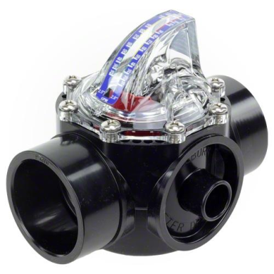
Flow Meters
Specific to pipe diameter
Proper placement in crucial
Bobbers frequently get stuck
Proper flow is necessary to ensure that you are achieving the proper turnover and that you are not exceeding the maximum filter flow

Slide 15
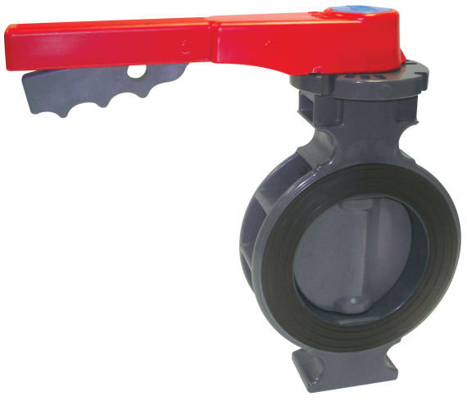
Throttle Valves
Must have been approved by the Ohio Department of Health during construction
Located between the pump and filter
Not ideal

Slide 16
Primary Disinfection
Dichlor/Trichlor
Sodium Hypochlorite (liquid)
Calcium Hypochlorite
Salt
Bromine
Characteristics of Disinfectants
 | Sodium hypochlorite | Calcium Hypochlorite | Lithium Hypochlorite | Gas Chlorine | Trichlor | Dichlor | Bromine
% available chlorine content | 10-12% | 65-78% | 35% | 100% | 90% | 56-63% | 27%
% Active strength | 10-12% | 65-78% | 29% | 100% | 99% | >99% | 95.5%
pH in 1% solution | 9-14 | 8.5-11 | 10.8 | 0 | 2.8-3.5 | 6.5-6.8 | 4.8
pH Effect in Water | Raises | Raises | Raises | Lowers | Lowers | Neutral | Lowers
Physical appearance | Liquid | Granular, tabs, briquette | Granular | Gas | Granular, tabs | Granular | Granular, tabs
Table 5-2. Characteristics of different forms of disinfectants.
National Swimming Pool Foundation 2009

Slide 17
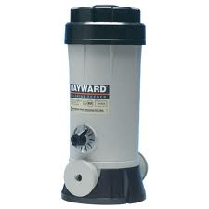
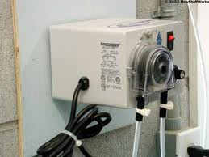
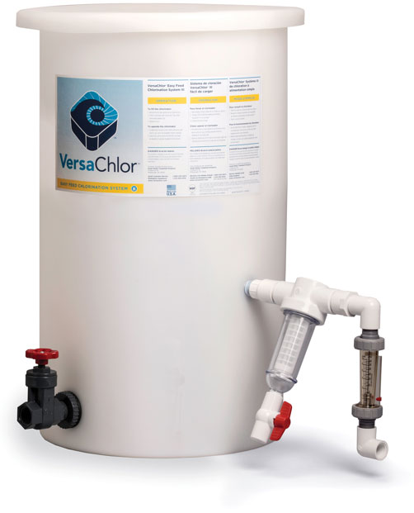
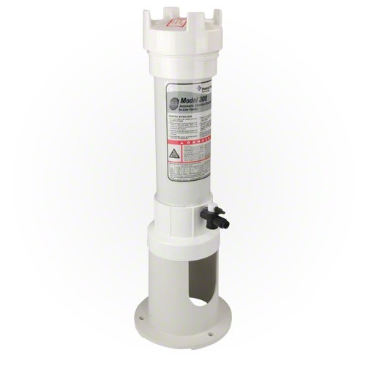
Disinfectant feeders
Erosion Feeder (dry form)
Liquid Feeder

Slide 18
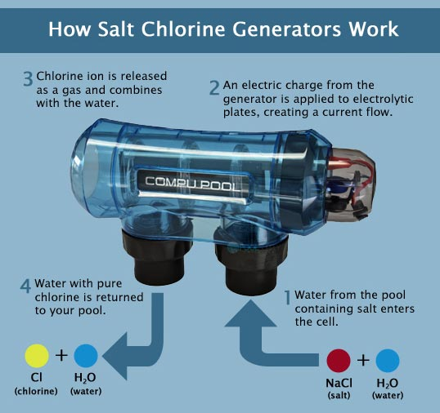
Salt Generators
https://www.poolsupplyunlimited.com/converting-to-salt-based-chlorination/blog/55

Slide 19
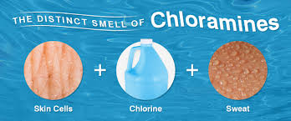
Secondary Disinfection
Commonly used in indoor pools to improve air quality.
Examples: UV light, Ozone
These units are effective in reducing chloramine levels by destroying the pathogens and organics that combine with the free chlorine
May only be used as secondary because there is not a residual disinfectant

Slide 20
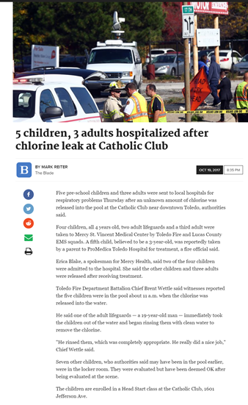
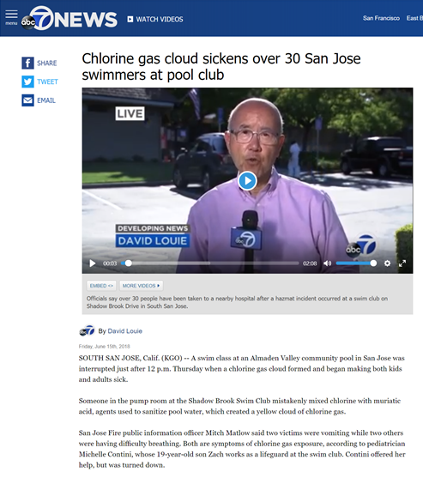
Preventing Unintended Chemical Injection
https://www.youtube.com/watch?v=4TjgvL8Ln18&t=1s

Slide 21
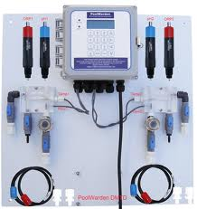
Automatic Chemical Controllers (ACC)
Required on all spas
Must display:
  pH (7.2-7.8)
  ORP (≥ 650 mV)
Audio or visual signal in event of malfunction or out of range
Flow switch to prevent chemical feed if recirculation quits
Acceptable list of units available on ODH website
Tested monthly and recorded on log

Slide 22
Flow interlock switch
Prevents the injection of chemicals from the auto-chemical controller when there is no or low flow
Must be tested in accordance with manufacturer’s specifications monthly
Must be recorded on the operation report
During your inspection, you may be instructed to demonstrate how you test the system

Slide 23
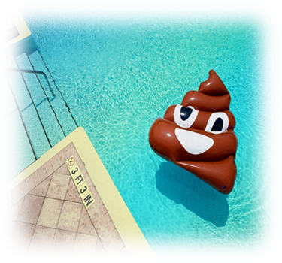
Recreational Water Illness (RWI)
https://www.youtube.com/watch?v=FLSe-qmfmVQ

Slide 24


Recreational Water Illness (RWI) Prevention
Education of your users through signage.
Have rules in place regarding exclusion of ill swimmers and showering before and after-and enforce them.
Have a response plan for fecal accidents that follows the CDC recommendations.
www.cdc.gov

Slide 25
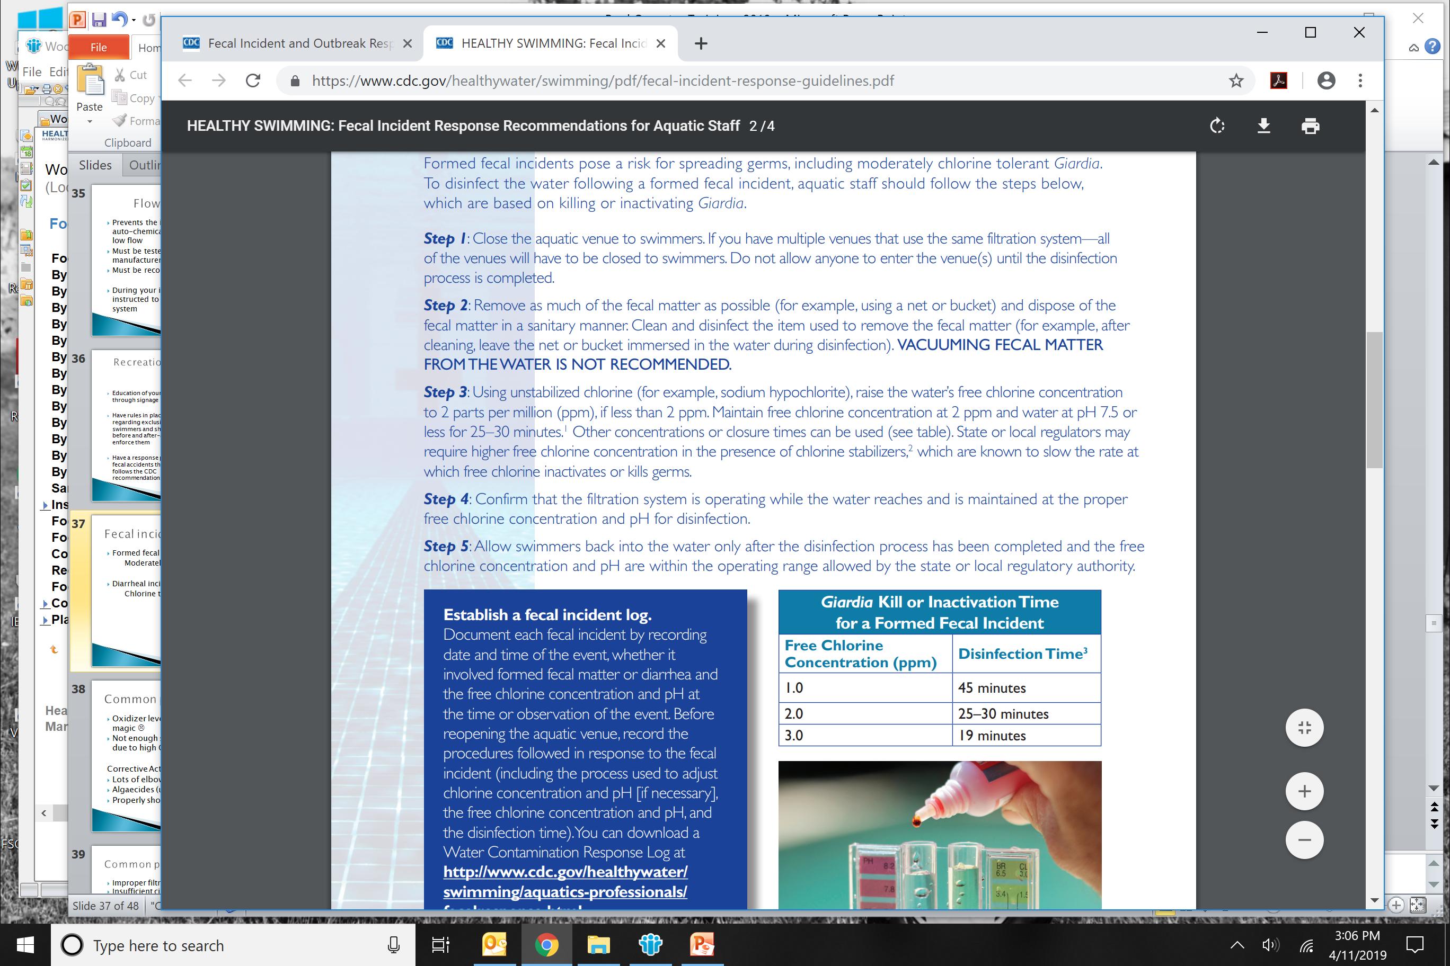
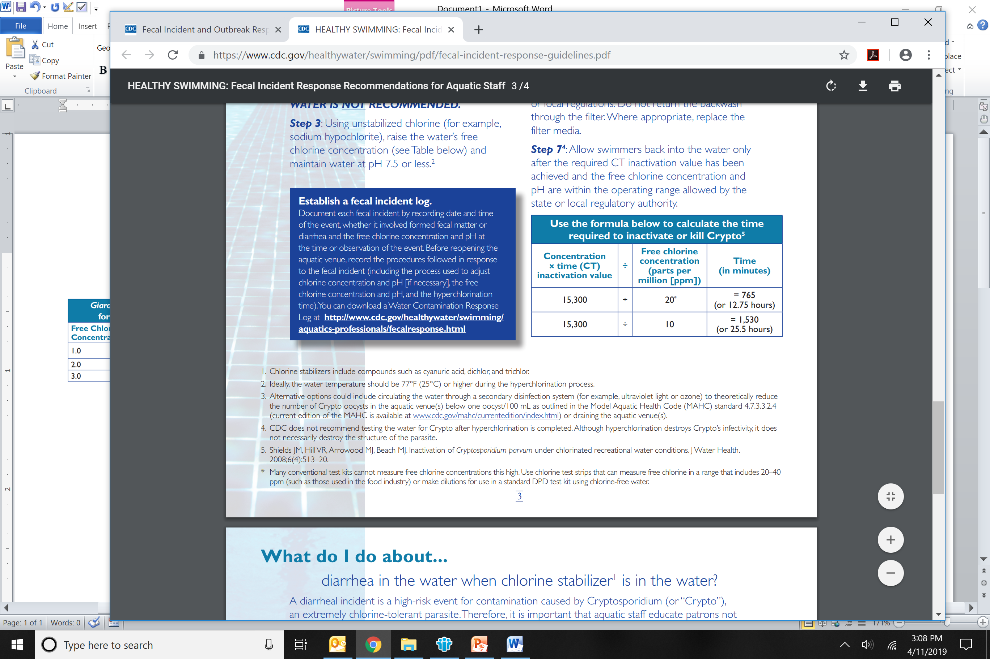
Fecal incidents
Formed fecal incidents- Giardia
Moderately chlorine tolerant
Diarrheal incidents- Cryptosporidium
Chlorine tolerant parasite
https://www.cdc.gov/healthywater/swimming/pdf/fecal-incident-response-guidelines.pdf

Slide 26
Cryptosporidium
Comes from humans, cattle, dogs…
Illness can occur 1-12 days after exposure
Illness lasts roughly 72 hours
Spreads person-to-person, contact with animals, or environmental contamination
FECAL ORAL ROUTE
Pool water being swallowed (involuntary or otherwise) or through the nose
  Does not take much at all to make you sick

Slide 27
Giardia
Comes from humans and animals
AKA “beaver fever”-beavers are one natural source
Illness starts 3-25 days after exposure
Illness is long lasting, 2-6 weeks
Spreads person-to-person, contact with animals, and environmental exposures
FECAL ORAL ROUTE
More common in natural water but still occurs in pools, spas, etc.

Slide 28
Recreational Waterborne Outbreaks in Ohio
Multi-county outbreak associated with Crypto in 2016. The largest in Ohio ever. 1,026 total cases. Delaware, Franklin, Columbus
184 cases associated with a waterpark
  Associated with Zoombezi Bay
Cases developed over months
Closing of the facility, draining water, hyper-chlorination, water testing
Water testing is usually unreliable…a negative doesn’t prove your facility isn’t infected but a positive might…

Slide 29
Zoombezi Bay & LHD Response
4 hyperchlorination treatments from July to September
          https://www.cdc.gov/healthywater/swimming/pdf/hyperchlorination-to-kill-crypto-when-chlorine-stabilizer-is-in-the-water.pdf
Water samples—all negative
Weekly education meetings with local pools and water parks
Needs assessment—UV sanitation was needed
Possibly started by asymptomatic carriers…how do you control for that?
Learned that many ill persons were some that swam with diarrhea (no one single reason this OB happened)

Slide 30
What can you do to prevent this from happening?
Monitoring-no diapers, posts signs about swimming with diarrhea (within 2 weeks), talk to patrons when entering the park about health swimming (handouts)
Keep an eye out for “accidents”
Report a suspected incident, we are here to help!

Slide 31
Record Keeping
Without Auto Chemical Controller | Disinfectant residual (free chlorine, bromine) | Every 4 hours
 | Combined chlorine | Every 4 hours
 | pH | Every 4 hours
 | Water temperature | Once per day
 | Water clarity | Continuously
 | Total alkalinity | Once per week
 | Cyanuric acid (for pool/spa using stabilizer) | Once per week
 | Total dissolved solids (salt generator pool) | Per manufacturer’s specification
With Auto Chemical Controller | Disinfectant residual (free chlorine, bromine) | Every 12 hours
 | Combined chlorine | Every 12 hours
 | pH | Every 12 hours
 | Water temperature | Once per day
 | Water clarity | Continuously
 | Total alkalinity | Once per week
 | Cyanuric acid (for pool/spa using stabilizer) | Once per week
 | Total dissolved solids (salt generator pool) | Per manufacturer’s specification

Slide 32
Record Keeping Reminders
First reading of the day must be obtained at water’s edge prior to bathers entering the water.
Chemicals added to the swimming pool/spa must be recorded.
Fecal accidents and injuries shall be recorded as they happen.
Test results and service records for auto chemical controllers and SVRS’s must be maintained. These systems must be tested in accordance with manufacturer instructions, and recorded monthly.
Records must be retained for at least 2 years.
Notes:
Discuss how some pool service companies may recommend testing from the pump room.

Slide 33
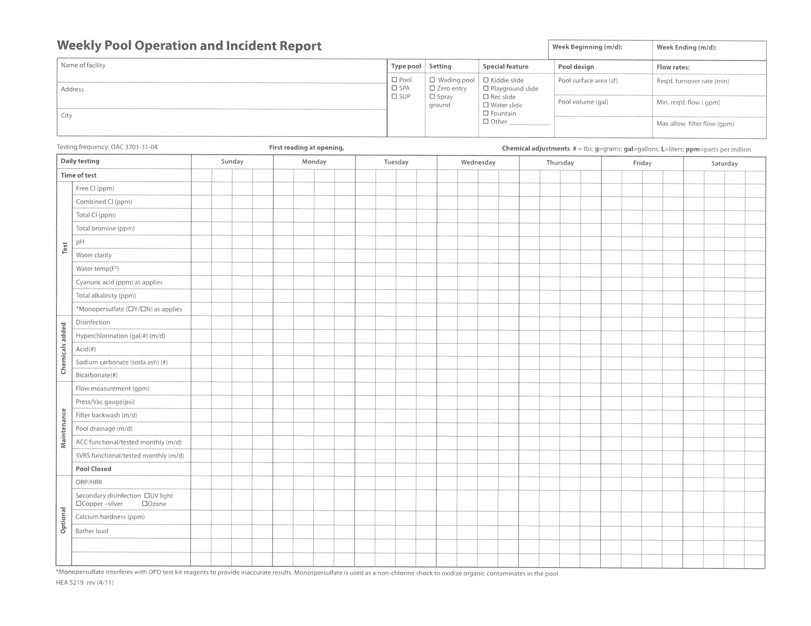

Slide 34
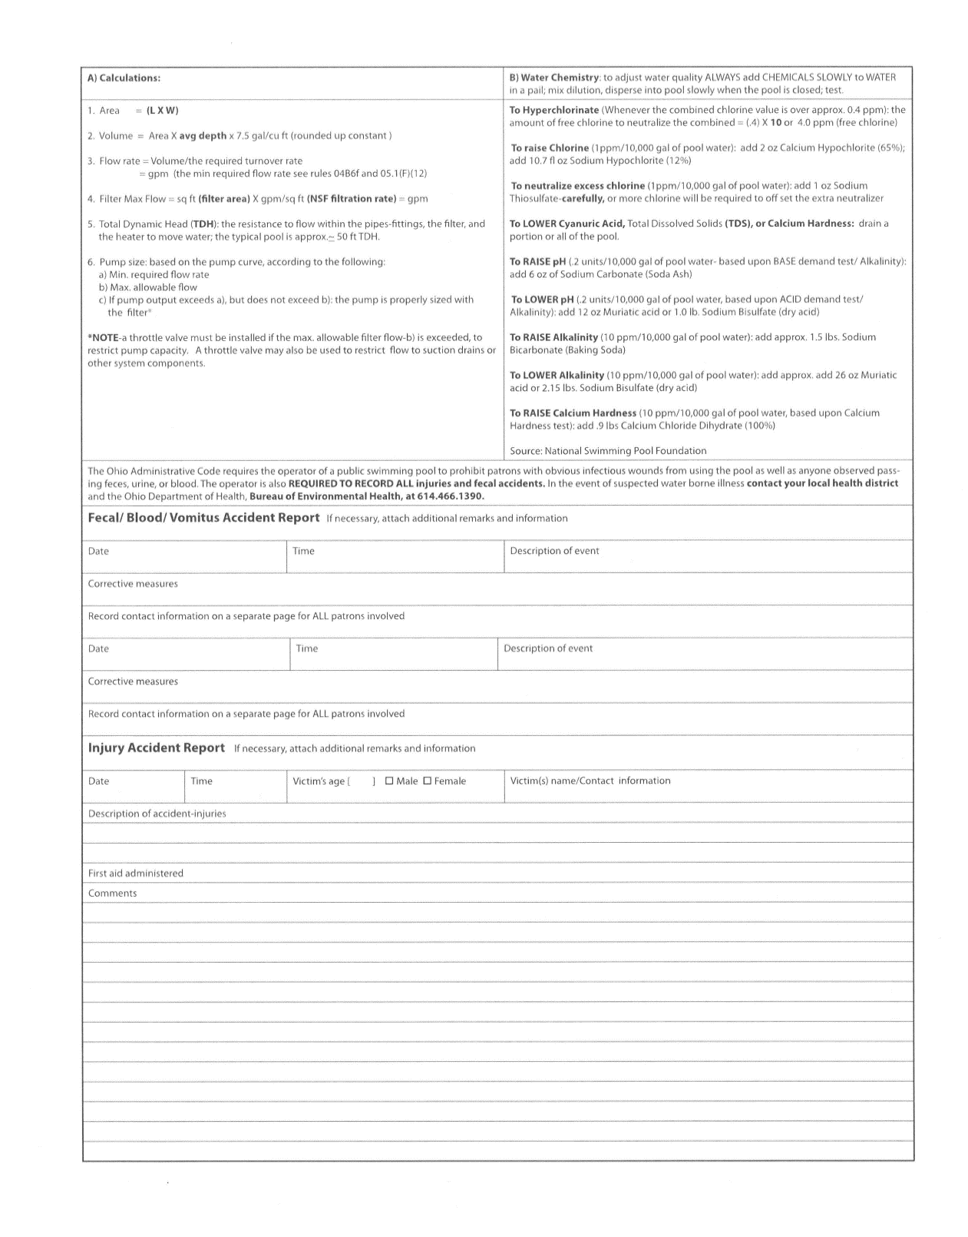
Must record all injuries and fecal incidents.
Suspected waterborne illnesses must be reported to the health department.

Slide 35
Why is record keeping important?
Helps you, the operator, understand and manage your pool.
Reduces wasteful spending.
Allows inspector to see your overall pool operation.
Diligent record keeping helps to maintain an awesome pool, and is your best legal defense!

Slide 36

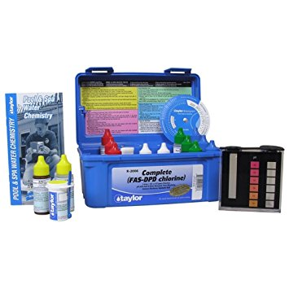
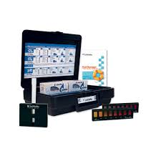

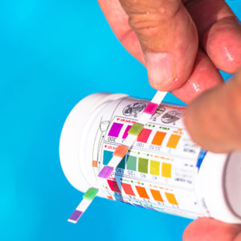
DPD Test Kits

Slide 37
Tips for proper sampling
Hold reagent bottles vertical to ensure uniform drop size.
Rinse comparator tube thoroughly between tests.
Hold comparator tube in natural light or against a white background to read the color chart.
Follow the directions that come with your kit!
Notes:
If comparator tube is stained (black) you must obtain a new tube or thoroughly clean the tube.

Slide 38
Bromine Calculation
DPD-Powder: test just as you would for chlorine then multiply the amount by 2.25
5 drops X 0.2 = 1.0 ppm
1.0 ppm X 2.25 = 2.25 ppm bromine

Slide 39
Proper sampling technique
https://www.youtube.com/watch?v=Y5V4RTvy5rc
Video courtesy of Taylor Technologies
www.taylortechnologies.com

Slide 40
Minimum Chemical Parameters
OAC 3701-31-04 (D)(6) | Pools | Spas
Free Chlorine | ≥ 1.0 ppm | ≥ 2.0 ppm
Combined Chlorine | ≤ 1.0 ppm | ≤ 1.0 ppm
Bromine | ≥ 2.0 ppm | ≥ 4.0 ppm
pH | 7.2 - 7.8 | 7.2 – 7.8
Alkalinity | ≥ 60 ppm | ≥ 60 ppm
Cyanuric Acid | ≤ 70 ppm | ≤ 70 ppm
Temperature | ≤ 90⁰ F | ≤ 104⁰ F
Clarity | Bottom Visible | Bottom Visible
ORP | 650 mV | 650 mV
Spray grounds: Free chlorine 2.0 Bromine 4.0 (measured at spray orifice)

Slide 41
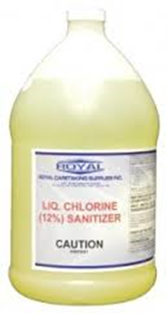
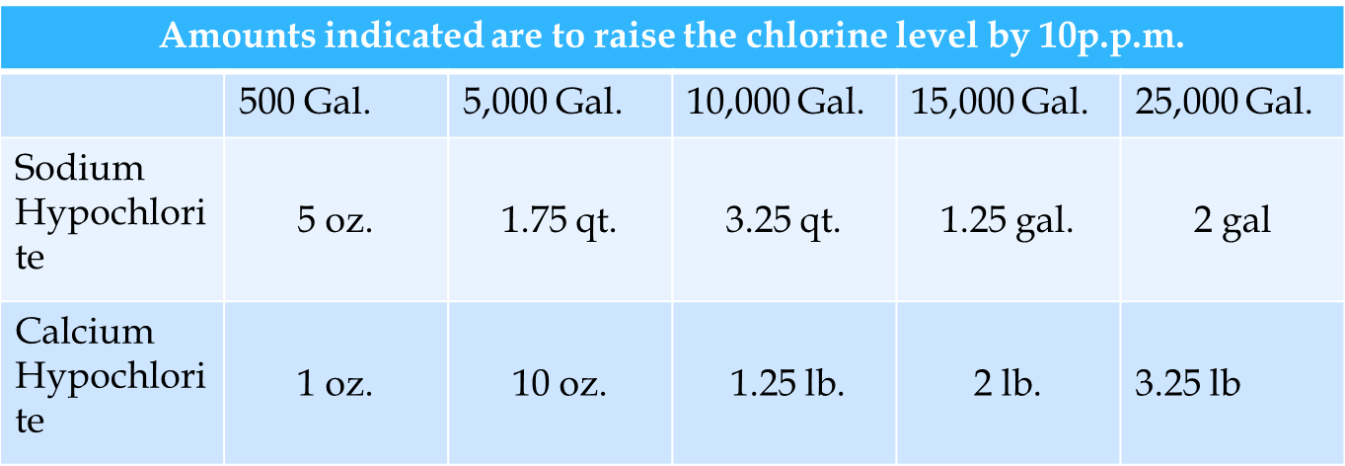
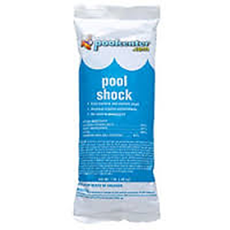
Breakpoint Chlorination
The elimination of inorganic chloramines by adding enough Free Chlorine to destroy them.
(CC x 10)

Slide 42
Volume and Surface Area
Determined during construction and ODH plan approval
Your inspector can always get the numbers we have on file here at WCHD
Why are volume and surface area important?
  You can only properly treat water if you know how much you have.
  How will the sun effect your pool?
  Do you need a life guard and if so, how many?

Slide 43
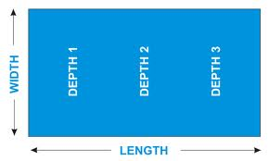
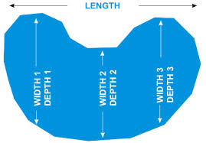
Pool Volume & Surface Area
Volume= Length x width x average depth x 7.5
Surface Area= length x width
Not so Easy:
Kidney shaped pool that is thirty feet long and has three widths of 15, 12, 15 and a depth of 3 foot at either and and 4 foot in the middle. Average the width first.
360 (sq ft) x 3.33 (avg depth) x 7.5 =10, 395 gal
Easy:
Rectangular pool that is 40 by 20 and goes from 3 foot to 5 foot to 8 foot.
800 sq ft x 8 foot x 7.5 =48,000 gal

Slide 44
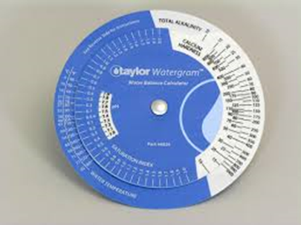
Water Balance
Properly balanced water:
Maximizes Disinfection
Prevents Corrosion
Provides an enjoyable swimming environment
Makes your health inspector happy ☺
***The Saturation Index can be a very useful tool when trying
to balance water.

Slide 45
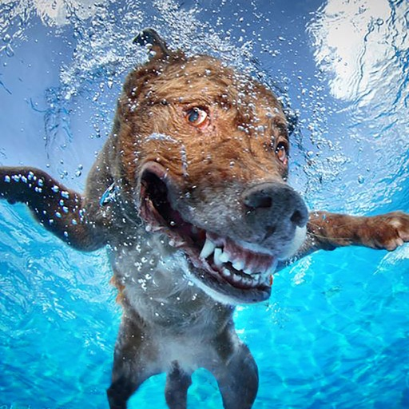
Animals at the Pool
3701-31-04(B)(7): Domestic animals. Unless otherwise permitted by law, animals are prohibited at a public swimming pool and within the pool barrier defining a pool area during the swim season.
Check with ADA regulations
regarding service animals.

Slide 46
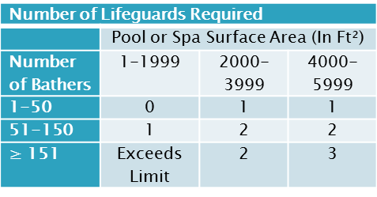
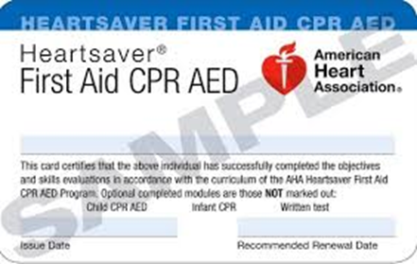
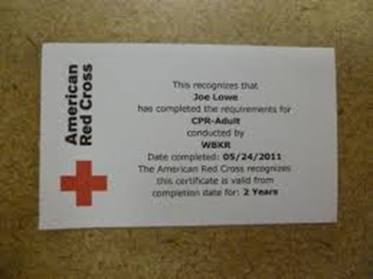


Lifeguards
>2000 sq. ft. surface area
Zero depth entry
Diving board
>50 swimmers (any pool)

Slide 47

Approved lifeguard training

Slide 48
Safety Equipment
Non-telescopic reach pole, 12 ft., with shepherd’s hook
Coast Guard-approved throwing device (life ring, etc.) with 30-60 ft. line attached required at pools without lifeguards
Backboard (only pools with lifeguard are required to have the straps and head immobilizers)
First-aid kit (gloves, bandaids, material to stop bleeding)
Working telephone at or within 500 feet of pool. Must be plugged in at all times.

Slide 49
Signage
“Warning-No Lifeguard”, if pool is not required to have a lifeguard.
“Swimming alone is not recommended” and “children must be supervised” signage if pool is not required to have a lifeguard.
“Danger: Pool Closed” signage.
Spa rules.
Slide safety recommendation signage.
If emergency phone/call box is not in the pool area, signage indicating where it is.
Spray ground warning signage.
Sign indicating location of the first aid kit if not in the pool area.

Slide 50
Updates/Repairs/Replacements
Original Plans
Is the replacement “like for like”?
Paint color/logos
ODH involved when work is considered a “substantial alteration”:
    changing basic design of pool, deck, diving board or fence
    replacing the entire recirculation system
    putting in a new, or relocating a diving board stand
    replacing a complete run of piping to or from pool
    change the main drain fitting/pipe
    replacing more than 50% of the gutter system or 50% of the inlets/outlets
    replacing filter type, pump, or disinfection type or feeder (Only Equipment Change Notification required)

Slide 51



Slide 52
Common violations
Disinfectant residual below required level
Low flow or flow meter stuck
Incomplete record keeping
Improper signage
Missing safety equipment/improper equipment/not properly maintained
Decreased water clarity
Automatic chemical controller not functioning properly

Slide 53

Common Pool/Spa Problems
Algae
Cloudy water
Inlet issues
Eye discomfort
Strong “chlorine” smell

Slide 54

Common pool problems- Algae
Oxidizer level dropped and sun worked its magic ☹
Not enough sanitizer OR sanitizer “locked” due to high CYA
Corrective Actions:
Lots of elbow grease
Algaecides (use sparingly)
Properly shock pool-and keep after it

Slide 55

Common problems- cloudy water
Improper filtration
Insufficient circulation
Poor water chemistry
Corrective steps:
Check filtration system: is flow rate where it should be for proper filtration and required turnover?
Water chemistry-saturation index
Cyanuric Acid

Slide 56
Common problems- Inlet “issues”
Sand or D.E. in Pool
D.E. filter grid has been compromised
Sand filter “manifold” is cracked
“Bubbling” Inlets
Indicates a “ leak” on the suction side of the pump… could be as simple as a gasket or as serious as a broken line

Slide 57
Common problems- Strong “chlorine” smell
Combined Chlorine, (aka chloramines) is a result of organic molecules containing nitrogen (sweat, urine☹) combining with the free chlorine.
Combined Chlorine is not an effective sanitizer
Combined chlorine is smelly, can cause respiratory issues, as well as eye and skin issues
This is a common problem in indoor pools: inadequate ventilation amplifies
Corrective steps:
Breakpoint chlorination (super-chlorination) is the way to “free” your chlorine again! Cross ventilation helps effectiveness of super-chlorination

Slide 58



Common problems- eye discomfort
Caused by :
Improper pH
  pH of human eye is approximately 7.4
Chloramines
  Caused by organic wastes combining with chlorine

Slide 59

When should my pool/spa be closed?
Bottom is not visible
Free chlorine below 1.0 ppm in pool
2.0 ppm in spa
Auto chemical controller not working properly
Circulation/disinfection system not functioning properly
SVRS system not functioning properly
Main drain covers/suction outlets not secure
Lifeguards unavailable
Fecal accidents
Improper or unauthorized chemicals
Electrical hazards

Slide 60
Please remember to contact your inspector for an inspection prior to opening for the 2019 season.
419-354-2702

Slide 61

Questions?

Slide 62

Lana Glore, R.S., Director of Environmental Health
lglore@co.wood.oh.us
Kelly Bechstein, M.S., R.S., Assistant Director of Environmental Health
kbechstein@co.wood.oh.us
Pool Sanitarians
Jillan Bodey- jbodey@co.wood.oh.us
Julie Nye- jnye@co.wood.oh.us
1840 E. Gypsy Lane Road
Bowling Green, OH 43402
419-354-2702
www.WoodCountyHealth.org

