Slide 1
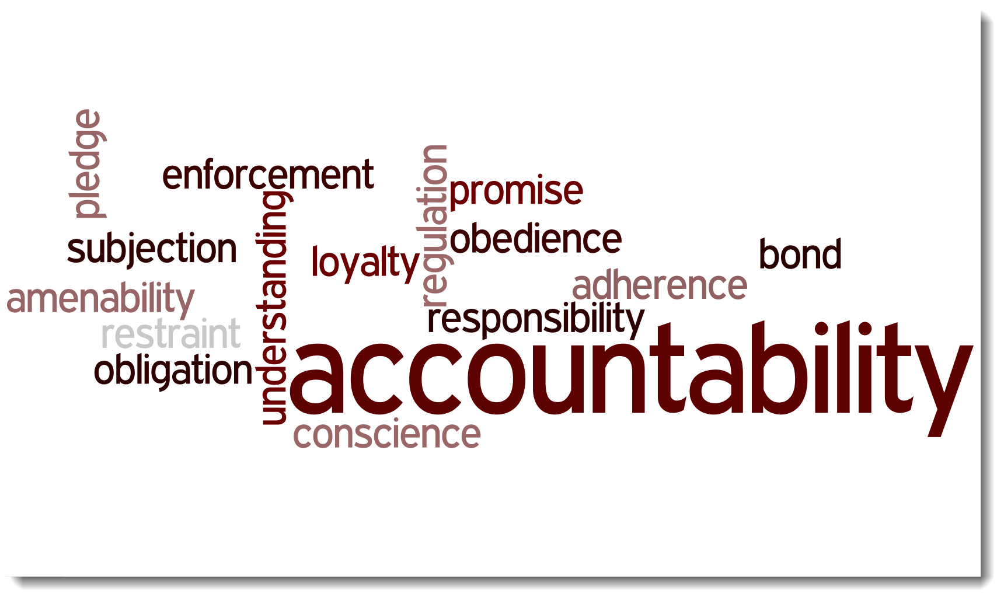

Slide 2
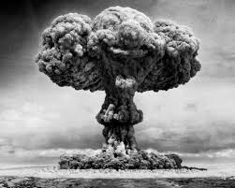

Slide 3
Accountability
Taking ownership of your decisions and actions
Admitting one’s faults

Slide 4
Accountability Isn’t
Passing the buck
Refusing to pay the cost of doing wrong.

Slide 5
Recognizing Who You Are Accountable To
God
You cannot escape your responsibility to God
You cannot hide or conceal your life and thoughts before God
There is a “recording” or “imputing” by God
How we conduct ourselves around others

Slide 6
Recognizing Who You Are Accountable To
Our spouses
Our brothers and sisters in Christ

Slide 7
What Are We Accountable For
What we say
What we do or don’t do
What you have and what you do with it
What can be done
What is taught or not taught

Slide 8
I have sinned–
2 Samuel 12.13

