Slide 1
Be Complete
2 Corinthians 13.10-12

Slide 2
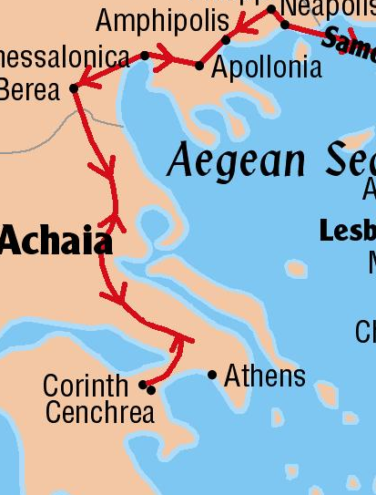
Background
Corinth – “the light of all Greece”
Paul’s letters
1 Corinthians around 57 AD from Ephesus
2 Corinthians later in 57 AD
Corinth in a nutshell
Problems - challenged his apostleship, idolatry
Good news – dealt with the brother in sin, wanted to help the needy saints in Jerusalem

Slide 3
Become Complete
Become – a process, transformation
“Become” is what Jesus wanted to apostles to do, Mark 1.17
Complete
Be perfect, ASV
Be made complete, NASV
Mend your ways, RSV
Aim for restoration, ESV

Slide 4
God’s word completes us
Man without God is incomplete
To the church at Corinth
Re-affirm their love for their brother, 2 Corinthians 2.8
Complete their aid to the poor saints at Jerusalem, 2 Corinthians 8.6-11

Slide 5
To Philippi
Complete the good works, Phil. 1.3-7
Become complete in Christ, Phil. 3.13-15

