Slide 2
The Book of Life

Slide 3
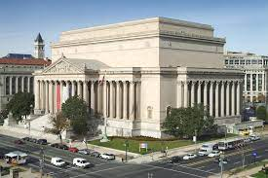
National Archives

Slide 4
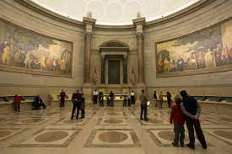
The Rotunda

Slide 5
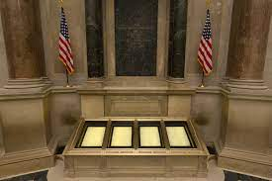
Founding Documents

Slide 6
Revelation 20:11 Then I saw a great white throne and Him who sat on it, from whose face the earth and the heaven fled away. And there was found no place for them. 12 And I saw the dead, small and great, standing before God, and books were opened. And another book was opened, which is the Book of Life. And the dead were judged according to their works, by the things which were written in the books.

Slide 7
13 The sea gave up the dead who were in it, and Death and Hades delivered up the dead who were in them. And they were judged, each one according to his works. 14 Then Death and Hades were cast into the lake of fire. This is the second death. 15 And anyone not found written in the Book of Life was cast into the lake of fire.

Slide 8
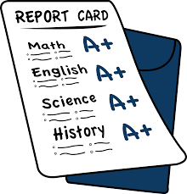
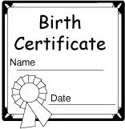
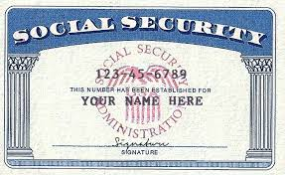
I) A Record of My Life is Being Kept
A) Most obvious is the idea of accountability.

Slide 9
God is keeping a record.
Israel when Aaron made the Golden Calf.
Exodus 32:33 And the LORD said to Moses, "Whoever has sinned against Me, I will blot him out of My book.

Slide 10
Daniel mentions a book.
Daniel 12:1 "At that time Michael shall stand up, The great prince who stands watch over the sons of your people; And there shall be a time of trouble, Such as never was since there was a nation, Even to that time. And at that time your people shall be delivered, Every one who is found written in the book. 2 And many of those who sleep in the dust of the earth shall awake, Some to everlasting life, Some to shame and everlasting contempt.

Slide 11
In Malachi we read of a book.
Malachi 3:16 Then those who feared the LORD spoke to one another, And the LORD listened and heard them; So a book of remembrance was written before Him For those who fear the LORD And who meditate on His name.

Slide 12
B) Don’t forget, records are being kept.
What does your say?

Slide 13
II) Eternal Consequences
A) No other record compares to this.
1 Our school work, grades, awards, certificates, may appear to be important but eventually they lose their importance.

Slide 14
B) Judgement is coming
Revelation 20:11 Then I saw a great white throne and Him who sat on it, from whose face the earth and the heaven fled away. And there was found no place for them.
Some will be cast into the lake of fire.

Slide 15
Some will have an eternal reward.
Revelation 21:26 And they shall bring the glory and the honor of the nations into it. 27 But there shall by no means enter it anything that defiles, or causes an abomination or a lie, but only those who are written in the Lamb's Book of Life.
Are you living with the knowledge of your eternal reward?

Slide 16
III) God Is Keeping Track of Your Record
A) Man’s record keeping
Is limited
Man sometimes missed things or makes wrong entries in their records.

Slide 17
B) God’s record keeping
1. He knows everything you think and do.
Hebrews 4:12 For the word of God is living and powerful, and sharper than any two-edged sword, piercing even to the division of soul and spirit, and of joints and marrow, and is a discerner of the thoughts and intents of the heart.

Slide 18
God is the only one who controls this Book.
Exodus 32:31 Then Moses returned to the LORD and said, "Oh, these people have committed a great sin, and have made for themselves a god of gold! 32 "Yet now, if You will forgive their sin-but if not, I pray, blot me out of Your book which You have written." 33 And the LORD said to Moses, "Whoever has sinned against Me, I will blot him out of My book.

Slide 19
God sees all.
Proverbs 15:3 The eyes of the LORD are in every place, Keeping watch on the evil and the good.
We will not be able to challenge or argue with what God has recorded.
Are you comfortable with that?

Slide 20
IV) Not Everyone Will Be in This Book of Life
A) Over 90 percent of people think they will go to heaven.
1. Most either do not believe hell is real or if it is, it is only for the really, really bad people.
2. They all agree that they nor their love ones will be lost.

Slide 21
B) A lot of people will be surprised
Those with no spiritual interest.
Philippians 4:3 And I urge you also, true companion, help these women who labored with me in the gospel, with Clement also, and the rest of my fellow workers, whose names are in the Book of Life.

Slide 22
Nothing compares to being in the Book of Life.
Luke 10:17 Then the seventy returned with joy, saying, "Lord, even the demons are subject to us in Your name." 18 And He said to them, "I saw Satan fall like lightning from heaven. 19 "Behold, I give you the authority to trample on serpents and scorpions, and over all the power of the enemy, and nothing shall by any means hurt you. 20 "Nevertheless do not rejoice in this, that the spirits are subject to you, but rather rejoice because your names are written in heaven."

Slide 23
Most of what we accomplish will be temporary but being in the Book of Life is not.
1 Peter 1:3 Blessed be the God and Father of our Lord Jesus Christ, who according to His abundant mercy has begotten us again to a living hope through the resurrection of Jesus Christ from the dead, 4 to an inheritance incorruptible and undefiled and that does not fade away, reserved in heaven for you,

Slide 24
V) Names Can Be Blotted Out
A) First one must get in the Book of Life.
1. Become a part of the body of Christ.
John 10:10 "The thief does not come except to steal, and to kill, and to destroy. I have come that they may have life, and that they may have it more abundantly.
John 14:6 Jesus said to him, "I am the way, the truth, and the life. No one comes to the Father except through Me.

Slide 25
One cannot be in the Book of Life without being in Christ.
The faithful will not be blotted out.
Revelation 3:5 "He who overcomes shall be clothed in white garments, and I will not blot out his name from the Book of Life; but I will confess his name before My Father and before His angels.

Slide 26
B) God will blot out the unfaithful.
Revelation 20:11 Then I saw a great white throne and Him who sat on it, from whose face the earth and the heaven fled away. And there was found no place for them. 12 And I saw the dead, small and great, standing before God, and books were opened. And another book was opened, which is the Book of Life. And the dead were judged according to their works, by the things which were written in the books.

Slide 27
13 The sea gave up the dead who were in it, and Death and Hades delivered up the dead who were in them. And they were judged, each one according to his works. 14 Then Death and Hades were cast into the lake of fire. This is the second death. 15 And anyone not found written in the Book of Life was cast into the lake of fire.

Slide 28
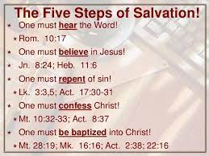
What is your relationship with God?

