Slide 1
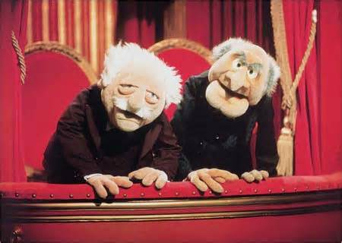
David’s Critic, Skeptic, and Naysayer

Slide 2
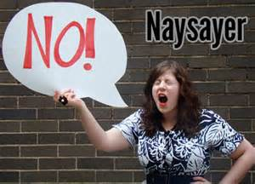
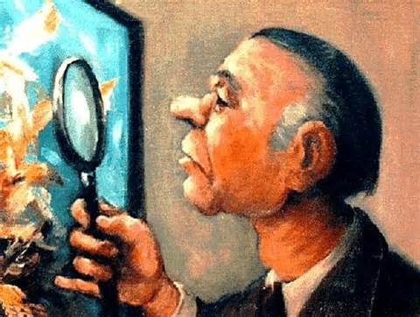
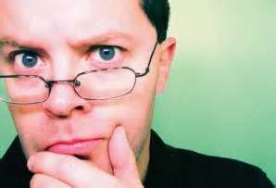
Naysayer
Critic
Skeptic

Slide 3
Details
Battle arrangement
The challenge
The lack of response
David’s response

Slide 4
David’s Naysayers
Eliab’s criticism
Saul’s skepticism
Goliath’s naysayer
David’s response to Eliab
To Saul
To Goliath

Slide 5
Lessons And Application
If you dare, you will have naysayers, critics, and skeptics
Often the biggest will be your brethren
We need to make sure we encourage one another
The best answer is
Rely on God
Do what you can
Have faith to move mountains

