Slide 1
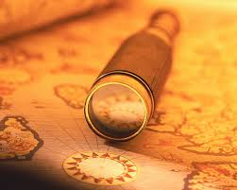

Slide 2
Explore
1. to traverse or range over (a region, area, etc.) for the purpose of discovery: to explore the island.
2. to look into closely; scrutinize; examine.

Slide 3
What Are We Exploring?
The Bible
Genesis 1.1
Inspiration = God breathed
The mind of God

Slide 4
The Bible Was Given So Mankind Can and Will Know the Mind of God
No One Inherently Knows the Will of God
We might know there is a Creator
Only through His word do we know His character, power, and will
Many today do not know God
Looking for some type of god, salvation

Slide 5
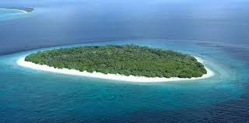
Each generation must explore (learn) the Bible for themselves

Slide 6
Exodus 19:8 (NKJV) ⁸ Then all the people answered together and said, "All that the Lord has spoken we will do." So Moses brought back the words of the people to the Lord.

Slide 7
2 Kings 22:8 (NKJV) ⁸ Then Hilkiah the high priest said to Shaphan the scribe, "I have found the Book of the Law in the house of the Lord." And Hilkiah gave the book to Shaphan, and he read it.

Slide 8
Nehemiah 8:14 (NKJV) ¹⁴ And they found written in the Law, which the Lord had commanded by Moses, that the children of Israel should dwell in booths during the feast of the seventh month,

Slide 9
How Do We Explore The Bible?
Read it!
Approach with the right attitude
Love the truth
Be a good listener
Study and do not just read
Consider the context of the passage
Study everything on a given subject

Slide 10
Let the plain explain the difficult
Walk by faith and not by sight

