Slide 1
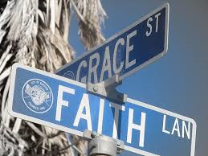

Slide 2
Definitions
Grace = unmerited favor
Grace = you get better than you deserve
Justice = you get what you deserve
Mercy = you do not get what you deserve

Slide 3
Problem
Grace Only
Works Only

Slide 4
Grace In The Universal Sense
God’s power and grace was extended to all mankind
Calvinist teaches total depravity
Grace and faith bestowed on man

Slide 5
Understanding Grace
Begins with God
Mankind did not merit Jesus’ sacrifice
At what point are we saved?
Salvation comes at the point where God says it comes
Jesus says when we are saved
Does our baptism merit salvation?
Acts 2.40; Phil. 2.12

Slide 6
Examples of Grace and Faith
Walls of Jericho
Naaman the leper
The blind man in John 9

Slide 7
The Nature of Faith
Absolute dependence on God
To trust in His way and not ours
Walls of Jericho, Naaman, the blind man had to trust in God’s plan
We have to trust (faith) in the Gospel
To receive God’s grace we must trust in God
Not change the conditions of salvation

Slide 8
Give ourselves to God
In heart
In attitude
In action

