Slide 1
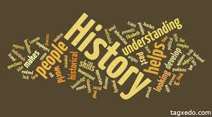

Slide 2
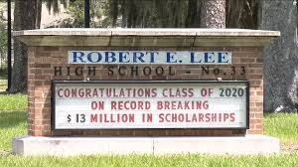
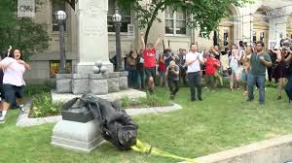
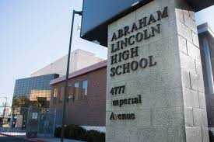

Slide 3
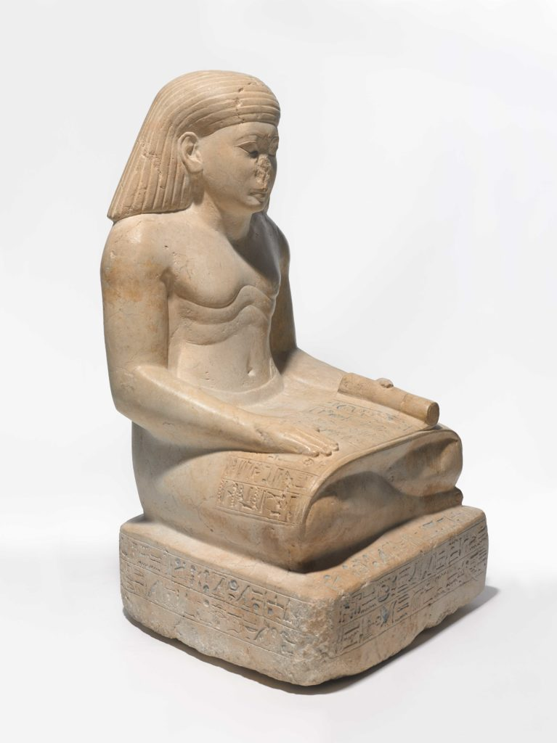
Ever Wonder Why Egyptian Sculptures Are Missing Their Noses? The Answer Will Surprise You
Ancient Egyptian statues were considered a portal to the gods.
Sarah Cascone, March 21, 2019

Slide 4
As revealed in “Striking Power: Iconoclasm in Ancient Egypt” at the Pulitzer Arts Foundation in St. Louis, this recurring damage was no accident, but a targeted destruction motivated by political and religious concerns.
And when you think about how hard these basalt and granite sculptures are, it becomes even more obvious that this defacement was intentional. “These would have been quite difficult to damage,” added Weissberg. “The sheer difficulty and effort involved in making modifications to these works really underscores the urgency and perceived importance of these objects.”
When Hatshepsut died after 22 years of ruling as co-pharaoh with her stepson Thutmose III (who ruled 1479–1425 BC), he attempted to erase her from history. By targeting artworks bearing her likeness, he was trying to ensure succession would pass through his line, and not his late stepmother’s.

Slide 5
Exodus 1:8 “Now there arose a new king over Egypt, who did not know Joseph.”
Various dynasties ruled Egypt, it is thought that at one time a group of outsiders were able to invade Egypt and take over.
After a while they were expelled and the Egyptians sought to erase all mention of that time.

Slide 6
I) History Does not Depend on Our Acceptance
Does not matter if we like it or not.
The founding of this nation, its slavery, the Civil War does not require our approval.
Television shows which traces someone’s lineage and sometimes the person finds out their ancestors were slave owners or did something bad.

Slide 7
I) History Does not Depend on Our Acceptance
The Bible tells the bad along with the good.
1. Judah’s sin with Tamar.
Genesis 38:15 When Judah saw her, he thought she was a harlot, because she had covered her face. 16 Then he turned to her by the way, and said, "Please let me come in to you"; for he did not know that she was his daughter-in-law. So she said, "What will you give me, that you may come in to me?"
Genesis 38:24 And it came to pass, about three months after, that Judah was told, saying, "Tamar your daughter-in-law has played the harlot; furthermore she is with child by harlotry." So Judah said, "Bring her out and let her be burned!" 25 When she was brought out, she sent to her father-in-law, saying, "By the man to whom these belong, I am with child." And she said, "Please determine whose these are -the signet and cord, and staff." 26 So Judah acknowledged them and said, "She has been more righteous than I, because I did not give her to Shelah my son." And he never knew her again.
2. David’s sin with Bathsheba and its after math was scandalous, 2 Samuel 11.

Slide 8
II) History is relevant as it relates to us (Jews)
God’s plan of salvation – Garden of Eden, Patriarchs, Abraham, David, to Jesus.
Romans 15:4 For whatever things were written before were written for our learning, that we through the patience and comfort of the Scriptures might have hope.
Common theme which relates to all mankind is sin and the seed of woman.
The Book of Acts is a history lesson dealing with the Acts of the Apostles, preaching of the Gospel, growth of the church.

Slide 9
II) History is relevant as it relates to us (Jews)
Jesus referred to history to teach lessons.
Days of Noah –
Luke 17:23 "And they will say to you, 'Look here!' or 'Look there!' Do not go after them or follow them. 24 "For as the lightning that flashes out of one part under heaven shines to the other part under heaven, so also the Son of Man will be in His day. 25 "But first He must suffer many things and be rejected by this generation. 26 "And as it was in the days of Noah, so it will be also in the days of the Son of Man:

Slide 10
II) History is relevant as it relates to us (Jews)
Jesus referred to history to teach lessons.
Destruction of Sodom
Luke 17:28 "Likewise as it was also in the days of Lot: They ate, they drank, they bought, they sold, they planted, they built; 29 "but on the day that Lot went out of Sodom it rained fire and brimstone from heaven and destroyed them all.

Slide 11
II) History is relevant as it relates to us (Jews)
Jesus referred to history to teach lessons.
Remember Lot’s wife.
Luke 17:31 "In that day, he who is on the housetop, and his goods are in the house, let him not come down to take them away. And likewise the one who is in the field, let him not turn back. 32 "Remember Lot's wife. 33 "Whoever seeks to save his life will lose it, and whoever loses his life will preserve it.

Slide 12
III) History is Fact Based.
Facts such as dates, places, names of people, and events.
The way those facts are used becomes commentary and often an effort to rewrite history.
But history itself does not change.

Slide 13
III) History is Fact Based.
Psalm 136 “His mercy endures forever”
God’s power to create
Psalms 136:5 To Him who by wisdom made the heavens, For His mercy endures forever; 6 To Him who laid out the earth above the waters, For His mercy endures forever; 7 To Him who made great lights, For His mercy endures forever- 8 The sun to rule by day, For His mercy endures forever; 9 The moon and stars to rule by night, For His mercy endures forever.

Slide 14
III) History is Fact Based.
Psalm 136 “His mercy endures forever”
The 10th plague on Egypt, dividing the Red Sea, the conquering of the kings who opposed them
Psalms 136:10 To Him who struck Egypt in their firstborn, For His mercy endures forever; 11 And brought out Israel from among them, For His mercy endures forever; 12 With a strong hand, and with an outstretched arm, For His mercy endures forever;

Slide 15
III) History is Fact Based.
Psalm 136 “His mercy endures forever”
Psalms 136:23 Who remembered us in our lowly state, For His mercy endures forever; 24 And rescued us from our enemies, For His mercy endures forever; 25 Who gives food to all flesh, For His mercy endures forever. 26 Oh, give thanks to the God of heaven! For His mercy endures forever.

Slide 16
III) History is Fact Based.
God’s punishment of Israel for their sins.
Ezra 9:7 "Since the days of our fathers to this day we have been very guilty, and for our iniquities we, our kings, and our priests have been delivered into the hand of the kings of the lands, to the sword, to captivity, to plunder, and to humiliation, as it is this day. 8 "And now for a little while grace has been shown from the LORD our God, to leave us a remnant to escape, and to give us a peg in His holy place, that our God may enlighten our eyes and give us a measure of revival in our bondage. 9 "For we were slaves. Yet our God did not forsake us in our bondage; but He extended mercy to us in the sight of the kings of Persia, to revive us, to repair the house of our God, to rebuild its ruins, and to give us a wall in Judah and Jerusalem. 10 "And now, O our God, what shall we say after this? For we have forsaken Your commandments, 11 "which You commanded by Your servants the prophets, saying, 'The land which you are entering to possess is an unclean land, with the uncleanness of the peoples of the lands, with their abominations which have filled it from one end to another with their impurity.

Slide 17
III) History is Fact Based.
God’s punishment of Israel for their sins.
A “preaching prayer” for everyone to hear and repent.
Covers their captivity, restoration to the land, and rebuilding the ruins, but they were sinning by marrying the people of the land.
3. Nehemiah 9 is almost like this

Slide 18
III) History is Fact Based.
Acts 7 Stephens history lesson.
The call of Abraham.
Acts 7:2 And he said, "Brethren and fathers, listen: The God of glory appeared to our father Abraham when he was in Mesopotamia, before he dwelt in Haran, 3 "and said to him, 'Get out of your country and from your relatives, and come to a land that I will show you.' 4 "Then he came out of the land of the Chaldeans and dwelt in Haran. And from there, when his father was dead, He moved him to this land in which you now dwell. 5 "And God gave him no inheritance in it, not even enough to set his foot on. But even when Abraham had no child, He promised to give it to him for a possession, and to his descendants after him.

Slide 19
III) History is Fact Based.
Acts 7 Stephens history lesson.
The call of Abraham.
6 "But God spoke in this way: that his descendants would dwell in a foreign land, and that they would bring them into bondage and oppress them four hundred years. 7 'And the nation to whom they will be in bondage I will judge,' said God, 'and after that they shall come out and serve Me in this place.' 8 "Then He gave him the covenant of circumcision; and so Abraham begot Isaac and circumcised him on the eighth day; and Isaac begot Jacob, and Jacob begot the twelve patriarchs.

Slide 20
III) History is Fact Based.
Acts 7 Stephens history lesson.
Abraham called out of Haran to Canaan.
The promises made to Abraham.
The sign of circumcision.
Their time in Egypt, v. 9-36
Joseph being sold into slavery, v. 9
Joseph’s elevation in Egypt and its famine, v. 10-11.
Jacob and his family going down into Egypt, v. 13-15.
Israel’s bondage, v. 17-19.

Slide 21
III) History is Fact Based.
Acts 7 Stephens history lesson.
Birth of Moses and deliverance, v. 20-36.
Moses’ birth, v. 20-21.
Being part of Pharaoh’s household, v. 21-22.
Moses killing a slave master and escaping to Midian for forty years, 23-29.
God speaking to Moses, v. 30-36.
Giving of the “living oracles” v. 38.
Israel’s rebellion in the wilderness, v.39-43.
Building of the tabernacle and then the temple, v. 44-50.

Slide 22
III) History is Fact Based.
Acts 7 Stephens history lesson.
Their ancestors killing the prophets.
Acts 7:51 "You stiffnecked and uncircumcised in heart and ears! You always resist the Holy Spirit; as your fathers did, so do you. 52 "Which of the prophets did your fathers not persecute? And they killed those who foretold the coming of the Just One, of whom you now have become the betrayers and murderers, 53 "who have received the law by the direction of angels and have not kept it."

Slide 23
III) History is Fact Based.
History does not require our approval.
Acts 7:54 When they heard these things they were cut to the heart, and they gnashed at him with their teeth. 55 But he, being full of the Holy Spirit, gazed into heaven and saw the glory of God, and Jesus standing at the right hand of God, 56 and said, "Look! I see the heavens opened and the Son of Man standing at the right hand of God!" 57 Then they cried out with a loud voice, stopped their ears, and ran at him with one accord; 58 and they cast him out of the city and stoned him. And the witnesses laid down their clothes at the feet of a young man named Saul. 59 And they stoned Stephen as he was calling on God and saying, "Lord Jesus, receive my spirit." 60 Then he knelt down and cried out with a loud voice, "Lord, do not charge them with this sin." And when he had said this, he fell asleep.

Slide 24
Facts of Salvation
Jesus died on the cross for our sins
Through His blood we have redemption, remission of our sins
We must believe Him to be the Son of God
We must confess Him as God’s Son
We must repent of our sins
We must be baptized for the remission of our sins

