Slide 1
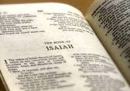

Slide 2
God’s Role as Judge
God punished the nations for their sins
A righteous judge is obligated to punish the evil doers
God uses different “instruments” to chasten His people
Sin is addictive and destructive

Slide 3
God’s Role As Redeemer
Used 13 times in Isaiah
From captivity
From the bondage of sin

Slide 4
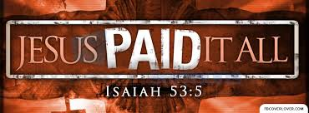
Jesus
Virgin birth
His nature and work
The Lamb of God

Slide 5
The church
What would be established
It’s place of origin
Time of Origin
Would go forth
A new name

Slide 6
The Gospel
Began to be preached on the Day of Pentecost
For all nations
The rejection of Christ and thus the Gospel
The acceptance of the Gospel

Slide 7
"Come now, and let us reason together," Says the Lord, "Though your sins are like scarlet, They shall be as white as snow; Though they are red like crimson, They shall be as wool. Isaiah 1:18 (NKJV)

