Slide 1
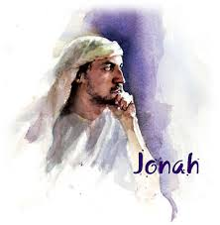
Jonah Preached & Nineveh Repented

Slide 2
Chapter 1

Slide 3
Chapter 2

Slide 4
Chapter 3

Slide 5
Chapter 4

Slide 6
Jonah Preached to a people he did not consider worthy of God’s grace
He preached with conviction
We don’t get to decide the message, the audience, or the reaction

Slide 7
Nineveh repented
They listened
Are we as good of listeners as the people of Nineveh

Slide 8
The messenger does not determine
The message
The audience
The response
The audience does not determine the
The message
The audience determines their attitude and response

