Slide 1
Marriage & Homosexuality
God Vs. Man

Slide 2
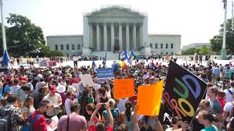
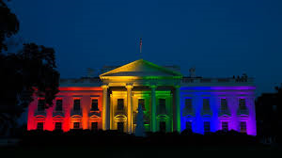
Reactions
Homosexuals and those supporting homosexual marriages
Christians
Disappointment
Realization how far our country has gone away from God

Slide 3
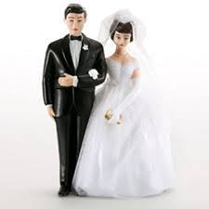
Things To Remember
Marriage is defined by God

Slide 4
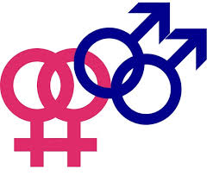
Homosexuality is still sin

Slide 5
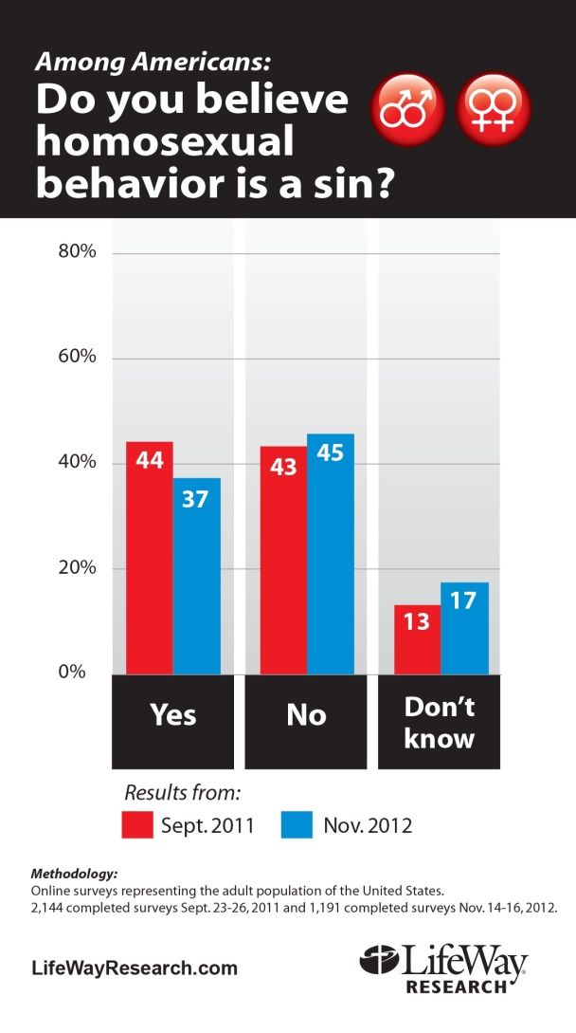
This will have a drastic effect on society

Slide 6
Things To Remember
God is still in control

