Slide 1
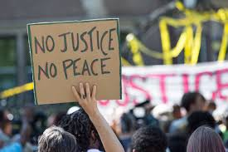

Slide 2
Justice -
Right, and righteous is closely associate with justice
Deals with our conduct, how we treat others, what is fair, and good
Romans 13:1 Let every soul be subject to the governing authorities. For there is no authority except from God, and the authorities that exist are appointed by God. 2 Therefore whoever resists the authority resists the ordinance of God, and those who resist will bring judgment on themselves. 3 For rulers are not a terror to good works, but to evil. Do you want to be unafraid of the authority? Do what is good, and you will have praise from the same. 4 For he is God's minister to you for good. But if you do evil, be afraid; for he does not bear the sword in vain; for he is God's minister, an avenger to execute wrath on him who practices evil.

Slide 3
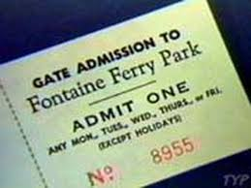
How do we determine what is just/fair/righteous?
God’s law defines what is fair and just.
- Leviticus 19:35 'You shall do no injustice in judgment, in measurement of length, weight, or volume. 36 'You shall have honest scales, honest weights, an honest ephah, and an honest hin: I am the LORD your God, who brought you out of the land of Egypt.

Slide 4
Six of the 10 commandments dealt with man’s dealing with his fellowman –.
Sometimes the penalty for disobedience was death, sometimes it was restitution, eye for eye/tooth for tooth. Exodus 21.24
not covet
not bear false witness
not steal
honor father and mother
not murder
not commit adultery

Slide 5
Peace
freedom from disturbance, soundness, healthy
God’s law promotes peace between man and his fellowman
Proverbs 16:7 When a man's ways please the LORD, He makes even his enemies to be at peace with him.
“LOVE HIS NEIGHBOR AS HIMSELF”, Matthew 22.39

Slide 6
Without justice there is hostility.
The statement itself recognizes the need for “justice” and therefore the need for “law.”
Isaiah 1:17 Learn to do good; Seek justice, Rebuke the oppressor; Defend the fatherless, Plead for the widow.

Slide 7
Man has often disagreed on how to have justice and peace
Sometimes man tries to set aside his law in order to create some type of peace (leniency)
Mercy

Slide 8
Know God’s Justice, Know Real Peace
God is Just and we will receive justice
Isaiah 45:21 Tell and bring forth your case; Yes, let them take counsel together. Who has declared this from ancient time? Who has told it from that time? Have not I, the LORD? And there is no other God besides Me, A just God and a Savior; There is none besides Me.
His Law is Just
Psalms 19:8 The statutes of the LORD are right, rejoicing the heart; The commandment of the LORD is pure, enlightening the eyes; 9 The fear of the LORD is clean, enduring forever; The judgments of the LORD are true and righteous altogether

Slide 9
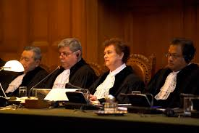
We cannot judge God’s Law
James 4:11 Do not speak evil of one another, brethren. He who speaks evil of a brother and judges his brother, speaks evil of the law and judges the law. But if you judge the law, you are not a doer of the law but a judge.

Slide 10
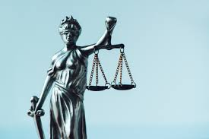
Jesus says we will receive justice before God
Matthew 16:27 "For the Son of Man will come in the glory of His Father with His angels, and then He will reward each according to his works.”
With God there is no partiality, Romans 2.11, Acts 10.34

Slide 11
God’s Law and His Grace
God’s law condemns us all as law breakers – Romans 3.23
Justice demands the penalty for sin be paid – Romans 6.23a
John 1:17 For the law was given through Moses, but grace and truth came through Jesus Christ.
Ephesians 2:5 even when we were dead in trespasses, made us alive together with Christ (by grace you have been saved),
Grace can be received or rejected

Slide 12
Peace – in and through Christ
Luke 2:10 Then the angel said to them, "Do not be afraid, for behold, I bring you good tidings of great joy which will be to all people. 11 "For there is born to you this day in the city of David a Savior, who is Christ the Lord. 12 "And this will be the sign to you: You will find a Babe wrapped in swaddling cloths, lying in a manger." 13 And suddenly there was with the angel a multitude of the heavenly host praising God and saying: 14 "Glory to God in the highest, And on earth peace, goodwill toward men!"

Slide 13
Peace
Acts 10:35 "But in every nation whoever fears Him and works righteousness is accepted by Him. 36 "The word which God sent to the children of Israel, preaching peace through Jesus Christ--He is Lord of all-- 37 "that word you know, which was proclaimed throughout all Judea, and began from Galilee after the baptism which John preached:
Ephesians 2:14 For He Himself is our peace, who has made both one, and has broken down the middle wall of separation, 15 having abolished in His flesh the enmity, that is, the law of commandments contained in ordinances, so as to create in Himself one new man from the two, thus making peace

Slide 14
Romans 3:21 But now the righteousness of God apart from the law is revealed, being witnessed by the Law and the Prophets, 22 even the righteousness of God, through faith in Jesus Christ, to all and on all who believe. For there is no difference; 23 for all have sinned and fall short of the glory of God, 24 being justified freely by His grace through the redemption that is in Christ Jesus, 25 whom God set forth as a propitiation by His blood, through faith, to demonstrate His righteousness, because in His forbearance God had passed over the sins that were previously committed, 26 to demonstrate at the present time His righteousness, that He might be just and the justifier of the one who has faith in Jesus.

Slide 15
God is righteous
1. The Old Law and Prophets point to something better, v. 21
2. This is to those who believe in Jesus Christ, v. 22.
3. Our righteousness is not based on our perfect in law keeping because we all sin, v. 23
In Christ, v. 24
1. Those who believe in Christ are made just (declared righteous) by God’s grace.
2. Redemption – Jesus paid the price for our sins.
3. Propitiation – refers to the righteous anger of God being satisfied by Jesus’ blood, v. 25
4. By His cleansing blood we are made just (free from sin), v. 26.

Slide 16
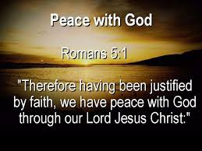
Philippians 4:6 Be anxious for nothing, but in everything by prayer and supplication, with thanksgiving, let your requests be made known to God; 7 and the peace of God, which surpasses all understanding, will guard your hearts and minds through Christ Jesus.

