Slide 1
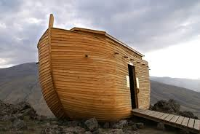
Noah A Preacher of Righteousness

Slide 2
Man’s free agency
God’s rejection of sin
Noah found grace
Faith, Hebrews 11.7
Grace – unmerited favor; justice getting what you deserve, mercy not getting what you deserve, grace who you get you don’t deserve

Slide 3
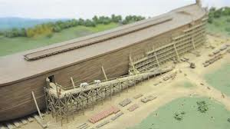
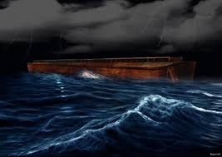
Noah did (Faith in action; obedience)
An alive faith
Worked on the ark
Preached
Entered the ark
The Lord shut the door
The rain came down (punishment of God is real)

Slide 4
The waters receded
God’s instructions
Noah built an altar
God’s covenant with Noah

Slide 5
Application
Condition of today’s world
What is your condition?
There will come a day when the “door” will be shut!

