Slide 1
Our God, He Is Alive
Psalms 111:1 Praise the LORD! I will praise the LORD with my whole heart, In the assembly of the upright and in the congregation. 2 The works of the LORD are great, Studied by all who have pleasure in them.

Slide 2
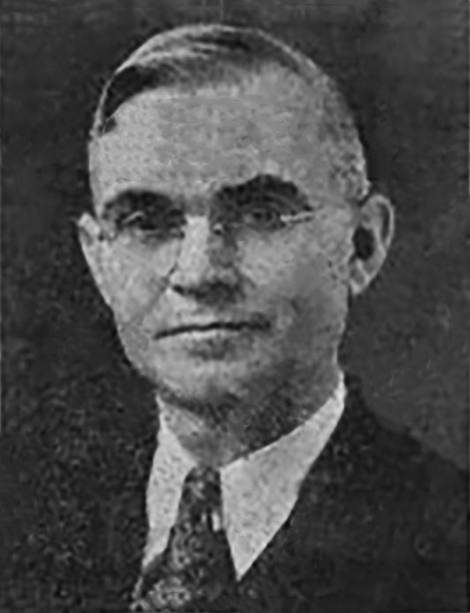
“If the Lord will allow me to get an education, I will use it in service to the Lord.”

Slide 3
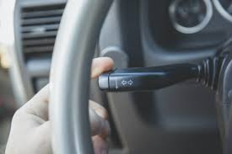
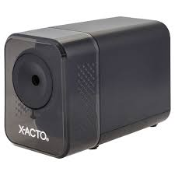
A) Inventor, Professor, Scientist

Slide 4
A) Inventor, Professor, Scientist
Degrees include a Bachelor’s of Science, eventually he earned a PH.D. from Indiana University in Bloomington.
Taught science at Indiana University
1930, he moved to Cookeville, Tennessee, to become professor and head of the department of physics at Tennessee Polytechnic Institute
He trained graduates in nuclear science
Specialized in atomic particles
In January, 1950, he moved to Temple Terrace, Florida, to become the dean of Florida Christian College

Slide 5
B) Preacher and Song writer
While head of Florida College he preached at a number of congregations within driving distance of Tampa
Eventually a group of saints started meeting at Temple Terrace, he was instrumental in the forming of that congregation
After retiring he took up the hobby of song writing.

Slide 6
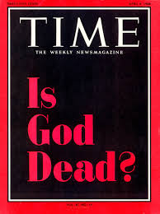
C) In the late 1960’s and early 70’s the God is dead movement had gained steam.
1966 Time Magazine
“Lord, I Believe” in 1966
“Our God, He Is Alive” in 1968

Slide 7
“Our God, He is Alive
There is, beyond the azure blue A God, concealed from human sight He tinted skies with heav'nly hue And framed the worlds with His great might
Azure blue -- is a bright, cyan-blue color named after the rock lapis lazuli. It is often described as the color of the sky on a clear day
A God we cannot see

Slide 8
Hebrews 11:3 By faith we understand that the worlds were framed by the word of God, so that the things which are seen were not made of things which are visible.
Psalms 33:6 By the word of the LORD the heavens were made, And all the host of them by the breath of His mouth. 7 He gathers the waters of the sea together as a heap; He lays up the deep in storehouses. 8 Let all the earth fear the LORD; Let all the inhabitants of the world stand in awe of Him. 9 For He spoke, and it was done; He commanded, and it stood fast…

Slide 9
Psalms 33:13 The LORD looks from heaven; He sees all the sons of men. 14 From the place of His dwelling He looks On all the inhabitants of the earth; 15 He fashions their hearts individually; He considers all their works.
Psalms 19:1The heavens declare the glory of God; And the firmament shows His handiwork. 2 Day unto day utters speech, And night unto night reveals knowledge. 3 There is no speech nor language Where their voice is not heard.

Slide 10
God whose voice the prophets heard He is the God that we should know Who speaks from His inspired word
2 Peter 1:19 And so we have the prophetic word confirmed, which you do well to heed as a light that shines in a dark place, until the day dawns and the morning star rises in your hearts; 20 knowing this first, that no prophecy of Scripture is of any private interpretation, 21 for prophecy never came by the will of man, but holy men of God spoke as they were moved by the Holy Spirit.

Slide 11
Without God’s word mankind is in darkness, inspiration – God breathed, used to describe the wind in the sails of a ship
The prophets heard, received His inspired word.
1 Corinthians 2:13 These things we also speak, not in words which man's wisdom teaches but which the Holy Spirit teaches, comparing spiritual things with spiritual.

Slide 12
Secure is life from mortal man
God holds the germ within His hand
Tho men may search they cannot find
For God alone does understand
Germ God holds within His hand
Genesis 2:7 And the LORD God formed man of the dust of the ground, and breathed into his nostrils the breath of life; and man became a living being.

Slide 13
Our God, whose Son upon a tree A life was willing there to give That He from sin might set man free And evermore with Him could live
Death of Jesus on the cross
Galatians 3:13 Christ has redeemed us from the curse of the law, having become a curse for us (for it is written, "Cursed is everyone who hangs on a tree"),

Slide 14
It is through the death on the cross that God demonstrates, shows, His love for mankind
In order to set man free.
John 8:31 Then Jesus said to those Jews who believed Him, "If you abide in My word, you are My disciples indeed. 32 "And you shall know the truth, and the truth shall make you free." 33 They answered Him, "We are Abraham's descendants, and have never been in bondage to anyone. How can you say, 'You will be made free'?" 34 Jesus answered them, "Most assuredly, I say to you, whoever commits sin is a slave of sin. 35 "And a slave does not abide in the house forever, but a son abides forever. 36 "Therefore if the Son makes you free, you shall be free indeed.

Slide 15
Chorus
John 8:58 Jesus said to them, "Most assuredly, I say to you, before Abraham was, I AM.“
Acts 17:28 "for in Him we live and move and have our being, as also some of your own poets have said, 'For we are also His offspring.' 29 "Therefore, since we are the offspring of God, we ought not to think that the Divine Nature is like gold or silver or stone, something shaped by art and man's devising.
There is a God, He is alive In Him we live and we survive From dust our God created man He is our God, the great I Am

Slide 16
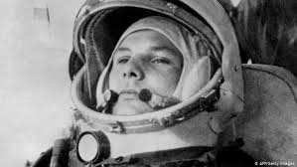
1961 Russian astronaut Uri Gargarin
“I see not God up here.”

Slide 17
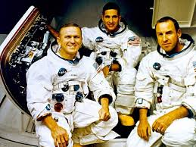
1968 Apollo 8, Frank Borman, William Anders, and Jim Lovell; circled the moon. On Christmas Eve, December 24, the following transmission occurred.

