Slide 1
Obligations

Slide 2
My son
Be strong in the grace that is in Christ Jesus

Slide 3
The Circle of Life
Teacher
New Convert
New Convert
Teacher

Slide 4
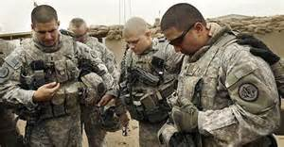
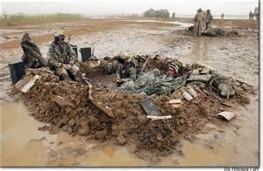
Obligations
A soldier
An athlete

Slide 5
