Slide 1

Rebuilding Our Homes (Families)

Slide 2
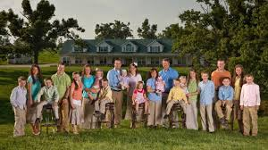


Slide 3
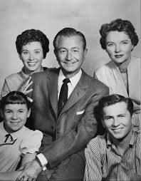
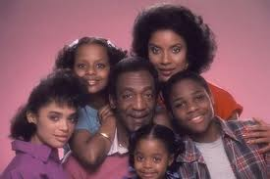

Slide 4


Slide 6
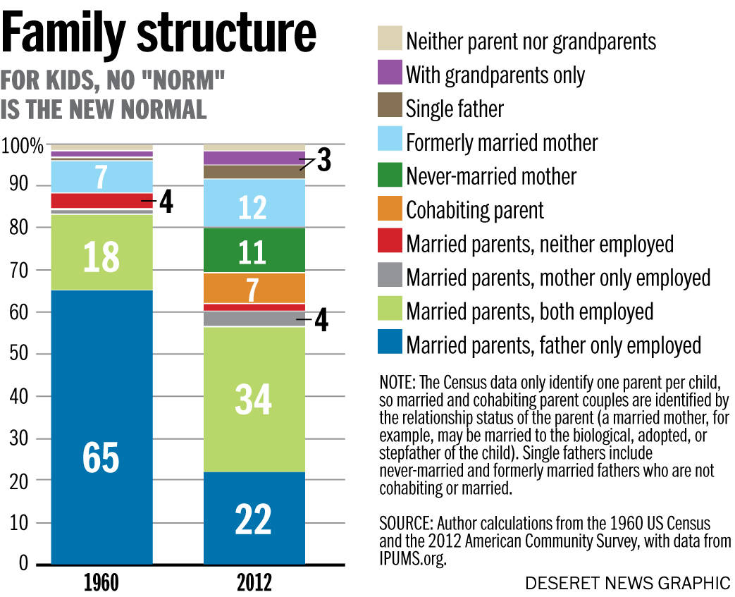

Slide 7
Wednesday, September 3, 2014
The Average American Family No Longer Exist
"Kids raised by their own intact, married parents are more likely to flourish.
Read more at http://national.deseretnews.com/article/2277/The-average-American-family-no-longer-exists.html#lbcrt0f8ym0Ekxyb.99

Slide 8
While the "nuclear family" consisting of a married couple with their own children is often seen as the average American family, such households constitute less than a quarter of all households.^{[1][4]} Married couples without children are currently the plurality constituting 28.7% of households, compared to 24.1% for nuclear families.

Slide 9
The Modern Family
Biological parents not rearing their children
One parent
Grandparents
Step parents
Etc.
Resulting in poverty for many
Lack of understanding of the family

Slide 10


Marriage
Early stages of Marriage
Dating
Child rearing

Slide 11
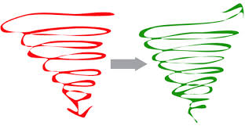
Romans 1

Slide 12
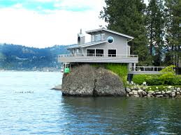
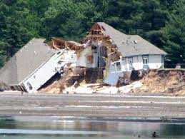
Basis of Marriage
Every house must have a foundation

Slide 13
Wrong Basis
Societal Approval
Children
Selfishness
Convenience
Etc.
God

Slide 14
Matthew 7
²⁴ "Therefore whoever hears these sayings of Mine, and does them, I will liken him to a wise man who built his house on the rock:
²⁵ and the rain descended, the floods came, and the winds blew and beat on that house; and it did not fall, for it was founded on the rock.
²⁶ But everyone who hears these sayings of Mine, and does not do them, will be like a foolish man who built his house on the sand:
²⁷ and the rain descended, the floods came, and the winds blew and beat on that house; and it fell. And great was its fall."

Slide 15
What does it mean to build upon God?
Understand what God says about marriage
Your relationship as husband/wife
Children
Child rearing
Solving Problems

Slide 16

God’s word and authority
We must be committed– to God

