Slide 2
Common Regrets People Have Before Dying
I wish I let myself be happier
I wish had staying in touch with my friends
I wish I had the courage to express my feelings
I wish had not worked so hard
I wish I had lived a true life to myself, not the life others expected of me.

Slide 3
Forbes Magazine “The 25 Biggest Regrets”
Working at expense of family and friends
Standing up to bullies in school and life
Staying in touch with good friends from my childhood
Turned off my phone more/left my phone at home
Breaking up with my true love
Worrying about what others thought about me so much
Not having confidence in myself
Burying the hatchet with family members or old friends

Slide 4
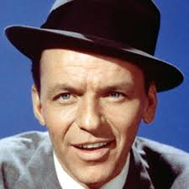
Facts About Regrets
Everyone has regretted something at one time or another
“I Did It My Way” ---
“Regrets, I’ve had a few, but then again to few to mention.”
“He always thought that song was self-serving and self-indulgent. He didn’t like it.”

Slide 5
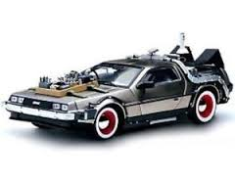
Facts About Regrets
Regrets fall into two categories
Those things we wish we had done.
Those things we wish we had not done.
We cannot go back and change the past.

Slide 6
Some Things You Will Not Regret
Showing kindness and love to those around you.

Slide 7
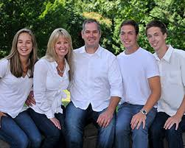
Some Things You Will Not Regret
Giving your family your best

Slide 8
Some Things You Will Not Regret
Burying the hatchet

Slide 9
Some Things You Will Not Regret
Thinking before you speak

Slide 10
Some Things You Will Not Regret
Cultivating a good reputation

Slide 11
Some Things You Will Not Regret

