Slide 1
Rules For Happiness

Slide 2
NOT
Voltarie
“I wish I had never been born”
Lord Byron
“The worm, the canker, and the grief are mine”
Gay Gould
I am the most miserable man on earth

Slide 3
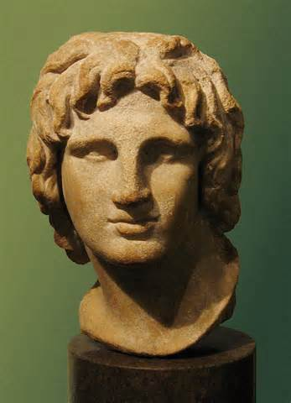
NOT
Lord Beaconsfield
“Youth is a mistake, manhood a struggle, old age a regret”
Alexander the Great
“There are no more worlds to conquer”

Slide 4
Where Is Happiness?
Keep life simple
Cultivate a yielding spirit
Cultivate a forgiving spirit
Be interested in others
Develop real friends
Be grateful for what you have
Live one day at a time

