Slide 1
Summer Time Tendencies

Slide 2
Immodesty
And there a woman met him, [With] the attire of a harlot, and a crafty heart. Proverbs 7.10
  Solomon did not have to describe this woman
1 Timothy 2.8-10
  Modest apparel
  Attitude (a crafty heart) which results in actions and apparel

Slide 3
Summer time problems with modesty
  Weather and clothing styles
  Activities
More acute during the summer
  Seen in attitude of immodest person
  Its affects on others
  Quotes

Slide 4
The way you dress can distract during worship.
I question whom you're dressing for. I hope you are not dressing to attract other men. When you expose yourself--showing cleavage or thighs, it's hard not to look. You make me feel very uncomfortable.

Slide 5
PLEASE consider your brothers! Don't wear low-cut blouses... Don't wear tight slacks or jeans that fit too closely... It's hard to keep a pure mind in the world, but if you dress like the world at church, you make it hard on us while worshipping as well.
When considering what to wear, ask your husband. Men know what causes other men to fail.

Slide 6
I respect sisters in Christ that dress modestly. I expect it from my wife and children. All should respect God's standard.
Leave the skin show to your husband. There is no reason to be wearing spaghetti straps, or shoulder-less dresses. If you're unmarried and doing this, it's the wrong way to attract the right man.

Slide 7
Men
  But I say to you that whoever looks at a woman to lust for her has already committed adultery with her in his heart. Matthew 5.28
  Are to dress modestly too!!

Slide 8
Sexual Sins
Increase during the summer time
Why?
  Manner of dress
  Increase of freedom
Proverbs 7.21-27
There is a cost
  Feeling of being used (shame)
  Pregnancy (fear)
  Reputation being harmed (Ridicule)
  Sin (Guilt)
  Anger (Retribution)

Slide 9
Therefore
Parents know where your children are and who they are with
Young people don’t place yourself in a situation to be tempted, James 1.13-15
Fact
  Teen pregnancies are about the same for “Christians” and non-Christians
  Lax attitudes exist

Slide 10
Vacations and Forgetting About God
Summer time offers more free time and more to do
Two dangers
  Doing things away from home we would not normally do
  Forsaking the assembling of the saints
  Can a virgin forget her ornaments, [Or] a bride her attire? Yet My people have forgotten Me days without number. Jeremiah 2.32

Slide 11
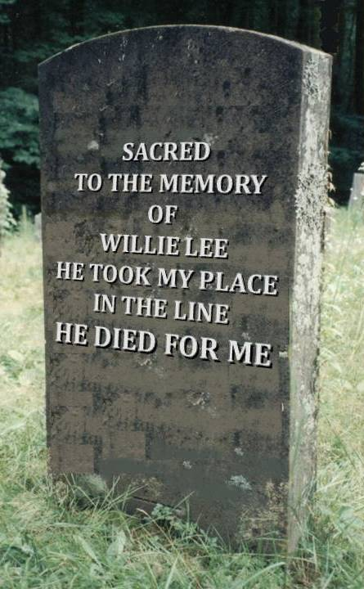
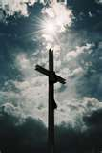
He Died For Me

