Slide 1
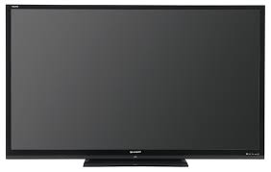

Slide 2
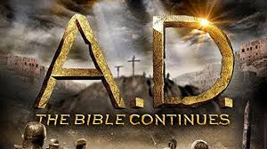

Slide 4
Facts
A lot of people are Biblically illiterate
Many will accept the television or movie as being accurate
The movie and television version is often wrong
Noah about environmentalism
Moses a terrorist
Jesus just a spiritual leader

Slide 5
Why Most Bible Stories and Movies Miss the Mark
Ignorance among the writers and producers
Human traditions
They do not believe the in the inspiration of the Bible
The Bible, 2013 docudrama “This program is an adaptation of Bible stories. It endeavors to stay true to the spirit of the Book.”

Slide 6
Why Most Bible Stories and Movies Miss the Mark
Ignorance among the writers and producers
Human traditions
They do not believe the in the inspiration of the Bible
Not content to speak where the Bible speaks and be silent where the Bible is silent
Skeptics and critics are making many movies

Slide 7
The Bible Is
Produced by God and not by mere men
Confirmed by miracles
A produce of inspiration

