Slide 1
The Christian Stand
Ephesians 6.11-14

Slide 2
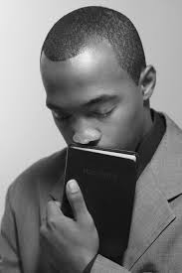
A Christian Stands Against Something
Against the devil
Against wrong
False doctrine

Slide 3
A Christian Stands For Something
The Gospel of Christ
Everything virtuous
Moral excellence
Good

Slide 4
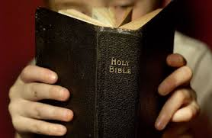
A Christian Stands Upon Something
God’s word
Cannot be broken
Promises of God

Slide 5
A Christian Stands In Something
The Grace of God
The Gospel
The Faith

