Slide 1
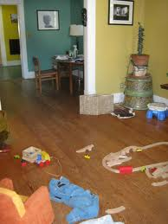
Parable of the Empty House

Slide 2
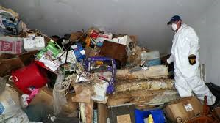

Slide 3
The Battle With Evil And Sin
Obedience demands an eviction of sin
Repentance demands a change of life
Evil is not destroyed

Slide 4
An Empty House Must Be Filled
New born babes in Christ are empty houses
They must be filled

Slide 5
The Return of Evil and Sin
Anybody can fall
The Bible warns us about leaving our first love

Slide 6
Remedy
Fill the house
10 Because of the violence done to your brother Jacob, shame shall cover you, and you shall be cut off forever. 11 On the day that you stood aloof, on the day that strangers carried off his wealth and foreigners entered his gates and cast lots for Jerusalem, you were like one of them. Ob 1:10-11 (ESV)

Slide 7
Remedy
Do some house cleaning from time to time

