Slide 1
You Cannot Lose

Slide 2
Lose
To no longer have, become unable to find, to fail to keep, to fail to win
Squander, neglect, forfeit

Slide 3
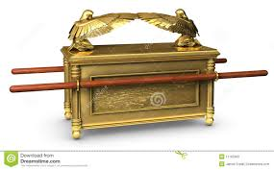
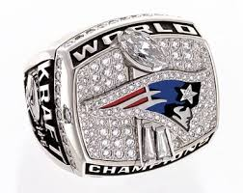
You Cannot Lose What You Don’t Have

Slide 4
You Cannot Lose What You Don’t Have
We don’t have tomorrow
We only have today
Bible warnings about the soul
We have a soul to lose

Slide 5
Cannot Lose Your Salvation
Not teaching the doctrine of once saved always saved
Many passages warns us about losing our salvation
A person who is faithful cannot lose their salvation

Slide 6
You Cannot Lose Your Faith
Bible speaks of those who were faithful becoming unfaithful
Making ship wreck of their faith
Others are mentioned
This means they had faith
You cannot lose your faith if…
You remain diligent
Continue in doing what the Bible says
Maintain your good works

