Slide 1
Recruiting Basics for Non-Recruiters Arrowhead Talent Solutions
Clark Harvey
clarkharvey@arrowheadtalentsolutions.com
www.arrowheadtalentsolutions.com
330.316.0867

Slide 2
Today’s Objectives
For you to have the ability to fill a position from beginning to end
To guide you through a recruiting process, step by step
To provide you the basic tools you need to be successful when recruiting new talent to your organization
To provide you with ample opportunities to add significant value the next time your organization needs to recruit new talent

Slide 3
Before You Start Recruiting
Create a hiring plan that includes:
A job description that fully and accurately reflects the position’s duties in a “human voice”
Pay range or budget for the position
Bonus/commission structure
Benefits offered
A clear and easy-to-follow recruiting process (example on next slide)
Identify the decision-making process and the decision-makers

Slide 4
Sample Recruiting Process
Hiring manager requests approval from his/her manager to fill an opening
Hiring manager requests approval from finance
Hiring manager emails approvals to HR
HR conducts kick-off meeting with hiring manager
HR posts job and sources for candidates
HR conducts 30-minute first-round phone interviews (between 4-7 candidates)
HR forwards top candidate resumes and interview notes to hiring manager
Hiring manager informs HR of candidates to invite to on-site interview
HR arranges on-site interviews
On-site interviews conducted
Offer extended to top candidate within 48 hours of on-site interview
Candidate given 3 business days to accept offer
HR proposes offer; to be approved by hiring manager and CEO
HR determines budget for position (hourly wage range or salary range)
Once all interviews done, HR conducts debrief meeting

Slide 5
Rules to Live by
Move quickly
Marketable candidates do not wait. Lack of decisiveness indicates a lack of interest to applicants
Always sell the company and opportunity
Highlight what is special about your company every step of the way
Identify talking points before you begin recruiting
Examples include:
Flexible hours
Remote work
Employee recognition
Generous vacation and benefits packages
Profit sharing/bonus/commission plans
Always identify a candidate’s hot-button issues that will determine how he/she will make the decision
Examples include:
Commute
Work/life balance
Pay range
Spouse’s input
Work environment
Re-affirm a candidate’s interest every step of the way and every time you talk to him/her

Slide 6
Kickoff Meetings
A well-run kickoff meeting with the hiring manager will set the tone for the entire hiring process
Use this time to review the job description, confirm pay/benefits, identify interview teams, confirm interview process, and create a profile for the ideal candidate
Temper an unrealistic manager’s expectations as soon as possible
If possible, use a form to guide the discussion, but do not reduce the importance of your kickoff meeting to simply completing a form

Slide 7
Sample Kickoff Meeting Form

Slide 8
Posting Jobs
If your company uses an applicant tracking system (ATS), start by posting the job there.
Many ATSs have a mechanism to post your job on additional websites like indeed.com and others
If you don’t have an ATS, consider posting on the following websites:
Indeed.com
LinkedIn.com
ZipRecruiter.com
Industry-specific job boards and publications
Do not “Post and Pray”

Slide 9
Marketing Your Open Job
You must market and sell your job and company to potential job seekers, especially if your organization does not have a strong employer brand
Ideas to market your job:
Have the hiring team and colleagues post about the job via LinkedIn
Post on your LinkedIn and other social media profiles
Visit local networking events
Sponsor a local job search group
Sponsor a local industry-specific meeting and speak to the group
Email blasts

Slide 10
Searching for Candidates
If you are fortunate enough to have a lot of interested applicants, count yourself lucky!
However, if your applicants are not hitting the mark or you need more candidate flow, consider hunting for candidates yourself
Potential strategies:
Join LinkedIn groups
Search for candidates on LinkedIn using your free account
Consider paying for a LinkedIn Recruiter account
Visit local colleges and career fairs to source candidates
Invite candidates to apply to your role on indeed.com

Slide 11
Screening Candidates
Review resumes as quickly as you can
Evaluate candidates using the requirements of the position as a guide
Use the “Nice-to-Have” skills on a secondary basis only
If no or very few candidates are hitting the mark, use this data to have a discussion with the hiring manager
Select candidates for a first-round phone interview (ideally, 5 candidates)

Slide 12
The Candidate Funnel
Sales professionals often talk of their “pipeline” or sales “funnel”
A recruiting process will be very similar.
If you interview 5 candidates over the phone…
Expect 3-4 to “pass”
Expect the hiring manager to select 2-3 candidates to interview from this batch
Expect to hire 1 of the final 2-3 candidates
5
3-4
2-3
1 hire

Slide 13
Phone Interviews
Use an interview guide to inform and shepherd the discussion (sample on next page)
Don’t be cagey about money. Tell candidate up front about your pay range and don’t ask what the candidate’s salary is. Only ask what he/she needs to make a move
Review the candidate’s resume ahead of time and prepare questions about his/her background
Shut down any potential distractions
Plan to spend 30 minutes on the phone
Start the discussion by setting the tone and being an open book. Define the role, talk about the company, introduce yourself, be friendly, sell the position
Don’t “check boxes”; be a real human being
Leave time for the candidate to ask questions

Slide 14
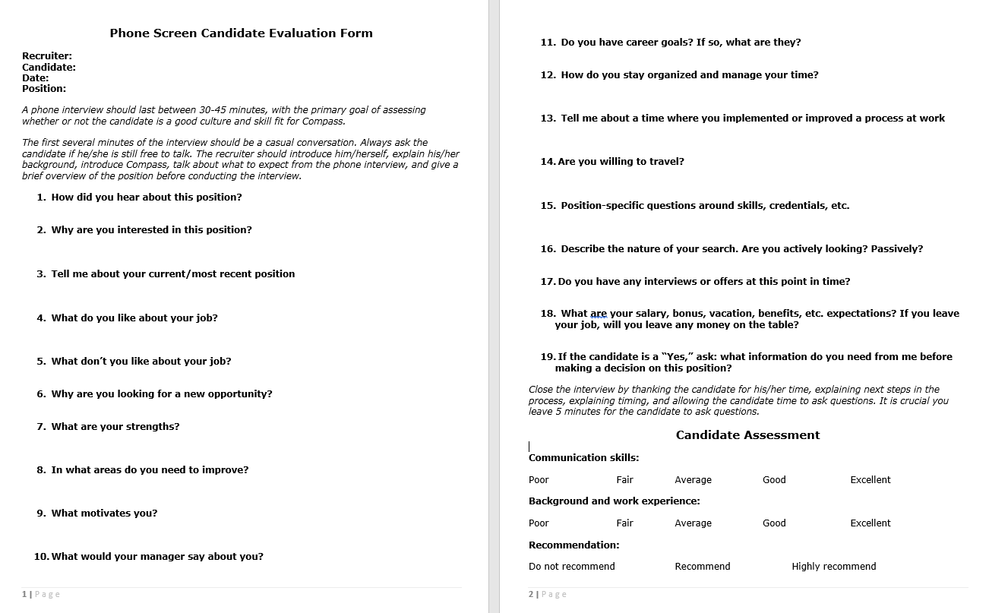
Sample Phone Interview Guide

Slide 15
On-Site Interviews
Ahead of time, send the candidate a confirmation email, copy of the job description, and an interview itinerary
Ensure interviewers are prepared (sample interview guide on next page)
Use this time to market the organization’s high points with your candidates
Take candidate on a facility tour
Introduce candidate to potential colleagues
Have drinks/snacks ready
Ensure that you’ve provided staff (especially front desk) an itinerary for the day
At conclusion of interviews, conduct a quick debrief meeting with the candidate
Conduct a 3rd round of interviews only if absolutely necessary

Slide 16
Sample On-Site Interview Guide

Slide 17
Post-Interview
Gather interview team for a quick debrief meeting to discuss all candidates for the role (Interview Debrief Process form on next page)
Use the A, B, C system to guide discussion
Display the ratings on a whiteboard if possible
Guide the decision-makers to a decision and insist it be made by the end of the meeting
Remember that time kills all deals

Slide 18
Interview Debrief Process Form

Slide 19
“One More Candidate”
If the hiring manager expresses a desire to see one more candidate, consider these options when responding:
“Why do you feel the need to review more candidates at this juncture?”
“How am I supposed to do that?”
“What is it about these candidates that doesn’t hit the mark?”
“Based on the job description and everything else you’ve told me about the role, this candidate is perfect.”
Use data:
12 candidates applied to the position
I sourced 4 candidates
I phone interviewed 7 candidates
You reviewed 5 resumes
You have interviewed 4 candidates on site, and we’ve classified 2 of the 4 as “A” candidates

Slide 20
Offers!
By this point in the process, you should feel good about your prospects of landing your top candidate, because you:
Have carefully planned and executed a strategic and thoughtful hiring process
Kept in constant communication with your top candidate and have a good understanding of what makes him/her “tick”
Regularly communicated with the hiring manager and other decision makers every step of the way
Have been very up-front with your top candidate about your compensation plan and his/her compensation expectations
Make a strong offer. Do not get cute at this juncture. Doing so will generate negative feelings and damage your relationship with the new hire
Make this an easy decision for your new hire and ensure he/she will be excited to accept
If the candidate wishes to negotiate, ensure he/she is doing so in good faith. From there, if you have wiggle room, do your best to close the candidate in as few iterations as possible

Slide 21
Onboarding
Now that you’ve closed the deal, your work continues
Providing an outstanding onboarding experience will make the candidate feel good about his/her decision to join your team
Have the following steps planned out ahead of time:
Drug screen
Background check
Physical
First day instructions
First day paperwork
Touch points with your candidate before start date
Working with candidate on when to put in notice at current company
Pre-hire gifts
Office supplies
Business cards
Physical access
Software access and email accounts
New hire orientation on first day
First week plan (sample next page)

Slide 22
Sample Onboarding Plan: Week 1

Slide 23
How Arrowhead Can Help
Search for you as a third party:
Contingent
Container
Project-Based
Retained services
Serve as in-house recruiter for a determined period of time
Recruiting process training if your company is rapidly growing and will need a dedicated, full-time recruiter

