Slide 1
Building Internal Capacity
Participation = Power

Slide 2
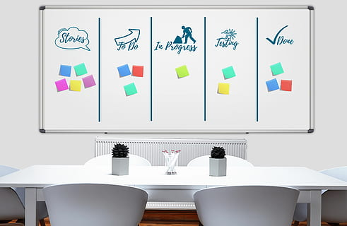
Another casualty of the pandemic - relationships
We know building unity is all about building relationships.
We missed saying goodbye to colleagues at the end of 2019-2020.
We missed saying hello to new colleagues at the beginning of 2020-2021.
We missed supporting each other in celebrations and challenges.

Slide 3

We have a solid foundation to rebuild on
In 2019-2020 our unity, participation, and membership were in a steady upswing.
We can start rebuilding those important connections before we return to school sites and as we come back together.

Slide 4
January Site Rep Rebuilding Task
Identify and ask between one - four non Site Reps (depending on the size of your school/group) to help you build communication and participation at your site.
How to do it?
Brainstorm who are the “go-to” people or influencers at your site. This is not asking for volunteers - you want to recruit the right person/people.
Identify who is the best person to make the “ask”. Plan what you are going to say. (You are asking them to agree to help Site Reps communicate with other staff and encourage them to participate in FSUTA activities).
Make the “ask”. It may take more than one conversation but the right person is worth the second (third) effort.

Slide 5

Your Executive Board contact will be checking in with you
Before January 25th, your Executive Board member will be contacting you to learn the name(s) of your Site Influencers.
If you need help, don’t hesitate to contact them at any time in the process.
Executive Board members will give a report of your success at the Executive Board meeting on January 25th.
Results will be shared at Rep Council on February 1.
If you don’t remember who your Executive Board contact is,
or how to reach them, the information is on FSUTA.org.

Slide 6
February Site Rep Rebuilding Task
Suspense builds!

