Slide 1
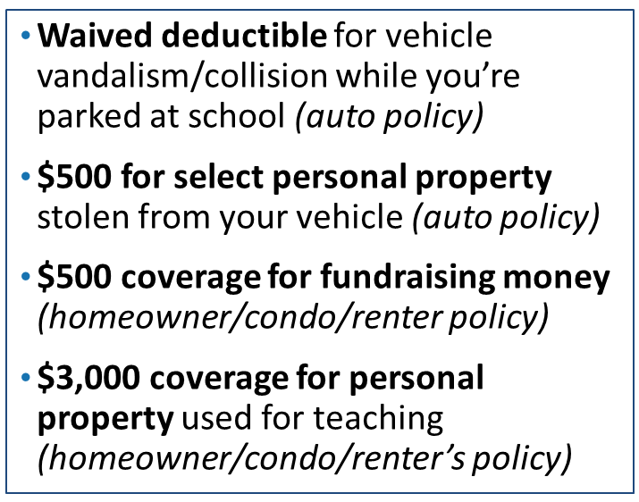
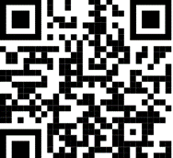
CTA Endorsed Auto & Home/Renters Insurance
SCAN FOR
GIFT CARD!
Tami Phillips
707-799-0221
www.readyforquote.com/tami
Notes:
Please know that you and your members can still expect excellent service from California Casualty. We are here for you! Please take a moment to complete our survey which can be accessed by scanning the QR code on the screen. Everyone from the Service Center tonight who completes the survey will be entered into a drawing for a chance to receive a $100 gift card of choice.
Please let us know when your next association meeting is so that we can share the scheduling details with your site representatives.

