Slide 1


Accommodations, and leaves for educators During covid-19
Presented by:
Michelle Washington, CTA Staff

Slide 2

Agenda
General Safety per MOU
Who is considered vulnerable and what are your rights under ADA/FEHA?
How do you obtain reasonable accommodations?
What leaves are available?
Handout available: bit.ly/covid19leaves
Note: I am not an attorney & this should not be considered legal advice.

Slide 3
Safety Precautions – from FSUTA mou
i. Hand sanitizer will be provided to occupied classrooms and used non-classroom workplaces. All hand washing/hand sanitizing supplies noted above or otherwise provided shall be checked and restocked / refilled as soon as possible based on a teacher’s notification to the front office that supply is running low. All sanitizers will be checked and refilled, as needed, nightly.
ii. Common Spaces - Physical distancing stickers, tape, signage, or floor markings will be provided in common or shared spaces such as cafeterias/multipurpose rooms, offices, staff rooms, copy rooms, libraries, hallways, and playgrounds when practical
.iii. Face coverings shall be worn on campus at all times.K-95 masks will be provided upon request from a bargaining unit member. .
iv. The District shall maintain the proper PPE supplies to meet student and employee needs including: face coverings, gloves, cleaning supplies, plexiglass, air purifiers, handwashing supplies, hand sanitizer, and anything else readily available in the district warehouse
v. The District shall ensure all HVAC systems operate on the mode which delivers the freshest air changes per hour when in use and will follow Article 17.1.i.
.
Notes:
FSUSD must follow CDPH & OSHA guidelines

Slide 4
Safety Precautions – Cont’d.
vi. The District shall provide a self-screening sheet for students and staff to adhere to and follow prior to entering a school ground. Unit members should self-monitor for symptoms and shall not report to their worksite if sick. A self-screening sheet will be provided to each staff member. They will use the self-screening sheet daily and follow the instructions on the sheet.
vii. Physical distancing is encouraged to the greatest extent possible; Adults should make every effort to stay 6 feet from one another and 6 feet away from students. Student chairs will be no less than four (4) feet apart. There will be no more than 20 students in a class, or the maximum number of students as prescribed by the student chairs distancing and teacher space distancing requirements. The final number used will be the lesser of the numbers.
viii. Unit members shall be trained on how to do visual checks of students for symptoms. The District shall provide written protocols to each unit member for how to report a student’s symptoms. Unit member shall send students who appear to be symptomatic to the office.

Slide 5
Reasonable accommodations - overview
The federal Americans with Disabilities Act (ADA) and the California Fair Employment & Housing Act (FEHA) protect the rights of employees with disabilities.
In addition to prohibiting discrimination based on disability, these laws also entitle employees with disabilities to reasonable accommodations so that they can perform the essential functions of their job.

Slide 6
What is a disability?
“Disability” means any physical or mental condition that limits one or more major life activities. This includes permanent as well as temporary conditions.
Many conditions that increase the risk of COVID-19 complications are likely themselves to be considered disabilities –e.g., chronic lung disease, moderate to severe asthma, serious heart conditions, diabetes, kidney / liver disease, hypertension, and conditions that compromise immunity (e.g., cancer treatment, immune deficiencies).
Diagnosed mental impairments –e.g., anxiety disorders, PTSD etc. –may be particularly acute for employees during the pandemic.

Slide 7
What is a disability? –cont’d.
But other conditions that increase the risk of COVID-19 complications are not disabilities –e.g., age and tobacco use.
The same applies to other equally compelling concerns, such as an employee’s family member(s) at heightened risk for COVID-19 complications.
And by themselves, obesity (which is a higher COVID-19 risk factor) and pregnancy (which might be a higher risk factor) are not disabilities, though obesity may be caused by a disability, and pregnancy may result in a disability.

Slide 8
Reasonable accommodations
An employee with a disability is entitled to a reasonable accommodation to permit him or her to perform the essential functions of the job.
This entails:
  Accommodation – some modification / adjustment to the job, including working from home, PPE, a restructured work site, transfer to a position with less contact with others, or unpaid leave.
  Reasonable – no undue hardship for the employer.
  Essential functions of the job – the point is to permit the employee to perform his or her essential job functions.

Slide 9
Reasonable accommodations
Once requested, the employer is required to engage in an interactive process with the employee to identify one or more reasonable accommodations.
Intended to be a flexible and informal process:
  No required timing –and may be renewed / modified as necessary;
  No required procedure –and no need for legal involvement;
  No required “magic words”

Slide 10
Interactive Process
The “interactive process” is intended to be both:
  Interactive – a non-adversarial back-and-forth between employee and employer; and
  A process – an ongoing discussion and collaborative problem-solving exercise, possibly over multiple meetings.
It is not a legal proceeding requiring specialized legal or medical knowledge.
Notes:
Parties must participate in good faith –sharing information and exchanging ideas in order to identify a reasonable accommodation.
Beyond this, there is no required format or procedure.
Though reasonable accommodations may be proposed, considered, and rejected, this is not collective bargaining. The process can be initiated without an identified reasonable accommodation, multiple accommodations can be proposed, and there is no impasse.

Slide 11
Interactive Process - CONT’D.
While there is no required format, it often proceeds as follows:
Identify – the disability, the physical or mental limitations impacting the ability to perform the work; the barriers that exist to performing the work; and the essential functions of the job.
Brainstorm – about ways that the disability can be accommodated.
Assess – whether the proposed accommodation is likely to be effective, reasonable, and not present an undue hardship.
Notes:
Because this is a process, these steps can be – and often are – performed repeatedly and over multiple meetings.

Slide 12
During the Interactive Meeting
HR may ask you:
  How the disability creates a limitation
  How the requested accommodation will effectively address the limitation
  Whether another form of accommodation could effectively address the issue
  How a proposed accommodation will enable you to continue performing the "essential functions" of your position
Notes:
(that is, the fundamental job duties)

Slide 13
Medical Documentation
The employer can request medical documentation.
The employer can ask for clarification but must identify the kind of additional information required and provide reasonable time for the employee to obtain and provide it.
The employer cannot ask for medical documentation or information unrelated to the accommodation request, including about the underlying medical cause of the disability.
Notes:
California recognizes that it may take considerably longer to obtain medical documentation during the coronavirus pandemic.

Slide 14
Union Representation
A Union has the legal right to represent employees in the interactive process.
No specialized legal or medical knowledge is required to assist a member in an interactive process. Instead, what’s most important is an understanding of the employee’s work environment and practical needs and a collaborative, problem-solving attitude. For this reason, union representatives are ideally situated to assist in the process.

Slide 15
Possible ACCOMODATIONS at the Worksite
N95 or kN95 mask
Portable HEPA air filter stationed near workspace
Open windows
Plexiglass barrier around teacher’s desk
Students seated more than 6 feet from teacher
Limited number of students in cohort
Attend meetings virtually/teleconferencing
Outside tented classroom
Remote assignment

Slide 16
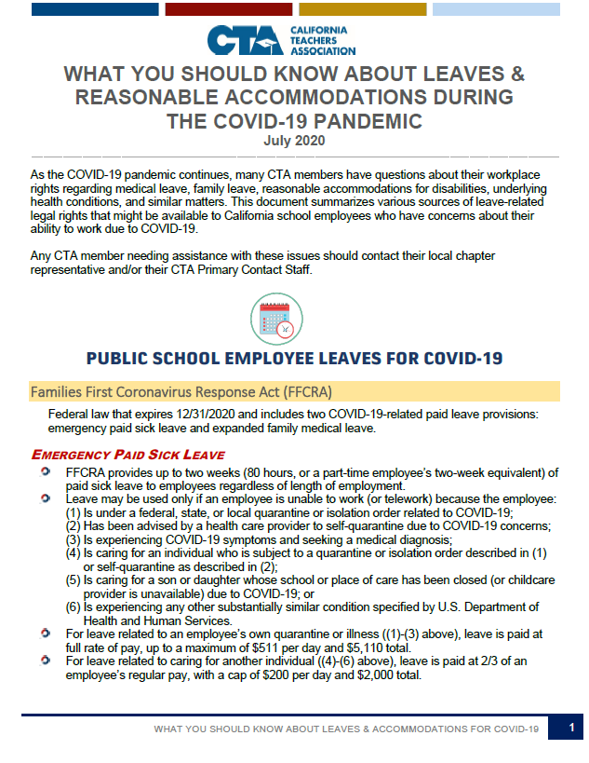
Leave Options in the COVID-19 Era
FMLA & CFRA
WORKERS’ COMPENSATION
CALIFORNIA EDUCATION CODE
CBA
OTHER LEAVES

Slide 17
Family and Medical Leave Act (FMLA) & California Family Rights Act (CFRA)
Up to 12 weeks of unpaid, job-protected leave in a 12-month period for:
  Employee’s own serious health condition that prevents employee from performing essential job functions;
  Family member’s serious health condition; or
  Child bonding within first year of birth, adoption, or foster care.
To qualify, employee must have been employed for at least: (1) 12 months; and (2) 1,250 hours in the preceding 12-month period.
COVID-19 should qualify as a “serious health condition” if it results in hospitalization, continuing treatment or supervision by a medical provider, or another serious condition such as pneumonia.

Slide 18
CA Pregnancy Disability Leave (PDL)
Up to 4 months of unpaid leave for employee who is disabled by pregnancy, childbirth, or a related medical condition.
  Because CFRA does not cover pregnancy as a serious health condition, and PDL separately provides leave for an employee disabled due to pregnancy, an eligible employee can take pregnancy-disability leave in addition to a 12-week child bonding leave.
  The CDC identifies pregnancy as a condition that might cause increased risk for severe illness from COVID-19. See CDC website.
Employer must continue health insurance.
No minimum hours or employment period required.

Slide 19
Workers’ Compensation And Industrial Accident & Illness Leave
The Workers’ Compensation system is the exclusive remedy of an employee against an employer for a work-related injury or illness.
Recent legislation established presumption re: contracting COVID-19 at the jobsite for purposes of awarding workers’ compensation benefits.
Under the California Education Code, public school employees whose workers’ compensation claims are approved are entitled to at least 60 days of full salary.
After industrial accident and illness leave is exhausted, the employee is entitled to sick leave and differential pay leave.

Slide 20
Sick Leave and Differential Leave
10 days per year for full-time employees.
  Prorated amount for part-time employees.
Accumulates from year to year.
Credit for leave of absence need not be accrued prior to taking the leave by the employee and the leave of absence may be taken at any time during the school year.
Up to 5 school months of differential pay due to illness or injury after exhausting all annual and accumulated sick leave.
  Differential pay is regular salary MINUS the amount actually paid to a substitute OR, if no sub is employed, the amount a substitute would have been paid.
  But if district adopts 50 percent rule under EC 44983 or EC 87786, employee must be paid 50 percent or more of regular pay after exhausting all sick leave.

Slide 21
Reemployment List
When sick leave and differential pay are exhausted, and the employee is not medically able to resume work, the employee is placed on a reemployment list:
  24 months, if probationary;
  39 months, if permanent.
When medically able, during the 24-or 39-month period, the employee shall be returned to employment in a position for which they are credentialed and qualified.

Slide 22
CBA & Other Leaves
CBA
  Don’t forget to check the collective bargaining agreement! (e.g., catastrophic leave bank, personal necessity leave, etc.).
Other Leaves
  Discretionary leaves for accident, illness, or quarantine. See EC 44964.
  Kin Care – Labor Code sections 233 and 246.5.
  Voluntary disability insurance.
  CalSTRS Disability.

Slide 23
HANDOUT: links to more resources
bit.ly/covid19leaves

