Slide 1
WELCOME TO YOUR UNION!
Three Associations. One Movement.
#WEARECTA
FSUTA
Educate! Engage! Empower!

Slide 2
The Beginning of
Your Professional Journey…
YOUR MEMBERSHIP IS
For nearly 160 years CTA members have advocated for educators and students to ensure every person has access to a free quality public education in California. Our successes include:
1867
1913
1915
1927
Access to public schools for all students
Retirement with dignity
Ending child labor in California
Preventing pregnancy firings

Slide 3
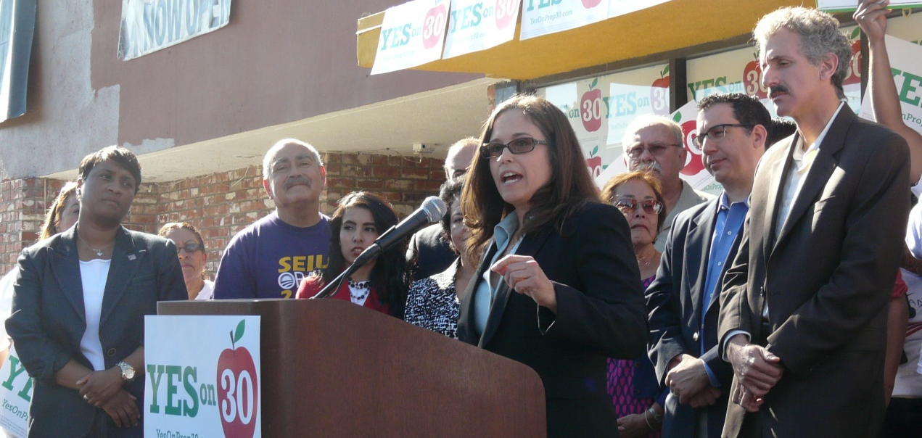

Your Journey Will Become Your Legacy
What part will you play in our progress toward greater equity, access and fairness for all California’s students?!
2012
CTA leaded the fight to pass the Prop. 30, generating $42 billion for public schools and local services over seven years.
2017
Supporting the nationwide #Red4Ed Movement and the fight for fundamental services for our public schools

Slide 4
Strengthening
Our Collective Power
We believe that highly-skilled professionals should have a voice in their workplace. After all, a good working environment is a good learning environment.
CTA supports your local leaders negotiate fair wages and healthcare benefits for all members.

Slide 5
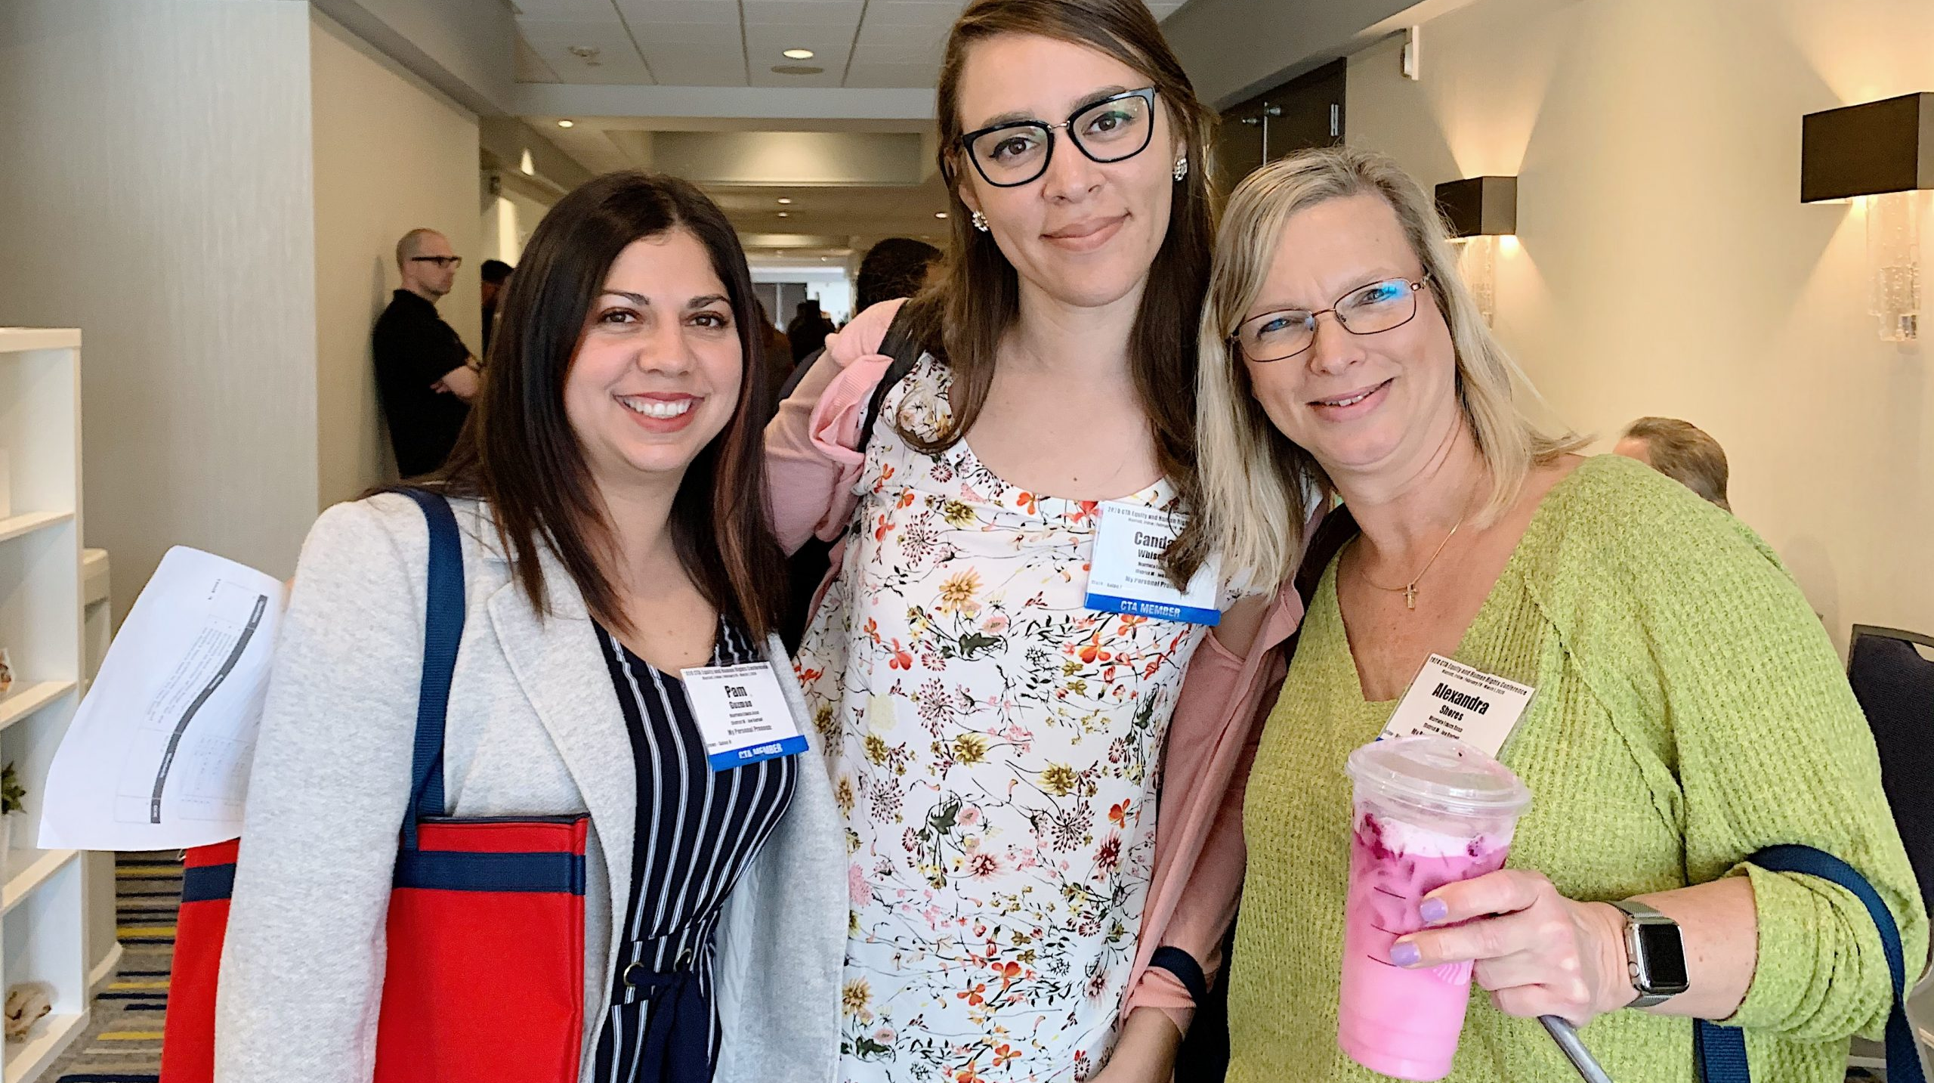
Professional Growth Opportunities
Improve your professional skills at the New Educator Weekends, Good Teaching Conferences, or other conferences offered each year.
And attend one (or many) of CTA’s Professional Development trainings…now virtual. You’ll learn how to connect with your students remotely, brush up on skills for distant teaching, and become a more well-rounded teacher.
www.CTA.org/events

Slide 6

Scholarships & Grants
CTA offers a number of scholarships and awards to educators and members of the community who promote quality public education and impact their students and community.
Through CTA’s Institute for Teaching, we award innovation grants every year to members who need extra money to bring their ideas to life.
www.CTA.org/scholarships

Slide 7
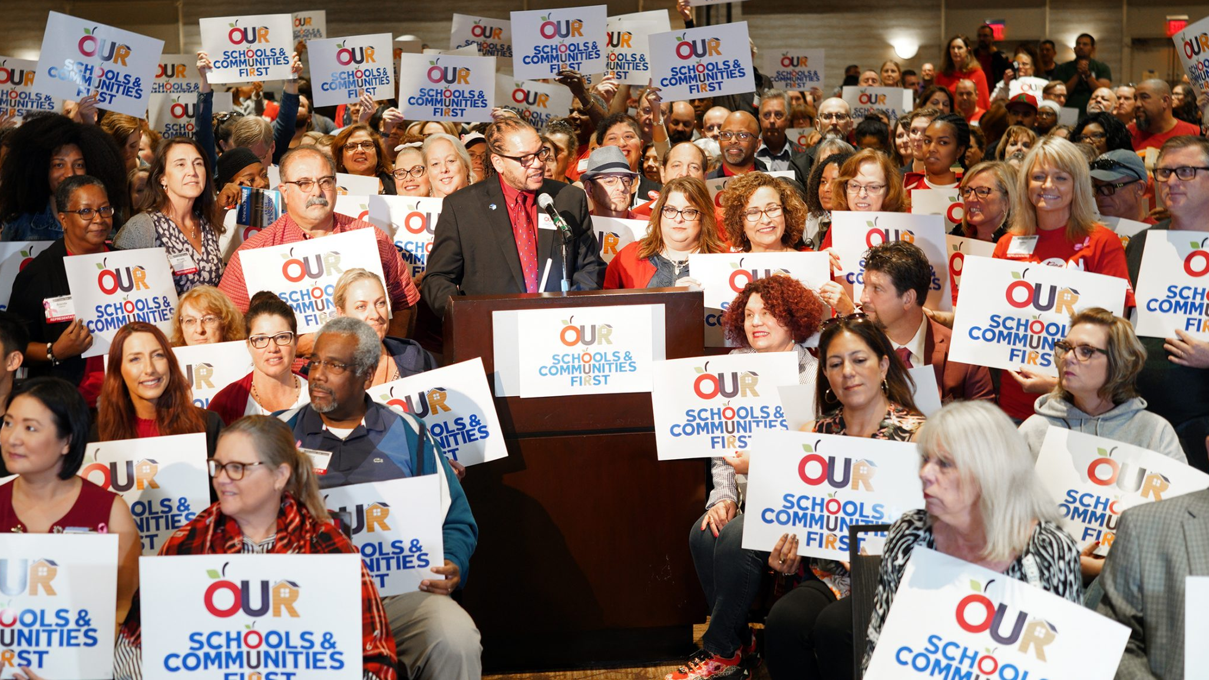
Advocating for You and Your Students
YOUR VOICE ON LOCAL, STATE & NATIONAL
CTA has built a legacy of standing together and working for our members, our students, our craft and the belief that public education is a cornerstone of American democracy. That belief drives our advocacy at the State Capitol and our nation’s Capitol, as well as our local school board meetings.
And, in the event that you need us, you’ve got a legal advocate to represent you on work-related issues.

Slide 8

CTA Access to Savings
CTA Access to Savings, for members only, features the nation’s largest private discount network.
Find savings up to 50% on travel, entertainment, along with everyday things like food, clothing, car care, even home and garden supplies. In fact, use the program regularly and you could save enough to offset the entire cost of your dues!
www.ctaMemberBenefits.org

Slide 9
Healthcare, Insurance and Long-Term Savings
While your local chapter negotiates salary and healthcare, your membership is your gateway to savings on discounted auto, home, and insurance programs. Loans for autos, personal- even home loans are available. Retirement planning should begin as soon as possible. Calculators and tools can assist you whatever your age.
www.ctaMemberBenefits.org
www.ctaInvest.org

Slide 10
FSUTA worked to improve the conditions of teaching and learning in your school through member-driven decision making.
Ratified 2019-20 contract with a salary increase and lower class sizes TK - 12
Negotiated flexibility during emergency learning in spring 2020
Frequent surveys of membership, monthly Site Representative Council, Sunday newsletters, committee updates, listening sessions/forums, lunchtime site visits, etc.
Paid preparation time during the work day, duty free lunch, paid overages for student contact, site based determination of collaboration, steps of progressive discipline, reduced adjunct duty, evidence based evaluation, paid PD days, Catastrophic Leave Bank, authorized use of leave to care for family members embedded in contract

Slide 11
#WeAreFSUTA
Members
Site Reps
Executive Board
President
CTA PCS
Committees
1100+ unit members
Almost100% membership
80+ Site Reps
13 Executive Board Members
20+ Committees
35 school sites and specialist groups
Award winning website FSUTA.org
#WeAreFSUTA on social media

Slide 12

Time sensitive Don’t miss out!
Complete FSUTA Membership Application
EEL Insurance
The Standard Disability Insurance 180 days to apply
Solano First Federal Credit Union – Dues rebates 10% each month
Catastrophic Leave Bank donation Deadline Sept. 30
Proof of Medical Benefits (if not taking employer benefit)
Not retroactive
California Casualty quote on auto, home, renters insurance

Slide 13



&
Of Membership $117.08/mo
If you were a CTA member in another district, you must reenroll to prevent a lapse in membership.
Dues are deducted from your pay check 10 months/year – no dues is deducted in July and August
Monthly dues covers your membership to NEA, CTA and FSUTA. FSUTA dues has not increased in 10 years.
So much value for your dues dollar:
Educator Employment Liability Insurance – something you cannot be without!
All the rights and benefits of NEA, CTA, and FSUTA including voting rights on contracts and elections
Professional Association advocating for social justice, equity, and protection of public education
Free participation in high quality PD and Conferences through NEA, CTA, FSUTA
Legal representation in all work related matters and yearly half hour for non-work related legal services
The Standard Disability Insurance – something you should not be without!
California Casualty Home/Auto/Renters Insurance
Deals and discounts large and small from hotdogs to Hawaii (ctamemberbenefits.org & MyDeals app)
Solano First Federal Credit Union – rebate covers more than one month of dues with a direct deposit
Money management services - Loan Forgiveness Programs and Investments
California Educator and NEA Today Magazines

Slide 14

Videos to Share
CTA/NEA UNION VIDEO (2:29)
CTA/NEA UNION VIDEO (0:30)
CTA WONDERFUL JOB VIDEO (0:31)
CTA ADVOCACY VIDEO (0:31)
MEMBER BENEFITS VIDEO (5:10)

Slide 15
Join Us
You can easily join online today.
Join.cta.org
Email
FSUTAOFFICE@gmail.com
JOIN

Slide 16

Last Thoughts before Questions
Nancy Dunn
fsutaprez@gmail.com
Fsuta.org

