Slide 1



Housing Authority of McDonough County
Housing Choice Voucher Landlord Resources

Slide 2
What is the Housing Choice Voucher Program?
Formally known as the Section 8 Program
Provides rental assistance to low-income families and individuals
Funding is provided by the US Departments of Housing and Urban Development (HUD)
HAMC Service Area (All cities and townships in McDonough County)
Interested individuals and families can only apply when the waiting list is open
Immediate housing assistance is not available

Slide 3

Why become an HCV Landlord?
You choose your own tenants
Less turnover
Reduce homelessness and offers housing stability for those in need
Steady monthly rent payments
Free advertising and marketing of your units at www.ilhousingsearch.org
Minimal paperwork

Slide 4

Selecting a Resident
Landlords are responsible for screening their potential residents
Tips for screening: Contact current or former landlords, meet the potential resident at their current residence for a unit inspection.
The HAMC does screen tenants during initial eligibility only. We screen for income restrictions and criminal backgrounds.
The HAMC does not screen tenants for previous rental history.

Slide 5
Easy steps to get the Housing Assistance Payment in your pocket!
List your property at www.ilhousingseach.org
Complete and submit the required unit documentation provided by the tenant/family
Negotiate rent and agree on an amount
Pass an HQS Inspection
Execute Housing Assistance Payment contract
Receive Housing Assistance Payment and enforce the lease

Slide 6
Required documentation for Move-Ins
W-9 Form
Copy of Social Security Card or EIN documentation
Sample Lease
Certificate of Occupancy, if applicable
Voucher
Proof of Ownership
Request for Tenancy Approval (RFTA)
Owner’s Declaration
Direct Deposit Form

Slide 7

Inspections
There are 5 types of inspections
    Initial
    Biennial
    Special
    Emergency
    Quality Control
Housing quality standards help to ensure that your home will be safe, healthy, and comfortable.
Every house or apartment must have at least a living room, kitchen, and bathroom. A one-room efficiency apartment with a kitchen area is all right. However, there must be a separate bathroom for private use. Generally, there must be one living/sleeping room for every two family members.

Slide 8
Common Inspection Fails
Damaged Door Hardware and locks (includes unauthorized double keyed dead bolts)
Missing knock out plugs on junction boxes in basements at light fixtures and furnaces
Inoperable/defective GFIs (not grounded)
Missing/improperly installed pressure relief valves and discharge lines on water heaters
Inoperable and Improperly installed Smoke and Carbon Monoxide Detectors
Inoperable stoves (all burners and oven must work)
Damaged and missing weather stripping around exterior doors
Inoperable windows (do not stay up when raised)
Defective interior and exterior paint surfaces-cracking, chipping and/or peeling
Missing and damaged handrails (interior and exterior)
Toilets not secured to the floor
Insecure and damaged faucets at kitchen and bathroom sinks
Dilapidated exterior buildings (sheds, carports, garages)

Slide 9


Rent Determination
“Rent Reasonableness”
In negotiating rental rates, the following factors must be considered:
◦ Current Payment Standard
◦ Number of bedrooms in unit versus what tenant is eligible for
◦ Utilities
◦ Rent comparables
Once landlord approves rent offer, Tenant is approved to move into the unit.

Slide 10
Legal Agreement between the Landlord and HAMC
Outlines the Landlord’s rights and obligations
Outlines the HAMC’s rights and obligations
Outlines tenant’s rights and obligations
Outlines who pays what utilities
Modification is not permitted
Executed and returned with the executed lease to the HAMC
Once the signed HAP and Lease are received, the Landlord will start receiving their monthly HAP payment
Housing Assistance Payment (HAP) Contract

Slide 11
Payment Standards
Payment Standards can change annually based on the Fair Market Rent
Payment Standards are not the contract rent that can be charged, unless the utilities are included.

Slide 12
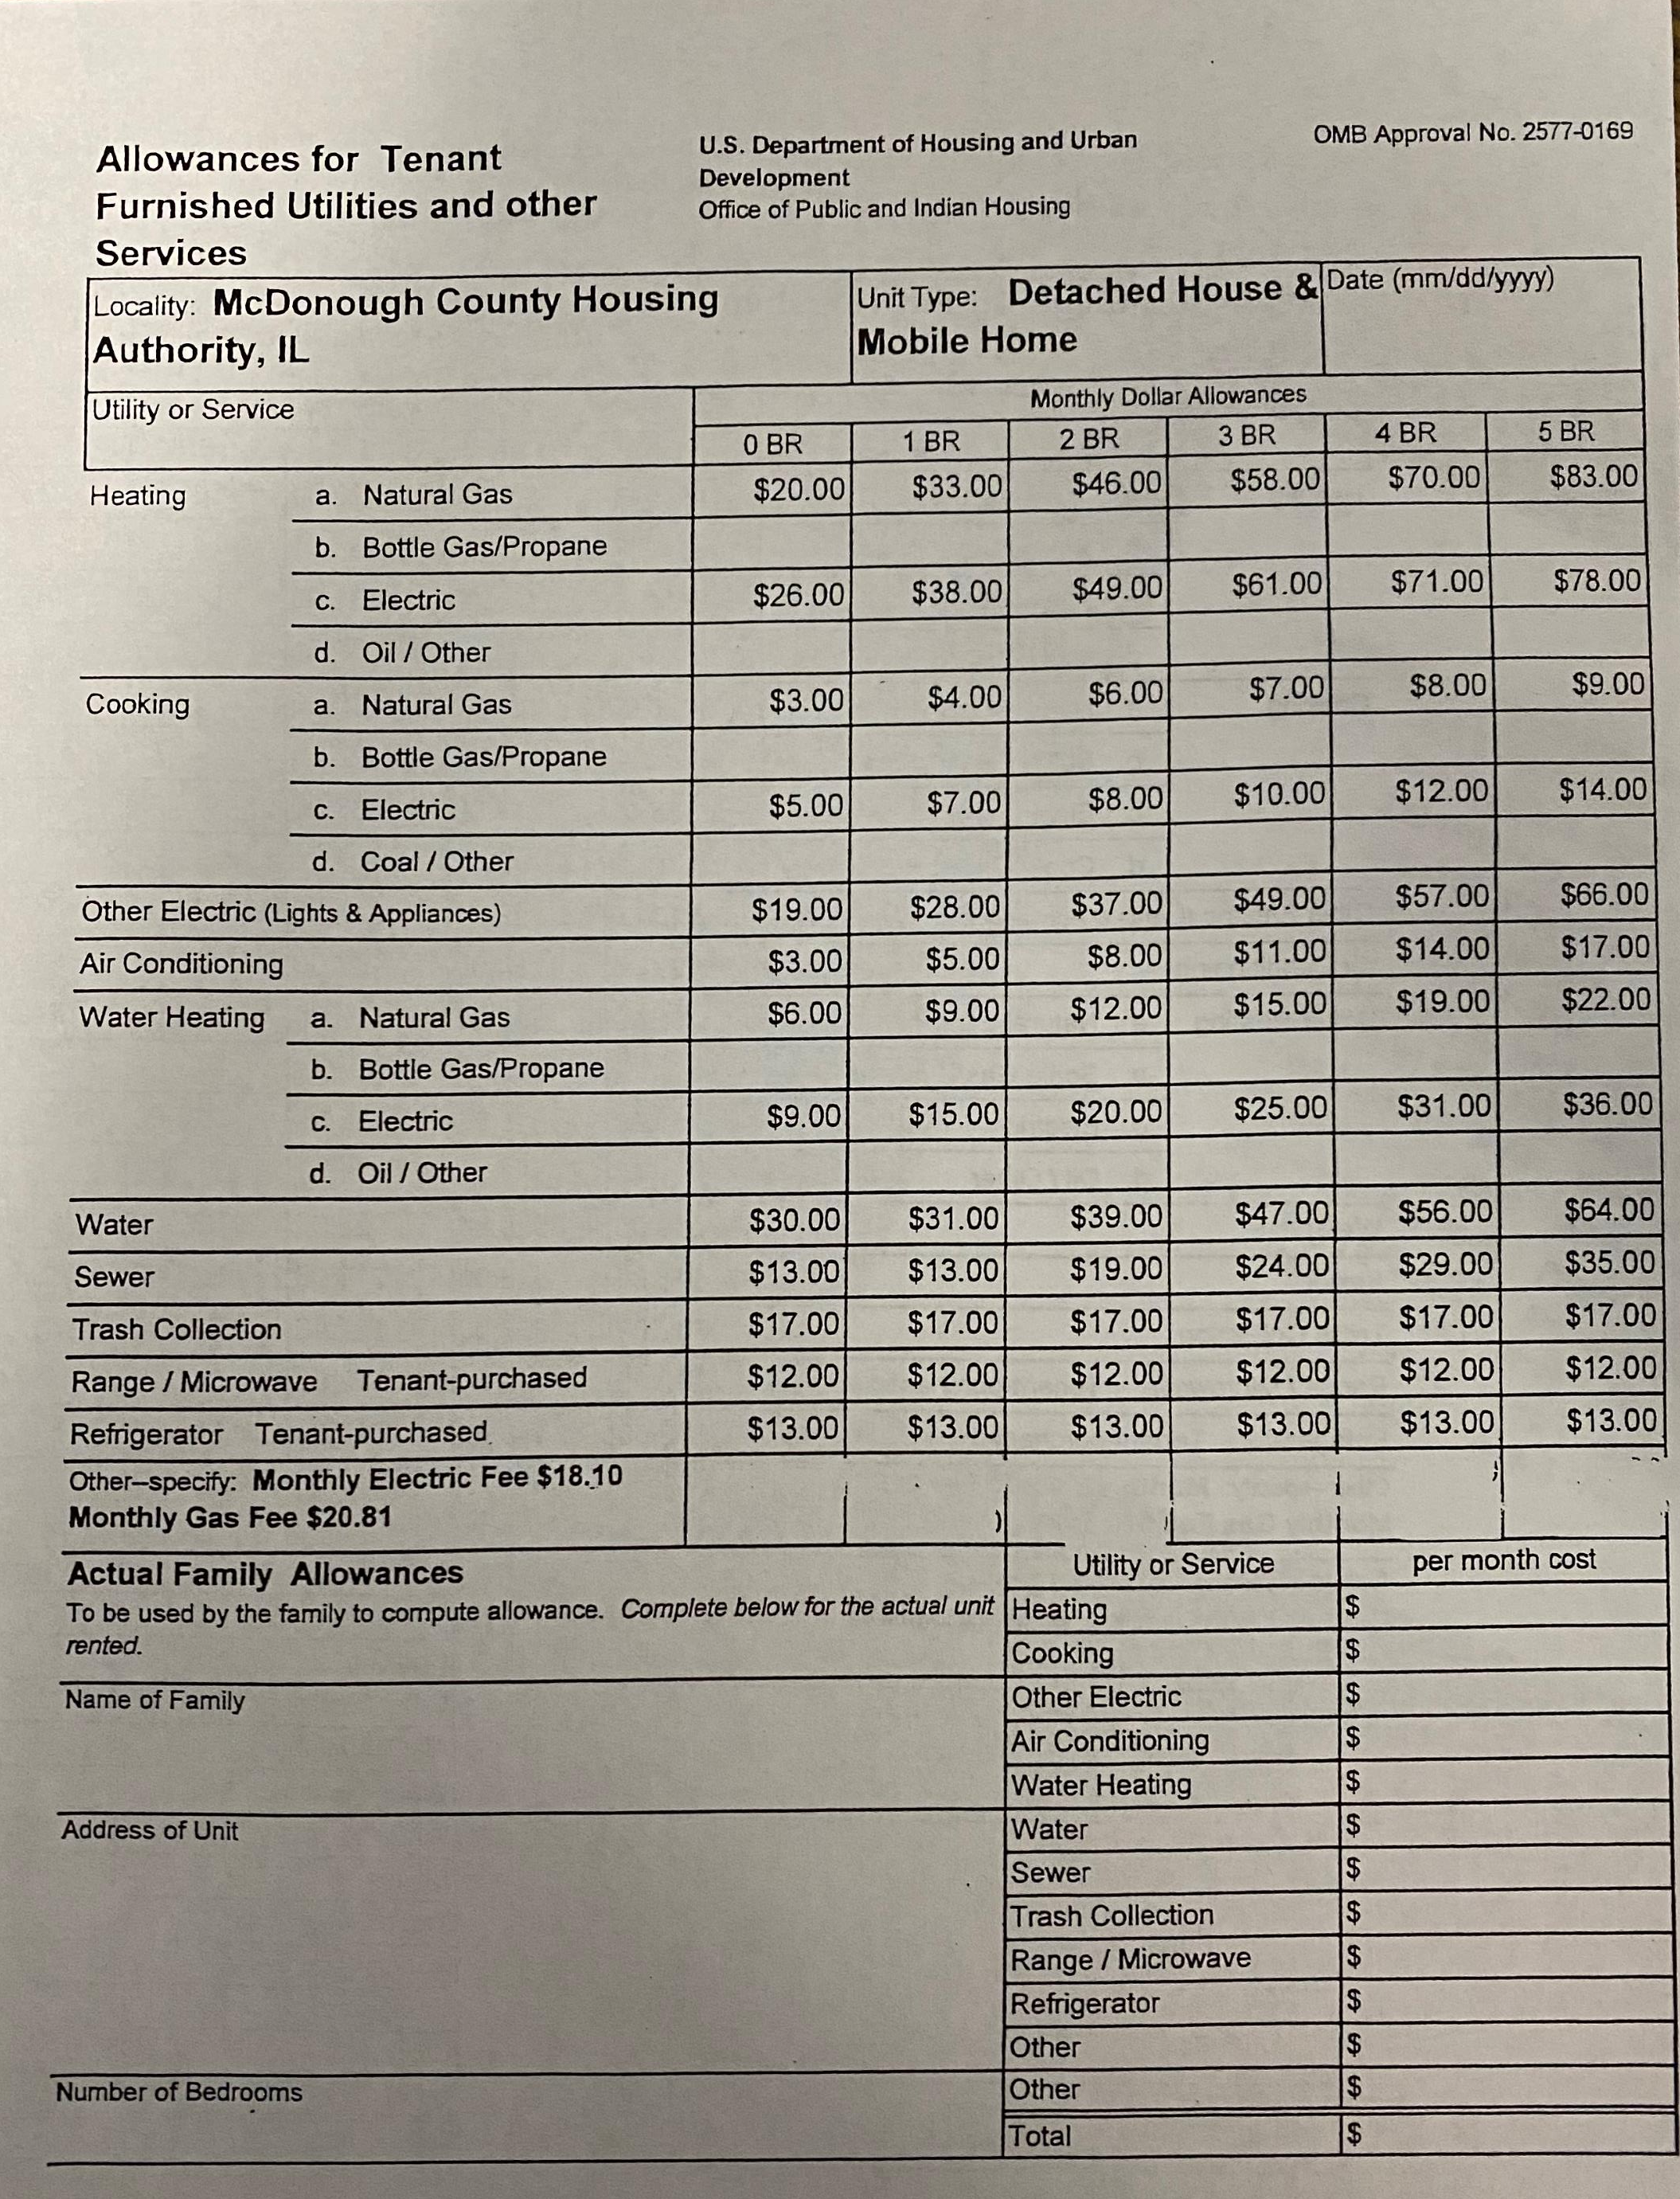
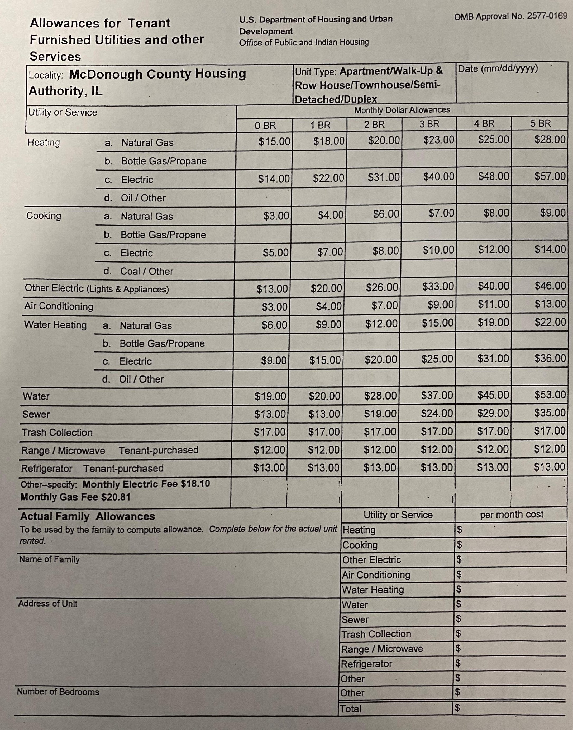
Utility Allowances
Utility Allowances are re-evaluated annually.
They increase and decrease on a local level which could result in a change in utility allowances annually.

Slide 13
Annual Recertifications
Tenants must recertify annually
Section 8 Coordinator verifies income, assets, expenses and family composition
HQS Inspection annually
Rent Increase Process
  Encouraged to submit 90 days prior to renewal date
  Form is sent to you in the “Renewal Packet”
  Tenants needs a 60-day notice from the landlord for a rent increase request and the landlord must notify the HAMC when the tenant receives that notice
  Rent must be reasonable (Cannot exceed the fair market rent for the current year see HUD.gov for up-to-date fair market rent)
  Tenant must agree to the increase
  If approved, it is effective on the recertification date

Slide 14

Amber Clark
425 N. Prairie Avenue
Macomb, IL 61455
Ph: (309) 575-3029
Fax: (309) 421-3939
Email: amber@macomb.com
Housing Choice Voucher (HCV) Program Coordinator
HCV Housing Quality Standards Specialist

