Slide 1


USPS FAST and Task Team 43 Updates
USPS FAST and Task Team 43 Yard Management Modernization updates

Slide 2
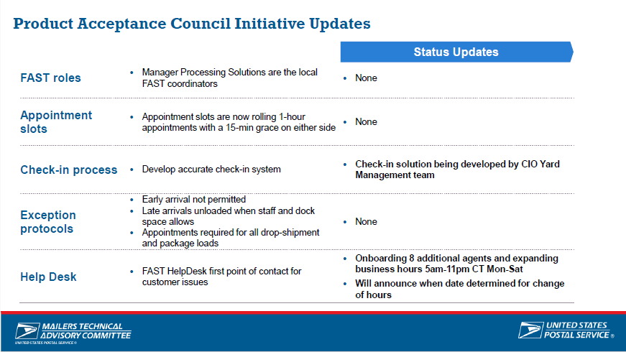

Slide 3
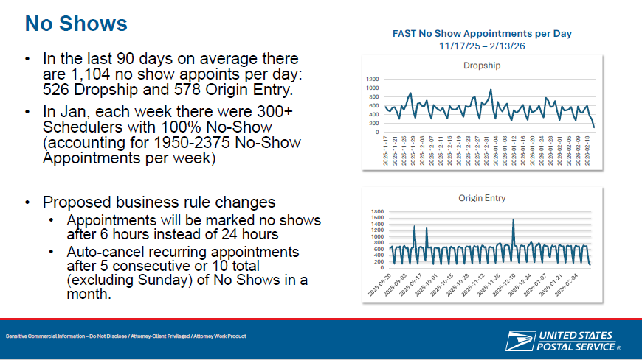

Slide 4
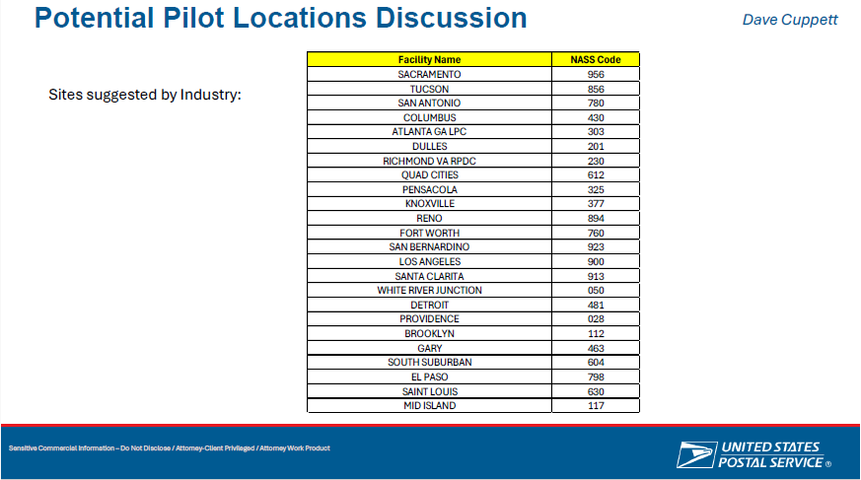

Slide 5
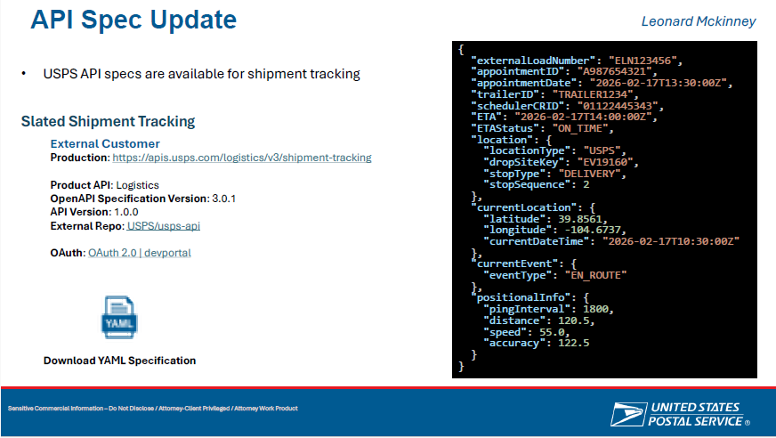


Slide 6
FAST API
1. The loads can be tracked to determine arrival
2. With 99M duplicates can be eliminated, increasing available
appointment slots
3. With the 99M plant management can see what is coming in
and expedite processing, 5 dig can go right to the DPBCS
4. With the GPS accurate arrival, unload, and depart can be monitored
5. The NOC can see immediately when a plant is failing
6. Multi-stop loads can be automatically updated

Slide 7
Political/Election Mail
New FAST Functionality
Notes:
7

Slide 8
Election vs Political Mail
    Election Mail
    Any item mailed to or from authorized Local Election Offices (LEO) that enables citizens to vote, such as:
  Official Ballot materials
  Voter registration cards
  Absentee applications
  Polling place notifications
    Political Mail
    Any material mailed for campaign purposes by a registered political candidate, campaign committee, or committee of a political party, or political message mailing by a political action committee (PAC), super PAC, or other organization engaging in an effort to influence or drive voter mobilization.
Notes:
8

Slide 9
Effective Monday July 13th Customers will be able to identify Political and Election Mail for both Drop-Ship and Origin Entry Appointments
The functionality will be added to enable users to indicate whether a FAST Appointment includes Political or Election Mail. The enhancement will apply to:
New “One Time” Appointments
New “Recurring” Appointments
“Existing” Appointments
The information can be reviewed in the following FAST Reports
Drop Ship Closeout Data Report
Facility Schedule Report
Notes:
9

Slide 10
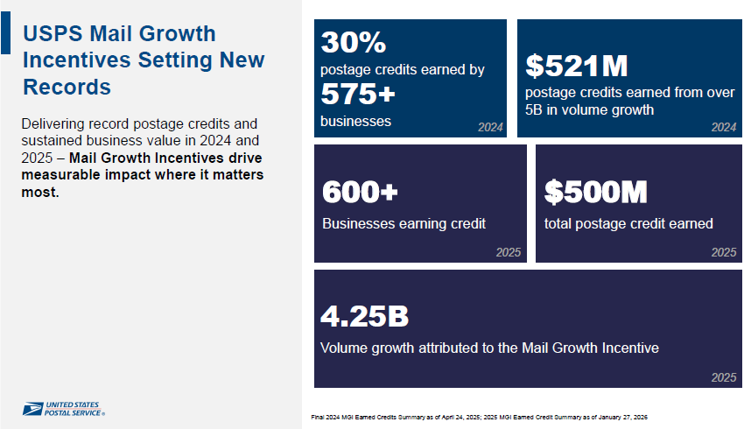

Slide 11


Growth Incentive Nightmare
Postal did an internal audit on the growth incentive credits in February. One of our clients was informed that they were having an adjustment of 5 million dollars removed from their total. Another client was informed they were having 58 Thousand added to their credits. A large bank refused the credit because it was almost double what they had for a total!
What is going on? How does this affect the July rate case?
Postal needs
to phone a friend!

Slide 12
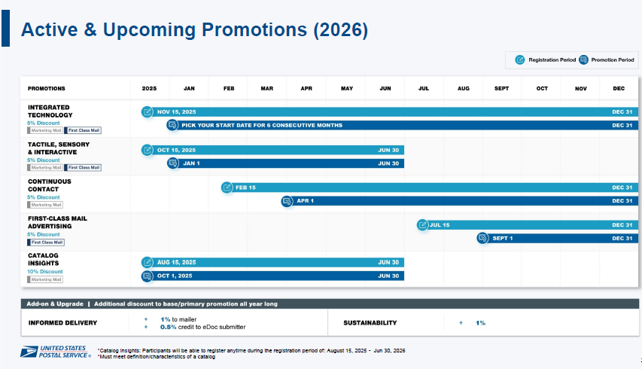

Slide 13
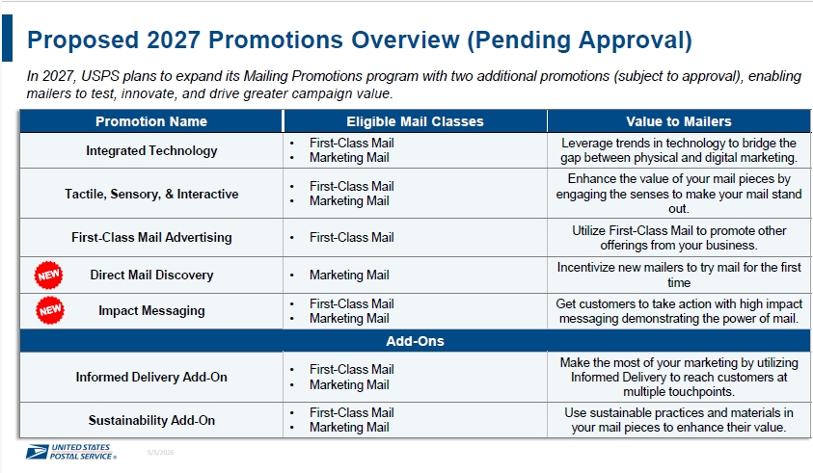

Slide 14
Who and How is going to determine if a company is a new mailer?
How does the MSP determine if a credit is available?
Would this include divisions of large companies?
What happens if 2 MSPs submit at the same time?
Does the company need their own permit or EPS account?
This promotion had a room full of mailing professionals shaking their heads and trying to come up with alternative suggestions.

Slide 15


