Slide 1


Interesting Trends in Advertising Mail Manufacturing 2026

Slide 2
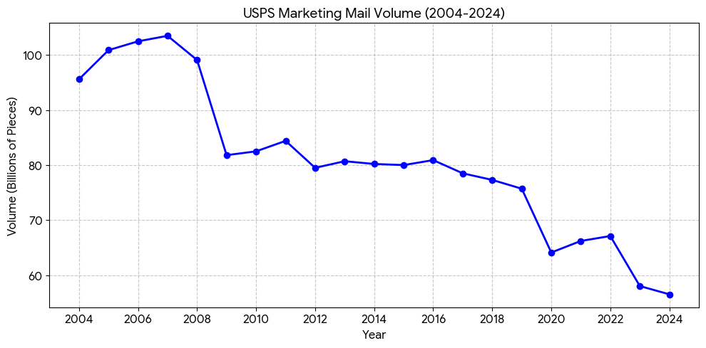
While the volume of advertising mail has gone down, the value of mail has gone up!
1
Data is much better and targeted
Everything and everyone is tracked
Shotgun mailers are gone
Higher Value per pcs
Volume

Slide 3
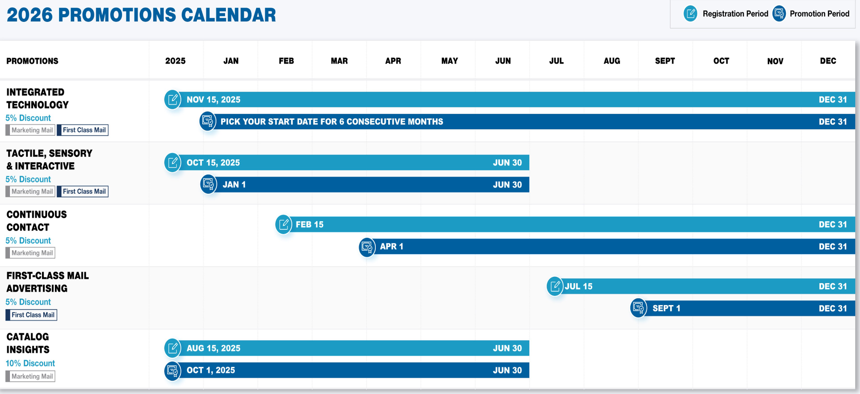

While the volume of advertising mail has gone down, the value of mail has gone up!
Packages are more complex
Higher cost per package
Higher return on investment

Slide 4
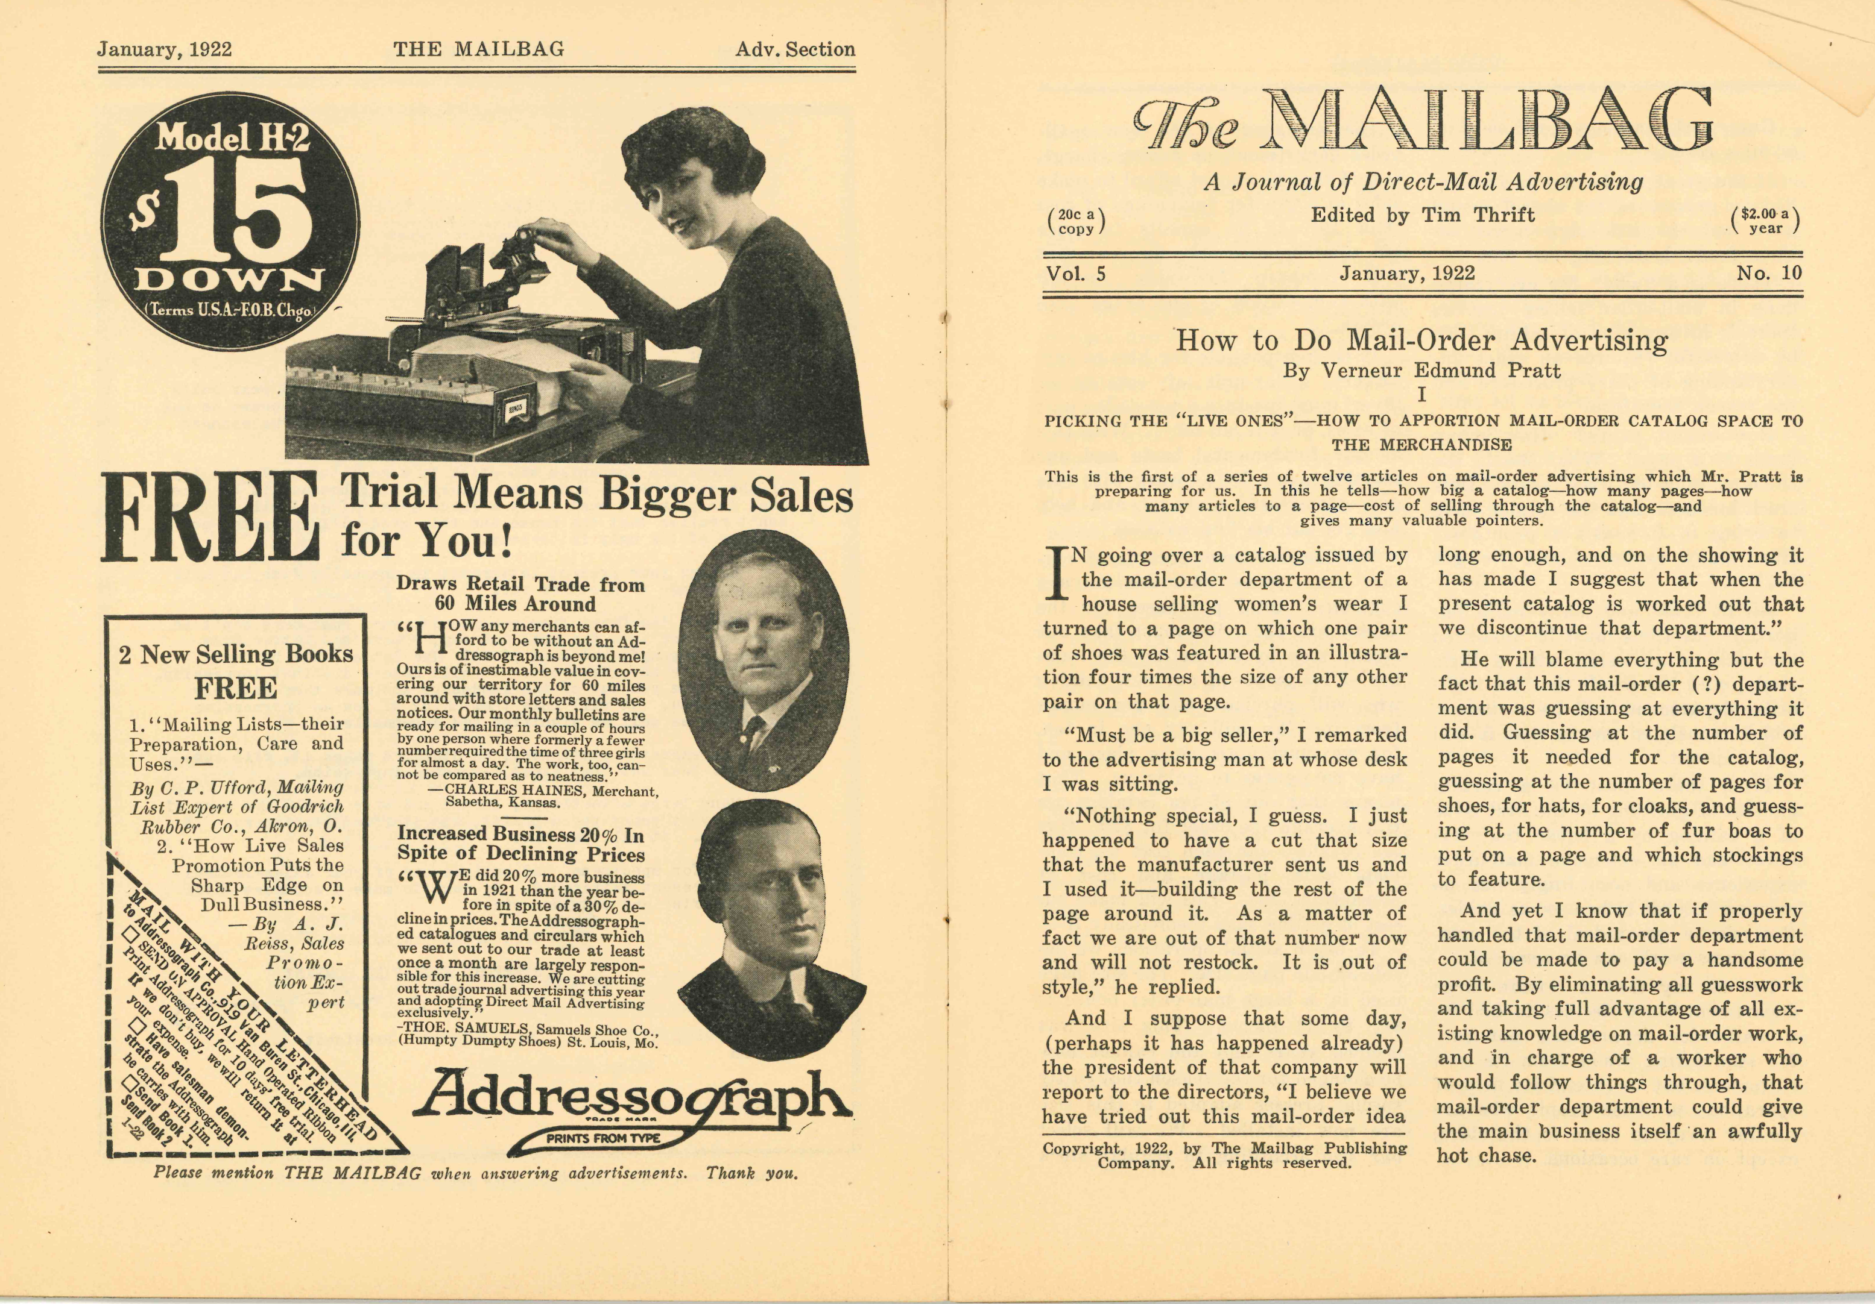
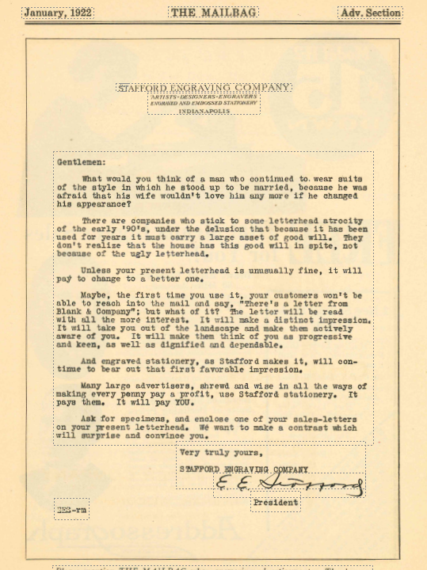
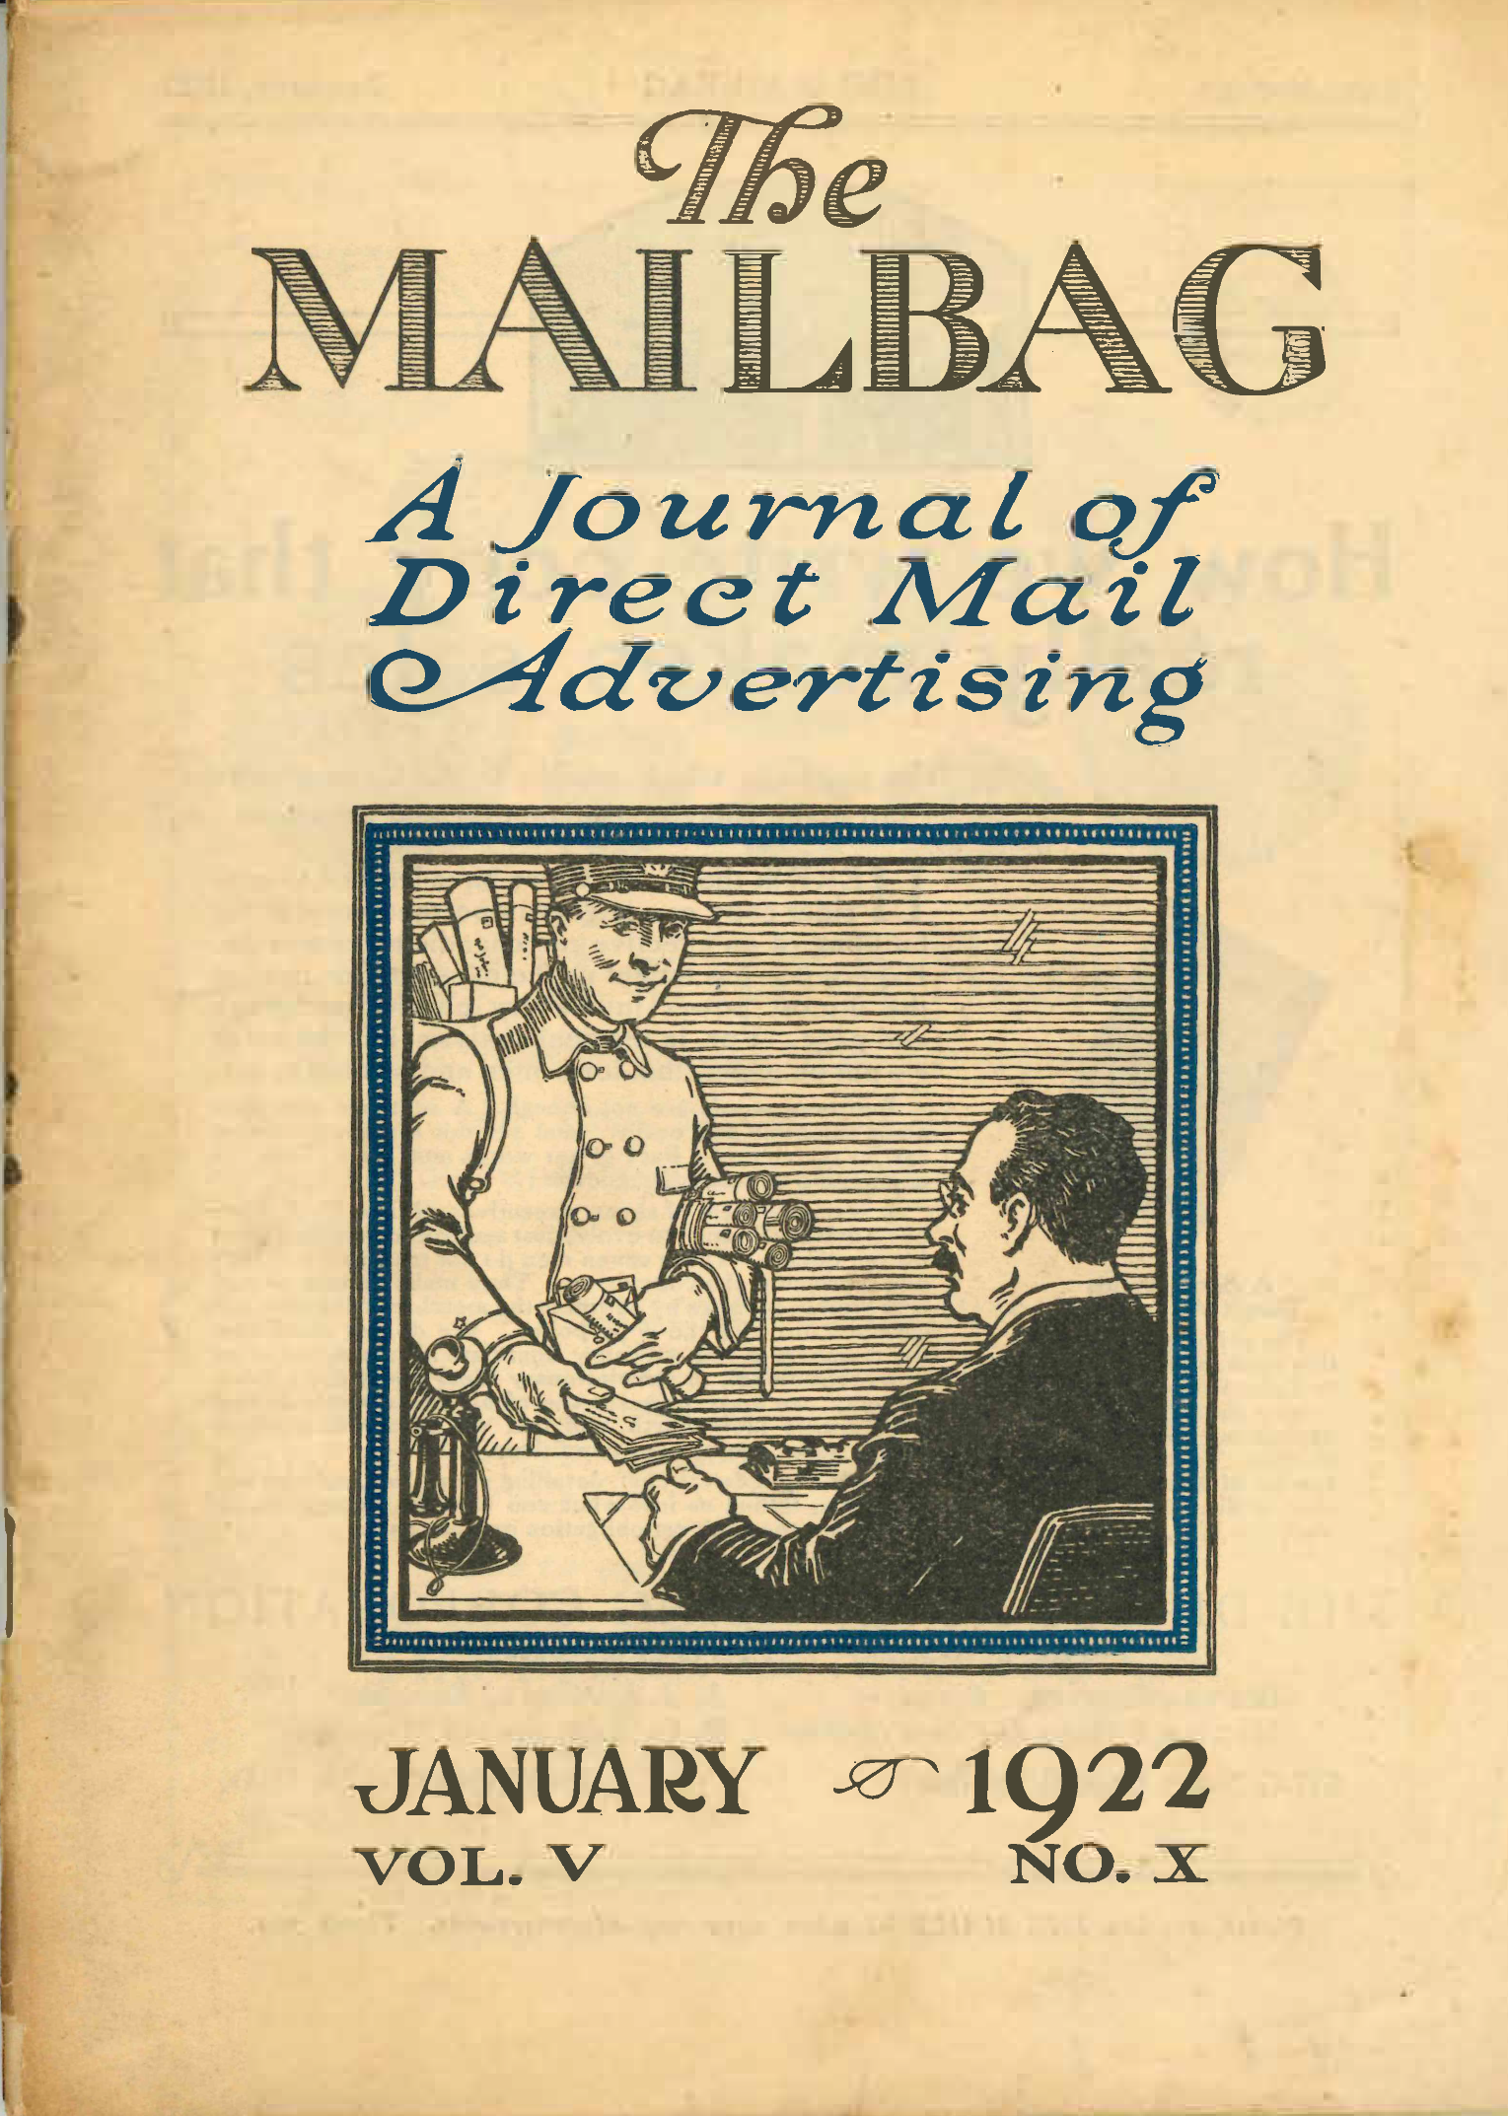
100 years of digital Digital Addressing Automation
2

Slide 5
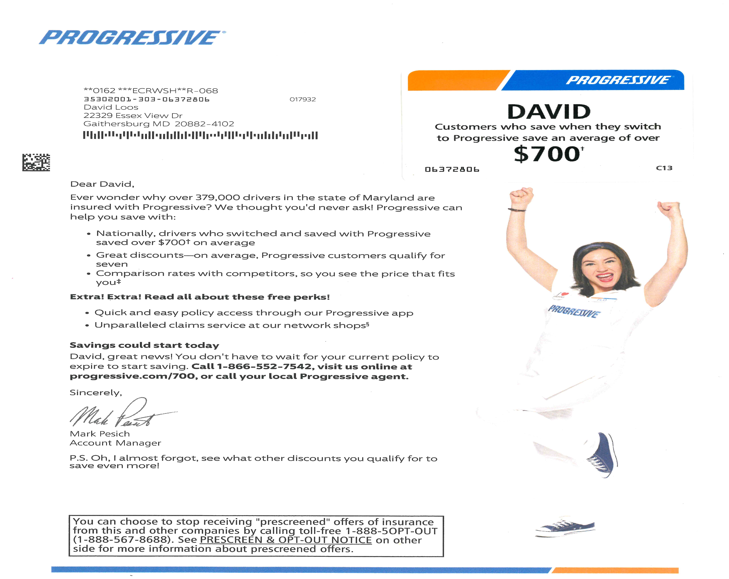
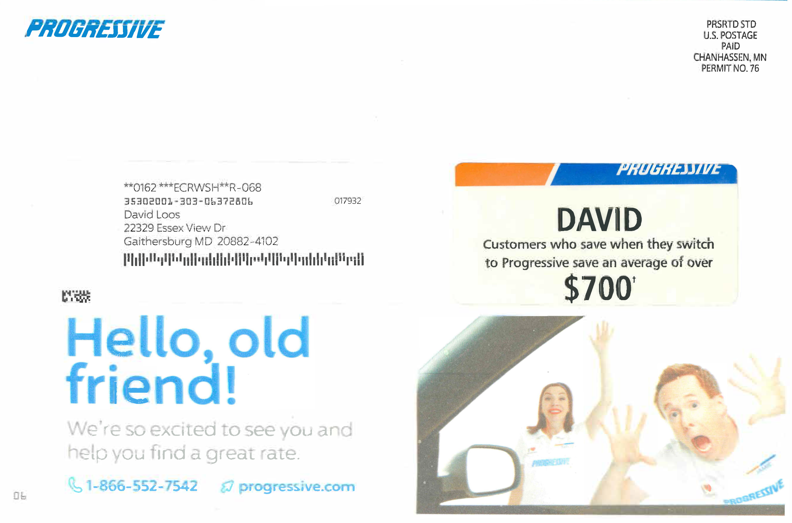
Digital Inkjet - 3 Way Match 12k an hour
Personalized Letter w/card attached
Personalized Card
Versioned Message
50 million every three months

Slide 6

Relationships Really Matter for Advertising Mail Manufacturing
3
Customers like
Good People – Working with people who know how to make mail
Good Work – Companies that make good mail products
Good Company’s – Company’s that will be around
Companies are closing down and seasoned mailing professions are retiring or quitting
Great Opportunity
Record amount of work is moving around
Be a Mail Manufacturing educator
Many new customers have no experience with mail manufacturing
Take the time to explain and educate

Slide 7
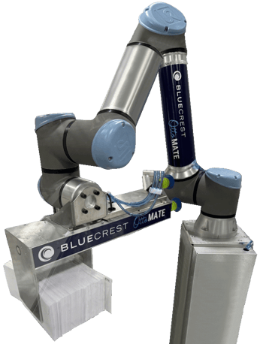

Labor is NOT going to get better
4
Advertising mail manufacturing competes with the entire US manufacturing market for labor
Accept the reality that you must reduce the need for labor
Labor cost will continue to rise
Expect LOWER technical skill sets
Higher quality control standards
What are you doing to keep Labor?
Still waiting for robots, automation helps today

Slide 8
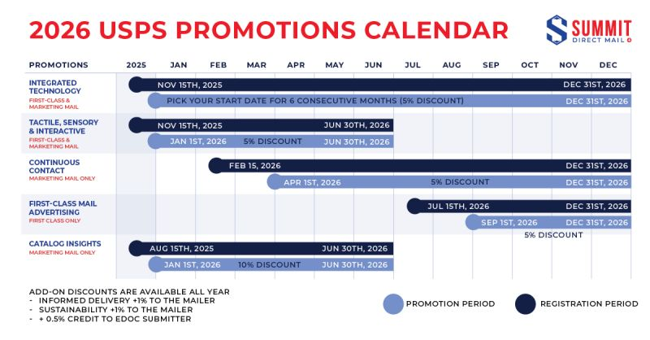

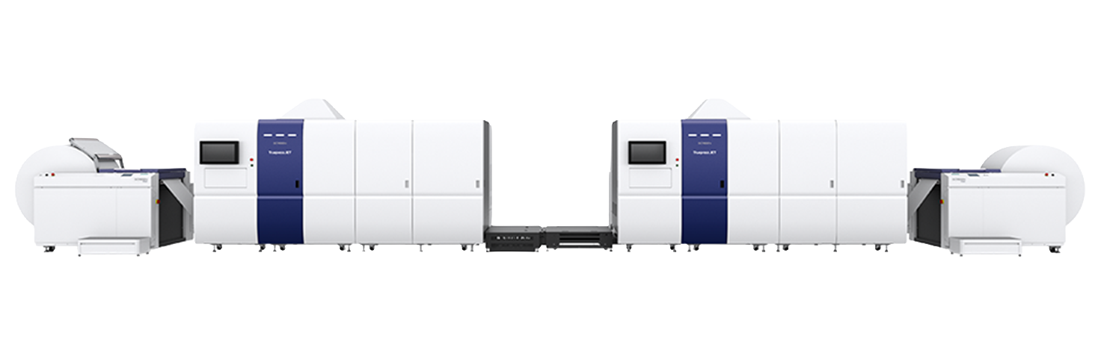

Winning Company's
Postal Knowledge
Manufacturing
Efficiency
People
Trust

Slide 9

Invest in young employees

