Slide 1
Navigating the 2026-2027 Postal Shift: Stability, Strategy, and Savings
This information is the sole property of the presenter and not approved or endorsed by the USPS . This may not be shared without prior permission.

Slide 2
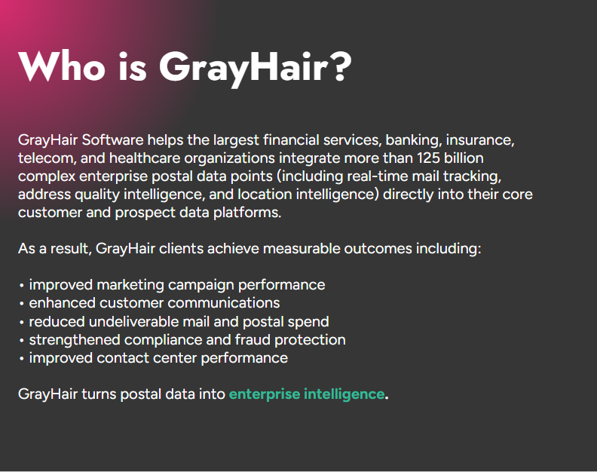

Slide 3
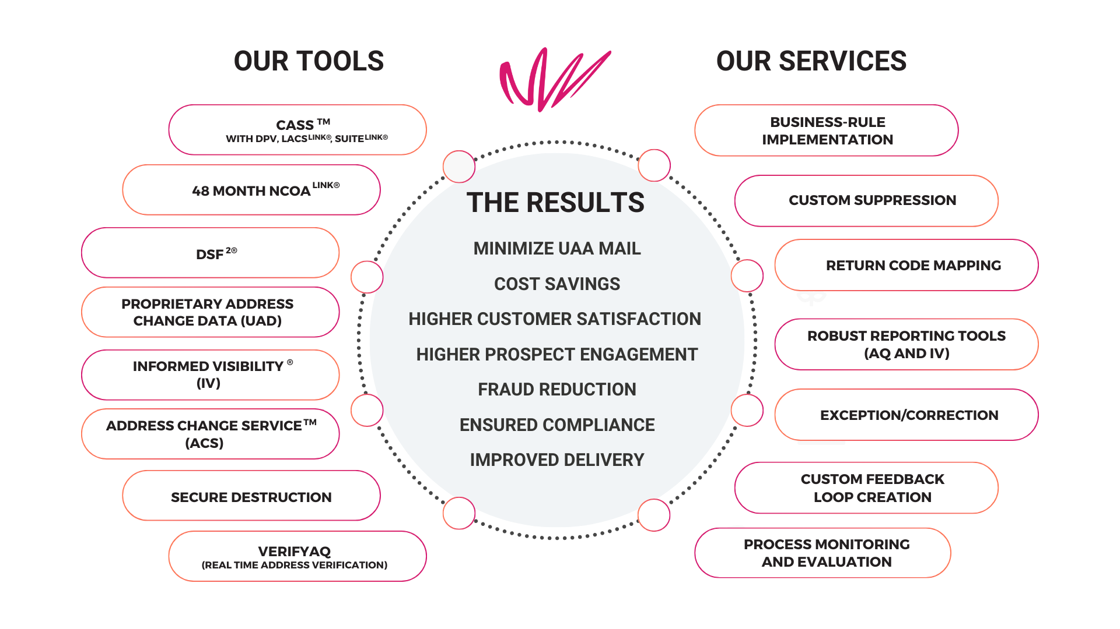
High Quality Address Data Unlocks Measurable Outcomes

Slide 4

Agenda
Timing of Price Changes
Postage Projection for July 2026 and Beyond
Postage Factors
Workshare Discounts
Structural Changes for July 2026
Promotions for 2026 & 2027
Legislation of Impact to Mailers
Network Changes
Deborah Damore
Head of Postal Affairs
GrayHair Software, LLC.
This information is the sole property of the presenter and not approved or endorsed by the USPS . This may not be shared without prior permission.

Slide 5
USPS Rate Making - Process
Market Dominant Products (e.g. First-Class, Marketing Mail, Periodicals)
USPS: The process begins internally when the USPS builds a rate case
Board of Governors Approval: The proposal is presented to the USPS Board of Governors to review and approve the proposed price adjustments and classification changes.
Official Filing (90-Day Notice): By law, the USPS must file a formal notice with the PRC at least 90 days before the intended effective date of any price change for Market Dominant products.
PRC Review Period (45 Days): Upon filing, the PRC has 45 days to review the proposal to ensure it complies with the "price cap" and other legal requirements.
Public Comment Opportunity: Shortly after the USPS files, the PRC opens a public docket and provides a window (typically 20-30 days) for stakeholders and the general public to submit comments.
PRC Final Determination: If the PRC finds the rates are legally compliant, it issues an order approving the changes. If not, it can remand the proposal back to the USPS for correction.
Implementation: Once approved and the full 90-day notice period has elapsed, the new rates go into effect

Slide 6





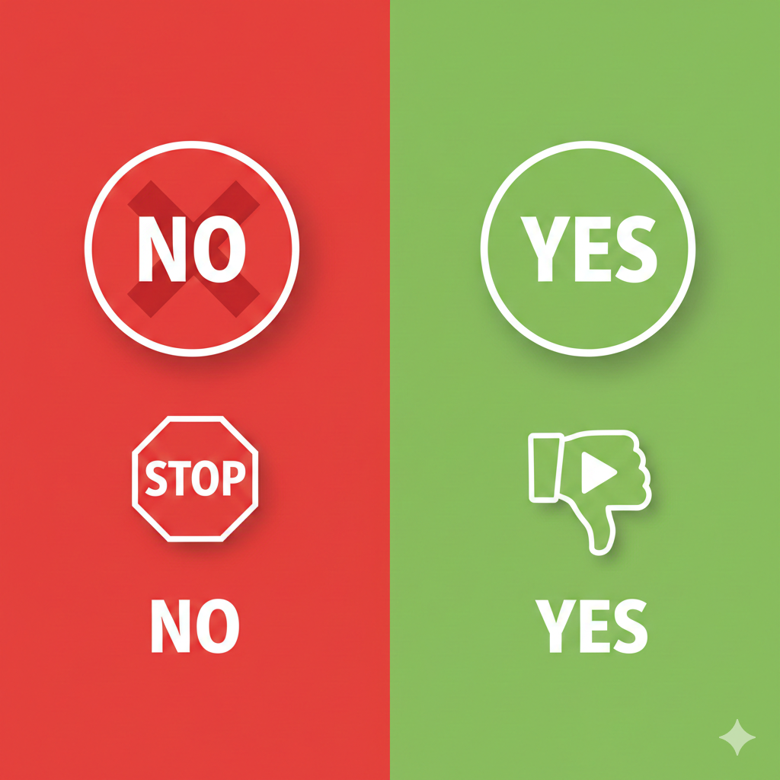
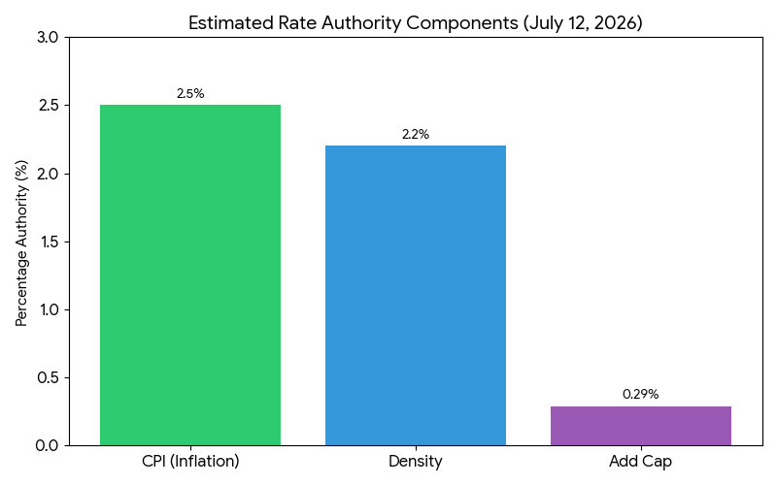
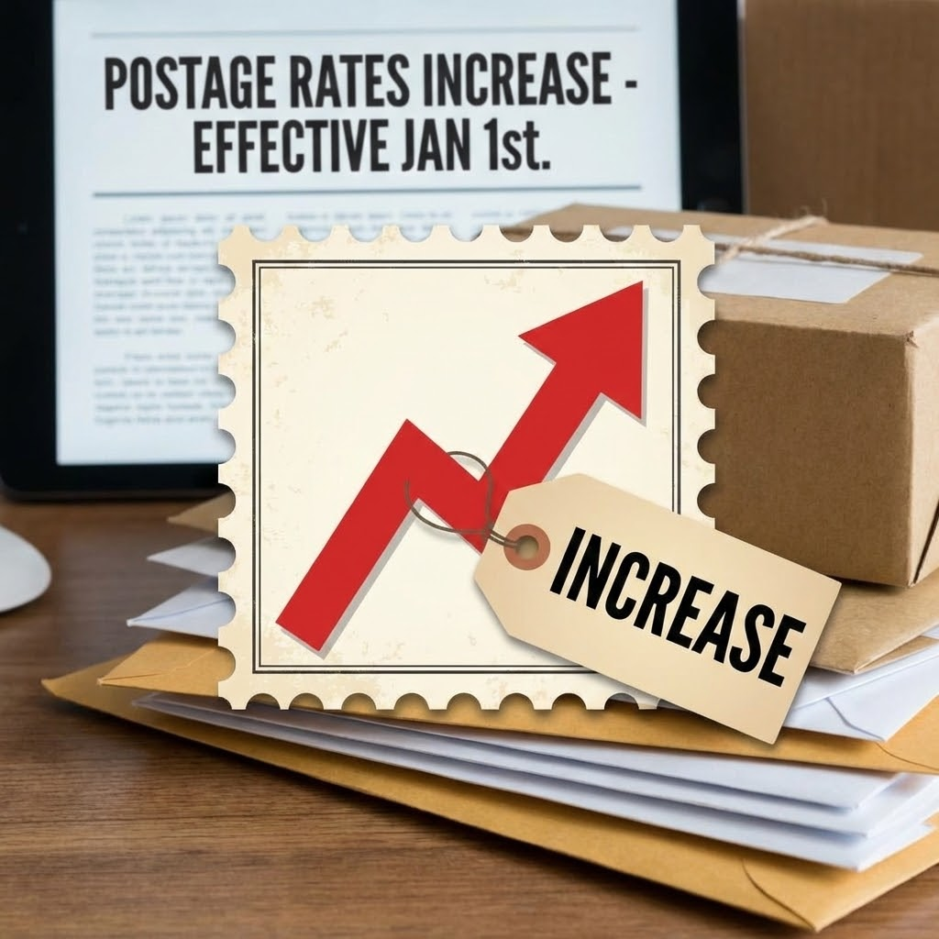
USPS Rate Making - July 12, 2026 Timing
Market Dominant Products (e.g. First-Class, Marketing Mail, Periodicals)
December 29th, 2025
April 10th, 2026
USPS published the Annual Compliance Determination Report (ACR)
The March CPI-U will be announced, the price filing must be filed prior to this date.
March 11th, 2026
Between May 1-12, 2026
The February CPI-U will be announced. This is the last of the 12 month rolling average USPS can use. (2.631%)
The PRC will open a docket and accept comments in this time period. They should only be addressing if USPS is compliant with the law.
March 30th, 2026
By May 25, 2026
PRC will issue the Annual Compliance Determination Report (ACD). USPS cannot file a price filing until this is published.
The PRC after their review will remand the price case back to USPS if not compliant, or will approve the proposal.
Between April 1-9 (likely April 8th or 9th)
July 12, 2026
USPS will file for a July 2026 postage increase.
USPS will implement the Market Dominant Price change.

Slide 7
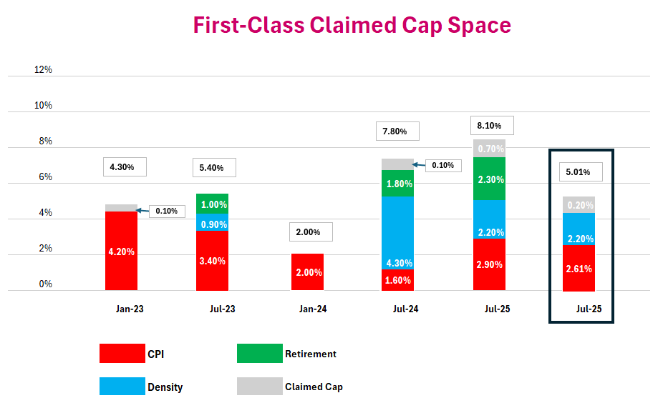
July 2026 Postage Projection

Slide 8
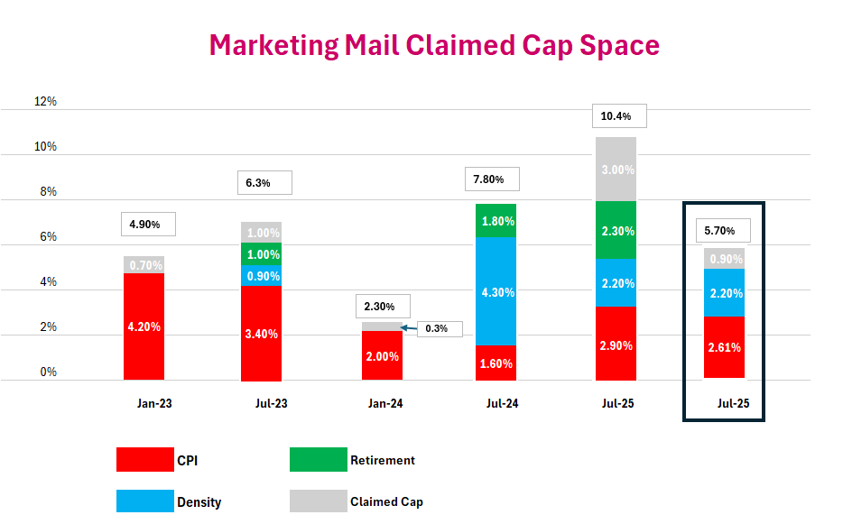
July 2026 Postage Projection

Slide 9
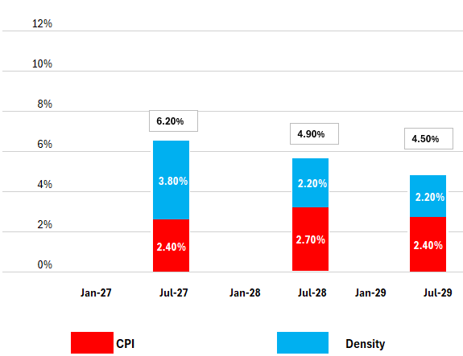
Postage Projections - Beyond 2026
Market Dominant Products (e.g. First-Class, Marketing Mail)
Based on current regulations.
CPI-U Projections are from Global Insights and will go up or down with inflationary changes.
Density Factor is based on increase in delivery points (approximately 1 - 2 million annually), and the decline in mail volume.
The higher year number in July 2027 is due to the decline in FY26 volume over FY25 that had high political mail volume.
As of now the USPS is restricted to one price increase annually.
We expect to see more changes to the factors allowed in rate setting over the next 12-18 months, but cannot forecast what those may be.

Slide 10
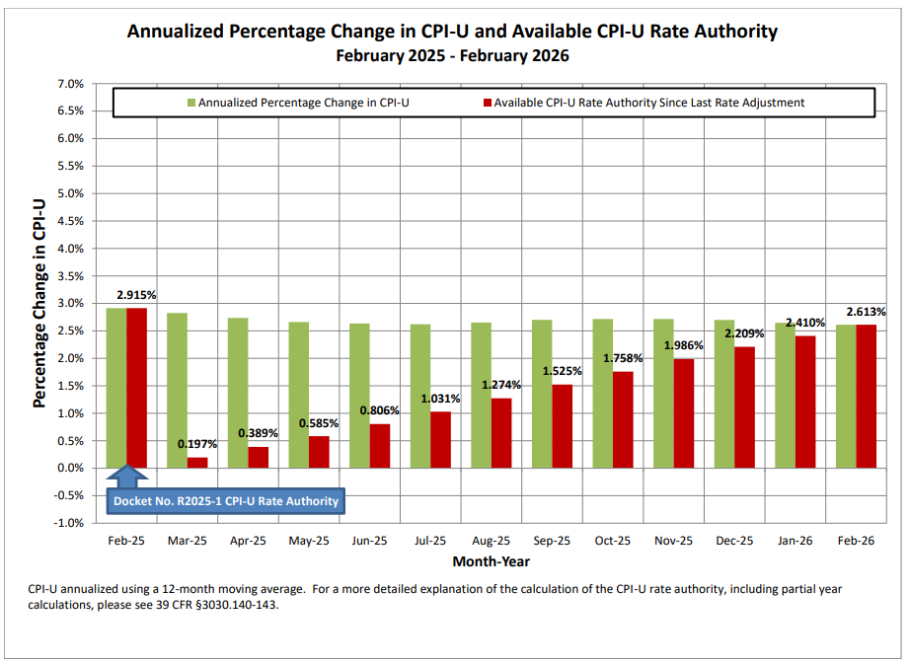
Consumer Price Index
Twelve Month Rolling Average

Slide 11
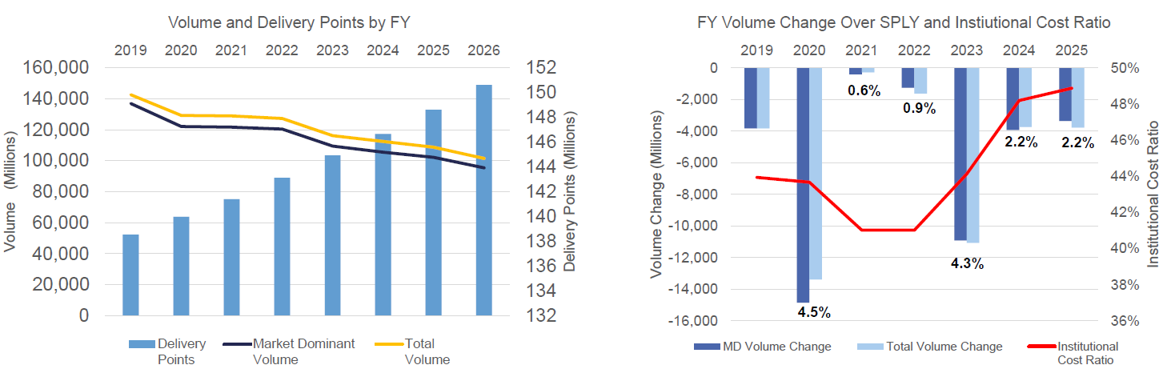
Understanding Density Factor
The math behind the Density Factor is based on a simple but painful reality for the USPS: The number of delivery points (houses and businesses) increases every year, but the number of mail pieces decreases.
Fixed Costs: The USPS has to drive to every house 6 days a week, regardless of whether they are delivering 10 letters or 1 letter. This "last mile" cost is mostly fixed.
Yearly the delivery points continue to grow approximately 1.5 m, while mail volume continues to decline.
The Calculation: The "density" is measured as Volume ÷ Delivery Points.
The Impact: If the density drops (meaning there is less mail per mailbox), the USPS is legally allowed to increase prices by a calculated percentage to cover the higher "per-piece" cost of delivery

Slide 12
Understanding Additional Claimed Cap - Gray bar
With each rate filing the USPS under current regulations has a Price Cap, that cap includes: CPI and the additional rate factors of Density and Non-Compensatory.
Once that total amount is calculated the change in revenue received should average to that amount.
When USPS sets price cells (e.g. 5-D Letters, MxdADC Flats) at the total cap space, and mailers use incentives and promotions the final net postage paid is lower than the total cap, so USPS does not realize that postage increase amount.
If the total dollar value of promotions, discounts, and incentives are the same as the prior year, then the gray bar would be 0%
If the value is less than last year, then the gray bar will be negative. Otherwise it will be positive.
The current projection considers the estimated effect of the Mail Growth Incentive program and Promotions/Incentives, with the value of 2025 relative to 2024.
First-Class gray bar is currently +0.2% (may change slightly before April filing)
Marketing Mail gray bar is currently +0.9%(may change slightly before April filing)
For the July 2025 increase, USPS paid out $500 Million in Mail Growth Incentives (MGI) from the 2024 Incentive as well as promotions, this was higher than any other year - so the gray bar was 0.715% for First-Class and 3.015% for Marketing Mail.
The amount paid out for the 2025 MGI is comparable to slightly lower, so that ‘additional cap’ is not as large.
Add-Ons were first used in promotions and added the new space.

Slide 13
Workshare Discount Components
Workshare discounts are typically, but not exclusively, less than or equal to the cost avoidance estimates measured by the Postal Service.
Workshare discounts are mandated (with a few exceptions) to be in the band of 85% - 100% passthrough.
Cost Avoidance is costs the USPS avoids by mailers performing worksharing activities, such as presorting and preparing the mail by zip code, barcoding, and entering mail at a USPS facility that is closer to the final destination of the mail.
Passthrough is the dollar amount the USPS calculates as its costs to process and deliver a specific product.
When the estimated reduction in USPS revenues equal the estimated reduction in USPS costs it is considered a “100% passthrough”. That is, the full amount of whatever USPS is expected to save will be passed along to the mailer via the worksharing discount.
When a passthrough shows over 100% the USPS is traditionally mandated by the PRC to reduce the workshare discount unless they can show it is needed for operational efficiency, or doing so would create such rate shock to be damaging to the mailing industry.
When a passthrough shows under 85% the USPS is traditionally mandated by the PRC to increase the workshare discount bringing it into compliance.
Annual Compliance Report (ACR) published ninety days (12/29) after the end of a USPS fiscal year reports out all USPS passthroughs, along with all costs and service information from that FY as mandated by the PRC.
Annual Compliance Determination Report (ACD) is published by the PRC ninety days (3/30) after receiving the ACR, it reviews USPS findings and states if they are in compliance.

Slide 14
Discounts Expected to Change in July 2026
When USPS does a rate increase they are generally limited in the changes up or down they can make in a workshare discount based on the compliance of 85% - 100% passthrough band.
These numbers are confirmed in the ACD that comes out around 3/30, that publication is necessary before USPS can do a price filing in April for a July increase.
Based on the FY25 ACR findings the below workshare discounts are expected to increase.
Type of Discount/Passthrough | Type of Worksharing | Benchmark | Current July 2025 Discount | ACR25 Cost Avoidance | Range discount needs to be in for compliance
Presort First-Class Mail Letters | Auto 5-digit Letters | Auto AADC Letters | $0.048 | $0.060 | $0.051 - $0.060
Presort Marketing Mail | Auto 3-digit Flats | AADC Flats | $0.115 | $0.184 | $0.139 - $0.184
Dropship Marketing Mail Letters | DSCF | Origin | $0.017 | $0.024 | $0.021 - $0.024
Dropship Marketing Mail Flats under 4oz | DSCF | Origin | $0.038 | $0.048 | $0.041 - $0.048
Dropship Marketing Mail Flats over 4oz, piece | DDU | Origin | $0.049 | $0.058 | $0.050 - $0.058
Dropship Marketing Mail Flats over 4oz, pound | DSCF | Origin | $0.312 | $0.428 | $0.364 - $0.428
Dropship Marketing Mail Flats over 4oz, pound | DDU | Origin | $0.403 | $0.515 | $0.438 - $0.515
Notes:
Lesley

Slide 15
Discounts Expected to Change in July 2026
When USPS does a rate increase they are generally limited in the changes up or down they can make in a workshare discount based on the compliance of 85% - 100% passthrough band.
USPS is directed in most all cases to bring discounts into compliance with the rate change.
Discounts can be brought down by the Postal Service
Based on the FY25 ACR findings the below workshare discounts are expected to decrease.
Type of Discount/Passthrough | Type of Worksharing | Benchmark | Current July 2025 Discount | ACR25 Cost Avoidance | Range discount needs to be in for compliance
Presort First-Class Mail Letters | Letters on SCF Pallets | Other Letters | $0.004 | $0.003 | $0.0026 - $0.003
Presort First-Class Mail Flats | Flats on SCF Pallets | Other Flats | $0.018 | $0.016 | $0.0136 - $0.016
Periodicals had 1 workshare at 100%, 11 in the band of 85% - 100%, 2 greater than 100%, and 16 below 85%
Piece spread from HD to Saturation should go down slightly from $0.035 to $0.034
Piece spread from CR to HD should go considerably up from $0.031 to $0.163
Piece spread from 5D to CR should go up from $0.266 to $0.365
The other big spreads are in the container rates, which are expected to change models in July 2026
Notes:
Lesley

Slide 16
USPS Structural Changes - July 2026
Market Dominant Products (e.g. First-Class, Marketing Mail, Periodicals)
Growth Strategies
2027 Promotions 2 new ones. 2 expiring 3 continuing +Add Ons Heavy Printed Matter (HPM) - new product. New 5D Direct Container and SCF pallet discounts HPM Adding Prices and fees to New Enhanced Addressing & NCOA+ API
Product Simplification
Restructure Periodicals Outside County Rates. Change BPM flats and parcels presorted and carrier route price structure. Marketing Mail Flat weight maximum increase. Eliminate ADC Rate Category
Elimination of Inefficient Pricing and Preparation
Minimum volume requirement for FCM cards and letters when combined. Elimination of bundling for Marketing Mail flats in tubs Elimination of NDC Nomenclature Package barcode quality non compliance fee
*Pending PRC Approval

Slide 17
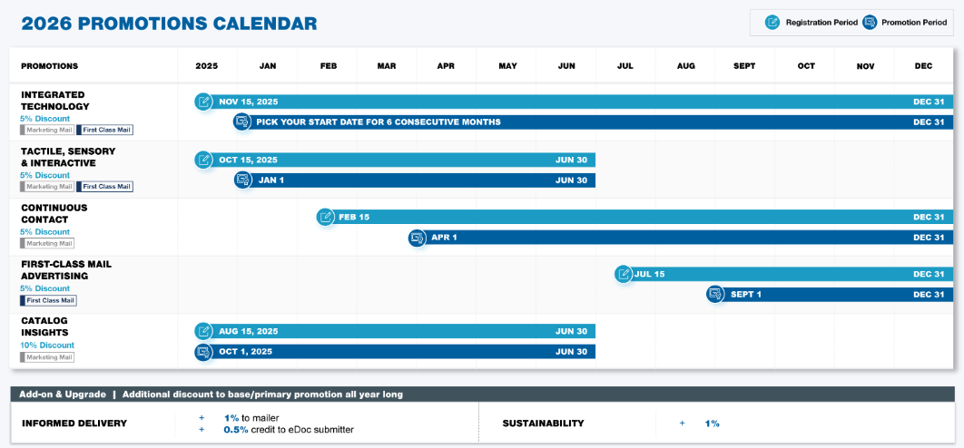
2026 Promotions
5%
10%
1%

Slide 18
2027 Promotions
2027 Promotions Plans (Pending PRC Approval)
Eliminate Continuous Contact & Catalog Insights Keep three existing Promotions Tactile, Sensory, and Interactive, FCM & MM Integrated Technology, FCM & MM First-Class Mail Advertising, FCM Keep the two Add-Ons, Informed Delivery & Sustainability Two NEW Promotions USPS is enhancing its technology and systems developing LUCID AI Pre-Approval resulting in faster reviews.
Impact Messaging
First-Class & Marketing Mail Discount x% Messaging demonstrating the power of mail
Direct Mail Discovery
Marketing Mail Only Discount xx%? to Mail Owner (we are told large) Discount x% to MSP 5,000 pieces max Designed to encourage MSP to help sell mail.
*Pending PRC Approval

Slide 19
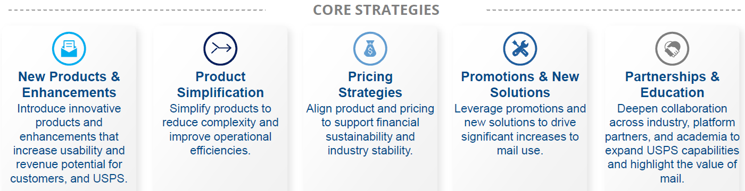
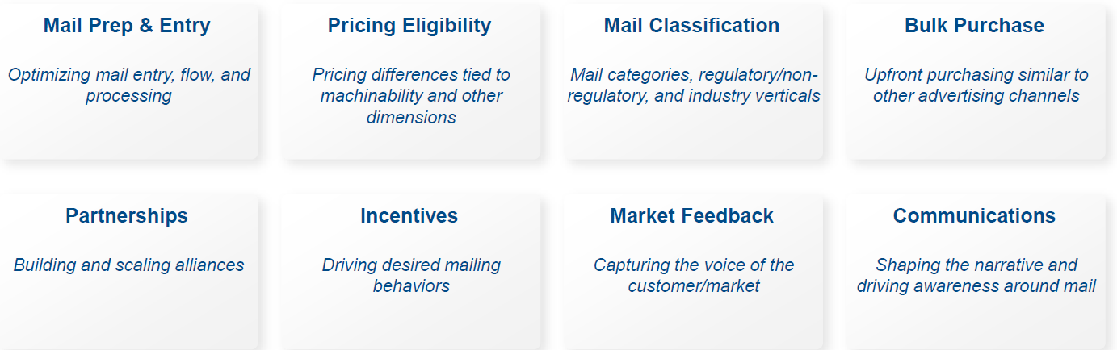
Reimagining Mail - Art of Possible
The Postal Service is redesigning mail products, pricing, operational handling, and customer value to drive growth, reduce costs, and strengthen long-term mail value. Outreach to associations, PCCs, AIMs, and others
Looking at eight proposed workstreams, each comprising cross-functional stakeholders with ELT oversight.

Slide 20
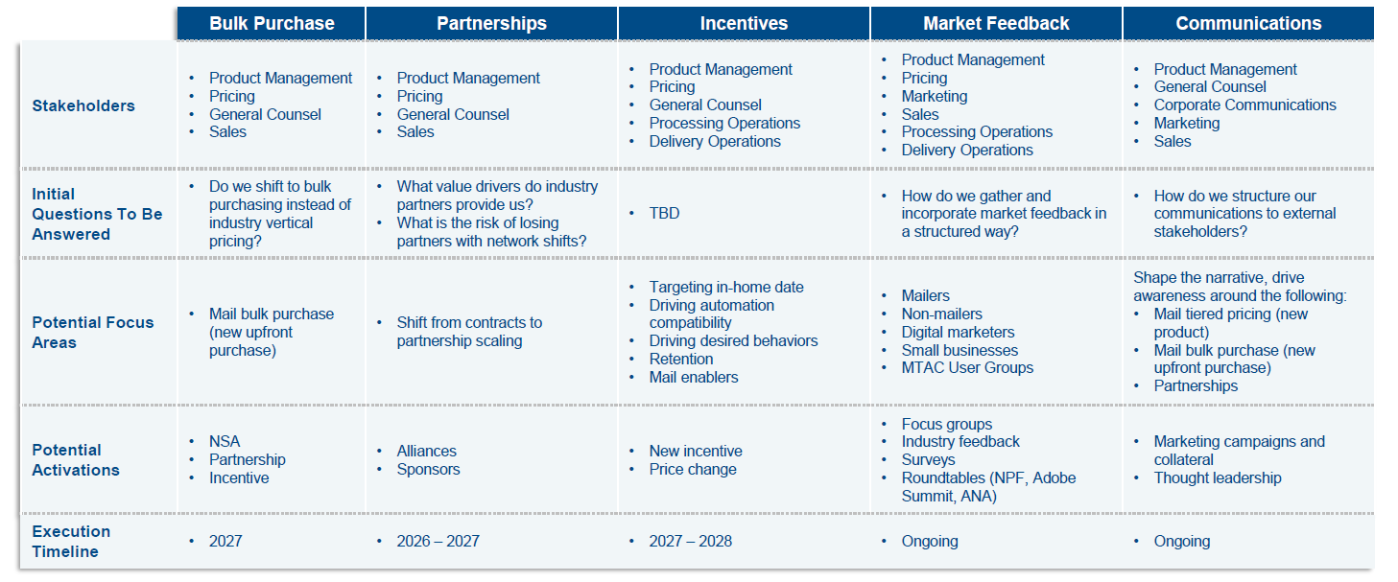
Reimagining Mail - Future State Discussions
Strategic approach to define stakeholders involvement, necessary questions to be answered, create a focus, a path to activation and an execution timeline.

Slide 21
Postal Legislation in the House
H.R. 3004 USPS SERVES US Act – April 2025
Sam Graves (R-MO), 3 co-sponsors, all R, Ralph Norman (R-SC), Derek Schmidt (R-KS), Tracey Mann (R-KS) - modernize the Postal Service regulations, and for other purposes.
Keeping CPI 12-month once annual, limiting underwater surcharges, limiting PRC from revising the system. Rate impacts for service failures, new demand models, investment of RHB set % into Federal Thrift plans. (Referred to House Oversight Committee)
H.R. 2103 Protect Postal Performance Act – March 2025
Nikki Budzinski (D-IL), 13 co-sponsors, 9 Dem, 4 R. To modify the procedures used by the United States Postal Service for the closure or consolidation of any post office or any processing and distribution center, and for other purposes (Referred to House Oversight Committee, some provisions moved and passed in FY26 budget - Stop Processing Center Closures, and recommending halt to RTO)
H.R. 1473 Postal Processing Protection Act – Feb 2025
Harriet Hageman (R-WY), 3 co-sponsors, all Dem. Emanuel Cleaer (D-MO), Eugene Vindman (D-VA), Donald Davis (D-NC) To require the United States Postal Service to apply certain requirements when closing a processing, shipping, delivery, or other facility supporting a post office and for other purposes. (sitting in House Oversight Committee)
H.RES. 70 Resolution to prohibit Privatization – January 2025 (an identical companion resolution is in the Senate S. Res. 147)
Stephen Lynch (D-MA) 229 co-sponsors
Expressing the sense of the House of Representatives that Congress should take all appropriate measures to ensure that the United States Postal Service remains an independent establishment of the Federal Government and is not subject to privatization.
( It is essentially "on deck" for a symbolic floor vote but faces resistance from House leadership)

Slide 22
Legislative Threats to Mail Volume
Legislative Threats: S. 1877 and H.R. 3383
The primary legislation driving this shift is S. 1877 – Improving Disclosure for Investors Act of 2025. It has been referred to the Senate Committee on Banking, Housing, and Urban Affairs, the bill directs the SEC to allow "covered entities," such as brokers and investment advisers, to satisfy delivery requirements electronically rather than via paper.
Under this framework, electronic delivery becomes the default. While investors would have 180 days to opt out and continue receiving paper versions, the burden shifts to the consumer to maintain their preferred communication method. A companion bill, H.R. 3383 (The INVEST Act), has already passed the House with a 302–123 vote and moved to the Senate.
If these bills become law, the impact on the United States Postal Service could be devastating, potentially resulting in the loss of approximately three billion pieces of profitable First-Class mail annually.
Business mailers and consumers must act now to protect the reliability of critical business and legal documents. Contact your representatives today to oppose S. 1877 and similar digital-default mandates.
Find your representatives here:
House: www.house.gov/representatives/find-your-representative
Senate & House: www.congress.gov/members/find-your-member

Slide 23
Broader Digital Shift in Agencies
Beyond specific bills, federal agencies are moving toward digital defaults through regulatory processes:
IRS: Starting January 2026, the IRS is prioritizing electronic payments and digital communication for the remaining 8.5% of individual filers receiving mailed refunds today.
The IRS will stop issuing paper checks for individual tax refunds.
Mandatory Electronic Delivery: Most refunds will be delivered via direct deposit, prepaid debit cards, or digital wallets.
Exceptions: Limited exceptions will exist for "unbanked" individuals or those facing hardships, though they may have to request these specifically via a dedicated phone line.
Other Agencies: The Social Security Administration, Department of Labor, and CMS are increasingly embracing electronic delivery as their primary method.
SSA: Mandatory Electronic Payments: Following a 2025 executive order, the SSA ended the routine issuance of paper benefit checks. Most payments are now issued via direct deposit or the Direct Express® prepaid debit card
DOL: Default Electronic Disclosures: Under these rules, plan administrators can provide required notices—such as Summary Plan Descriptions and fee disclosures—electronically by default if they have a valid email or mobile number on file.
CMS is shifting toward "digital-first" health care infrastructure, focusing on interoperability and electronic data exchange.

Slide 24
USPS Network Updates, RPDC, LPC, & S&DC
As part of the FY25 ACR the PRC issued a Chairman's Information Request (CHIR) to the Postal Service requiring them to provide updated information on the roll out plans of RPDCs and LPCs.
Within the response, USPS identified they are now planning for 56 Regional Processing and Delivery Centers (RPDC) down from the original DFA plan of 60. Of the 56 RPDC fourteen have been activated. The remaining RPDCs activation dates are listed as TBD.
The list of Local Processing Centers (LPCs) now totals 199, with 25 of those being co-located in RPDCs. The spreadsheet provided to the PRC lists the 3D groupings for each of the RPDC and LPC regions.
Many of the LPCs are currently aligned with the SCF L005 label lists, but not all. This report gives you an advanced view of which zip codes will be moved over the next few years.
As of today, there are 151 Sorting and Delivery Centers (S&DCs).
The most recent update is to the Pompano Beach, FL S&DC site; it received an additional three 5D zip codes on February 7, 2026.
Cancellation services. Of the 108 planned sites, 31 will be stand-alone RPDCs, 52 in stand-alone LPCs and 25 will be co-located RPDC/ LPC sites.
RPDC Region | Activation Date
Richmond, VA | 7/9/2023
Boise, ID | 7/1/2023
Atlanta, GA, Portland, OR | 2/24/2024
Houston, TX | 8/24/2024
Chicago, IL | 10/16/2024
Indianapolis, In | 1/18/2025
Charlotte, NC | 2/24/2025
Jacksonville, FL | 6/14/2025
Birmingham, AL, Greensboro, NC, Jersey City, NJ, Memphis, TN, Saint Louis, MO | 1/26/2026

Slide 25
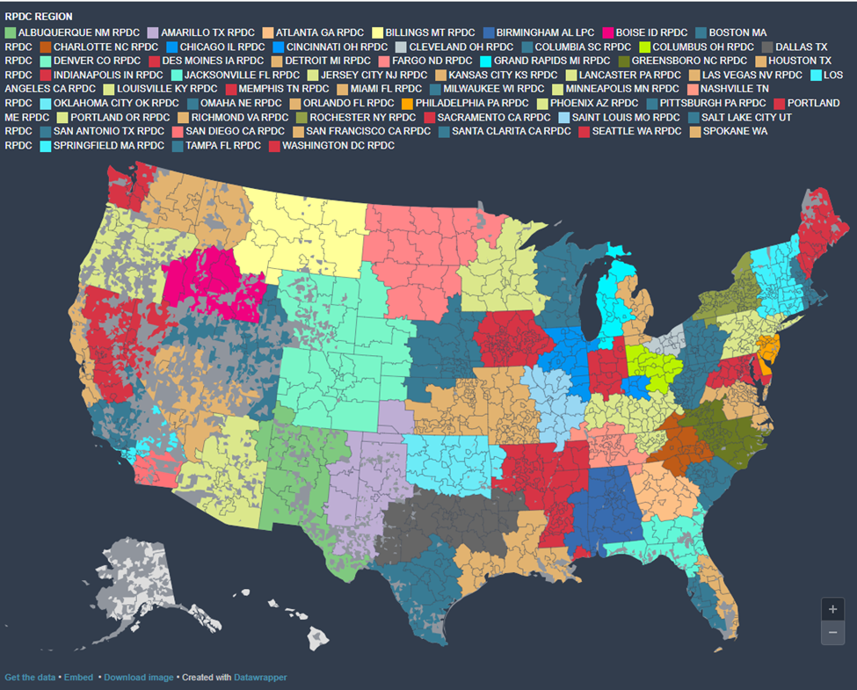
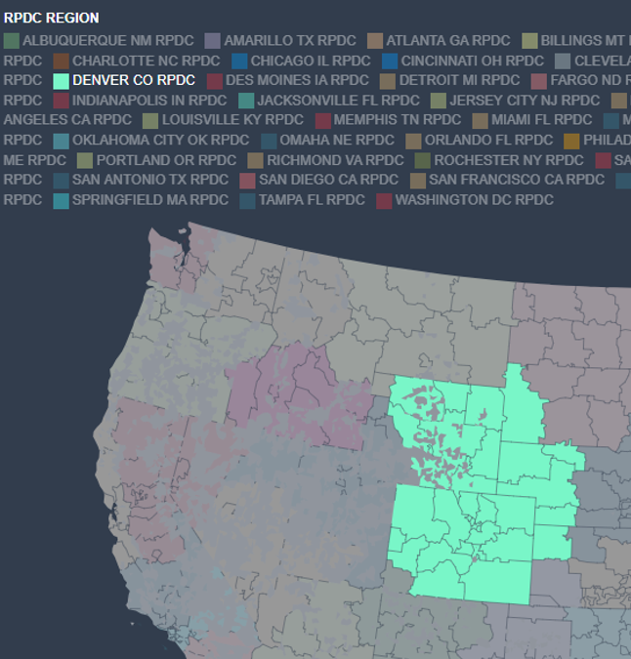
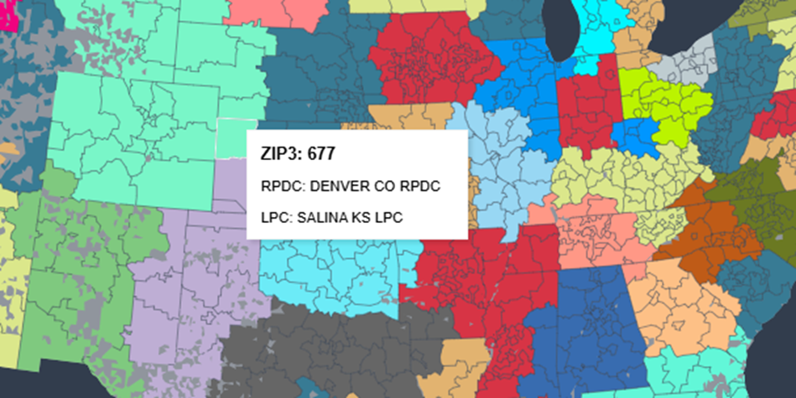
Visual Mapping Tools
Source: Save the Post Office https://www.savethepostoffice.com/
The color code areas represent the planned RPDC regions. Clicking into any of the 3-D areas you can identity the LPC along with the supporting RPDC.
You can scroll or click on any of the RPDC regions listed at top and it will show you on the map where that region is, example below is showing the Denver CO RPDC region.

Slide 26
USPS Postage 2026 Summary
Market Dominant Products (e.g. First-Class, Marketing Mail, Periodicals)
USPS Market Dominant postage rates are regulated by the 2006 PAEA and PRC Order No. 5763.
Rate increases are based on a Multi-Factor cap including CPI-U, Density, and an Additional Cap.
The Multi-Factor cap replaced the original CPI-only price cap to address USPS financial stability.
Density Factor is an authority to raise rates to offset higher per-unit costs from declining mail volume and growing delivery points.
A new PRC review (RM-2024-4) is underway, with a final rule enacted that limits annual rate changes.
Workshare discounts are legally mandated to be in the 85% - 100% passthrough band of avoided costs, USPS now restricted from setting workshare discounts farther away from their avoided costs.
The next Market Dominant price change is scheduled to take effect on July 12, 2026.
Projected rate increases are 5.0% for First-Class and 5.7% for Marketing Mail products.
There are several structural changes planned for July, 2026.
This information is the sole property of the presenter and not approved or endorsed by the USPS . This may not be shared without prior permission.

Slide 27
Resources
Postal Regulatory Commission
Current CPI Rate Authority
U.S. Code: Title 39 - Postal Service
PostalPro
Postal Explorer
July 2026 Overview
GrayHair Postal Affairs
Deborah Damore
ddamore@grayhairsoftware.com

