Slide 1

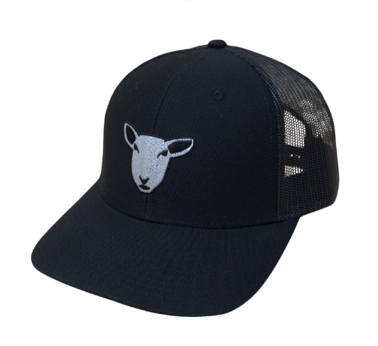
The Sheep Shop
A White Sheep Company
2025
Financial Review

Slide 2
Table of Contents
1
Summary
5
Salaries & Benefits
2
Revenue
6
Marketing
3
Cost of Merchandise
7
Other Expenses
4
Gross Margin
Supplementary Material Index

Slide 3
Summary Financials
Top Line Revenue Increased $157K or 74% YoY
COGS increased $44K or 53%
Expenses increased $60K or 62%
EBITDA increase $24K or 132%
Net Income Increased $21K or 420%
1
2
3
4
5
6
7

Slide 4
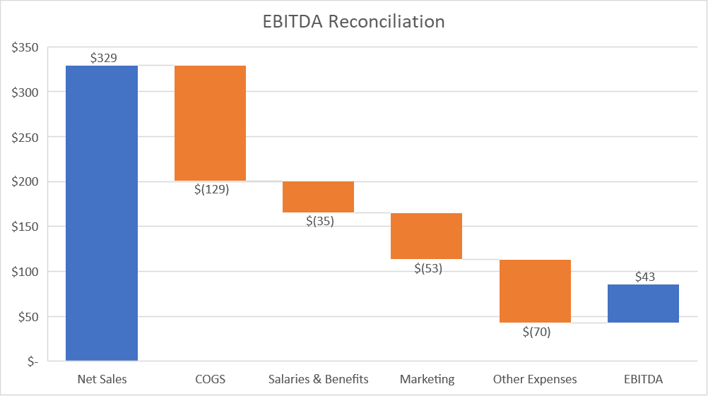
EBITDA
1
2
3
4
5
6
7

Slide 5
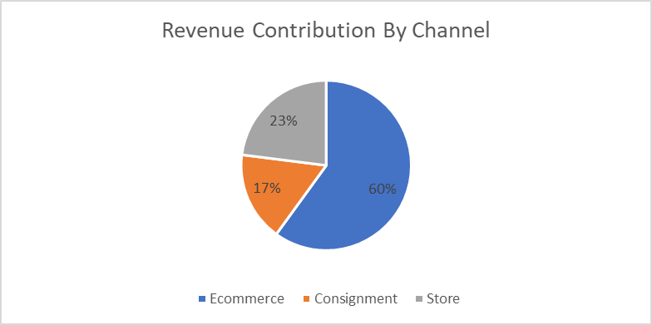
Revenue – Channels
(Expansion into consignment increased net sales by 20%)
1
2
3
4
5
6
7

Slide 6
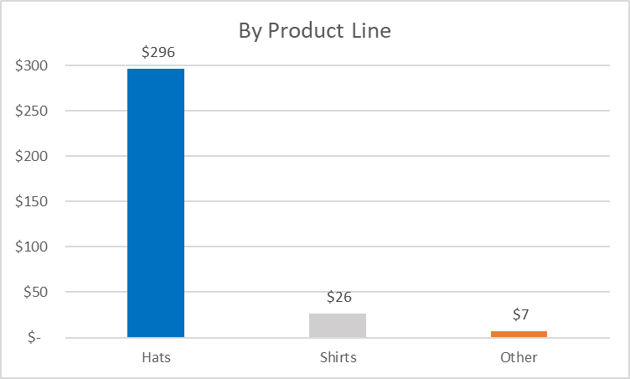
Revenue – Product Line
(Addition of Shirts added $26K to net sales in FY25)
1
2
3
4
5
6
7

Slide 7
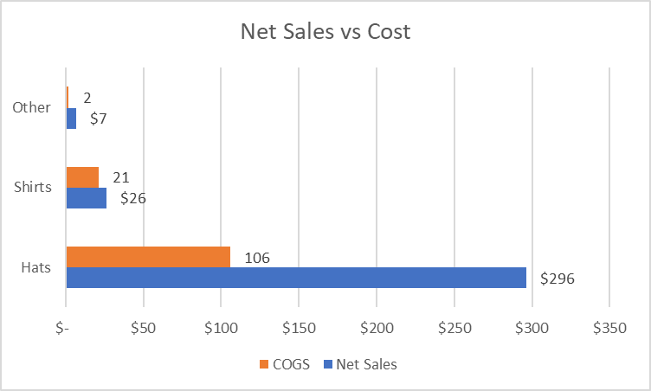
Merchandise Cost
1
2
3
4
5
6
7

Slide 8
Gross Margin
Total margin improved 5% with margin in hats improving by more than 10%
Margin in other improved significantly as planned from the move away from noncore lower margin items
1
2
3
4
5
6
7

Slide 9
Salaries & Benefits
Salaries & Benefits more than tripled due to addition of 2 more PT fulfillment team members, increased accounting services, onboarding a PT marketing associate & customer service team member
1
2
3
4
5
6
7

Slide 10
Marketing
Moved further away from internet ads and into other areas due to decreasing returns
Increased Event involvement due to direct ROAS and other favorable longer-term metrics
Added Agency & contractor services in FY25
1
2
3
4
5
6
7

Slide 11
Other Expenses
Entry into consignment came with significant rent costs
Supplies did not increase proportionate to sales due to finding better suppliers
Increased activity led to increased water & electricity usage
FY24 included tech consultant fees for WMS implementation assistance
1
2
3
4
5
6
7

Slide 12
Supplementary Materials Index
EBITDA Notes
Sales by Period
Traffic, AOV, Conversion by Channel
Sales by Product SKU
Margin by Product SKU
Margin by Subcategory
Changes in Top 10 SKUs
Breakdown of Salaries & Benefits YoY
ROAS by Marketing Category
Major Projects (Closed Totals & Spend to Date on Active Projects)
CAPEX FY25 vs FY24
CAPEX FY26 Projections

