Slide 1



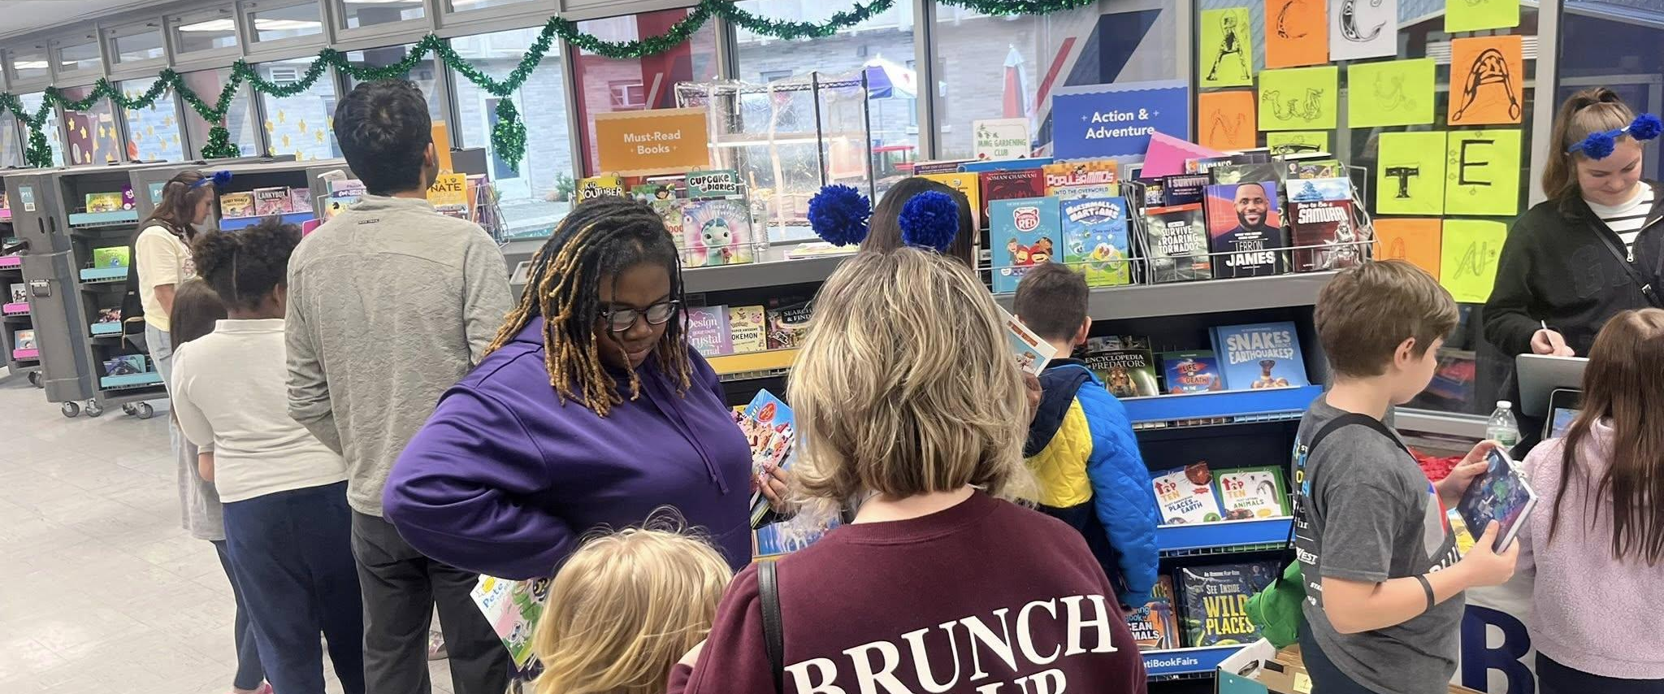


Literati Book Fair Impact Report
511
91%
BOOKS SOLD
% of Books from Total Sales
Fund Our Teacher Wishlists
We have 18 teacher wishlists—help us reach our goals during the final 2 days of shopping!
Mission Success: Creating a love for reading
Books Over Toys: Strategic selection helped kids prioritize literacy.
https://literati.com/a/wishlists/bookfair/019c58ba-dca6-2d65-54d9-28178167301a
Accessible Pricing: $3-$7 options available and re-filled daily.
Community Support: Parents and Literati both buying for classrooms.
Final Opportunity: Gift card balances still valid online for $4+ books; Wishlists and Book Clubs are available

Slide 2
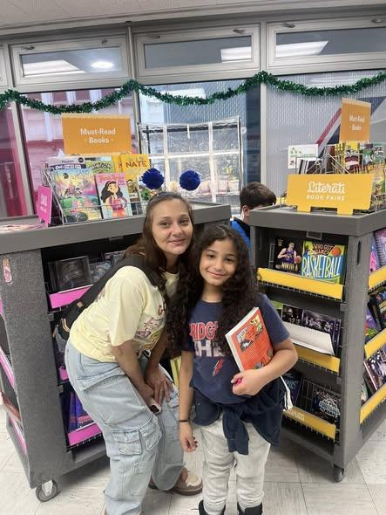
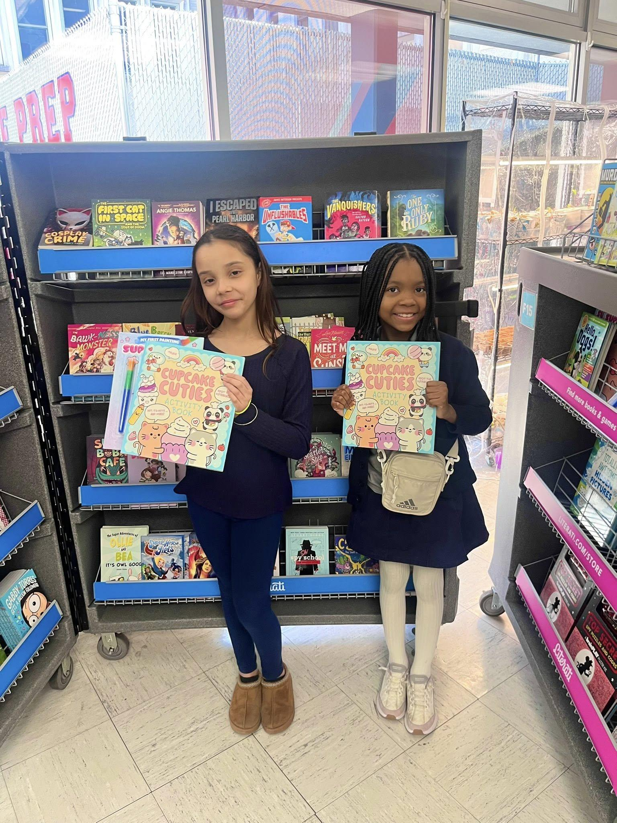
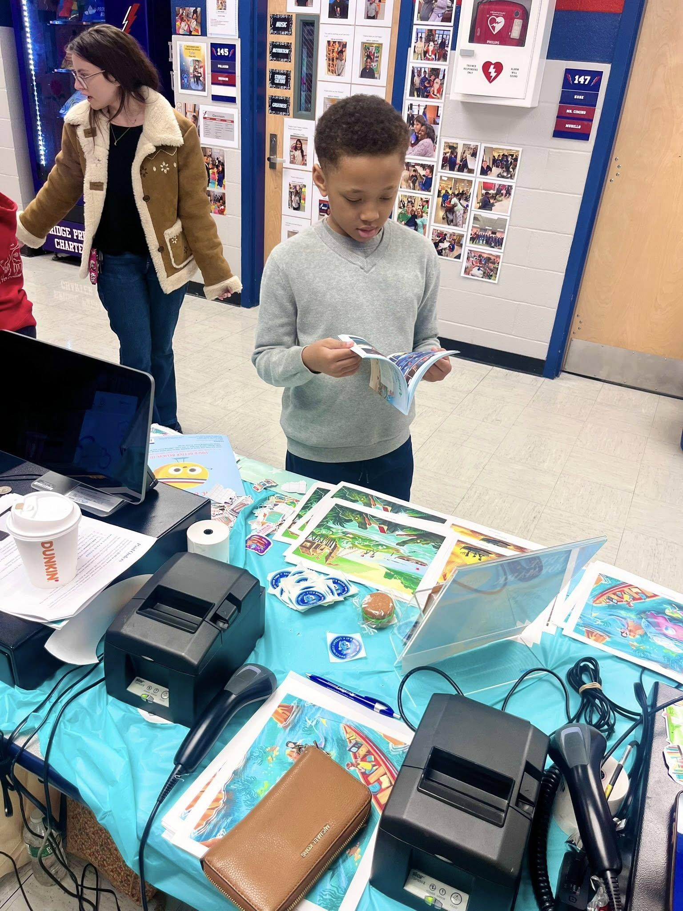
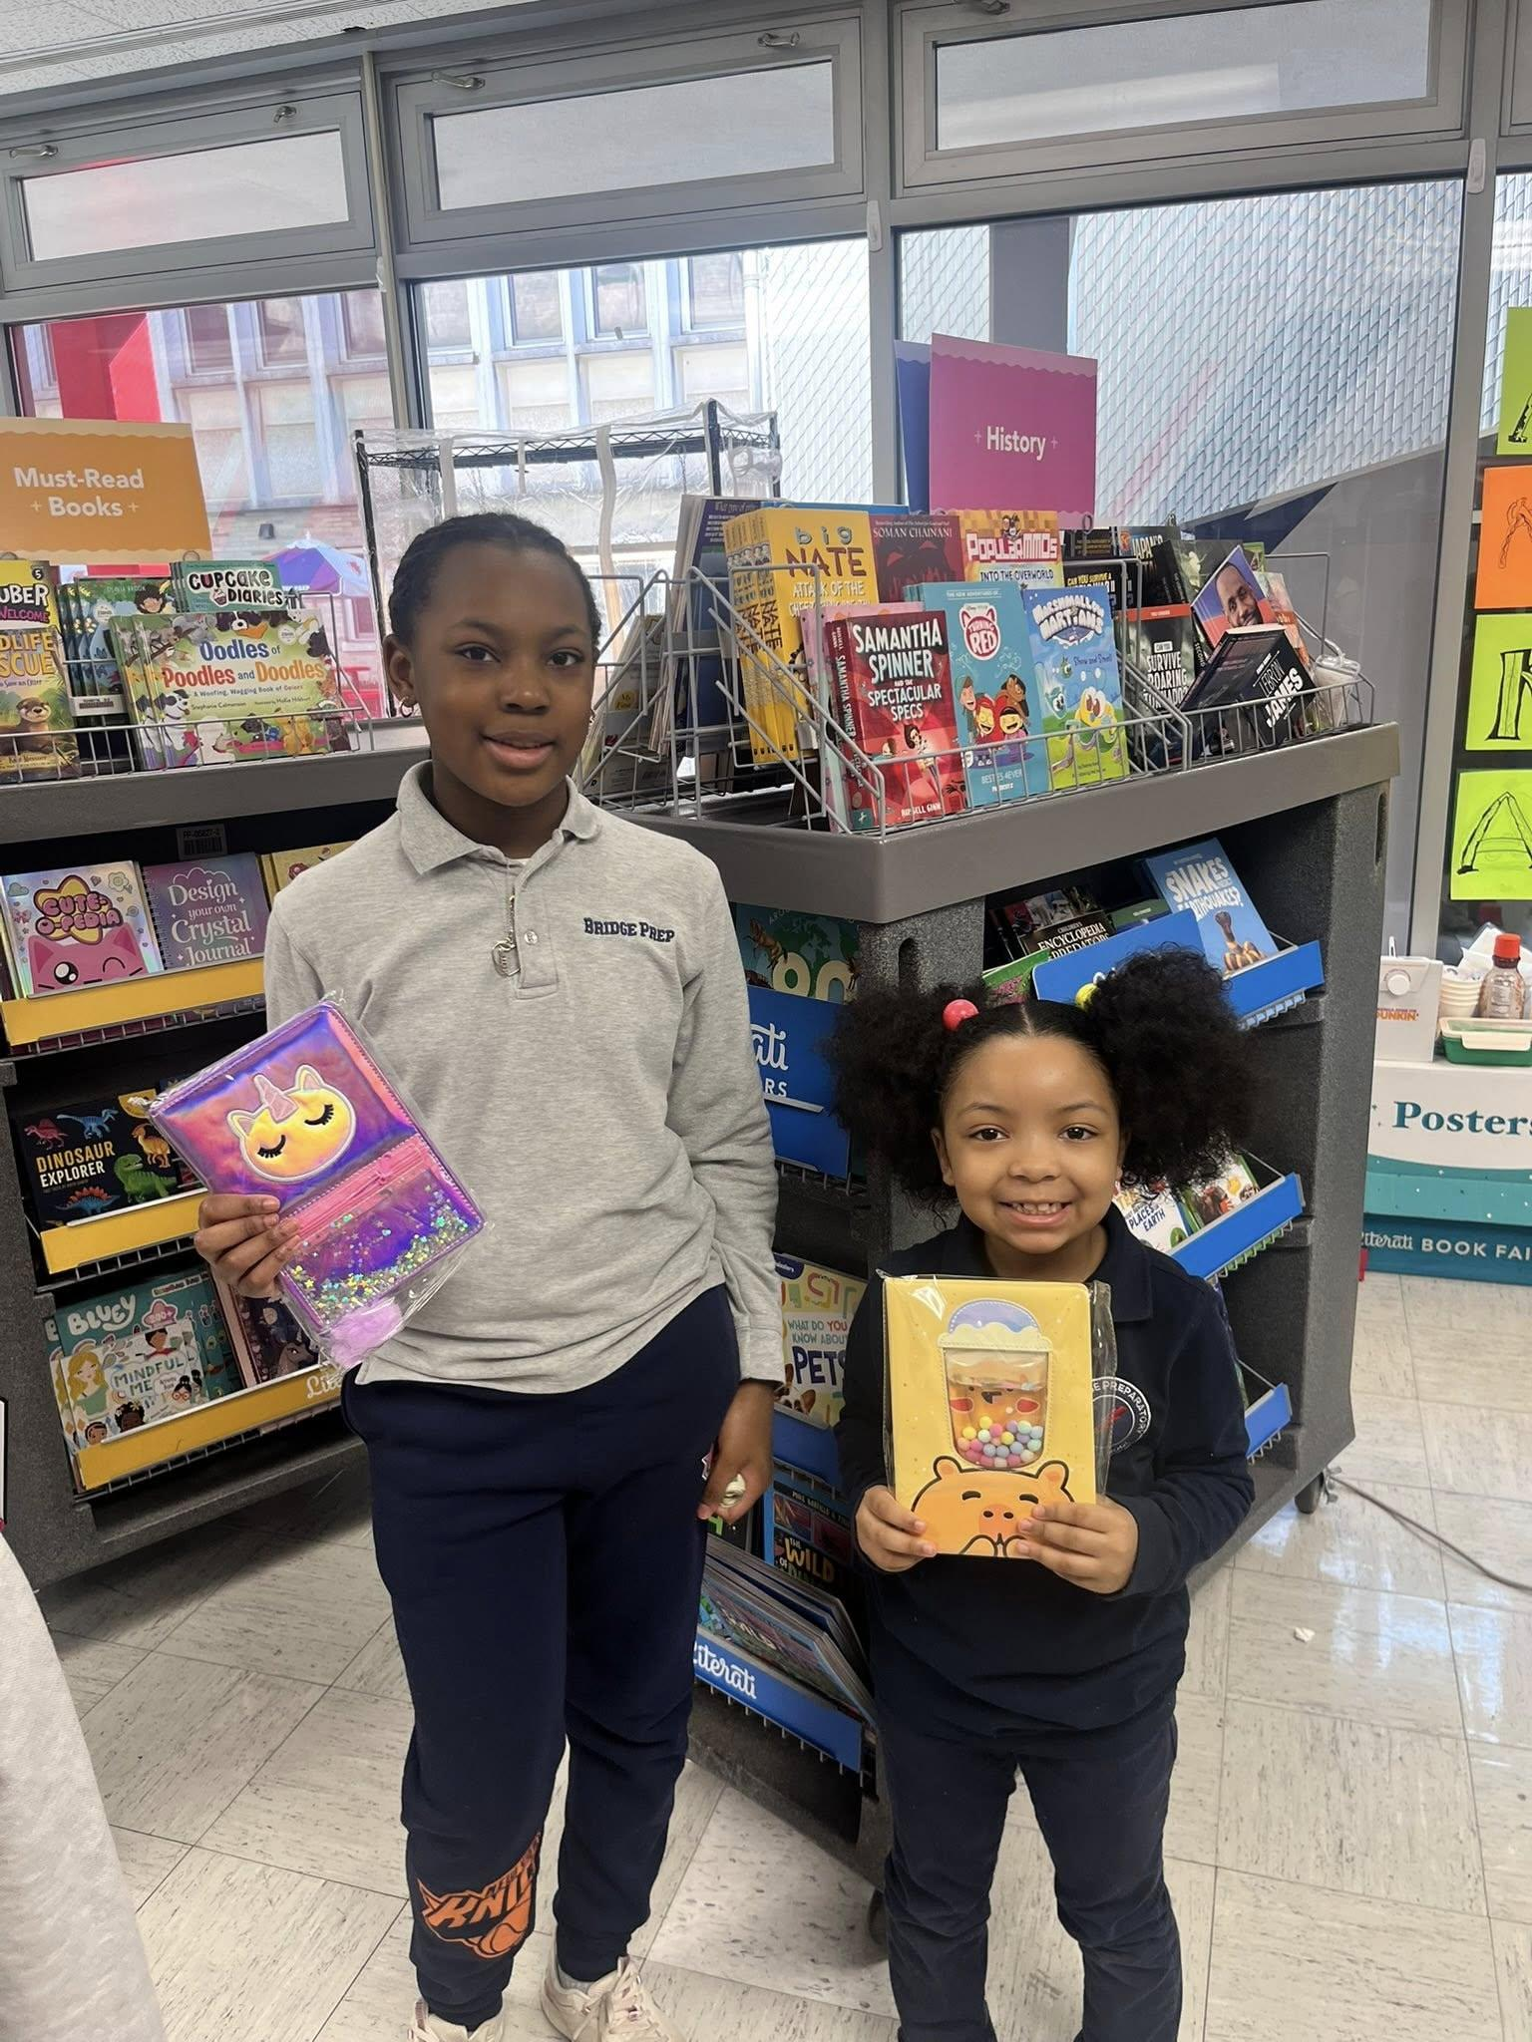
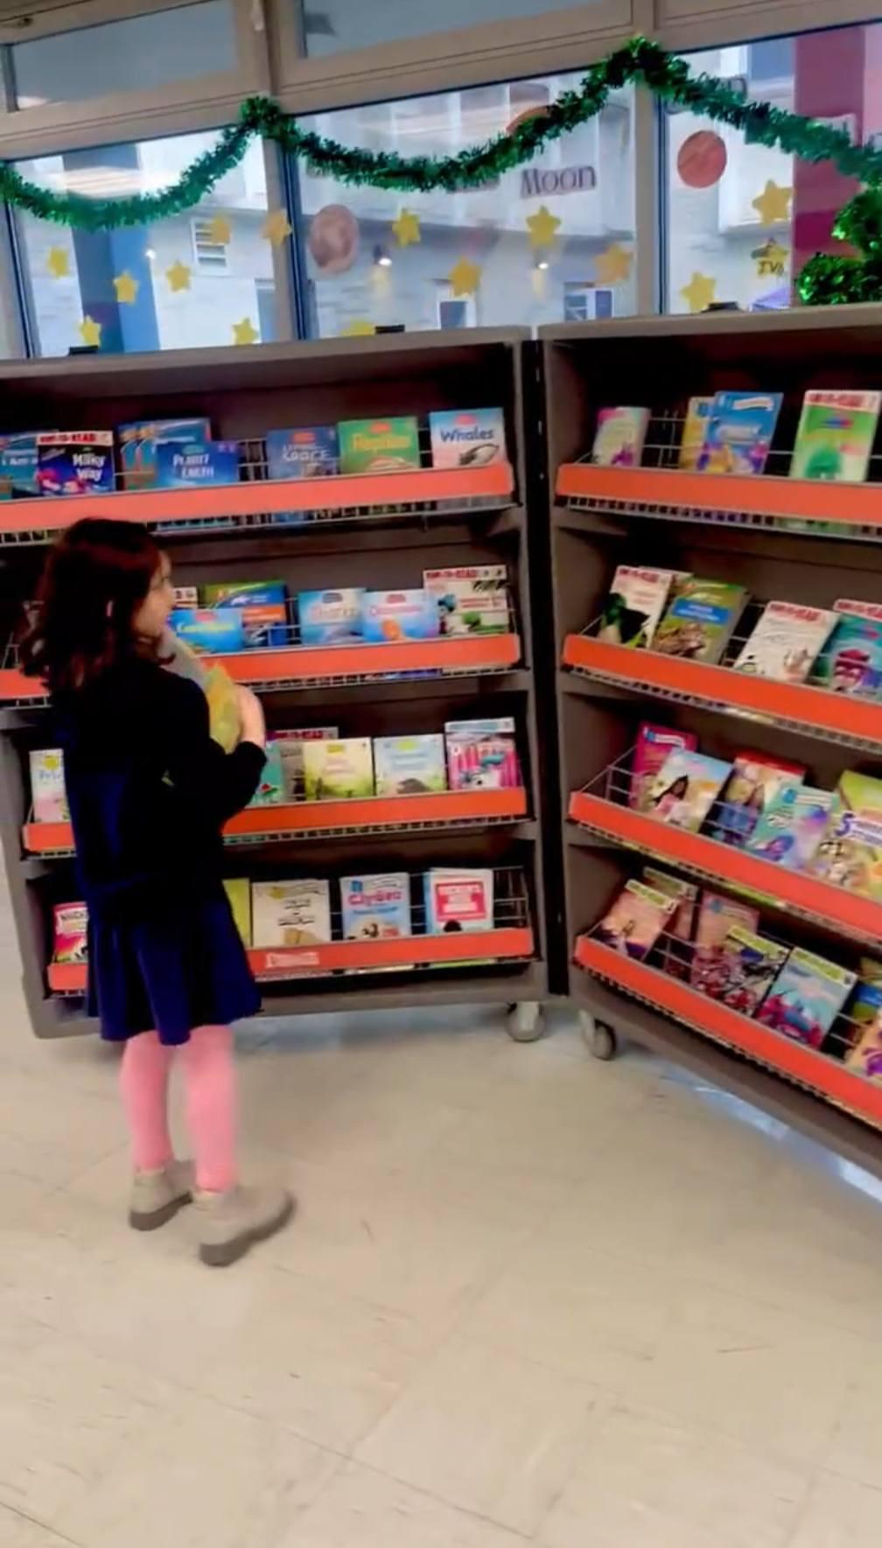
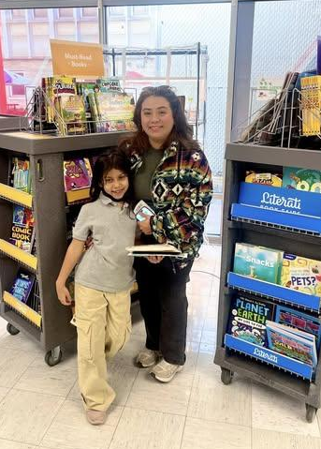
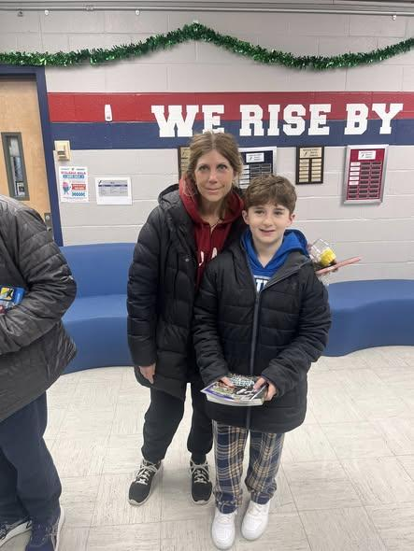
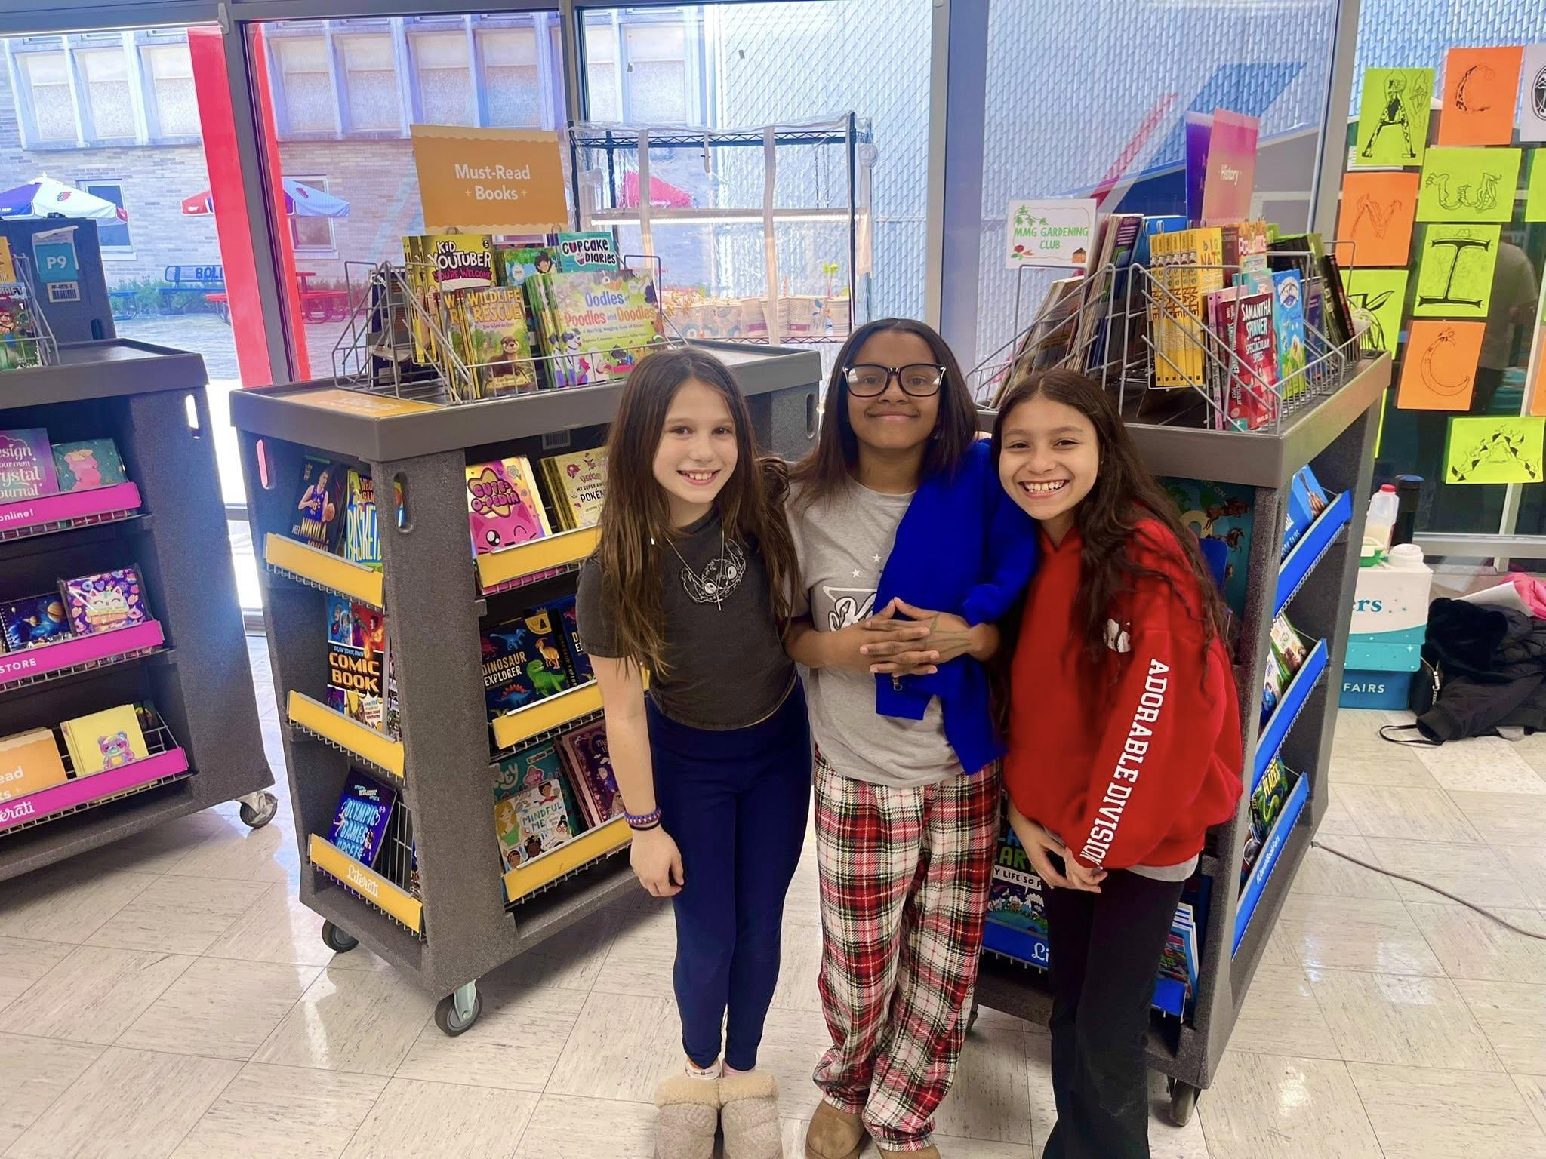
Literacy & Joy: Event Highlights
Diverse Selection: High-quality options for every reading level.
Classroom Impact: Literati and parents funding 18 wishlists.
Successful Event: Making the book fair fun and impactful for all kids.
Event Recap (March 23 - April 17): Our 4-day in-person event brought the community together to celebrate literacy. With over 500 books sold, we have successfully provided our children with high-value reading material while supporting our incredible teaching staff.

