Slide 1

Family Association
Azalia Volpe - President
Deirdre Medina - Vice President
Amber Zick - Treasurer
Rachael Bulla - Secretary
bpfachacrter@gmail.com
December 21, 2020
Opening Remarks and Brief Introductions
1. President's Report just a quick thank you to everyone who participated in the Pasta Fundraiser.
2. Co-President's Report: success of SI Zoo and Cost
3. Treasurer's Report
4. Rachael: reading of the November Minutes
5. pass to adopt the meetings
6. Future Fundraising sub-committees
7. Thanks to everyone
closing remarks

Slide 2


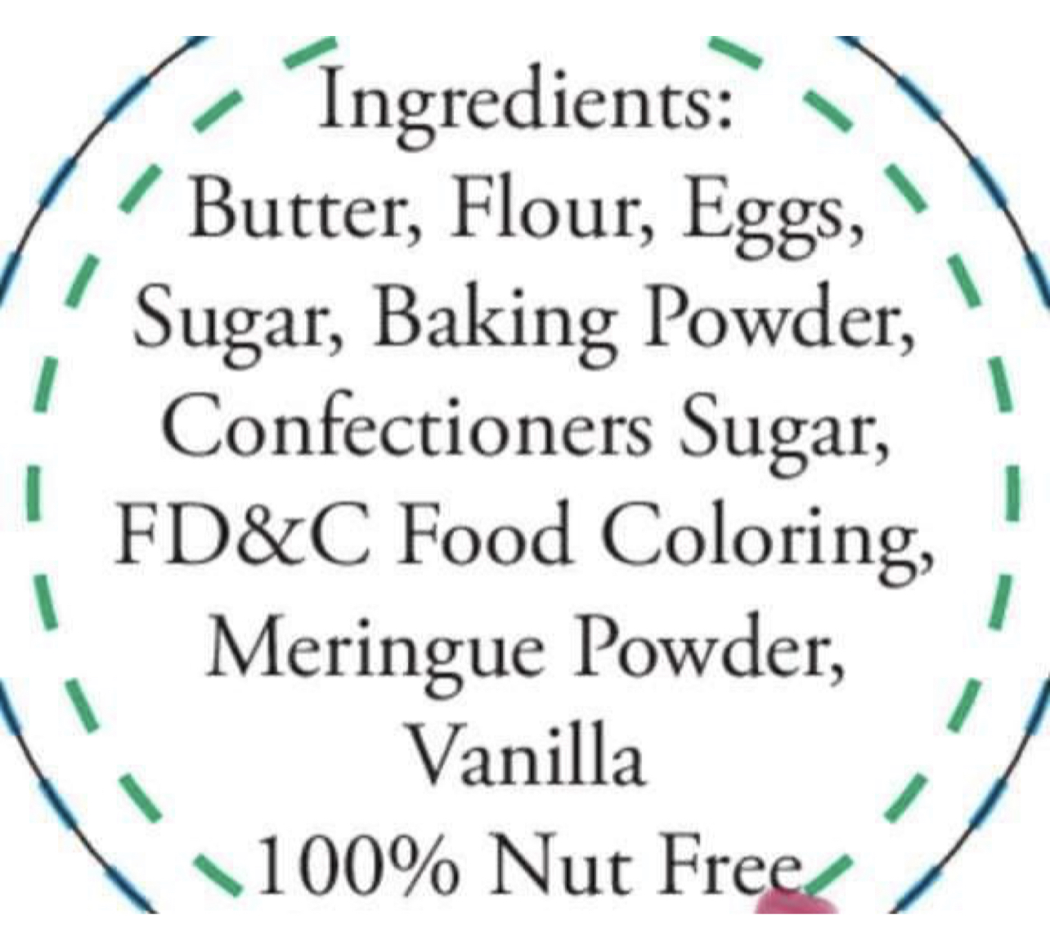
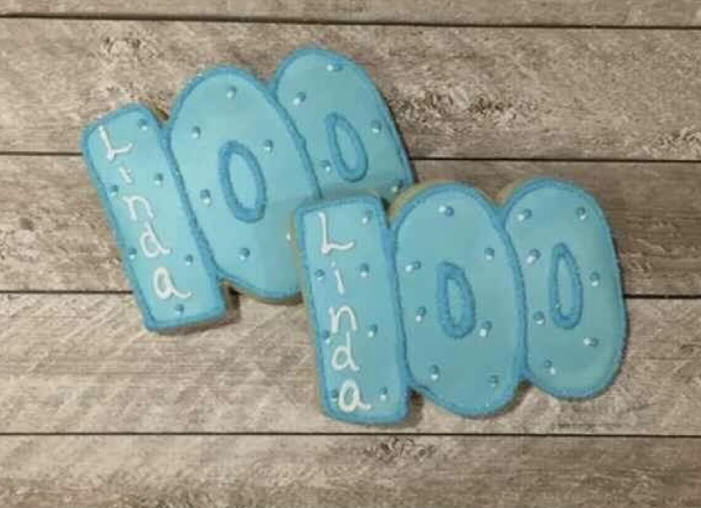
Family Association
Azalia Volpe - President
Deirdre Medina - Vice President
Amber Zick - Treasurer
Rachael Bulla - Secretary
bpfachacrter@gmail.com
Let’s Celebrate the 100th Day of school together! The Family Association will be selling 100th Day cookies from Cutest Cookies. They are baked fresh so we have to have orders in no later than 2/2. Please complete the order form and return to school no later than 2/2. Cookies will be distributed in school 2/10. Payments can be accepted using PayPal or cash. When paying in cash please include the order form below. When using PayPal please give amount of cookies ordered, child’s name and class. Any questions, email us.
--------------------------------------------------------------------------------------------------------------------
100th Day cookie order form
Number of cookies ordered _______
Total amount purchased $______
Child’s Name____________________________________
Child’s Class_____________________________________
Please put money in envelope with order form and put BPFA Cookie Sale on front.
Cookies will be white with a red outline.

